Slide 1
Lecture 15 Nonlinear Problems Newton’s Method
Notes:
This is the second of three lectures on solving non-linear problems.
Today’s methods are more algebraically-complex than last lectures,
but the are qualitatively straightforwards and intuitive.

Slide 2
Syllabus
Lecture 01 Describing Inverse Problems Lecture 02 Probability and Measurement Error, Part 1 Lecture 03 Probability and Measurement Error, Part 2 Lecture 04 The L₂ Norm and Simple Least Squares Lecture 05 A Priori Information and Weighted Least Squared Lecture 06 Resolution and Generalized Inverses
Lecture 07 Backus-Gilbert Inverse and the Trade Off of Resolution and Variance Lecture 08 The Principle of Maximum Likelihood Lecture 09 Inexact Theories Lecture 10 Nonuniqueness and Localized Averages Lecture 11 Vector Spaces and Singular Value Decomposition
Lecture 12 Equality and Inequality Constraints Lecture 13 L₁ , L∞ Norm Problems and Linear Programming Lecture 14 Nonlinear Problems: Grid and Monte Carlo Searches Lecture 15 Nonlinear Problems: Newton’s Method Lecture 16 Nonlinear Problems: Simulated Annealing and Bootstrap Confidence Intervals Lecture 17 Factor Analysis Lecture 18 Varimax Factors, Empircal Orthogonal Functions Lecture 19 Backus-Gilbert Theory for Continuous Problems; Radon’s Problem Lecture 20 Linear Operators and Their Adjoints Lecture 21 Fréchet Derivatives Lecture 22 Exemplary Inverse Problems, incl. Filter Design Lecture 23 Exemplary Inverse Problems, incl. Earthquake Location Lecture 24 Exemplary Inverse Problems, incl. Vibrational Problems

Slide 3
Purpose of the Lecture
Introduce Newton’s Method
Generalize it to an Implicit Theory
Introduce the Gradient Method
Notes:
The first section introduces a new problem and applies it in the overdetermined case.
The second section generalizes it.
The third introduces a different method, the gradient method,
distinct from Newton’s Method but with some underlying similarities.

Slide 4
Part 1 Newton’s Method
Notes:
Newton as in Sir Isaac. The method has been around for a long time.

Slide 5
grid search Monte Carlo Method are completely undirected alternative take directions from the local properties of the error function E(m)
Notes:
A criticism of the two methods introduced last lecture,
Grid Search and Monte Carlo, is that they are completely “undirected”.
The space of possible models is searched exhaustively.
The methods do not rely on any notion of where in the model space the solution might be.
The alternative is a method that uses the local properties of the error surface
to make an estimate of where the solution might be.

Slide 6
Newton’s Method start with a guess m^{(p)} near m^{(p)} , approximate E(m) as a parabola and find its minimum set new guess to this value and iterate
Notes:
The idea is to approximate the error surface with a parabola.
To do this, you need to know the error and its first and second derivatives at a point.
Once you have the parabola, you find its minimum, and assume it is close to the minimum in the error.
Of course, it won’t be exactly the right point, so you iterate,
Homing in on the solution.

Slide 7
E(m)
m
m_{n}^{est}
m^{GM}
m_{n+1}^{est}
Notes:
Graphical interpretation.
The paraabola touches the error curve at a point.
At this point, the value and the first two derivatives match.
The minimum of the parabola is near the minimum in the error.
Fig. 9.7. The iterative method locates the global minimum, m^{GM}, of the error, E(m), (black curve) by determining the paraboloid (red curve) that is tangent to E at the trial solution, m_{n}^{est}. The improved solution, m_{n+1}^{est}, is at the minimum (red circle) of this paraboloid, and, under favorable conditions, can be closer to the solution corresponding to the global minimum than is the trial solution. MatLab script gda09_09.

Slide 8
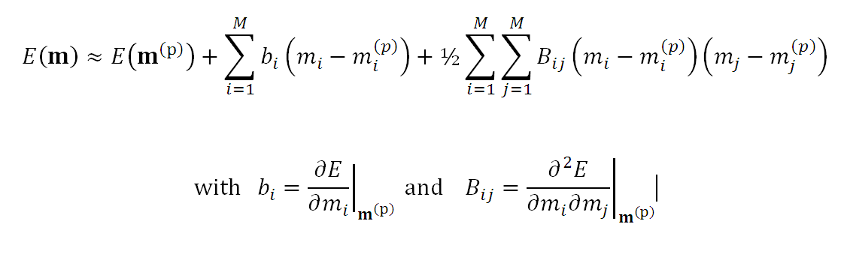
Taylor Series Approximation for E(m)
expand E around a point m^{(p)}
Notes:
Use a multi-dimensional Taylor Series to find the parabola.
The derivatives are evaluated at a particular point m^{(p)}
which is an initial guess for the solution

Slide 9
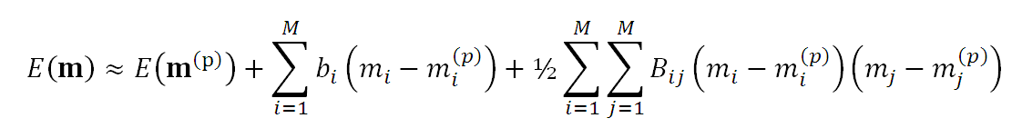
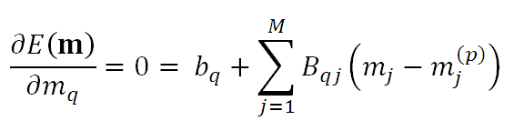
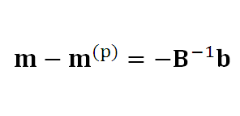
differentiate and set result to zero to find minimum
Notes:
Now find the minimum of the parabola in the usual way.
The formula for the improved solution involes
the vector of first devivatives, b
and the matrix of second derivatives, B

Slide 10

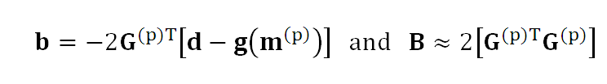
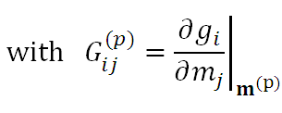
relate b and B to g(m)
linearized
data kernel
Notes:
Now relate the vector b and the matrix B to
the observed data d and the predicted data g(m).
Note that the formulas involve the derivative of g(m) with respect to m
It’s a matrix G that acts like a data kernel.
Note also that we have made an appoximation in the calculation of B
It’s really B = db/dm = -2 [dG/dm]^{T} (d-gm) + 2G^{T}G
and not B=2G^{T}G.
if this were a linear problem, then G would be a constant,
and its derivative would be exactly zero. So we will hope
that our problem is close to linear, so that the derivative
of G is small enough to be ignored.

Slide 11

formula for approximate solution
Notes:
Putting everything together,
we achieve a recursion formula for m.

Slide 12
relate b and B to g(m)
very reminiscent
of least squares
Notes:
Note that contains something that looks like a least-squares generalized inverse,
except that it contains the linearized data kernel.

Slide 13
what do you do if you can’t analytically differentiate g(m) ?
use finite differences to numerically differentiate
g(m)
or
E(m)
Notes:
Somehow, you need to compute b and B.
If you can’t analytically differentiate the theory
you could use finite difference derivatives

Slide 14
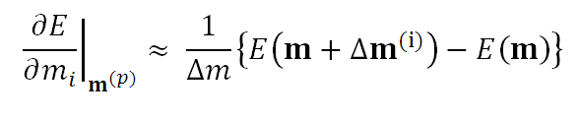
first derivative
Notes:
We’ve seen this approximation of the derivative before, in the “gap-filling problem”.

Slide 15
first derivative
vector
Δm [0, ..., 0, 1, 0, ..., 0]^{T}
need to evaluate E(m) M+1 times
Notes:
You must be able to choose a sensible delta-m to use it.
You must also evaluate the function M+1 times, so its computationally expensive.

Slide 16
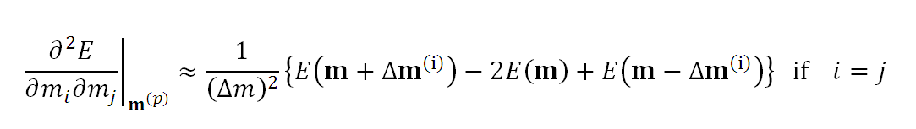
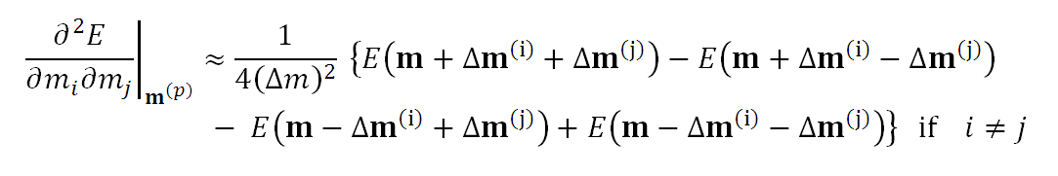
second derivative
need to evaluate E(m) about ½M² times
Notes:
The second derivative requires even more computations.
So, given the choice between building b,B from the first and second derivatives of E
or from the first derivative if g,
you choose the latter.
But you don’t always have a choice.

Slide 17
what can go wrong? convergence to a local minimum
Notes:
Newton’s method is based on local information about the error surface.
You can find a minimum in E, but you have no idea whether it’s the deepest.
That requires global information about the surface.

Slide 18
E(m)
local
minimum
global minimum
m
m_{n}^{est}
m_{n+1}^{est}
m^{GM}
Notes:
Here, the solution will converge to the local minimum.
Fig. 9.8. If the trial solution, m_{n}^{est}, is too far from the global minimum, m^{GM}, the method may converge to a local minimum. MatLab script gda09_10.

Slide 19
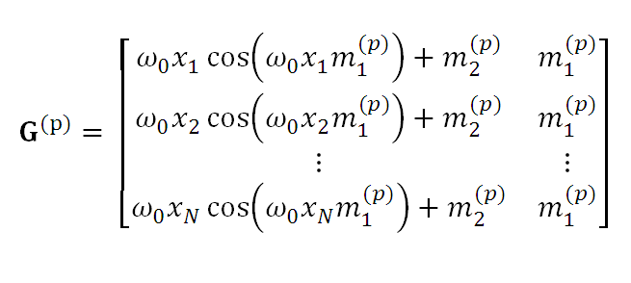
analytically differentiate
sample inverse problem
d_{i}(x_{i}) = sin(ω₀m₁x_{i}) + m₁m₂
Notes:
Now we do an example, using the same non-linear relationship between data and model parameters
that we used in the Grid Search and Monte Carlo examples.
Note that we can analytically differentiate g(m)

Slide 20
(A)
(B)
(C)
Notes:
The solution converges in about 5 iterations.
That compares to 10,000 needed for the grid search
and 2000 for the relatively lousy Monte Carlo solution.
Of course, we’re doing a bit more work during each iteration.
Evaluating the gradient and solving a least-squares problem.
Fig. 9.9. Newton’s Method (linearized least squares) is used to solve the same non-linear curve fitting problem as in Figure 9.5. (A) The observed data (black circles) are computed from the true data (black curve) by adding random noise. The predicted data (red curve) are based on the results of the method. (B) Error surface (colors), showing true solution (green circle), and a series of improved solutions (white circles connected by red lines) determined by the method. (C) Plot of error, E, and model parameters, m₁ and m₂ as a function of iteration number. MatLab script gda09_11.

Slide 21
often, the convergence is very rapid
Notes:
If the initial guess is a good one, the solution very often converges in just a handful of iterations.

Slide 22
often, the convergence is very rapid
but
sometimes the solution converges to a local minimum
and
sometimes it even diverges
Notes:
If the solution is too far from the global minimum,
Newton’s Method will fail.

Slide 23
mg = [1, 1]’;
G = zeros(N,M);
for k = [1:Niter]
dg = sin( w0*mg(1)*x) + mg(1)*mg(2);
dd = dobs-dg;
Eg=dd'*dd;
G = zeros(N,2);
G(:,1) = w0*x.*cos(w0*mg(1)*x) + mg(2);
G(:,2) = mg(2)*ones(N,1);
% least squares solution
dm = (G'*G)\(G'*dd);
% update
mg = mg+dm;
end
Notes:
The hard part of the code is the middle part that calculates the derivatives.
Here we were lucky and could do them analytically.
If we have to resort to finite difference derivatives, the code
gets more complicated.

Slide 24
Part 2 Newton’s Method for an Implicit Theory
Notes:
This is a straight forward extension to the case of an implicit theory that includes a priori information.

Slide 25
Implicit Theory f(d,m)=0 with Gaussian prediction error and a priori information about m
Notes:
Gaussian of course.

Slide 26


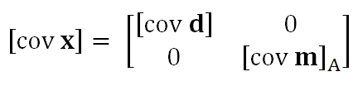
to simplify algebra group d, m into a vector x
Notes:
As we did when we studied the linear problem, we group data and model parameters into a vector x.

Slide 27
parameter, x₂
<x₂>
<x₁>
parameter, x₁
Notes:
We’ve shown this diagram in previous lectures. It’s nothing new.
Without any information about the theory,
The state of information is a cloud of probability
centered at the observed data and the a priori model parameters.
Fig. 9.10. The data and model parameters are grouped together in a vector, x. The prior information for x is then represented as a probability density function (colors) in the (M+N)-dimensional space, S(x). MatLab script gda09_12.

Slide 28
represent data and a priori model parameters as a Gaussian p(x)
f(x)=0 defines a surface in the space of x
maximize p(x) on this surface
maximum likelihood point is x^{est}
Notes:
The theory is surface through the space of x.
So apply the principle of maximum likelihood and
find the point on the surface where the probability is the highest.

Slide 29
(A)
x₂^{est}
x₂
(B)
p(x₁)
x₁^{ML}
x₁^{est}
<x₁>
x₁
x₁
f(x)=0
Notes:
Graphical example.
The white curve is the theory. Evaluate the probability along this curve and you get (B).
Find the maximum likelihood point and that’s the solution.
Fig. 9.11. A) The estimated solution, x^{est}, (black circle) is at the point on the surface, f(x)=0 (white curve) where the a priori probability density function (colors) attains its largest value. B) The probability density function, p(x₁), evaluated along the surface, as a function of position, x₁. Since the function is non-Normal, its mean, <x₁>, may be distinct from its mode, x₁^{ML} (although in this case they are similar). MatLab script gda09_13.

Slide 30
can get local maxima if f(x) is very non-linear
Notes:
Could get complicated if the theory is a very wiggly surface.

Slide 31
(A)
x₂^{est}
x₂
(B)
p(x₁)
<x₁>
x₁^{est}
x₁^{ML}
x₁
x₁
f(x)=0
Notes:
In that case, the might be many local maxima on the surface,
only the highest of which is the global maximum.
Fig. 9.12. A) A highly non-linear inverse problem corresponds to a complicated surface, f(x)=0 (white curve). B) The probability density function, p(x₁), evaluated along the surface, as a function of position, x₁. It may have several peaks, and since it is non-Normal, its mean, <x₁>, may be distinct from its mode, x₁^{ML}. MatLab script gda09_14.

Slide 32

mathematical statement of the problem
its solution (using Lagrange Multipliers)
with F_{ij} = ∂f_{i}/∂x_{j}
Notes:
We omit here all the math.

Slide 33
mathematical statement of the problem
its solution (using Lagrange Multipliers)
reminiscent of
minimum length solution
Notes:
Looks like a minimum length type solution

Slide 34
mathematical statement of the problem
its solution (using Lagrange Multipliers)
oops!
x appears in 3 places
Notes:
But will be hard to solve, since the unknown x appears in three places.

Slide 35
solution iterate !
old value for x
is x^{(p)}
new value for x
is x^{(p+1)}
Notes:
But the formula can be iterated.
Now it starts to look like Newton’s Method.

Slide 36



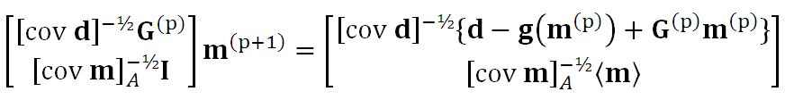
special case of an explicit theory f(x) = d-g(m)
equivalent to solving
using simple least squares
Notes:
In fact, if we work out the special case where the theory is explict,
we find that it its more-or-less Newton’s method,
with a few embellishments.

Slide 37
special case of an explicit theory f(x) = d-g(m)
weighted least squares generalized inverse
with a linearized data kernel
Notes:
The generalized inverse is now not simple least squares,
but instead, weighted least squares.
That makes sense, for we introduced a priori information
and covariance matrices that allowed different quantities to have different error.

Slide 38
special case of an explicit theory f(x) = d-g(m)
Newton’s Method, but making E+L small
not just E small
Notes:
The recursion is pretty much the same as before,
except that the solution is being driven to a point that minimizes E+L
not just E

Slide 39
Part 3 The Gradient Method
Notes:
On to a new method.
Suppose that you only knew the slope (gradient, first derivative) of the error at the trial solution.
Not its curvature (second derivative).
You still know what direction is downhill.
So you should be able to achieve a solution.

Slide 40
What if you can compute E(m) and ∂E/∂m_{p} but you can’t compute ∂g/∂m_{p} or ∂²E/∂m_{p}∂ m_{q}
Notes:
Sometimes its easier to compute the gradient of error than anything else.

Slide 41
E(m)
m^{GM}
m_{n}^{est}
Notes:
Graphically, all you know is the slope (red).
You know what direction to go to move towards the minimum.

Slide 42
you know the direction
towards the minimum
but not how far away it is
E(m)
m^{GM}
m_{n}^{est}
Notes:
But you don’t know how far away the minimum is.
You jump to the right ... but how big a jump do you take.
Fig. 9.7. The iterative method locates the global minimum, m^{GM}, of the error, E(m), (black curve) by determining the paraboloid (red curve) that is tangent to E at the trial solution, m_{n}^{est}. The improved solution, m_{n+1}^{est}, is at the minimum (red circle) of this paraboloid, and, under favorable conditions, can be closer to the solution corresponding to the global minimum than is the trial solution. MatLab script gda09_09.

Slide 43
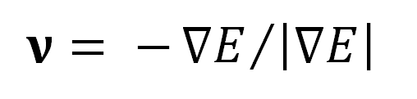

unit vector pointing towards the minimum
so improved solution would be
if we knew how big to make α
Notes:
Mathematically, you know a direction, nu.
If you also knew a length alpha, you could jump that length in that direction.

Slide 44

Armijo’s rule provides an acceptance criterion for α
with c≈10⁻⁴
simple strategy
start with a largish α
divide it by 2 whenever it fails Armijo’s Rule
Notes:
Fortunately, there’s a rule for figuring out whether you jump is likely to be too big.
So if a proposed jump is too big, you make it smaller.

Slide 45
(A)
d
x
(B)
(C)
Error, E
iteration
m₁
m₁
iteration
m₂
iteration
m₂
Notes:
Took several hundred iterations. Not nearly as good as Newton’s Method.
Fig. 9.13. Gradient method is used to solve the same non-linear curve fitting problem as in Figure 9.5. (A) The observed data (black circles) are computed from the true data (black curve) by adding random noise. The predicted data (red curve) are based on the results of the method. (B) Error surface (colors), showing true solution (green circle), and a series of improved solutions (white circles) determined by the method. (C) Plot of error, E, and model parameters, m₁ and m₂ as a function of iteration number. MatLab script gda09_15.

Slide 46
% error and its gradient at the trial solution
mgo=[1,1]';
ygo = sin( w0*mgo(1)*x) + mgo(1)*mgo(2);
Ego = (ygo-y)'*(ygo-y);
dydmo = zeros(N,2);
dydmo(:,1) = w0*x.*cos(w0*mgo(1)*x) + mgo(2);
dydmo(:,2) = mgo(2)*ones(N,1);
dEdmo = 2*dydmo'*(ygo-y);
alpha = 0.05;
c1 = 0.0001;
tau = 0.5;
Niter=500;
for k = [1:Niter]
v = -dEdmo / sqrt(dEdmo'*dEdmo);
Notes:
top part: initial solution mgo, its error, and the gradient of the error
middle part: some constants
bottom part: start of a loop that moves the solution in the downslope direction
the last line is the direction in which the move occurs

Slide 47
% backstep
for kk=[1:10]
mg = mgo+alpha*v;
yg = sin(w0*mg(1)*x)+mg(1)*mg(2);
Eg = (yg-y)'*(yg-y);
dydm = zeros(N,2);
dydm(:,1) = w0*x.*cos(w0*mg(1)*x)+ mg(2);
dydm(:,2) = mg(2)*ones(N,1);
dEdm = 2*dydm'*(yg-y);
if( (Eg<=(Ego + c1*alpha*v'*dEdmo)) )
break;
end
alpha = tau*alpha;
end
Notes:
A nested loop to figure out whether the current alpha is good, or should be made smaller.
Move provisionally a distance alpha.
Then check Armijo’s rule. If it fails, decrease alpha and try again.
If it passes, break the inner loop

Slide 48
% change in solution
Dmg = sqrt( (mg-mgo)'*(mg-mgo) );
% update
mgo=mg;
ygo = yg;
Ego = Eg;
dydmo = dydm;
dEdmo = dEdm;
if( Dmg < 1.0e-6 )
break;
end
end
Notes:
The last iteration of the inner loop produced an acceptable new solution.
Go with it.
Break the outer loop if the solution no longer changes from iteration to iteration.

Slide 49
often, the convergence is reasonably rapid

Slide 50
often, the convergence is reasonably rapid
exception
when the minimum is in along a long shallow valley
Notes:
We saw a bit of that in the example.
The solution bounces back and forth across the valley walls, making something of a sawtooth.

