Slide 1
Lecture 17 Factor Analysis
Notes:
This is the third of three lectures on solving non-linear problems.
Today’s method, simulated annealing, is more conceptually subtle than previous methods,
but is algebraically straightforward.
We also discuss a technque for computing conficence intervals that works well for nonlinear problems.

Slide 2
Syllabus
Lecture 01 Describing Inverse Problems Lecture 02 Probability and Measurement Error, Part 1 Lecture 03 Probability and Measurement Error, Part 2 Lecture 04 The L₂ Norm and Simple Least Squares Lecture 05 A Priori Information and Weighted Least Squared Lecture 06 Resolution and Generalized Inverses
Lecture 07 Backus-Gilbert Inverse and the Trade Off of Resolution and Variance Lecture 08 The Principle of Maximum Likelihood Lecture 09 Inexact Theories Lecture 10 Nonuniqueness and Localized Averages Lecture 11 Vector Spaces and Singular Value Decomposition
Lecture 12 Equality and Inequality Constraints Lecture 13 L₁ , L∞ Norm Problems and Linear Programming Lecture 14 Nonlinear Problems: Grid and Monte Carlo Searches Lecture 15 Nonlinear Problems: Newton’s Method Lecture 16 Nonlinear Problems: Simulated Annealing and Bootstrap Confidence Intervals Lecture 17 Factor Analysis Lecture 18 Varimax Factors, Empircal Orthogonal Functions Lecture 19 Backus-Gilbert Theory for Continuous Problems; Radon’s Problem Lecture 20 Linear Operators and Their Adjoints Lecture 21 Fréchet Derivatives Lecture 22 Exemplary Inverse Problems, incl. Filter Design Lecture 23 Exemplary Inverse Problems, incl. Earthquake Location Lecture 24 Exemplary Inverse Problems, incl. Vibrational Problems

Slide 3
Purpose of the Lecture
Introduce Factor Analysis
Work through an example
Notes:
The first section introduces a new method for solving nonlinear problems is developed and applied.
The second introduces a new way to compute confidence intervals.

Slide 4
Part 1 Factor Analysis
Notes:
Factor analysis is very closely related to the idea of mixing of endmembers

Slide 5
source A
source B
ocean
sediment
s₁
s₂
s₃
s₄
Notes:
Fig 10.1. Material from sources A and B is eroded into the ocean and fix to form sediment. Samples, s_{i}, of the sediment are collected and their chemical composition is determined. The data are used to infer the composition of the sources.

Slide 6

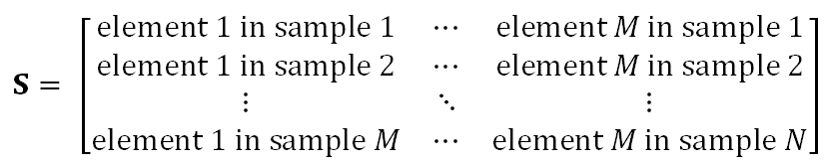
sample matrix S
S arranged row-wise
but we’ll use a column vector s^{(i)} for individual samples)

Slide 7
theory
samples are a linear mixture of sources
S = C F

Slide 8
theory
samples are a linear mixture of sources
S = C F
samples contain “elements”

Slide 9
theory
samples are a linear mixture of sources
S = C F
sources called “factors” factors contain “elements”

Slide 10
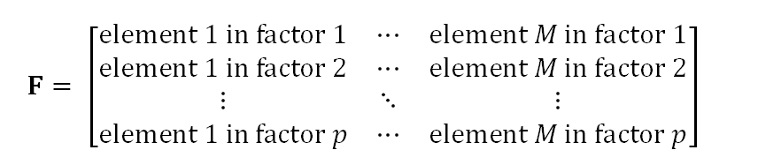
factor matrix F
F arranged row-wise
but we’ll use a column vector f^{(i)} for individual factors

Slide 11
theory
samples are a linear mixture of sources
S = C F
coefficients
called “loadings”

Slide 12

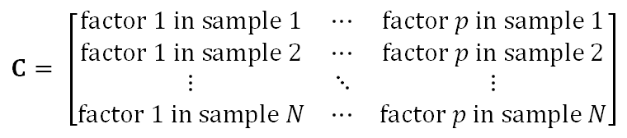
loading matrix C

Slide 13
inverse problem
given S
find C and F
so that S=CF

Slide 14
very non-unique
given T with inverse T⁻¹
if S=CF
then S=[C T⁻¹][TF] =C’F’

Slide 15
very non-unique
so a priori information needed to select a solution

Slide 16
simplicity
what is the minimum number of factors needed
call that number p

Slide 17
does S span the full space of M elements?
or just a p –dimensional subspace?

Slide 18
A
s₁
s₁
s₃
s₄
E₃
B
E₂
E₁
Notes:
Fig 10.2. The composition of the samples, s_{i}, (black arrows) lies on a triangular sector of a plate bounded by the composition of the sources A and B (red arrows). MatLab script gda10_01.

Slide 19

we know how to answer this question
p is the number of non-zero singular values

Slide 20
A
s₁
E₃
s₂
v₁
s₃
s₄
B
E₂
v₃
E₁
v₂
Notes:
Fig 10.3. Eigenvectors, v₁ and v₂ , lie in the plane of the samples (v₁ is closest to the mean sample). Eigenvector, v₃ , is normal to the plane. MatLab script gda10_02.

Slide 21
SVD identifies a subspace
but the SVD factors
f^{(i)} = v^{(i)} i=1, p
not unique
usually not the “best”

Slide 22


factor f⁽¹⁾ v with the largest singular value
usually near the mean sample
sample mean <s>
minimize
eigenvector <v>
minimize

Slide 23
factor f⁽¹⁾ v with the largest singular value
usually near the mean sample
sample mean <s>
minimize
eigenvector <v>
minimize
about the same if samples are clustered

Slide 24
(A)
(B)
f⁽¹⁾
f⁽¹⁾
s₁
s₁
s₂
s₂
E₃
s₃
E₃
s₃
s₄
s₄
f⁽²⁾
f⁽²⁾
E₂
E₂
E₁
E₁
Notes:
Fig 10.4. Any two factors f⁽¹⁾ and f⁽¹⁾ (red arrows) that lie in the plane of the samples and that bound the range of sample compositions (black arrows) are acceptable, such as those shown in (A) and (B). MatLab script gda10_03.

Slide 25
in MatLab
[U, LAMBDA, V] = svd(S,0);
lambda = diag(LAMBDA);
F = V';
C = U*LAMBDA;

Slide 26
in MatLab
“economy” calculation
LAMBDA is M⨉M
[U, LAMBDA, V] = svd(S,0);
lambda = diag(LAMBDA);
F = V';
C = U*LAMBDA;

Slide 27
since samples have measurement noise
probably no exactly singular values
just very small ones
so pick p
for which
S≈CF
is an adequate approximation

Slide 28
Atlantic Rock Dataset
SiO₂ TiO₂ Al₂O₃ FeO_{t} MgO CaO Na₂O K₂O
51.97 1.25 14.28 11.57 7.02 11.67 2.12 0.07
50.21 1.46 16.41 10.39 7.46 11.27 2.94 0.07
50.08 1.93 15.6 11.62 7.66 10.69 2.92 0.34
51.04 1.35 16.4 9.69 7.29 10.82 2.65 0.13
52.29 0.74 15.06 8.97 8.14 13.19 1.81 0.04
49.18 1.69 13.95 12.11 7.26 12.33 2 0.15
50.82 1.59 14.21 12.85 6.61 11.25 2.16 0.16
49.85 1.54 14.07 12.24 6.95 11.31 2.17 0.15
50.87 1.52 14.38 12.38 6.69 11.28 2.11 0.17
(several thousand more rows)

Slide 29
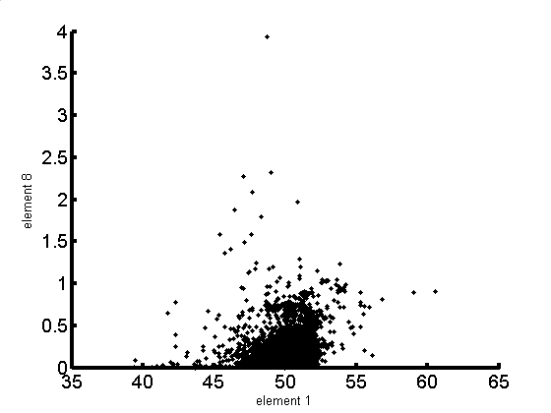
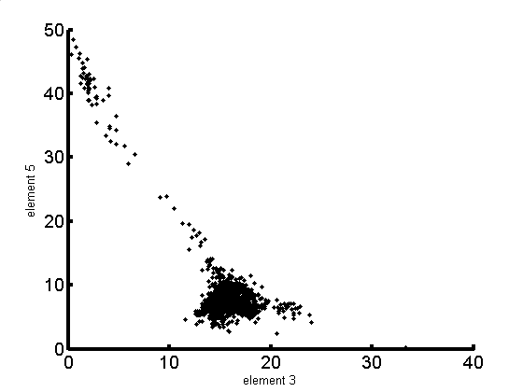
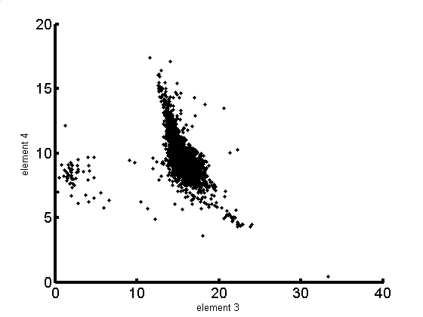
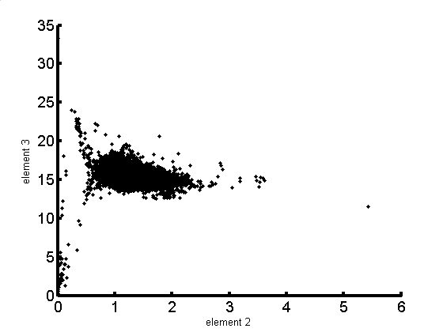
A)
B)
K₂0
Mg0
Si0₂
Al₂0₃
C)
D)
Fe0
Al₂0₃
Al₂0₃
Ti0₂
Notes:
Fig. 2.12 Scatter plot of four combinations of chemical components of the Atlantic Ocean rock sample dataset. MatLab script eda01_12

Slide 30
singular values, λ_{i}
index, i
Notes:
Fig. 10.5.. Singular values λ_{i} of the Atlantic Ocean rock dataset. MatLab script gda10_04.

Slide 31
SiO₂
TiO₂
Al₂O₃
FeO_{total}
MgO
CaO
Na₂O
K₂O
f⁽²⁾
f⁽³⁾
f⁽⁴⁾
f⁽⁵⁾
Notes:
Fig. 10.8. Factors, f⁽²⁾ through f⁽⁵⁾ , of the Atlantic Rock data set, as calculated by singular value decomposition.

Slide 32
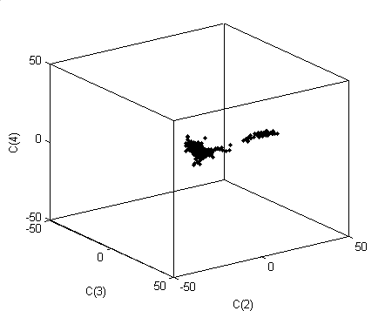
C₄
C₃
C₂
Notes:
Fig. 10.6. Three dimensional perspective view of the coefficients, C_{i}, of factors 2, 3 and 4 in each of the rock samples (dots) of the Atlantic Ocean Rock dataset. MatLab script gda10_04.

