Slide 1
Lecture 18 Varimax Factors and Empircal Orthogonal Functions
Notes:
This is the second of two lectures on factor analysis.
It has two parts,
the first uses a priori information to choose spiky factors, called varimax factors
the second uses factor analysis to find the “most important” patterns in spatial-temporal data.

Slide 2
Syllabus
Lecture 01 Describing Inverse Problems Lecture 02 Probability and Measurement Error, Part 1 Lecture 03 Probability and Measurement Error, Part 2 Lecture 04 The L₂ Norm and Simple Least Squares Lecture 05 A Priori Information and Weighted Least Squared Lecture 06 Resolution and Generalized Inverses
Lecture 07 Backus-Gilbert Inverse and the Trade Off of Resolution and Variance Lecture 08 The Principle of Maximum Likelihood Lecture 09 Inexact Theories Lecture 10 Nonuniqueness and Localized Averages Lecture 11 Vector Spaces and Singular Value Decomposition
Lecture 12 Equality and Inequality Constraints Lecture 13 L₁ , L∞ Norm Problems and Linear Programming Lecture 14 Nonlinear Problems: Grid and Monte Carlo Searches Lecture 15 Nonlinear Problems: Newton’s Method Lecture 16 Nonlinear Problems: Simulated Annealing and Bootstrap Confidence Intervals Lecture 17 Factor Analysis Lecture 18 Varimax Factors, Empircal Orthogonal Functions Lecture 19 Backus-Gilbert Theory for Continuous Problems; Radon’s Problem Lecture 20 Linear Operators and Their Adjoints Lecture 21 Fréchet Derivatives Lecture 22 Exemplary Inverse Problems, incl. Filter Design Lecture 23 Exemplary Inverse Problems, incl. Earthquake Location Lecture 24 Exemplary Inverse Problems, incl. Vibrational Problems

Slide 3
Purpose of the Lecture
Choose Factors Satisfying A Priori Information of Spikiness
(varimax factors)
Use Factor Analysis to Detect
Patterns in data
(EOF’s)
Notes:
This is the second of two lectures on factor analysis.
It has two parts,
the first uses a priori information to choose spiky factors, called varimax factors
the second uses factor analysis to find the “most important” patterns in spatial-temporal data.

Slide 4
Part 1: Creating Spiky Factors
Notes:
“Spiky”
A possible meaning of “simple”
A factor is simple if it has just a few large elements.

Slide 5
can we find “better” factors that those returned by svd() ?
Notes:
Remember that SVD determines the subspace of numerically important factors,
but the axes in that subspace are arbitrary.

Slide 6
mathematically
S = CF = C’ F’
with F’ = M F and C’ = M⁻¹ C
where M is any P×P matrix with an inverse
must rely on prior information to choose M
Notes:
Emphasize that a priori information plays an important role in choosing “good” factors.
A priori information determines the choice of the matrix M

Slide 7
one possible type of prior information factors should contain mainly just a few elements
Notes:
That is, the factor is “spiky”

Slide 8
example of rock and minerals rocks contain minerals minerals contain elements
Mineral | Composition
Quartz | SiO₂
Rutile | TiO₂
Anorthite | CaAl₂Si₂O₈
Fosterite | Mg₂SiO₄
Notes:
The point here is that each mineral contains just a few chemical elements,
but the rock contains many elements.

Slide 9
example of rock and minerals rocks contain minerals minerals contain elements
factors
Mineral | Composition
Quartz | SiO₂
Rutile | TiO₂
Anorthite | CaAl₂Si₂O₈
Fosterite | Mg₂SiO₄
most of these minerals are “simple” in the sense that each contains just a few elements
Notes:
The point here is that each mineral contains just a few chemical elements.

Slide 10
spiky factors factors containing mostly just a few elements
Notes:
Here we starting to quantify the degree to which a factor contains just a few elements.
“Spiky” is taken as more-or-less synonymous with “containing mostly just a few elements”

Slide 11
How to quantify spikiness?
Notes:
You might ask the class to contribute some ideas.

Slide 12
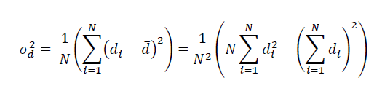
variance as a measure of spikiness
Notes:
E.g. The variance of [1, 1, 1, 1, 1] is zero. The variance of [1, 0, 0, 0, 0] is greater than zero.

Slide 13
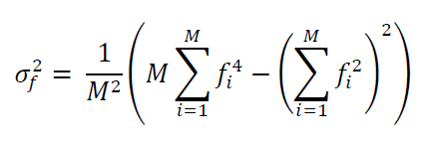
modification for factor analysis
Notes:
This is the variance of f_{i}², not f_{i}.

Slide 14
modification for factor analysis
depends on the square, so positive and negative values are treated the same
Notes:
The underlying notion is that the signs of components of the factor are less important than
the absolute size.

Slide 15
f⁽¹⁾= [1, 0, 1, 0, 1, 0]^{T} is much spikier than f⁽²⁾= [1, 1, 1, 1, 1, 1]^{T}
Notes:
(top) only three elements in this factor
(bottom) 6 factors

Slide 16
f⁽²⁾=[1, 1, 1, 1, 1, 1]^{T} is just as spiky as f⁽³⁾= [1, -1, 1, -1, -1, 1]^{T}
Notes:
(top) six elements of equal size, a positive
(bottom) six elements of equal size, but alternating size
have the same spikiness

Slide 17
“varimax” procedure
find spiky factors without changing P
start with P svd() factors
rotate pairs of them in their plane by angle θ
to maximize the overall spikiness
Notes:
Since the P factors are being mixed together with each other, and not with the M-P factors
with zero eigenvalues, the value of P doen’t change.

Slide 18
f’_{A}
f_{B}
f_{A}
θ
f’_{B}
Notes:
Two factors, f_{A} and f_{B}, are rotated in their plane by a angle θ
The angle θ is chosen to maximize the spikiness of the two factors.

Slide 19
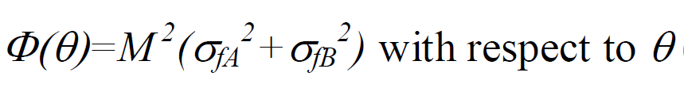
determine θ by maximizing
Notes:
This is a standard maximization problem.
Take derivative of Phi with respect to theta and set the result to zero.

Slide 20
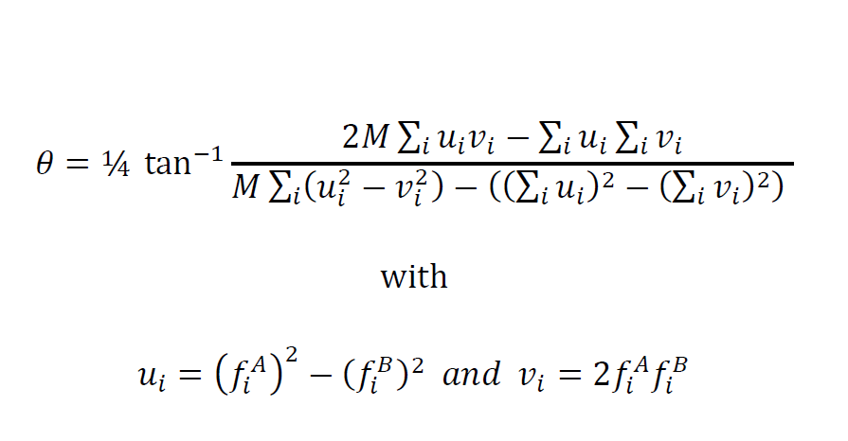
after tedious trig the solution can be shown to be
Notes:
Looks complicated,
but actually,
is trivial tocin MatLab

Slide 21
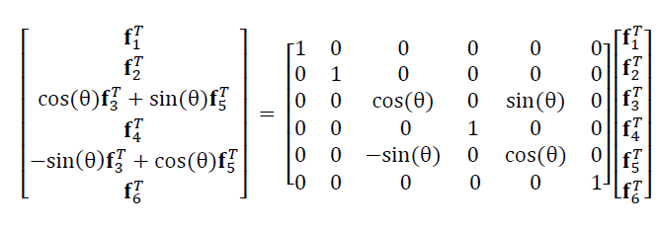

and the new factors are
in this example A=3 and B=5
Notes:
M is a rotation matrix that rotates only in the plane of factors A and B (3 and 5, as sown above).
M obeys M⁻¹ = M^{T}.

Slide 22
now one repeats for every pair of factors and then iterates the whole process several times until the whole set of factors is as spiky as possible
Notes:
The overall rotation matrix is just the product of the individual ones.
It needs to be ‘accumulated’ during the iterations.

Slide 23
example: Atlantic Rock dataset
Old
New
SiO₂
TiO₂
Al₂O₃
FeO_{total}
MgO
CaO
Na₂O
K₂O
f₂
f₃
f₄
f₅
f’₂
f’₃
f’₄
f’₅
Notes:
svd factors; B) varimax factors. Note that the latter has few large (black) values.

Slide 24
example: Atlantic Rock dataset
Old
New
SiO₂
TiO₂
Al₂O₃
FeO_{total}
MgO
CaO
Na₂O
K₂O
not so spiky
f₂
f₃
f₄
f₅
f’₂
f’₃
f’₄
f’₅
Notes:
svd factors; B) varimax factors. Note that the latter has few large (black) values.

Slide 25
example: Atlantic Rock dataset
Old
New
SiO₂
TiO₂
Al₂O₃
spiky
FeO_{total}
MgO
CaO
Na₂O
K₂O
f₂
f₃
f₄
f₅
f’₂
f’₃
f’₄
f’₅
Notes:
svd factors; B) varimax factors. Note that the latter has few large (black) values.

Slide 26
Part 2: Empirical Orthogonal Functions
Notes:
This is an important extension of factor analysis.

Slide 27
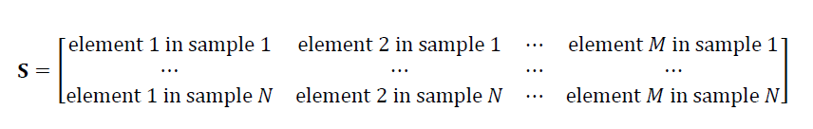
row number in the sample matrix could be meaningful
example: samples collected at a succession of times
time
Notes:
Ordering by time is common, but many other types of ordering are useful.

Slide 28
column number in the sample matrix could be meaningful
example: concentration of the same chemical element at a sequence of positions
distance
Notes:
Ordering by distance is common, but many other types of ordering are useful.

Slide 29
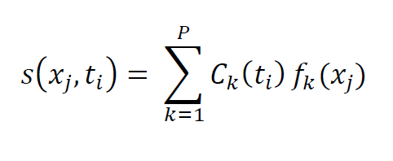
S = CF becomes

Slide 30
S = CF becomes
distance dependence
time dependence

Slide 31
S = CF becomes
each factor:
a spatial pattern of variability of the element
each loading: a temporal pattern of variability of the corresponding factor

Slide 32
S = CF becomes
there are P patterns and they are sorted into order of importance

Slide 33
S = CF becomes
factors now called EOF’s (empirical orthogonal functions)

Slide 34
example 1
hypothetical mountain profiles
what are the most important spatial patterns
that characterize mountain profiles
Notes:
Here we use EOF’s simply to classify spatial patterns.
How do they differ from one another?

Slide 35
this problem has space but not time
s( x_{j} , i ) = Σ_{k=1}^{p} c_{ki} f ^{(k)}(x_{j})
Notes:
The s(x, i) is the ith profile.
It is composed of a sum of p factors f(x).

Slide 36
this problem has space but not time
s( x_{j} , i ) = Σ_{k=1}^{p} c_{ki} f ^{(k)}(x_{j} )
factors are spatial patterns that add together to make mountain profiles
Notes:
note that the factors are functions of position x

Slide 37
Notes:
Here are 15 mountain profiles.
Fig 10.9. A set of hypothetical mountain profiles. The variability of shape will be determined using factor analysis. MatLab script gda10_06

Slide 38
elements:
elevations ordered by distance along profile
Notes:
In terms of our standard lingo.
the elements are “elevations at particular spatial positions”.
Each profile is one ROW of the sample matrix S
Fig 10.9. A set of hypothetical mountain profiles. The variability of shape will be determined using factor analysis. MatLab script gda10_06

Slide 39
λ₁ = 38
λ₂ = 13
λ₃ = 7
EOF 1
EOF 2
EOF 3
f_{i} ⁽¹⁾
f_{i} ⁽²⁾
f_{i} ⁽³⁾
index, i
index, i
index, i
Notes:
Here are the factors corresponding to the 3 biggest factors.
EOF 1 is the average mountain.
EOF 2 characterizes the most important way the profiles differ from the average,
in this case, by left-right assymetry.
EOF 3 characterizes the second most important way that the mountain profiles differ from the average,
in this case,
by the “pointiness” (sharpness) of their summit
Fig 10.10. The three largest factors, f⁽¹⁾, f⁽¹⁾ and f⁽³⁾ in the representation of the mountain profiles in Figure 10.?. A) The factor with the largest singular value, λ_{i}=38.4, has the shape of the average profile. B) The factor with the second largest singular value, λ_{i}=12.7, quantifies the asymmetry of the profiles. C) The factor with the third largest singular value, λ_{i}=7.4 quantifies the sharpness of the mountain summits. MatLab script gda10_06.

Slide 40
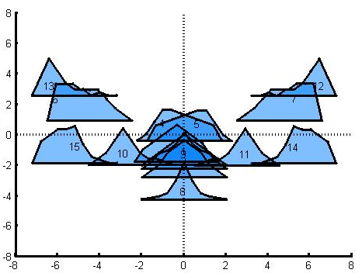
factor loading, C_{i3}
factor loading, C_{i2}
Notes:
Here we use the loadings of the second and third factors to organize the profiles.
Fig 10.11. The mountain profiles of Figure 10.?, arranged according to the relative amounts of factors 2 and 3 contained in each profile’s orthogonal decomposition; that is, by the size of the factor loadings, C_{i2} and C_{i3}. MatLab script gda10_06

Slide 41
example 2
spatial-temporal patterns
(synthetic data)
Notes:
Start with synthetic data that contains known patterns.

Slide 42
the data
Notes:
Synthetic data.
Fig 10.13. Time sequence of N=25 images. Each image represents a parameter, such as pressure or temperature, that varies spatially in the (x,y) plane. MatLab script gda10_07.

Slide 43
the data
y
x
t=1
spatial
pattern at
a single
time
Notes:
Each image is spatial (x,y).
Sequence of images is spatial, t.
Fig 10.13. Time sequence of N=25 images. Each image represents a parameter, such as pressure or temperature, that varies spatially in the (x,y) plane. MatLab script gda10_07.

Slide 44
the data
time
Notes:
time goes this way
Fig 10.13. Time sequence of N=25 images. Each image represents a parameter, such as pressure or temperature, that varies spatially in the (x,y) plane. MatLab script gda10_07.

Slide 45
the data
Notes:
Have the class stare at this.
How many patterns do they see?
How do they vary with time?
Fig 10.13. Time sequence of N=25 images. Each image represents a parameter, such as pressure or temperature, that varies spatially in the (x,y) plane. MatLab script gda10_07.

Slide 46
need to unfold each 2D image into vector
4
6
1
9
1
2
1
3
6
4 | 6 | 1
9 | 1 | 2
1 | 3 | 6
s
Notes:
Need to unwrap each image into a vector so as to be able to build a sample matrix S.
Fig 10.12. A matrix A representing a discrete version of a two dimensional function A_{ij}=a(x_{i},y_{j}), is unfolded row-wise into a vector a using the rule a_{k}=A_{ij} with k=(i-1)M+j.

Slide 47
λ_{i}
index, i
p=3
Notes:
Singular values: Only three big ones.
Fig 10.14. Singular values, λ_{i}, of the image sequence shown in Figure 10.12. Only p=3
singular values have significant amplitudes. MatLab script gda10_07.

Slide 48
(A)
(B)
EOF 1
EOF 2
EOF 3
loadng1
time, t
loadng2
time, t
loadng3
time, t
Notes:
(Top) the three most-important spatial patters.
(Bottom) the time dependence of their loadings:
At what time is a particular EOF important?
Fig 10.15. (A) First three Empirical Orthogonal Functions (EOFs) of the image sequence shown in Figure 10.12. (B) Corresponding loadings as a function of time, t. MatLab script gda10_07.

Slide 49
example 3
spatial-temporal patterns
(actual data)
sea surface temperature in the Pacific Ocean
Notes:
Same deal, now apply to real data.

Slide 50
CAC Sea Surface Temperature
29°N
equatorial Pacific Ocean
latitude
29°S
124°E
290°E
longitude
sea surface temperature (black = warm)
Notes:
Equatorial Pacific – home of El Nino / Southern Osscilation

Slide 51
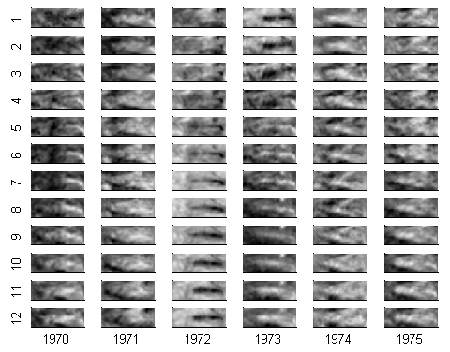
Notes:
Sea surface temperature for each month of the year.
The complete dataset is longer than shown here, January 1970 to March 2003, or 399 months of data.

Slide 52
the image is 30 by 84 pixels in size, or 2520 pixels total
to use svd(), the image must be unwrapped into a vector of length 2520

Slide 53
2520 positions in the equatorial Pacific ocean
399 times
“element” means temperature
Notes:
Arrangement of the sample matrix

Slide 54
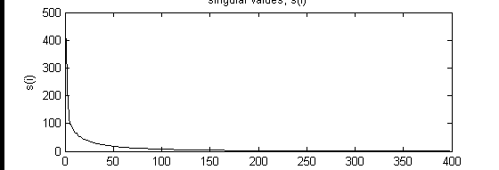
singular values
singular values, Σ_{ii}
index, i
Notes:
Note singular values fall off smoothly with index. No clear cutoff.
Typical of real data containing observational noise.

Slide 55
singular values
singular values, Σ_{ii}
index, i
no clear cutoff for P, but the first 12 singular values are considerably larger than the rest
Notes:
Pick arbitrary cut off of 12.

Slide 56
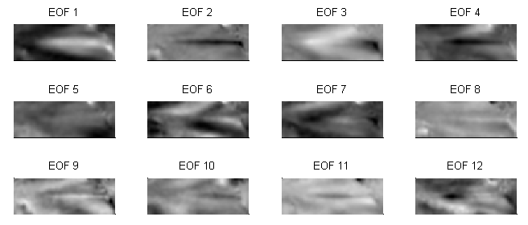
Notes:
EOF 1 is the most important pattern. It has a wide cool band running E-W across the equator.
EOF 2 it the second most important. It has a thin hot band running E-W across the equator.
The EOFs become progressively more and more complicated in spatial pattern.

Slide 57
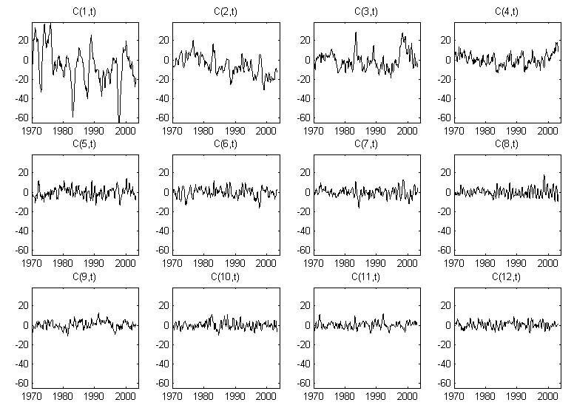
Notes:
Amplitude time series, C_{i}(t), of the First 12 EOF’s of the CAC sea surface temperature dataset for the time period January 1970 to March 2003.

Slide 58
Notes:
C₁(t), which give the time-varying amplitude of the first EOF. It varies with periods of a few years.
Flash back to the EOF plot and point out that the first EOF is a wide cool band across the equator.
This is a La Nina pattern, so C₁(t) functions like a La Nina index. large during La Nina, small during El Nino.

Slide 59
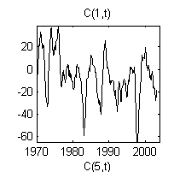
Notes:
C₁(t), which give the time-varying amplitude of the first EOF. It varies with periods of a few years.
Flash back to the EOF plot and point out that the first EOF is a wide cool band across the equator.
This is a La Nina pattern, so C₁(t) functions like a La Nina index. large during La Nina, small during El Nino.

Slide 60
Notes:
C₈(t), which give the time-varying amplitude of the 8th EOF, seems to have annual variability.
Flash back to look at EOF 8.
It is large in the northeast, small in the southwest, intermediate (near zero) elsewhere.
The pattern flips in sign every 6 months, reflecting the change from northern-summer to northern-winter.

Slide 61
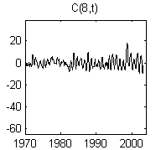
Notes:
C₈(t), which give the time-varying amplitude of the 8th EOF, seems to have annual variability.
Flash back to look at EOF 8.
It is large in the northeast, small in the southwest, intermediate (near zero) elsewhere.
The pattern flips in sign every 6 months, reflecting the change from northern-summer to northern-winter.

Slide 62
using SVD to approximate data
Notes:
First few EOFs capture most of the variability of the data.

Slide 63
S=C_{M}F_{M} S=C_{P}F_{P} S≈C_{P’}F_{P’}
With M EOF’s, the data is fit exactly
With P chosen to exclude only zero singular values, the data is fit exactly
With P’<P, small non-zero singular values are excluded too, and the data is fit only approximately
Notes:
Because of observational noise, the singular values rarely fall into two distinct groups, one
non-zero and the other zero. More common is the case where their size diminishes smoothly
with index, i, so that one has to make a decision on which ones to include; that is, how accurate
the approximation S≈CF ought to be.

Slide 64
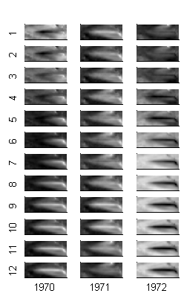
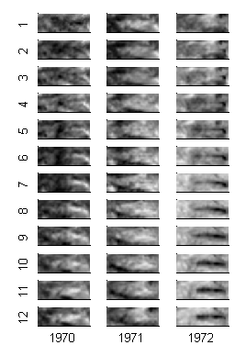
A) Original
B) Based on first 5 EOF’s
Notes:
You should flash back to the slide showing the first 12 EOF’s.
Ask the class to describe what is accurate about the approximation, and what is not.

