Slide 1
Lecture 19 Continuous Problems: Backus-Gilbert Theory and Radon’s Problem
Notes:
In this lecture,
we start a formal discussion of continuous inverse theory.
The trick is to be a rigorous as possible,
without having to pull too many facts from functional analysis out of the hat.

Slide 2
Syllabus
Lecture 01 Describing Inverse Problems Lecture 02 Probability and Measurement Error, Part 1 Lecture 03 Probability and Measurement Error, Part 2 Lecture 04 The L₂ Norm and Simple Least Squares Lecture 05 A Priori Information and Weighted Least Squared Lecture 06 Resolution and Generalized Inverses
Lecture 07 Backus-Gilbert Inverse and the Trade Off of Resolution and Variance Lecture 08 The Principle of Maximum Likelihood Lecture 09 Inexact Theories Lecture 10 Nonuniqueness and Localized Averages Lecture 11 Vector Spaces and Singular Value Decomposition
Lecture 12 Equality and Inequality Constraints Lecture 13 L₁ , L∞ Norm Problems and Linear Programming Lecture 14 Nonlinear Problems: Grid and Monte Carlo Searches Lecture 15 Nonlinear Problems: Newton’s Method Lecture 16 Nonlinear Problems: Simulated Annealing and Bootstrap Confidence Intervals Lecture 17 Factor Analysis Lecture 18 Varimax Factors, Empircal Orthogonal Functions Lecture 19 Backus-Gilbert Theory for Continuous Problems; Radon’s Problem Lecture 20 Linear Operators and Their Adjoints Lecture 21 Fréchet Derivatives Lecture 22 Exemplary Inverse Problems, incl. Filter Design Lecture 23 Exemplary Inverse Problems, incl. Earthquake Location Lecture 24 Exemplary Inverse Problems, incl. Vibrational Problems

Slide 3
Purpose of the Lecture
Extend Backus-Gilbert theory to continuous problems
Discuss the conversion of
continuous inverse problems to discrete problems
Solve Radon’s Problem
the simplest tomography problem
Notes:
This is a three part lecture.
Part 1 extends Backus-Gilbert theory to continuous functions. It is
really the only approach that can deal with continuous model parameters
without any discretizing approximations.
Part 2 discusses the approximatuon of continuous functions as sets of discrete parameters,
which is necessary if the non-Backus-Gilbert parts of inverse theory are to be applied.
Part 3 begins a discussion of tomography, and solves the simplest tomography problem,
called Radon’s Problem.

Slide 4
Part 1 Backus-Gilbert Theory
Notes:
The salient parts of this theory are
the use of localized averages as the “solution” to inverse problems;
the focus on spread of resolution as a way to slect a good solution/

Slide 5
Continuous Inverse Theory the data are discrete but the model parameter is a continuous function
Notes:
The data are still discrete and noisy, but the model parameters are
now continuous functions of one or more variables.

Slide 6
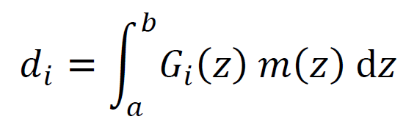
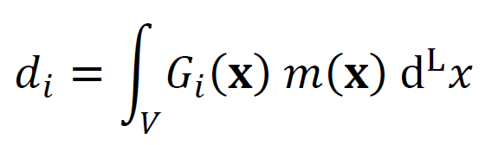
One or several dimensions
Notes:
Top: one-dimensional case with position variable x.
Bottom: L-dimensional case with position variable bold-x.

Slide 7
One or several dimensions
data
model function
Notes:
In both cases, the formula relating data and model function are integrals.

Slide 8
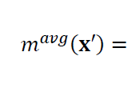
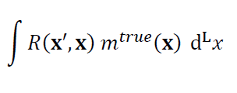
hopeless to try to determine estimates of model function at a particular depth m(z₀) = ?
localized average is the only way to go
Notes:
Since a function has “an infinite number of points”, its hopeless to try to
estimate them all.

Slide 9
hopeless to try to determine estimates of model function at a particular depth m(z₀) = ?
the problem is that an integral, such as the data kernel integral, does not depend upon the value of m(z) at a “single point” z₀
localized average is the only way to go
continuous version of resolution matrix
Notes:
In fact, an integral,
such as the data kernel integral,
does not even depend on the value of a function at any particullar point.
A localized average, however, is still completely sensible.
But the averaging function/ resolution matrx is now a function.
Its’s usually called the ‘resolving kernel’.

Slide 10
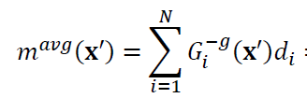
let’s retain the idea that the “solution” depends linearly on the data
Notes:
We start by proposing that the solution is a linear function of the data,
involving a generalized inverse.

Slide 11
let’s retain the idea that the “solution” depends linearly on the data
continuous version of generalized inverse
Notes:
This inverse is the continuous version of the matrix G^{-g} we encountered in discrete problems
that satisfied m=G^{-g}d

Slide 12
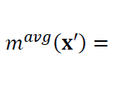
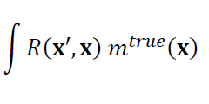
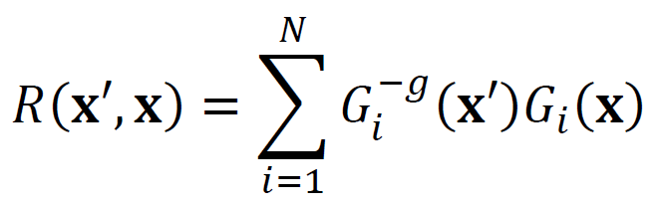
implies a formula for R
Notes:
The formula for the resolving kernel is derived exactly in analogy to the discrete case.

Slide 13
<m>=G^{-g}d
comparison to discrete case
d=Gm
<m>=Rm
R=G^{-g}G
Notes:
Here’s the discrete case for comparison.

Slide 14
implies a formula for R
Notes:
You might want to flash back and forth between this slide and the previous one.
Note which quantities remain matrices and which become continuous functions.

Slide 15
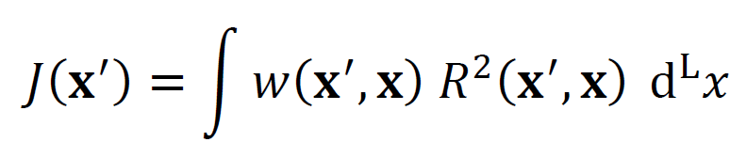
Now define the spread of resolution as
Notes:
The spread of resolution is defines exactly as it was in the discrete case,
except that the sum becomes an integral.

Slide 16

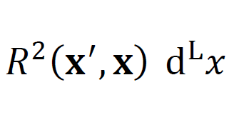
fine generalized inverse that minimizes the spread J with the constraint that
= 1
Notes:
Minimizing the spread of resolution leads to a particular choice for the generalized inverse.
As in the discrete case, one adds a constraint that the area under the resolving kernel is unity.

Slide 17
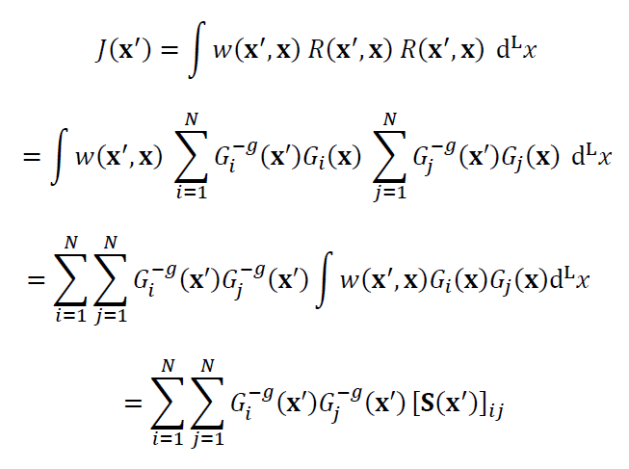
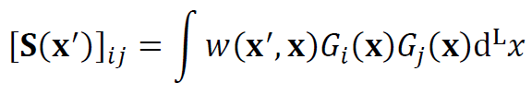
Notes:
J is quadratic in the elements of the generalized inverse.
It involves a matrix S.

Slide 18
J has exactly the same form as the discrete case only the definition of S is different
Notes:
There is almost no difference between the continuous case and the discrete case.

Slide 19
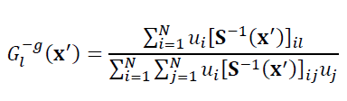

Hence the solution is the same as in the discrete case
where
Notes:
Hence the solution is very similar.
Just integrals in two places where in the discrete case there are sums.

Slide 20
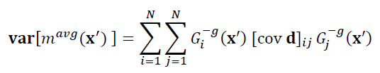
furthermore, just as we did in the discrete case, we can add the size of the covariance
where
Notes:
Furthermore, its easy to add a measure of variance to the problem,

Slide 21

as before this just changes the definition of S
and leads to a trade-off of resolution and variance
α=1
size of variance
α=0
spread of resolution
Notes:
So as to be able to choose a generalized inverse that is a compronise
between an average with good resolution but high variance
and an average with low variance but poor resolution.
Fig. 11.1. Typical trade-off of resolution and variance for a linear continuous inverse problem. Note that the size(spread) function decreases monotonically with spread and that it is tangent to the two asymptotes at the endpoints, α=1 and α=0.

Slide 22
Part 2 Approximating a Continuous Problem as a Discrete Problem
Notes:
We have done this approximation many times before in the course,
usually in the context of ‘time series approximations’,
that is, approximating a continuous function as sequence of closely sampled values.
But we need to be a little more rigorous,

Slide 23
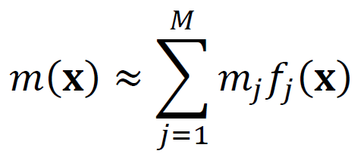
approximation using finite number of known functions
Notes:
A general way of approximating a function is by
superimposing (adding together) a finite number
of known functions. There the coefficients mj
become the discrerte model parameters.

Slide 24
approximation using finite number of known functions
known functions
continuous function
unknown coefficients
= discrete model parameters

Slide 25
posssible f_{j}(x)’s
voxels (and their lower dimension equivalents)
polynomials
splines
Fourier (and similar) series
and many others
Notes:
Many different approaches

Slide 26
does the choice of f_{j}(x) matter?
Yes!
The choice implements prior information
about the properties of the solution
The solution will be different depending upon the choice
Notes:
Every choice of functions implies a different type of a priori information.
The solution depends on the choice.

Slide 27
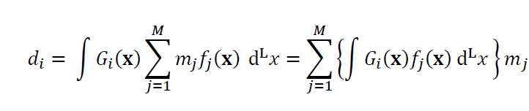
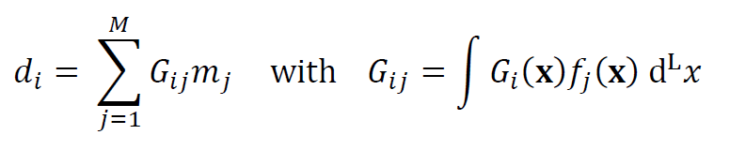
conversion to discrete Gm=d
Notes:
Plug formula for m(x) into first integral, reverse the order of sum and integral, and integrate.

Slide 28
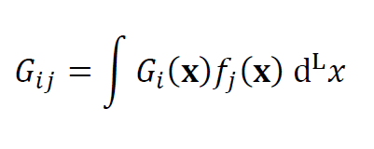
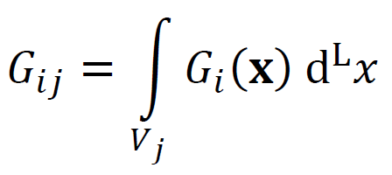
special case of voxels
1 if x inside V_{i}
f_{i}(x) =
0 otherwise
size controlled by the scale of variation of m(x)
integral over voxel j
Notes:
Voxels: Discrete data kernel is integral of continuous data kernel over volume of voxel.

Slide 29
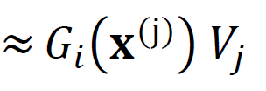
approximation when G_{i}(x) slowly varying
center of voxel j
size controlled by the scale of variation of G_{i}(x)
more stringent condition than scale of variation of m(x)
Notes:
The voxel integral can be approximated by
the volume of the voxel
times
the value of the data kernel at the center of the voxel.
This is the multi-dimensional form of the Reiman Summation formula.
But for this approximation to work, the data kernel must be slowly varying.

Slide 30
Part 3 Tomography
Notes:
Tomography – from Greek “tomos”

Slide 31
Greek Root
tomos
a cut, cutting, slice, section
Notes:
Meaning slice or cut.

Slide 32
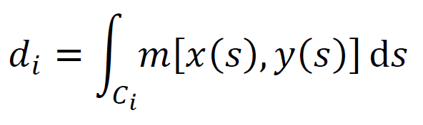
“tomography” as it is used in geophysics
data are line integrals of the model function
curve i
Notes:
In our usage, a special form of the relationship between
data and model parameter,
which are related by line integrals.

Slide 33
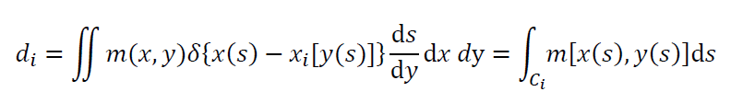
you can force this into the form
if you want
G_{i}(x)
but the Dirac delta function is not square-integrable, which leads to problems
Notes:
You can force this into a standard data kernel formulation,
but the kernel will involve delta functions,
which can be nasty.

Slide 34
Radon’s Problem straight line rays data d treated as a continuous variable
Notes:
Simples tomography problem
straight line rays
data for every possible ray, so data can be treated as a continuous variable

Slide 35
(u,θ) coordinate system for Radon Transform
y
s
integrate over this line
u
θ
x
Notes:
every straight-line ray is defined bu a (u, theta).
u: distance of line from origin
theta: angle between ray perpendicular and x-axis.
The integral is over arc-length s of a line.
Fig. 11.2. The Radon transform is performed by integrating a function of (x, y) along straight lines (bold) parameterized by the arc-length, s, perpendicular distance, u, and angle, θ.

Slide 36
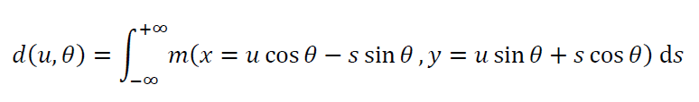
Radon Transform m(x,y) → d(u,θ)
Notes:
We can consider Radon’s Problem as defining
a new type of integral transform, the Radon Transform.
which transforms m(x,y)
to d(u, theta)

Slide 37
(A) m(x,y)
(B) d(u,θ)
x
u
y
θ
Notes:
Here’s an example of the forward transform.
Fig. 11.4. (A) A test image, m^{true}(x,y), of 256×256 discrete values, or pixels. This synthetic image depicts a hypothetical magma chamber beneath a volcano. (B) The Radon transform, d(u,θ), of the image in A), also evaluated at 256×256 points. (C) The image, m^{est}(x,y), reconstructed from its Radon transform by direct application of the Fourier slice theorem. Small errors in the reconstruction arise from the interpolation of the Fourier-transformed image onto a rectangular grid. MatLab script gda11_02.

Slide 38
Inverse Problem
find m(x,y) given d(u,θ)
Notes:
Can we invert it?

Slide 39
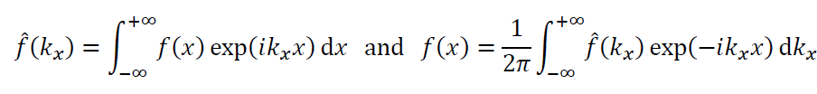
Solution via Fourier Transforms
x→k_{x}
k_{x} → x
Notes:
Yes, we can invert it using Fourier transforms.
Here we “remind you” what the forward and inverse Fourier Transforms look like.
If you’ve never seen them before, you had best skip the rest of the lecture,
except to admire the reconstructed image on the last slide.

Slide 40
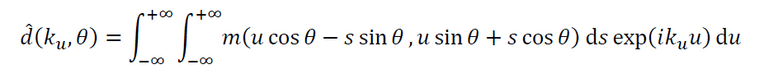
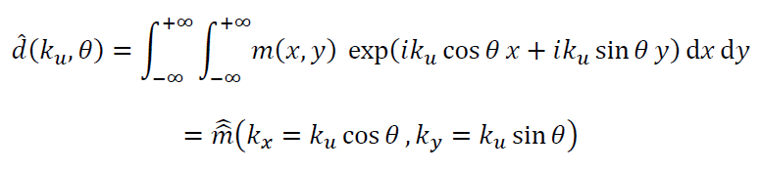
now Fourier transform
u→k_{u}
now change variables
(u,θ) →(x,y)
Notes:
Three steps:
1) Fourier transform d(u, theta) to d( ku, theta )
2) Change variables from (u, theta) to (x, y)
3) Interpret results as m-hat-hat(kx,ky),
that is, the Fourier transform of m(x,y).

Slide 41
now Fourier transform
u→k_{u}
now change variables
(s,u) →(x,y)
J=1, by the way
Fourier transform of d(u,θ)
Fourier transform of m(x,y)
evaluated on a line of slope θ
Notes:
So just have to take inverse transform of m-hat-hat(kx,ky),
to get back to m(x,y).
Simple as pie!

Slide 42
y
k_{y}
^
^
m(x,y)
m(k_{x},k_{y})
d(u,θ₀)
u
θ₀
θ₀
x
k_{x}
FT
Notes:
Graphical representation of “Fourier Slice Theorem”.
Fig. 11.3. (Left) The function, m(x,y), is integrated along a set of parallel lines (dashed) in a Radon transform to form the function, d(u, θ₀). This function is called the projection of m(x,y) at the angle, θ₀. (Right) The Fourier slice theorem states that the Fourier Transform of the projection (here denoted FT) is equal to the Fourier-transformed image evaluated along a line (bold) of angle, θ₀, in the (k_{x}, k_{y}) plane.

Slide 43
Learned two things
Proof that solution exists and unique, based on “well-known” properties of Fourier Transform
Recipe how to invert a Radon transform using Fourier transforms
Notes:
The Fourier transform can be uniquely inverted if it is known at all (kx,ky).
Inspection of the formula show that all (kx,ky)’s can be computed from d(u,theta),
as long as all u’s and thetas are samples,
Hence Radon’s Problem has a unique solution.
And the formula provide the inversion method.

Slide 44
(A)
(B)
(C)
x
u
x
y
θ
y
Notes:
An example. Image (C) is reconstructed from Radon Transform (B).
It compares favorably to the true image (A).
Fig. 11.4. (A) A test image, m^{true}(x,y), of 256×256 discrete values, or pixels. This synthetic image depicts a hypothetical magma chamber beneath a volcano. (B) The Radon transform, d(u,θ), of the image in A), also evaluated at 256×256 points. (C) The image, m^{est}(x,y), reconstructed from its Radon transform by direct application of the Fourier slice theorem. Small errors in the reconstruction arise from the interpolation of the Fourier-transformed image onto a rectangular grid. MatLab script gda11_02.

