Slide 1
Lecture 20 Continuous Problems Linear Operators and Their Adjoints
Notes:
Over the past twenty years,
important advanced have been made in inverse theory
using tools drawn from functional analysis
that are centered about the concept of ‘adjoint operators’.
In oceanography and atmospheric science, the are associated with the
lingo ‘data assimilation’.
And in seismology, with the waveform tomography.

Slide 2
Syllabus
Lecture 01 Describing Inverse Problems Lecture 02 Probability and Measurement Error, Part 1 Lecture 03 Probability and Measurement Error, Part 2 Lecture 04 The L₂ Norm and Simple Least Squares Lecture 05 A Priori Information and Weighted Least Squared Lecture 06 Resolution and Generalized Inverses
Lecture 07 Backus-Gilbert Inverse and the Trade Off of Resolution and Variance Lecture 08 The Principle of Maximum Likelihood Lecture 09 Inexact Theories Lecture 10 Nonuniqueness and Localized Averages Lecture 11 Vector Spaces and Singular Value Decomposition
Lecture 12 Equality and Inequality Constraints Lecture 13 L₁ , L∞ Norm Problems and Linear Programming Lecture 14 Nonlinear Problems: Grid and Monte Carlo Searches Lecture 15 Nonlinear Problems: Newton’s Method Lecture 16 Nonlinear Problems: Simulated Annealing and Bootstrap Confidence Intervals Lecture 17 Factor Analysis Lecture 18 Varimax Factors, Empircal Orthogonal Functions Lecture 19 Backus-Gilbert Theory for Continuous Problems; Radon’s Problem Lecture 20 Linear Operators and Their Adjoints Lecture 21 Fréchet Derivatives Lecture 22 Exemplary Inverse Problems, incl. Filter Design Lecture 23 Exemplary Inverse Problems, incl. Earthquake Location Lecture 24 Exemplary Inverse Problems, incl. Vibrational Problems

Slide 3
Purpose of the Lecture
Teach you a tiny bit of analysis
enough for you to understand
Linear Operators and their Adjoints
because they are the core technique
used in the so-called
adjoint method of computing data kernels
Notes:
This lecture is all mathematic.
Sorry, but there’s no way around it.
We’re going to suppose that you have some familiarity with
differential equations,
So here goes.

Slide 4
everything we do today is based on the idea of generalizing discrete problems to continuous problems
Notes:
The approach we will take is to show that almost all of the linear algebra
concepts that we have drawn upon in the course,
have extensions into the world of continuous functions.

Slide 5
a function m(x) is the continuous analog of a vector m
Notes:
A function is analagous to a vector.
We’ve used this many times in the class,
approximating a function as a vector of discrete values, with some sampling delta-x.

Slide 6
a function m(x) is the continuous analog of a vector m
simplification:
one spatial dimension x
Notes:
By the way,
All the discussion today is for 1D functions.
The generalization to 3D involves no huge conceptual leaps.
Its just messier.

Slide 7
comparison m is of length M m(x) is infinite dimensional
Notes:
You might consider a function as a vector with an infinite number of components.

Slide 8
What is the continuous analog of a matrix L ?
Notes:
So if the continuous analog to a vector is a function,
what is the continuous analog of a matrix.

Slide 9
We’ll give it a symbol, ℒ and a name, a linear operator
Notes:
Start out by giving it a name & symbol.
Now start to look at the properties of matrices,
and see which ones we might want to have in
a linear operator.

Slide 10
Matrix times a vector is another vector b = L a so we’ll want linear operator on a function is another function b(x) = ℒ a(x)
Notes:
A matrix “turns one vector into another”.
So a linear operator should change one function into another.

Slide 11
Matrix arithmetic is not communative L⁽¹⁾ L⁽²⁾ a ≠ L⁽²⁾ L⁽¹⁾ a so we’ll not expect that property for linear operators, either ℒ ⁽¹⁾ ℒ⁽²⁾ a(x) ≠ ℒ ⁽²⁾ ℒ⁽¹⁾ a(x)
Notes:
Matrix multiplication is not communitive.
That will carry over.

Slide 12
Matrix arithmetic is associative (L⁽¹⁾ L⁽²⁾) L⁽³⁾ a = L⁽¹⁾ (L⁽²⁾ L⁽³⁾ ) a so well want that property for linear operators, too (ℒ ⁽¹⁾ ℒ⁽²⁾ )ℒ⁽³⁾ a(x) = ℒ ⁽¹⁾ (ℒ⁽²⁾ ℒ⁽³⁾) a(x)
Notes:
But it is associative.
That will carry over.

Slide 13
Matrix arithmetic is distributive L [a+b] = La + Lb so well want that property for linear operators, too ℒ [a(x)+ b(x)] = ℒ a(x)+ ℒ b(x)
Notes:
And it its distributive.
That will carry over.

Slide 14
Hint to the identity of ℒ matrices can approximate derivatives and integrals
Notes:
We have already used matrices to approximate
derivatives.
For example, when we used them to quantify roughness
in problems were the a priori information of smoothness was important.
And they can approximate integrals, too.

Slide 15
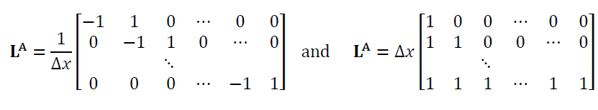
B
Notes:
Left: finite difference approximation for a derivative.
Right: Riemann summation approximation for an integral.

Slide 16
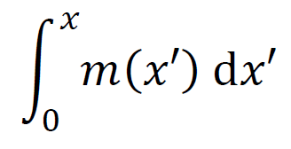
B
L^{A}a ≈ da/dx
Lªa ≈
Notes:
left: derivative
right: indefinite integral

Slide 17
Linear Operatorℒ any combination of functions, derivatives and integrals
Notes:
A linear operator is anything that can be approximated as a matrix.
So functions, derivatives and integrals are all fine.

Slide 18
ℒ a(x)= c(x) a(x) ℒ a(x)= da/dx ℒa(x) = b(x)da/dx + c(x) d²a/dx ² ℒ a(x)= ∫₀^{x} a(ξ)dξ ℒ a(x)= f(x)∫₀∞ a(ξ)g(x,ξ ) dξ
all perfectly good ℒ a(x)’s
Notes:
Some examples.
Its best to write ℒa instead of just ℒ
so you can be sure where the a goes.

Slide 19
What is the continuous analog of the inverse L⁻¹ of a matrix L ? call it ℒ ⁻¹
Notes:
L-inverse “undoes” multiplication by L
so ℒ ⁻¹ should “undue” the operation of ℒ.

Slide 20
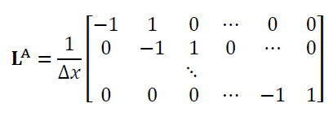
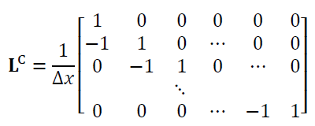
Problem L^{A} not square, so has no inverse
derivative determines a function only up to an additive constant
Patch by adding top row that sets the constant
Now L^{B} L^{C} = I
Notes:
Problem that the matrix representation of the derivative is not square, so it has no inverse.
This is associated with the fact that you can’t undo a derivative unless you know
the value of the function at one point – the integration constant.
So we add a row that says the first value of the vector is known.
Now LC is exactly the matrix inverse of LA.

Slide 21

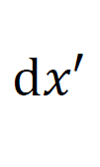

lesson 1: ℒ may need to include boundary conditions
lesson 2:
then
if
ℒ = d/dx
ℒ ⁻¹ =
since
Notes:
Likewise, a linear differential operator may have to include boundary conditions
for it to have an inverse.
So we have discovered that if the linear operator is a derivative
its inverse is an indefinite integral
and vice versa

Slide 22

the analogy to the matrix equation
L m = f
and its solution
m = L⁻¹ f
is the differential equation
ℒ m = f
and its Green function solution
ℒ
Notes:
One way to think about a matrix inverse
is that it can be used to invert (solve) a matrix equation.
The continuous analog of a matrix equation is a differential equation.
So by analogy, the inverse operator solves the differential equation.
But the solution of a differential equation is a Green function integral.
(We’ll, it’s a leap of faith here assuming that the class knows about
the use of Green functions to solve differential equations, but what
cn one do?)
So the inverse of a differential operator is its Green function integral

Slide 23



so the inverse to a differential operator ℒ
is the Green function integral
ℒ ⁻¹ a(x) =
a(ξ)
where F solves
Notes:
Hence the inverse operator to a linear differential operator is the Green function integral.
That allows us to use our toolkit of techniques learned about differential equations to
construct inverse operators
At least in the case whethere the operators are differential operators
meaning that they contain no integrals.

Slide 24
What is the continuous analogy to a dot product ?
a^{T}b = Σ_{i} a_{i} b_{i}
Notes:
Dot products are very important in discrete inverse theory.
So what is the continuous analog?

Slide 25
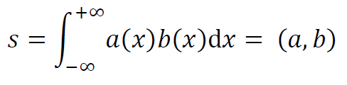
The continuous analogy to a dot product
s = a^{T}b = Σ_{i} a_{i} b_{i}
is the inner product
Notes:
Easy.
Just replace the vectors with functions
and convert the sum to an integral.
The integral is given a name
the inner product
and a symbol
the (a,b) notation.

Slide 26
squared length of a vector |a|² = a^{T}a
squared length of a function
|a|² = (a,a)
Notes:
Note that this is also the square of the L2 norm of a fucntion.

Slide 27
important property of a dot product
(La)^{T} b = a^{T} (L^{T}b)
Notes:
At first glace, this relationship seems pretty trivial.
But actually, its very important.

Slide 28
important property of a dot product
(La)^{T} b = a^{T} (L^{T}b)
what is the continuous analogy ?
(ℒa, b )= (a, ?b )
Notes:
Its important because the analogous continuous operation allows you to
move a linear operator from side of the inner product to the other.

Slide 29
in other words ...
what is the continuous analogy of the transpose of a matrix?
(ℒa, b )= (a, ?b )
by analogy , it must be another linear operator
since transpose of a matrix is another matrix
Notes:
The transpose of a matrix is a matrix,
so by analogy,
the analog is a linear operator.

Slide 30
in other words ...
what is the continuous analogy of the transpose of a matrix?
(ℒa, b )= (a, ?b )
give it a name “adjoint “ and a symbol ℒ †
Notes:
So we give it a name
Adjoint
and symbol
curly-L dagger

Slide 31
so ...
(ℒa, b )= (a, ℒ † b )
Notes:
Here’s the definition.
The adjoint of curly-L
is whatever linear operator
makes this true.

Slide 32
so, given ℒ, how do you determine ℒ † ?
Notes:
But what is it?

Slide 33
so, given ℒ, how do you determine ℒ † ?
various ways ,,,
Notes:
Depending upon the linear operator,
different methods work to determine it.

Slide 34
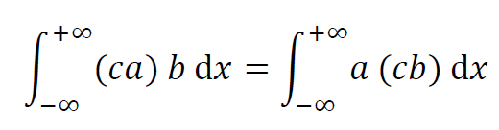
the adjoint of a function is itself
if ℒ=c(x) then ℒ † =c(x)
Notes:
Most methods start with the definition of the inner product.
Here, just by moving around parentheses
we can show that the adjoint of a function is itself.

Slide 35
the adjoint of a function is itself
if ℒ=c(x) then ℒ † =c(x)
a function is self-adjoint
Notes:
In the lingo of operators,
“self-adjoint”
A self-adjoint operator is the continuous analog to ...

Slide 36
the adjoint of a function is itself
if ℒ=c(x) then ℒ † =c(x)
self-adjoint operator anagous to a symmetric matrixx
Notes:
A self-adjoint operator is the continuous analog to ...
a symmetric matrix.

Slide 37
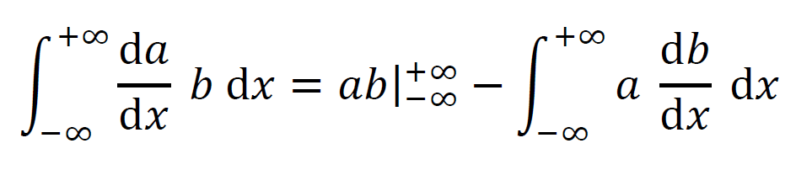
the adjoint of d/dx (with zero boundary consitions) is –d/dx
if ℒ=d/dx then ℒ † =-d/dx
Notes:
Little more complicated for a derivative.
Start with the definition of an inner product
and then use ...

Slide 38
the adjoint of d/dx (with zero boundary consitions) is –d/dx
integration by parts
if ℒ=d/dx then ℒ † =-d/dx
Notes:
and then use ...
integration by parts to get derivative from “a” to “b”.

Slide 39
the adjoint of d²/dx ² is itself
apply integration by parts twice
if ℒ=d²/dx ² then ℒ † =d²/dx ²
a function is self-adjoint
Notes:
Could apply integration twice,
in which case you find that the second derivative is self adjoint
(as long as a, b go to zero at +- infinity).

Slide 40
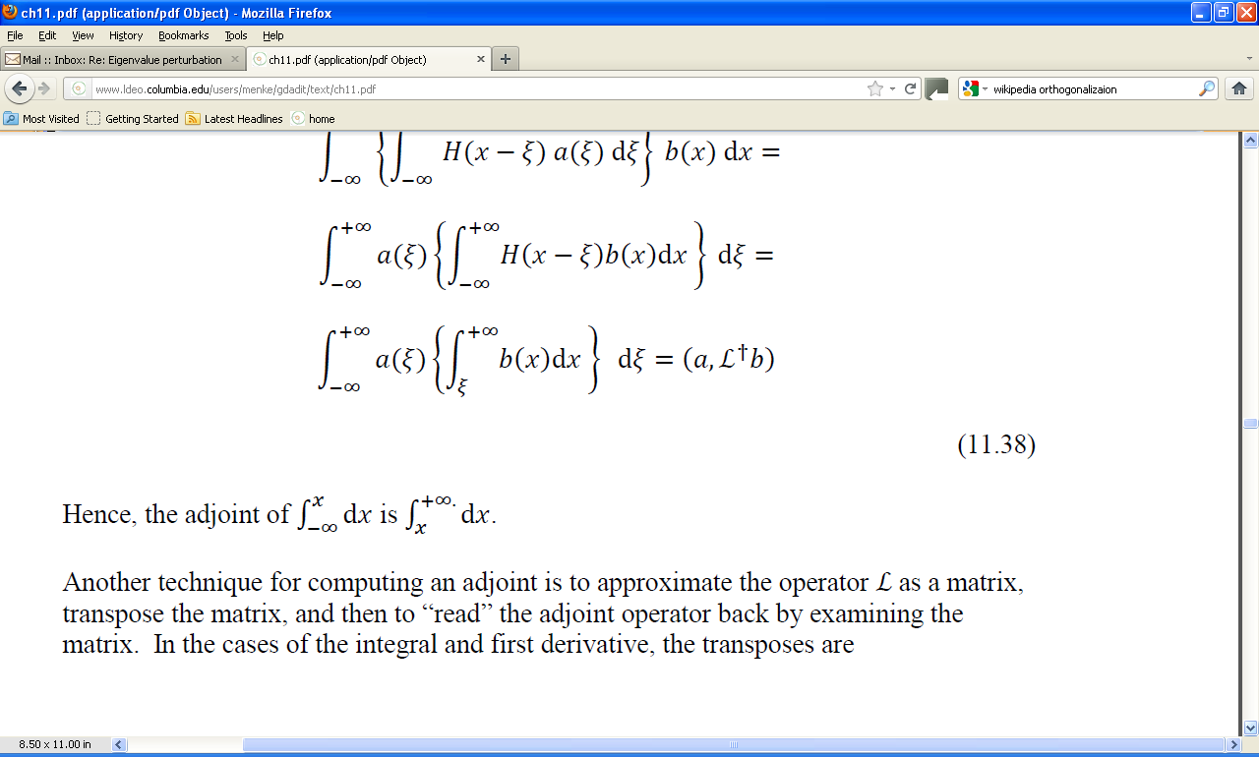
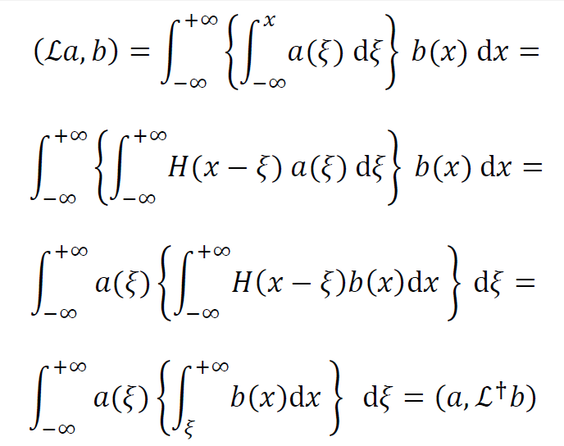
trick using Heaviside step function
Notes:
Indefinite integral is trick.
Massage it into the form of an inner product
by introducing the step function.
Then switch order of integration.

Slide 41
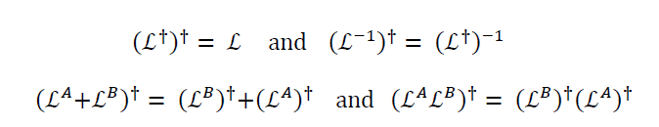
properties of adjoints
Notes:
Adjoints have almost all of the properties of matrix transposes.

Slide 42
table of adjoints
c(x)
d/dx
d²/dx²
c(x)
-d/dx
d²/dx²
Notes:
Here’s a table of the adjoints we just worked out.
We’ll use them next lecture.

Slide 43
analogies
m
L
Lm=f
L⁻¹
f=L⁻¹m
s=a^{T}b
(La) ^{T}b= a ^{T}(L^{T}b)
L^{T}
m(x)
ℒ
ℒm(x)=f(x)
ℒ⁻¹
f(x) =ℒ⁻¹f(x)
s=(a(x), b(x))
(ℒa, b) =(a, ℒ†b)
ℒ†
Notes:
Here’s a summary of the analogies.
You should go through it line by line.

Slide 44
how is all this going to help us?
Notes:
Now ... what good is all this analyis ?
As we’ll see in the next lecture, it will help us calculate
data kernels
in some important cases.

Slide 45
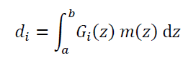
step 1
recognize that
standard equation of inverse theory
is an inner product
d_{i} = (G_{i}, m)
Notes:
The first step is to recognize that the
basic equation of inverse theory is an inner product.

Slide 46
step 2
suppose that we can show that
d_{i} = (h_{i}, ℒm)
then do this
d_{i} = (ℒ†h_{i}, m)
so
G_{i} = ℒ†h_{i}
Notes:
The second step is specialized.
Suppose that we can related the data
to an inner product
that imvolves ℒm
as contrasted to m.
Then we can use adjoints to
“move the linear operator”
from one side of the inner product to the other
And in doing so, manipulate it into the standard form of the data equation
thus determining a formula for the ...

Slide 47
step 2
suppose that we can show that
d_{i} = (h_{i}, ℒm)
then do this
d_{i} = (ℒ†h_{i}, m)
so
G_{i} = ℒ†h_{i}
formula for the data kernel
Notes:
thus determining a formula for ...
the data kernel.

