Slide 1
Lecture 22 Exemplary Inverse Problems including Filter Design
Notes:
Today’s lecture discusses several exemplary inverse problems.
Key issues are
indentifying the underlying theory, that is the relationship between data and model parameters
determining a formula for the data kernel
and if possible analytic formula for the other matrices like G^{T}G that involve the data kernel
choosing a solution method
assessing the results

Slide 2
Syllabus
Lecture 01 Describing Inverse Problems Lecture 02 Probability and Measurement Error, Part 1 Lecture 03 Probability and Measurement Error, Part 2 Lecture 04 The L₂ Norm and Simple Least Squares Lecture 05 A Priori Information and Weighted Least Squared Lecture 06 Resolution and Generalized Inverses
Lecture 07 Backus-Gilbert Inverse and the Trade Off of Resolution and Variance Lecture 08 The Principle of Maximum Likelihood Lecture 09 Inexact Theories Lecture 10 Nonuniqueness and Localized Averages Lecture 11 Vector Spaces and Singular Value Decomposition
Lecture 12 Equality and Inequality Constraints Lecture 13 L₁ , L∞ Norm Problems and Linear Programming Lecture 14 Nonlinear Problems: Grid and Monte Carlo Searches Lecture 15 Nonlinear Problems: Newton’s Method Lecture 16 Nonlinear Problems: Simulated Annealing and Bootstrap Confidence Intervals Lecture 17 Factor Analysis Lecture 18 Varimax Factors, Empircal Orthogonal Functions Lecture 19 Backus-Gilbert Theory for Continuous Problems; Radon’s Problem Lecture 20 Linear Operators and Their Adjoints Lecture 21 Fréchet Derivatives Lecture 22 Exemplary Inverse Problems, incl. Filter Design Lecture 23 Exemplary Inverse Problems, incl. Earthquake Location Lecture 24 Exemplary Inverse Problems, incl. Vibrational Problems

Slide 3
Purpose of the Lecture
solve a few exemplary inverse problems
image deblurring
deconvolution filters
minimization of cross-over errors
Notes:
The three exemplary problems are image deblurring, deconvolution and minimization of crossover errors.
We’ll explain each when the time comes.

Slide 4
Part 1
image deblurring
Notes:
We’ve all taken blurry photo’s from time to time
because the camera moved during the exposure.
Can blurry images be post-processed to remove the blur?

Slide 5
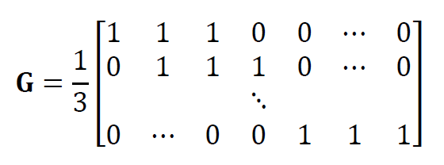
three point blur (applied to each row of pixels)
Notes:
At its simplest, blurring is just averaging neighboring pixels.
For simplicity, suppose that the camera moved parallel to the rows of pixels,
so each row is blurred independently of the others.
Here’s a three-point blurring filter.
We’ve seen it before in the context of averaging.
Each datum is the average of three neighboring model parameters,
where the model parameters represent scene brightnesses.

Slide 6
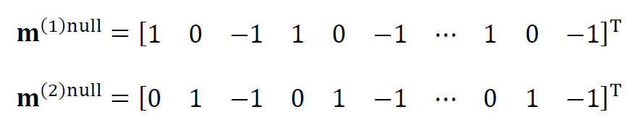
null vectors are highly oscillatory
Notes:
Deblurring must be non-unique, because the averaging equation has null vectors.
In the case of the three-point average, there are two null vectors.
Here they are.
Note that the are highly oscillatory.
Blurring “erases” spatially oscillatory information from the image.

Slide 7

solve with minimum length
Notes:
Since the problem is non-unique, we might consider solving it with the minimum length method.
This means that we will be forcing the highly oscillatory null vectors to have zero amplitude.

Slide 8
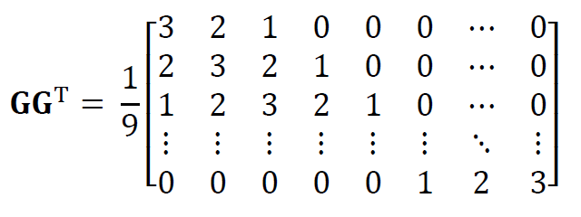
note that GG^{T} can deduced analytically
and is Toeplitz
might lead to a computational advantage
Notes:
Note that we can either let the computer calculate GGT, or compute it ourselves, analytically.
There might be advantage to the analytic method, especially because GTG has a particularly simple form.

Slide 9
Solution Possibilities
Use sparse matrix for G
together with mest=G’*((G*G’)\d)
(maybe damp a little, too)
2. Use analytic version of GG^{T}
together with mest=G’*(GGT\d)
(maybe damp a little, too)
3. Use sparse matrix for G
together with bicg() to solve GG^{T}λ=d
(maybe with a little damping, too)
and then use m^{est}=G^{T}λ
Notes:
But there are many different approaches to computing the solution.
#1 is the simplest, and pretty foolproof. The only question is whether the
very inefficient calculation of GGT is going to consume significant amounts of
computer time (which depends on the size of the image).
#2 speeds things up by using the analytic version of GGT.
#3 avoids forming GGT and works just with G, using the biconjugate gradient
method. Note that one first solves for a vector lambda, and then forms
the solution by matrix multiplication.

Slide 10
Solution Possibilities
Use sparse matrix for G
together with mest=G’*((G*G’)\d)
(maybe damp a little, too)
2. Use analytic version of GG^{T}
together with mest=G’*(GGT\d)
(maybe damp a little, too)
3. Use sparse matrix for G
together with bicg() to solve GG^{T}λ=d
(maybe with a little damping, too)
and then use m^{est}=G^{T}λ
we used the simplest, which worked fine
Notes:
We used the simplest method.

Slide 11
image blurred due to camera motion
(100 point blur)
Notes:
Here’s a blurred image,
created with a 100 point average.

Slide 12
(A)
(B)
(C)
pixel number
(D)
(E)
(F)
pixel number
pixel number
pixel number
pixel number
Notes:
Here’s the result.
The top row is the entire image – true, blurred and deblurred.
The bottom row is a detail.
The deblurring does pretty well
Figure 12.1. Example of removing blur for image. (A) True image. B) Image blurred with 100 pixel wide boxcar filter. C) Estiamted image, unblurred using the minimum length generalized inverse. ( D)-(F) Enlargement of portion of images A-C. MatLab script gda12_01.

Slide 13
(A)
[G^{-g}]₇₂₈
row number
(B)
sidelobes
R₇₂₈
pixel number
row number
Notes:
(Top) The generalized inverse contains a series of ‘first derivative operators’.
(Bottom) The model resolution matrix is pretty spiky, except for small sidelobes.
Some of the sidelobes are far from the dentral diagonal, however, which is bad.
Interestingly, the Backus-Gilbert method (not shown) does not work on the problem.
It does not deblur the image at all.
Apparently, any attempt to suppress the sidelobes just gives back the original smooth image.
Figure 12.2. (A) Central row (row 728) of the generalized inverse of the image de-blurring problem. (B) Central row (row728) of the corresponding resolution matrix. The sidelobes are about 6% of the amplitude of the central peak. MatLab script gda12_01.

Slide 14
Part 2
deconvolution filter
Notes:
The second example involves a process called ‘deconvolution’,
which undoes the effect of ‘convolution’

Slide 15
Convolution
general relationship for
linear systems
with translational invariance
Notes:
Convolution is very important in the physical sciences,
because it embodies a very general relationship
for linear systems that obey translational invariance
which includes many important physical systems.

Slide 16
Convolution
general relationship for
linear systems
with translational invariance
model m(t)
and
data d(t)
related by linear operator
Notes:
By a linear system, we mean one in which the data and model functions are
connected by a linear operator, as it was defines in our discussion of continuous
inverse theory.

Slide 17
Convolution
general relationship for
linear systems
with translational invariance
only relative time matters
Notes:
By translational invariance, we mean that only relative coordinates (such as space and time)
matter. We invoke this sort of invariance when we propose that an experiment performed
today – say reacting two chemicals - will give the same results as an otherwise identical
experiment performed yesterday or tomorrow. All that matters is time relative to the
start of the experiment, not absolute time of day.

Slide 18
underlying principle linear superposition
Notes:
Convolution is the mathematical relationship that embodies the idea of linear superposition,
that is,
if input 1 yields output 1
and
if input 2 yields output 2
then inputs 1 and 2, acting together
will yield the sum of outputs 1 and 2.

Slide 19
If the input of a spike m(t)=δ(t)
spike
m(t)=δ(t)
0
time , t, after impulse
causes the output of d(t)=g(t)
d(t)= g(t)
0
time , t, after impulse
Notes:
The heart of convolution is the ‘impulse response’
Suppose a spike (Dirac delta function) in input
leads to some function g(t) in output.
Fig. 7.2. Hypothetical impulse response of the hot plate scenario. A) An impulse (spike) of heat, h, is applied to the bottom of the plate at time, t=0. B) The temperature, θ, of the top surface of the plate first increases, as heat begins to diffuse through plate. It then decreases, as the plate cools.

Slide 20
Then the general input m(t)
spike of amplitude, m(t₀)
m(t)
time, t
t₀
causes the general output d(t)=m(t)*g(t)
m(t₀)g(t−t₀)
d(t)
time, t
t₀
Notes:
A general input m(t) can be thought of as a sum of closely spaced spikes,
each with a differrent amplitude.
A spike at time t0 has amplitude m(t0).
It causes a output m(t0)g(t-t0), where the m(t0) is the amplitude and the g(t-t0) is the shape.
Note that the function g(t) has been repositioned at a different point along the time axis.
That’s the translational invariance.
The general output is the sum of an infinite number of functions m(t0)g(t-t0),
each for a different t0.
This kind of summing – actually integration – is called a convolution.
Fig. 7.3. Interpretation of the response to heating. A) The heat, h(t), is viewed as consisting of a sequence of impulses (spikes). B) The temperature, θ(t), is viewed as consisting of a sum of scaled and delayed, impulse responses (dashed curves). A spike of amplitude, h(t₀) at time, t=t₀, makes a contribution, h(t₀)g(t−t₀), to the overall temperature.

Slide 21
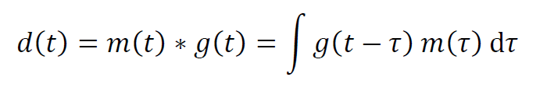
convolution d=m*g
Notes:
Here’s its formula.
Note that its abbreviated using the asterisk notation, which is easier than having to write the integral.
By the way, one of the properties of the convolution that we will not prove here
is that its sommutative, that is, a*b=b*a.

Slide 22
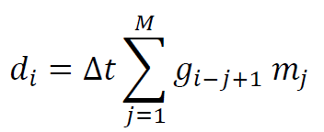
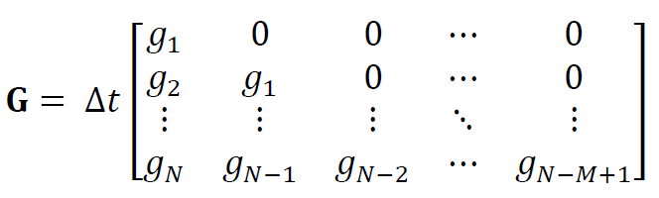
discrete convolution d=m*g
standard matrix from d=Gm
Notes:
In a dicrete world, convolution becomes a sum,
which can also be arranged into a matrix equation.
Note that the data kernel is both lower triangular and Toeplitz.

Slide 23
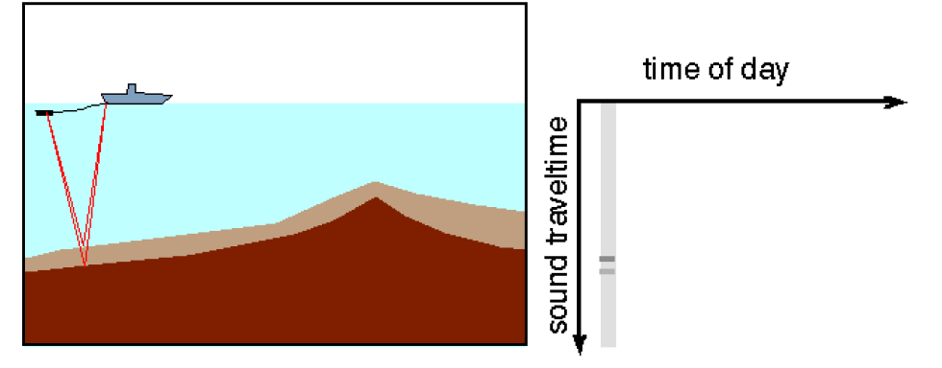
seismic reflection sounding
Notes:
In order to put deconvolution into a physical context,
we examine a seismic reflection sounding experiment.
Here a ship tows an airgin, a type of sound source.
The sound propagates down to the sea floor,
reflects off of layers there,
and them propagates back up to the ship.
A plot of pressure vs time encodes both the depth of the water
and the thickness of any layers.
and

Slide 24
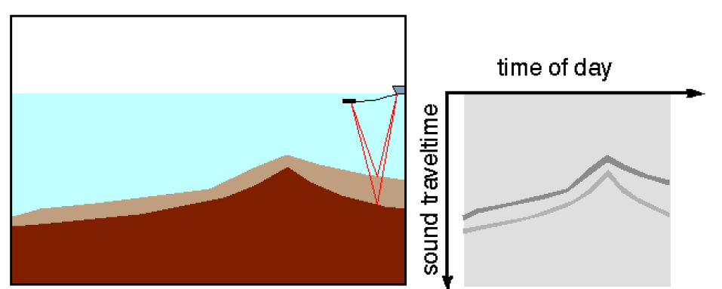
Notes:
As the ship moves along, it creates a picture of the features at the bottom.
Of course, this picture will be clearest if the sound from the airgun is impulsive.

Slide 25
want airgun pulse to be as spiky as possible
p(t) = g(t) * r(t)
pressure = airgun pulse * sea floor response
so as to be able to detect pulses
in sea floor response
p(t) ≈ r(t)
Notes:
In terms of convolutions,
the observed sound pressure p(t) is the convolution of
the airgun pulse g(t) and some function r(t) that represents the “response” of the sea floor.
The function r(t) is the one a geologist would be interested in.
The sound pressure equals the response only in the case where the airgun pulse is a delta function
since convolution by a delta function returns the original function.

Slide 26
actual airgun pulse is ringy
g(t)
time, t
Notes:
Unfortunately, most airguns no not produce impulsive bursts of sound,
but are instead rather ringy, as shown above.
Figure 12.3. (A) An airgun signal, g(t), after Smith (1975). Ideally, the inverse filter, g^{inv}(t), when convolved with g(t) should produce the spike, δ(t-t₀), centered at time, t₀. (B) Estimate of the inverse filter, g^{inv}(t), for t₀=0.04, computed via generalized least squares with a priori information on solution size and smoothness. (C) The convolution of g(t) with the estimated g^{inv}(t). While not a perfect spike, the result is significantly spikier than the airgun signal, g(t). MatLab script gda12_02.

Slide 27
so construct a deconvolution filter m(t) so that
g(t) *m(t) = δ(t)
and apply it to the data
p(t) =g(t) * r(t)
p(t)*m(t) = g(t)*m(t)*r(t) = r(t)
Notes:
Our goal is therefore to construct a function m(t),
called a deconvolution filter,
which when convolved with the airgin pulse produces a spike..
Convolving the pressure equation with this filter then removes the effect of the airgun g(t),
leaving only the sea floor response r(t).

Slide 28
so construct a deconvolution filter m(t) so that
g(t) *m(t) = δ(t)
this is the equation we need to solve
and apply it to the data
p(t) =g(t) r(t)
p(t)*m(t) = g(t)*m(t)*r(t) = r(t)
Notes:
So we need a function m(t)
that when convolves with the airgin pulse g(t)
produces a spike (that is, a Dirac delta function).
We’ve written the equation above as a convolution,
but we can equally well write it as the matrix equation Gm=d,
where the function g(t) becomes the columns of the matrix G
and the Dirac function becomes the d.

Slide 29
use discrete approximation of convolution
g(t) *m(t) = δ(t)
discrete approximation of delta function
Gm = d
1 0
0
m =
...
Notes:
So we need a function m(t)
that when convolves with the airgin pulse g(t)
produces a spike (that is, a Dirac delta function).
We’ve written the equation above as a convolution,
but we can equally well write it as the matrix equation Gm=d,
where the function g(t) becomes the columns of the matrix G
and the Dirac function becomes the d.

Slide 30
solve with damped least squares
m^{est} = [G^{T}G + ε²I]⁻¹ G^{T}d
with d = [1, 0, 0, ..., 0]^{T}
(or something similar)
matrices G^{T}G and G^{T}d can be calculated analytically
Notes:
We only want one solution “that works”,
so we don’t really care if the problem is underdetermined.
Hence, we might try to solve this equation with damped least squares.
As we mentioned in the last slide,
the vector d represents the Dirac delta function.
However, we have some leeway to choose its exact shape.
In particular, we don’t need to have the spike exactly at zero.
Often delaying it to a point where g(t) has its largest amplitude works better.
We also don’t need a perfect spike. A narrow gaussian curve would also work.

Slide 31
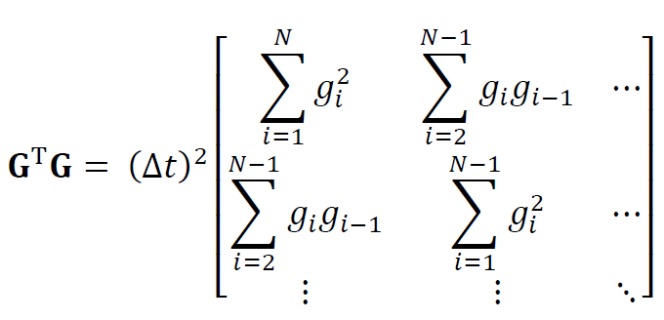
Notes:
Note that GTG can be computed analytically.

Slide 32

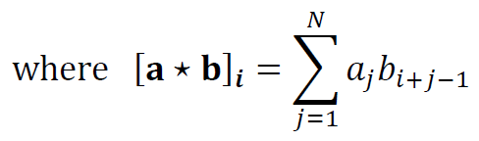
approximately Toeplitz with elements
Notes:
In fact, if we ignore that fact that the limits on the sums are all slightly different,
and approximate with all the sums having a top limit of N
then the matrix is Toeplitz.

Slide 33
approximately Toeplitz with elements
autocorrelation of g
Notes:
The formulas for the elements of GTG are exactly the ‘autocorrelation’ of g(t),
a mathematical operation similar to the convolutuion that is defined at right and
that is often abbreviated with the five-pointed star.
(Don’t worry if you’ve never heard about autocorrelation, just treat it as a formula).

Slide 34
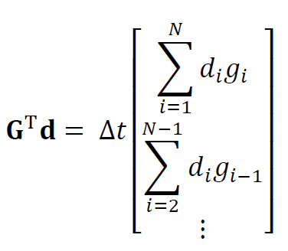


Slide 35
cross-correlation of g and d
Notes:
It has exactly the form of a mathematical operation called the ‘cross-correlation’,
defined at the right and also abbreviated with the five-pointed star.
(Note that the autocorrelation is just the cross-correlation of a function with itself).
Again, don’t worry of you’ve never heard of this operation. Just treat it as a formula.
But it is interesting that these two operations,
which are quite important in the field of signal-processing,
appear in the formula for the least squares solution.
It hints to some deep connection between the two fields.

Slide 36
Solution Possibilities
Use sparse matrix for G
together with mest=(G’*G)\(G’*d)
(maybe damping a little, too)
2. Use analytic versions of G^{T}G and G^{T}d
together with mest=GTG\GTd
(maybe damp a little, too)
3. Never form G, just work with its columns, g
use bicg() to solve G^{T}G m = G^{T}d
but use conv() to compute G^{T}(Gv)
4. Same as 3 but add a priori information of
smoothness
Notes:
Once again, there are a variety of ways to compute the solution,
ranging from the very simplest to sophisticated.
#1 is just lets the computer do all the work.
#2 uses the analytic formlas.
#3 uses biconjucate gradients. It can be set up in a way that the
matrix G never needs to be formed. All the calculations can\
be performed just using the column-vector g, which makes up
the columns of G. That saves considerable space.
#4 is a variant of #3 that implements smoothness.

Slide 37
Solution Possibilities
Use sparse matrix for G
together with mest=(G’*G)\(G’*d)
(maybe damping a little, too)
2. Use analytic versions of G^{T}G and G^{T}d
together with mest=GTG\GTd
(maybe damp a little, too)
3. Never form G, just work with its columns, g
use bicg() to solve G^{T}G m = G^{T}d
but use conv() to compute G^{T}(Gv)
4. Same as 3 but add a priori information of
smoothness
we used this complicated but very fast method
Notes:
We use #3, mainly because the software we use
(see the corresponding script)
can easily be modified to include smoothness information,
whereas implementing smoothness via #1 or #2 is much harder.
(We have not computed a smooth case, though)

Slide 38
(A)
g(t)
(B)
time, t
m(t)
(C)
time, t
m(t)*g(t)
time, t
Notes:
The top function is the airgun pulse.
The middle function is the deconvolution filter.
The bottom function is the top convolves with the middle.
It should be a spike centered at the first minima of g(t), and it comes
pretty close to achieving this goal.
However, it contains a bit of high-frequency noise that
a smoothness constraint might have eliminated.
Figure 12.3. (A) An airgun signal, g(t), after Smith (1975). Ideally, the inverse filter, g^{inv}(t), when convolved with g(t) should produce the spike, δ(t-t₀), centered at time, t₀. (B) Estimate of the inverse filter, g^{inv}(t), for t₀=0.04, computed via generalized least squares with a priori information on solution size and smoothness. (C) The convolution of g(t) with the estimated g^{inv}(t). While not a perfect spike, the result is significantly spikier than the airgun signal, g(t). MatLab script gda12_02.

Slide 39
(A) Original
d(t)
(B) After deconvolution
d(t)*m(t)
Notes:
The top function is a series of echoes from layering in the sea floor.
The bottom is the echoes “cleaned up” by convolution with the deconvolution filter.
The results are pretty good. Its pretty clear that there are exactly three echoes.

Slide 40
Part 3
minimization of cross-over errors
Notes:
This is technique is often used when preparing maps,
to help remove inconsistencies in data.

Slide 41
true
latitude
gravity anomaly, mgal
longitude
estimated
note streaks
latitude
longitude
Notes:
Here’s an example, a gravity anomaly map based on satellite data.
The top is the true gravity.
The bottom is the map.
Note all the streaks. The streaks correspond to individual satellite “tracks”.
The problem is that there are inconsistencies in the data between the tracks.

Slide 42
general idea
data s is measured along tracks
data along each track is off by an additive constant
theory
s_{j}^{obs (track i)} = s_{j}^{true (track i)} + m^{(track i)}
goal is to estimate the constants by minimizing the error at track intersections
Notes:
The key assumpltion is that the data are inconsistent because
the data values along each track are shifted up or down with respect to one another,
that is, an additive constant needs to be added to the data value for each track.

Slide 43
5
cross-over points
6
7
8
4
3
2
1
Notes:
Here’s an example of 8 tracks, for ‘ascending” and four “descending”,
intersecting at 16 “cross-over” points. Ideally, the two data )one for each track)
at an intersection point should be the same.
point
Figure 12.4. Descending tracks 1-4 intersect ascending tracks 5-9 at 16 points. The heigh of the satellite along each track is determined by minimizing the cross-over error at the intersections.

Slide 44
ith intersection has
ascending track A_{i} and descending track D_{i}
s_{Ai}^{obs}= s_{Ai}^{true} + m_{Ai}
s_{Di}^{obs}= s_{Di}^{true} + m_{Di}
subtract
s_{Ai}^{obs}-s_{Di}^{obs}= m_{Ai}- m_{Di}
has form
d=Gm
Notes:
The additive constants are the model parameters, m, one per track.
Each intersection point has two data values, one for each track,
and two model parameters, one for each track.
The observed datum for the ascending track equals its true value plus the additive constant for that track.
The observed datum for the descending track equals its true value plus the additive constant for that track.
A standard linear inverse problem results when these two equations are subtracted.

Slide 45

the matrix G is very sparse
every row is all zeros, except for a single +1 and a single -1
Notes:
The matrix G is very sparse.

Slide 46
note that this problem has an inherent non-uniqueness m is determined only to an overall additive constant one possibility is to use damped least squares, to choose the smallest m (you can always add a constant later)
Notes:
Superficially, the inverse problem seems overdetermined, since there will typically be many
more intersection points than tracks.
But actually, there is one type of inherent nonuniqueness.
The model parameter vector is determined only up to an overall additive constant,
corresponding to shifting ALL the data up or down in value.
This non-uniqueness can be suppressed with damped least squares.
The resulting solution is driven to zero-additive constant.
If zero is not physically reasonable, any other constant can always be added, after the fact.

Slide 47
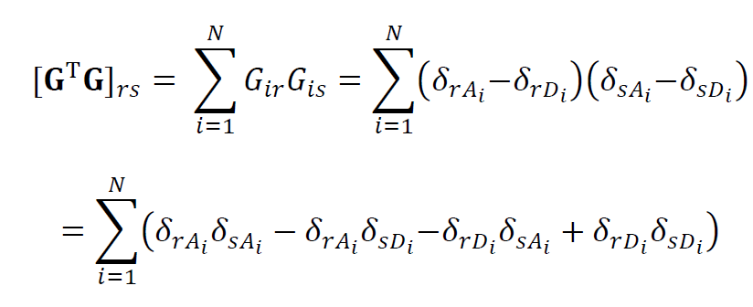
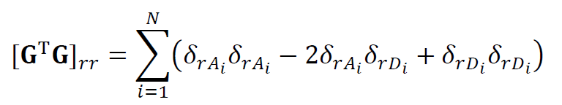
the matrices G^{T}G and G^{T}d can be calculated semi-analytically
Notes:
As in the previous cases, analytic forms of GTG and GTd can be worked out. Here’s GTG.

Slide 48
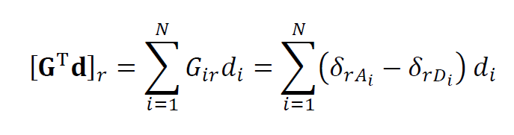
Notes:
And herer’s GTd.

Slide 49
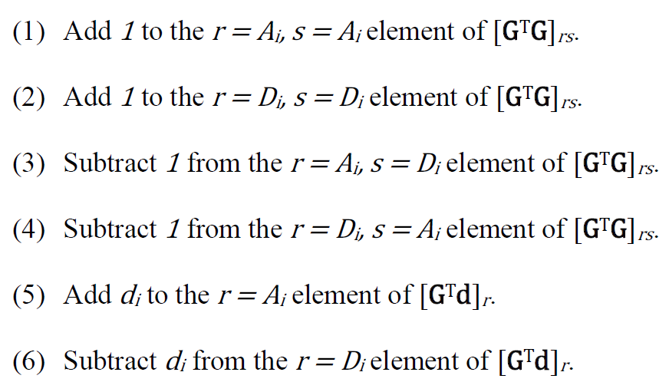
recipe starting with zeroed G^{T}G and G^{T}d
Notes:
Together, they create a recipe for building GTG and GTd, starting with a zero matrix and vector.
One merely runs through a table of intersection points, doing these six operations for each row of the table.

Slide 50
Solution Possibilities
Use sparse matrix for G
together with damped least squares mest=(G’*G+e2*speye(M,M))\(G’*d)
2. Use analytic versions of G^{T}G and G^{T}d
add damping directly to the diagonal of G^{T}G
then use mest=GTGpe2I\GTd
3. Use sparse matrix for G
together with bicg() version of damped least squares
4. Methods 1 or 2, but use hard constraint instead of damping to implement Σ_{i} m_{i} = 0
Notes:
As before, several possible solution techniques are available.
The key questions are
1. whether to create just G and let the computer do the
rest of the work, or to employ analytic formula for matrices such as GTG; and
2. Whether to use MatLab’s default equation solver, embodied in the \ command.
or to use the biconjugate gradient method.
Here we use a bicg() implementation of damped least squares.
It’s also possible to use hard constraints instead of damped least squares to remove the
nonuniqueness.

Slide 51
Solution Possibilities
Use sparse matrix for G
together with damped least squares mest=(G’*G*e2*speye(M,M))\(G’*d)
2. Use analytic versions of G^{T}G and G^{T}d
add damping directly to the diagonal of G^{T}G
then use mest=GTG\GTd
3. Use sparse matrix for G
together with bicg() version of damped least squares
4. Methods 1 or 2, but use hard constraint instead of damping
our choice
Notes:
We use biconjugate gradients.
Generally speaking, our practice is to always use bicg(),
except in very small problems,
because it provides so much control over how the critical matrix multiplication
is being performed.
Since

Slide 52
(A)
(B)
latitude
latitude
longitude
longitude
(C)
(D)
gravity anomaly, mgal
latitude
latitude
longitude
longitude
Notes:
The results (D) have removes the streaks in the original map (B).
Figure 12.5. Example of cross-over error adjustment of satellite gravity data. (A) True gravity anomaly data for the equatorial Atlantic ocean. It reflects variations in the depth of the seafloor and density variations within the oceanic crust. (B) Hypothetical satellite tracks, along which the gravity is measured. The measurements along each track have a constant offset reflecting errors in the assumed altitude of the satellite. (C) Reconstructed gravity anomaly without cross-over correction. Artifacts parallel to the tracks are clearly visible. (D) Reconstructed gravity anomaly with cross-over correction. The artifacts are eliminated. Data courtesy of Bill Haxby, Lamont-Doherty Earth Observatory. MatLab script gda12_03.

