Slide 1
Lecture 23 Exemplary Inverse Problems including Earthquake Location
Notes:
Today’s lecture discusses several exemplary inverse problems.
Key issues are
indentifying the underlying theory, that is the relationship between data and model parameters
determining a formula for the data kernel
and if possible analytic formula for the other matrices like G^{T}G that involve the data kernel
choosing a solution method
assessing the results

Slide 2
Syllabus
Lecture 01 Describing Inverse Problems Lecture 02 Probability and Measurement Error, Part 1 Lecture 03 Probability and Measurement Error, Part 2 Lecture 04 The L₂ Norm and Simple Least Squares Lecture 05 A Priori Information and Weighted Least Squared Lecture 06 Resolution and Generalized Inverses
Lecture 07 Backus-Gilbert Inverse and the Trade Off of Resolution and Variance Lecture 08 The Principle of Maximum Likelihood Lecture 09 Inexact Theories Lecture 10 Nonuniqueness and Localized Averages Lecture 11 Vector Spaces and Singular Value Decomposition
Lecture 12 Equality and Inequality Constraints Lecture 13 L₁ , L∞ Norm Problems and Linear Programming Lecture 14 Nonlinear Problems: Grid and Monte Carlo Searches Lecture 15 Nonlinear Problems: Newton’s Method Lecture 16 Nonlinear Problems: Simulated Annealing and Bootstrap Confidence Intervals Lecture 17 Factor Analysis Lecture 18 Varimax Factors, Empircal Orthogonal Functions Lecture 19 Backus-Gilbert Theory for Continuous Problems; Radon’s Problem Lecture 20 Linear Operators and Their Adjoints Lecture 21 Fréchet Derivatives Lecture 22 Exemplary Inverse Problems, incl. Filter Design Lecture 23 Exemplary Inverse Problems, incl. Earthquake Location Lecture 24 Exemplary Inverse Problems, incl. Vibrational Problems

Slide 3
Purpose of the Lecture
solve a few exemplary inverse problems
thermal diffusion
earthquake location
fitting of spectral peaks
Notes:
The three exemplary problems are image thermal diffusion, earthquake location and fitting of spectral peaks.
We’ll explain each when the time comes.

Slide 4
Part 1
thermal diffusion
Notes:
Heat transport is a diffusive process.
An initial pattern of temperature variation is slowly “washed away”
as the heat spreads out.
We deal with the question of how well an initial pattern can be determined,
given measurements at some later time.
In a way, this problem is conceptually similar to the deblurring one that we consider last lecture,
except that the form of the blurring is more complicated.

Slide 5

0
temperature in a cooling slab
1.0
h
erf(x)
x
0.5
ξ
0.0
1
2
3
x
Notes:
Suppose that we start with a hot slab, as depicted in the lower left.
For simplicity, we’ll assume that it is the same material as its surroundings,
so that the only thing that distinguishes it from those surroundings is its heat.
As time progresses, the heat spreads out in the direction normal to the slab,
which we call the x diection.
The formula for the temperature, obtained by solving the relevant partial differential equation,
is shown at top. It involves the error function, erf(), that has the functional form shown at right.
Note that the formula for temperature contains a factor of the square root of time.
That’s a typical behavior for diffusive systems.
We’ll abbreviate the complicated spatial-temporal behavior with the function g, when depends
on time t, the position x of the observer, and the position xi of the center of the slab.
It has an overall scaling factor, To, the initial temperature of the slab.
There’s a lot of change at first, but then the cooling process slows down.
Figure 12.8. (A) Single hot slab of thickness, h, located at position, x=ξ. (B) Temporal evolution of the temperature, T(x,t), of 100 adjacent slabs. The initial temperature distribution of the slabs, T(x,t=0), is taken to be the model parameter vector, m. It is nonzero only for slabs near |x|≤20. The temperature, T(x,t=0), at subsequent times, t, can be computed from the initial temperature distribution, since the data kernel can be calculated from the physics of heat transport. Note that the band of hot temperatures widens with increasing time, and that fine scale temperature fluctuation are preferentially attenuated. MatLab script gda12_06.

Slide 6
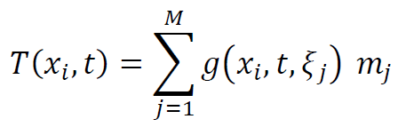
temperature due to M cooling slabs
(use linear superposition)
Notes:
Now imagine that we have many slabs, placed adjacent to one another, face to face.
Heat flow is a liner process, so we can simply superimpose (add together) the formulas for each slab.
Note that we’ve renamed the initial temperature of the slab from To to mi.

Slide 7
temperature due to M slabs
each with initial temperature m_{j}
temperature measured at time t>0
initial
temperature
Notes:
The temperature at any position x-sub-i and time t is a linear function of the initial temperature m-sub-j.

Slide 8
inverse problem
infer initial temperature m
using temperatures measures at a suite of xs
at some fixed later time t
data
model parameters
d = G m
Notes:
The inverse problem that we will examine is how well we can recover the initial temperatures of the
slab, given measurements at all spatial positions x-sub-i at just one time t in the past.
The problem is already in standard form,
with the function g evaluated at observer position x-sub-i and slab position xi-sub-j
being the elements of the matrix G

Slide 9
distance, x
-100
0
100
0
time, t
temperature, T
200
Notes:
Here’s a plot of the forward problem,
with a set of M=100 slabs from -100 to 100.
But only the central group of slabs, between -20 and 20, start out hot.
The rest have zero temperature.
Figure 12.8. (A) Single hot slab of thickness, h, located at position, x=ξ. (B) Temporal evolution of the temperature, T(x,t), of 100 adjacent slabs. The initial temperature distribution of the slabs, T(x,t=0), is taken to be the model parameter vector, m. It is nonzero only for slabs near |x|≤20. The temperature, T(x,t=0), at subsequent times, t, can be computed from the initial temperature distribution, since the data kernel can be calculated from the physics of heat transport. Note that the band of hot temperatures widens with increasing time, and that fine scale temperature fluctuation are preferentially attenuated. MatLab script gda12_06.

Slide 10
distance, x
-100
0
100
0
initial temperature consists of 5 oscillations
time, t
200
Notes:
The initial temperature distribution has 5 hots bands spaced evenly between x equals -20 and +20.
Figure 12.8. (A) Single hot slab of thickness, h, located at position, x=ξ. (B) Temporal evolution of the temperature, T(x,t), of 100 adjacent slabs. The initial temperature distribution of the slabs, T(x,t=0), is taken to be the model parameter vector, m. It is nonzero only for slabs near |x|≤20. The temperature, T(x,t=0), at subsequent times, t, can be computed from the initial temperature distribution, since the data kernel can be calculated from the physics of heat transport. Note that the band of hot temperatures widens with increasing time, and that fine scale temperature fluctuation are preferentially attenuated. MatLab script gda12_06.

Slide 11
distance, x
-100
0
100
0
oscillations still visible
so accurate reconstruction possible
time, t
200
Notes:
At a little later time, sat time t=20, the banding has started to blur away, but it is still visible.
We would probably do a pretty good job reconstructing the original temperature distribution,
on the basis of data collected at this time.
Figure 12.8. (A) Single hot slab of thickness, h, located at position, x=ξ. (B) Temporal evolution of the temperature, T(x,t), of 100 adjacent slabs. The initial temperature distribution of the slabs, T(x,t=0), is taken to be the model parameter vector, m. It is nonzero only for slabs near |x|≤20. The temperature, T(x,t=0), at subsequent times, t, can be computed from the initial temperature distribution, since the data kernel can be calculated from the physics of heat transport. Note that the band of hot temperatures widens with increasing time, and that fine scale temperature fluctuation are preferentially attenuated. MatLab script gda12_06.

Slide 12
distance, x
-100
0
100
0
time, t
little detail left, so reconstruction will lack resolution
200
Notes:
On the other hand, at a time of say t=80, all the banding is gone.
The central region (yellow) is still much hotter than its surroundings (blue)
but all detail is gone.
We don’t expect to be able to reconstuct the initial temperature very well at all
using measurements made at this time.
Figure 12.8. (A) Single hot slab of thickness, h, located at position, x=ξ. (B) Temporal evolution of the temperature, T(x,t), of 100 adjacent slabs. The initial temperature distribution of the slabs, T(x,t=0), is taken to be the model parameter vector, m. It is nonzero only for slabs near |x|≤20. The temperature, T(x,t=0), at subsequent times, t, can be computed from the initial temperature distribution, since the data kernel can be calculated from the physics of heat transport. Note that the band of hot temperatures widens with increasing time, and that fine scale temperature fluctuation are preferentially attenuated. MatLab script gda12_06.

Slide 13
What Method ?
The resolution is likely to be rather poor, especially when data are collected at later times
damped least squares
G^{-g} = [G^{T}G+ε²I]⁻¹G^{T}
damped minimum length
G^{-g} = G^{T} [GG^{T}+ε²I]⁻¹
Backus-Gilbert
Notes:
Any sort of deblurring process is probably going to have some nonuniqueness,
because the data are very insensitive to any short-wavelength oscillations that were originally present.
They will constitute null vectors – or nearly null vectors.
This we must use some sort of damping or else the solution will contain wild oscillations.
This means either using damped minimum length or damped least squares ...

Slide 14
What Method ?
The resolution is likely to be rather poor, especially when data are collected at later times
damped least squares
G^{-g} = [G^{T}G+ε²I]⁻¹G^{T}
damped minimum length
G^{-g} = G^{T} [GG^{T}+ε²I]⁻¹
Backus-Gilbert
actually, these generalized inverses are equal
Notes:
But actually, there is no difference between
damped minimum length and damped least squared.
As long as the matrix inversed exist, the two solutions are
precisely equal (as was shown back in chapter 3).
We can use either, though from the point of computational efficiency,
we should use least squares when GTG is smaller than GGT, and vice versa.

Slide 15
What Method ?
The resolution is likely to be rather poor, especially when data are collected at later times
damped least squares
G^{-g} = [G^{T}G+ε²I]⁻¹G^{T}
damped minimum length
G^{-g} = G^{T} [GG^{T}+ε²I]⁻¹
Backus-Gilbert
might produce solutions with fewer artifacts
Notes:
However, this is a problem that very likely has poor resolution.
Least squares may well yeild solutions with artifacts, arising from sidelobes in the resolution matrix.
Backus-Gilbert provides an alternative.
It will need some damping too, of course.

Slide 16
Try both
damped least squares
Backus-Gilbert
Notes:
This is a tiny inverse problem, with matrices of just a few hundred data and unknowns.
There’s no reason we can’t try both.

Slide 17

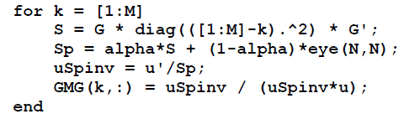
Solution Possibilities
Damped Least Squares:
Matrix G is not sparse
no analytic version of G^{T}G is available
M=100 is rather small
experiment with values of ε²
mest=(G’*G+e2*eye(M,M))\(G’*d)
2. Backus-Gilbert
use standard formulation, with damping α
experiment with values of α
Notes:
There are no special issues here.
G is not sparse, but it is small.
We don’t know how to compute GTG analytically, so we allow the computer to do all the work.
In both the damped least squares and Backus-Gilbert case, we need to experiment with
the damping parameters a little.

Slide 18
Solution Possibilities
Damped Least Squares:
Matrix G is not sparse
no analytic version of G^{T}G is available
M=100 is rather small
experiment with values of ε²
mest=(G’*G+e2*eye(M,M))\(G’*d)
2. Backus-Gilbert
use standard formulation, with damping α
experiment with values of α
try both
Notes:
Again, we try both.
Neither has any special issues.

Slide 19
estimated initial temperature distribution as a function of the time of observation
True
Damped LS
Backus-Gilbert
time
time
time
distance
distance
distance
Notes:
Here are the results.
The left plot is the true solution,
the initial temperature distribution.
We’ve plotted it – artificially – as a function of time, for reasons that will become apparent in a moment.
But it’s not really a function of time, just of distance.
The middle plot is the damped least squares results,
for a suite of datasets, each collected at a different time.
Keep in mind that it’s the data that’s a function of time,
not the solution, the initial temperature.
So if the data from one time was just as good as the data from a different time
the middle plot would look like the left one.
But actually, the later that data is collected, the worse the reconstruction is.
The right plot shows the analogous Backus-Gilbert solution.
Figure 12.9. Model for the temperature distribution problem. (A) The true model is the initial temperature distribution, T(x,t=0). While this function is not a function of time, it is displayed on the (x,t) image for comparison purposes. (B) Minimum Length (ML) estimate of the model, T(x,t=0), for a dataset consisting of observations at all distances at a single time, t>0. (C) Corresponding Backus-Gilbert (BG) estimate. In both the ML and BG cases, the ability of the data to resolve fine details declines with time, with the BG case declining fastest. MatLab script gda12_06.

Slide 20
estimated initial temperature distribution as a function of the time of observation
True
Damped LS
Backus-Gilbert
time
time
time
distance
distance
distance
Damped LS does better at earlier times
Notes:
In the case of Damped Least Squares,
The reconstruction is pretty good using data collected at early times, say t<20.
The 5 red bands are well-recovered.
they are not well recovered for times much beyond that.
The Backus-Gilbert solution does pretty well when applied to data in this time range,
but not quite as well as Damped Least Squares.
This is a pretty typical behavior.
Backus-Gilbert solutions usually tend to be smoother than Direchlet solutions.
Figure 12.9. Model for the temperature distribution problem. (A) The true model is the initial temperature distribution, T(x,t=0). While this function is not a function of time, it is displayed on the (x,t) image for comparison purposes. (B) Minimum Length (ML) estimate of the model, T(x,t=0), for a dataset consisting of observations at all distances at a single time, t>0. (C) Corresponding Backus-Gilbert (BG) estimate. In both the ML and BG cases, the ability of the data to resolve fine details declines with time, with the BG case declining fastest. MatLab script gda12_06.

Slide 21
estimated initial temperature distribution as a function of the time of observation
True
Damped LS
Backus-Gilbert
time
time
time
distance
distance
distance
Damped LS contains worse artifacts at later times
Notes:
When data collected at very late times is used,
damped least squares yields solutions that contain artifacts,
two wide red bands instead of five narrow ones.
Backus-Gilbert is better in the sense that it is artifact free,
with a uniformly yellow central region.
Backus-Gilbert does not do any better at recovering detail
but at least it doesn’t put in bogus detail.
Note that both methods do well in determining the overall
width of the initially hot zone.
That is, the boundaries between the yellow zone and the surrounding blue region
is in the right place.
Figure 12.9. Model for the temperature distribution problem. (A) The true model is the initial temperature distribution, T(x,t=0). While this function is not a function of time, it is displayed on the (x,t) image for comparison purposes. (B) Minimum Length (ML) estimate of the model, T(x,t=0), for a dataset consisting of observations at all distances at a single time, t>0. (C) Corresponding Backus-Gilbert (BG) estimate. In both the ML and BG cases, the ability of the data to resolve fine details declines with time, with the BG case declining fastest. MatLab script gda12_06.

Slide 22
model resolution matrix when for data collected at t=10
Damped LS
Backus-Gilbert
distance
distance
distance
distance
Notes:
Here’s the resolution matrices for a time, t=10, when both methods are
able to recover the five bands ...
Figure 12.10. Model resolution matrices for the temperature distribution problem. (A.)Minimum Length (ML) solution for data at time, t=10. (B) ML solution for data at time, t=40. (C) Backus-Gilbert Solution for data at time, t=10. (D) BG solution for data at time, t=40. Note that the BG resolution matrix has smaller sidelobes than the corresponding ML case. MatLab script gda12_06.

Slide 23
model resolution matrix when for data collected at t=10
Damped LS
Backus-Gilbert
distance
distance
distance
distance
resolution is similar
Notes:
They are pretty similar.
Figure 12.10. Model resolution matrices for the temperature distribution problem. (A.)Minimum Length (ML) solution for data at time, t=10. (B) ML solution for data at time, t=40. (C) Backus-Gilbert Solution for data at time, t=10. (D) BG solution for data at time, t=40. Note that the BG resolution matrix has smaller sidelobes than the corresponding ML case. MatLab script gda12_06.

Slide 24
model resolution matrix when for data collected at t=40
Damped LS
Backus-Gilbert
distance
distance
distance
distance
Notes:
Here’s the resolution at a later time, t=40.
Figure 12.10. Model resolution matrices for the temperature distribution problem. (A.)Minimum Length (ML) solution for data at time, t=10. (B) ML solution for data at time, t=40. (C) Backus-Gilbert Solution for data at time, t=10. (D) BG solution for data at time, t=40. Note that the BG resolution matrix has smaller sidelobes than the corresponding ML case. MatLab script gda12_06.

Slide 25
model resolution matrix when for data collected at t=40
Damped LS
Backus-Gilbert
distance
distance
distance
distance
Damped LS has much worse sidelobes
Notes:
In both cases, the central band is wider than at t=10.
The data at t=40 is not able to resolve small-scale features.
However, damped least squares has begin to develop some serious side lobes,
while Backus-Gilbert is still pretty much
Figure 12.10. Model resolution matrices for the temperature distribution problem. (A.)Minimum Length (ML) solution for data at time, t=10. (B) ML solution for data at time, t=40. (C) Backus-Gilbert Solution for data at time, t=10. (D) BG solution for data at time, t=40. Note that the BG resolution matrix has smaller sidelobes than the corresponding ML case. MatLab script gda12_06.

Slide 26
Part 2
earthquake location
Notes:
Earthquake location is an important procedure in seismology,
since observations of earthquakes are used for so many different purposes:
for example, hazard analysis, studies of the faulting process, and imaging the structure of the earth.

Slide 27
ray approximation
vibrations travel from source to receiver along curved rays
r
x
S
s
P
z
Notes:
The earthquake is considered a point source, S.
In the ray approximation, energy propagates from the source to a receiver, along curved paths called rays.
In a solid, there are two modes of propagation of the energy, P waves and S waves.
Fig. 12.17. Compressional P and shear S waves travel along rays from earthquake source s (circle) to receiver r (triangle).

Slide 28
ray approximation
vibrations travel from source to receiver along curved rays
r
x
S wave
slower
S
s
P
z
P wave
faster
P, S ray paths not necessarily the same, but usually similar
Notes:
The P wave is faster than the S wave by about a factor of roughly 1.7
The two ray paths can be different, but usually are roughly similar.
Fig. 12.17. Compressional P and shear S waves travel along rays from earthquake source s (circle) to receiver r (triangle).

Slide 29
travel time T
integral of slowness along ray path
r
x
T^{S} = ∫_{ray} (1/v^{S}) d𝓁
S
s
P
z
T^{P} = ∫_{ray} (1/v^{P}) d𝓁
Notes:
The travel time of energy along a ray is the integral of slowness (reciprocal velocity) along the ray.
The forward problem is to determine the travel time of energy from source to receiver.
The hard part is to determine shape of the ray paths, which depend on how the velocity varies spatially.
Once the ray path is known, the travel time is just an intergral.
We will not discuss how ray paths are found in any detail, except to say that the process involves solving a differential equation.
Fig. 12.17. Compressional P and shear S waves travel along rays from earthquake source s (circle) to receiver r (triangle).

Slide 30

arrival time = travel time along ray + origin time
Notes:
Here’s a statement of the forward problem.
The arrival time of the energy at a station
is the start time (the time of occurrence of the earthquake, or origin time)
plus the travel time along the ray.
That’s true for both P and S waves.

Slide 31
arrival time = travel time along ray + origin time
data
data
earthquake location
3 model parameters
earthquake origin time
1 model parameter
Notes:
The data are the P and S wave arrival times at each receiver.
The unknowns are the location of the earthquake and its origin time.

Slide 32
arrival time = travel time along ray + origin time
explicit nonlinear equation
4 model parameters
up to 2 data per station
Notes:
The equation is nonlinear and explicit.
There are four model parameters,
and up to 2 data (P and S) per station.
Thus, one ought to be able to locate an earthquake
with just 4 observations.
Four stations that only observe P waves,
Two stations that observe both P and S,
etc.

Slide 33

arrival time = travel time along ray + origin time
linearize around trial source location x^{(p)}
t_{i}^{P} = T_{i}^{P}(x^{(p)},x^{(i)}) + [∇T_{i}^{P}] • ∆x + t₀
trick is computing this gradient
Notes:
We will use Newton’s method to solve the inverse problem.
The trick is computing the gradient in travel time,
that is,
the change in travel time given a small change in earthquake location.

Slide 34
Geiger’s principle
r
r
ray
x⁽¹⁾
Δx
x⁽¹⁾
x⁽⁰⁾
x⁽⁰⁾
Δx
[∇T_{i}^{P}] = -s/v
unit vector parallel to ray pointing away from receiver
Notes:
Fortunately, it gradient is easy to calculate.
If the source is moved parallel to the ray, then the travel time changes by an amount Delta-x over velocity.
If the source is moved perpendicular to the ray, then the travel time does not change at all to first order.
Thus the gradient is the ray tangent s divided by the velocity at the source,
with a minus sign thrown in if the tangent is defines a positive when pointing away from the source.
Fig. 12.18. (A) Moving the source a distance Δx from x⁽⁰⁾ to x⁽¹⁾ parallel to the ray path leads to a large change in travel time. (B) Moving the source perpendicular to the ray path leads to no (first-order) change in travel time. The partial derivative of travel time with respect to distance can therefore be determined with minimal extra effort.

Slide 35
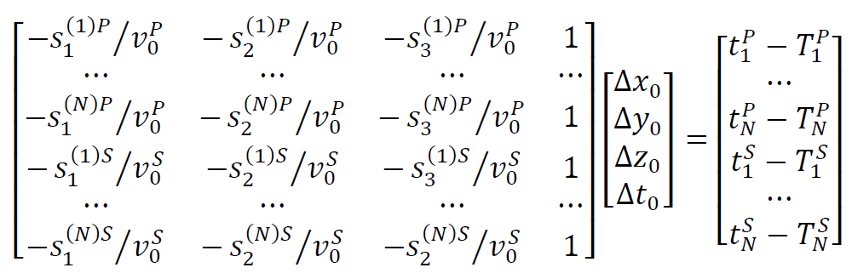
linearized equation
Notes:
The linearized equation is then pretty simple.
The only hard piece of information to obtain is the ray tangent, s.
You need to solve the ray equation to get it.
Note that matrix contains a columns of ones that multiply origin time.
Shifting the origin time shifts the arrival time of everything in a 1:1 ratio.

Slide 36
Common circumstances when earthquake far from stations
All rays leave source at the same angle
x
z
All rays leave source at nearly the same angle
x
z
Notes:
But there’s a problem – sometimes.
In cases where the earthquake is far from all the stations,
all the rays tend to leave the source at nearly the same angle.
That means that they all have the same tangent.
Fig. 12.20. (A) In layered media, rays follow “refracted” paths, such that the rays to all receivers (triangles) leave the source (circle) at the same angle. The position and traveltime of the source on the dashed line therefore trade off. (B) This phenomenon also occurs in non-layered media if the source is far from the receivers.

Slide 37
then, if only P wave data is available
(no S waves)
these two columns are
proportional to one-another
Notes:
Mathematically, that means that two columns of the data kernel will be proportional to one another.
That’s very bad. It means that depth and origin time will trade off in the solution.
This will only happen in the special case when both conditions occur:
there’s only P wave data
and
all the stations are far from the earthquake
but actually
it a fairly common occurrence
that need to be detected

Slide 38
depth and origin time trade off
x
z
deep and late
shallow and early
Notes:
An early shallow source will have exactly the same
pattern of arrival times as a late deep source.
Fig. 12.20. (A) In layered media, rays follow “refracted” paths, such that the rays to all receivers (triangles) leave the source (circle) at the same angle. The position and traveltime of the source on the dashed line therefore trade off. (B) This phenomenon also occurs in non-layered media if the source is far from the receivers.

Slide 39
Solution Possibilities
Damped Least Squares:
Matrix G is not sparse
no analytic version of G^{T}G is available
M=4 is tiny
experiment with values of ε²
mest=(G’*G+e2*eye(M,M))\(G’*d)
2. Singular Value Decomposition
to detect case of depth and origin time trading off
test case has earthquakes “inside of array”
Notes:
The easiest way to solve this problem is by least squares,
with a little damping thrown in to that
in the nonunique case described previously
at least you will get some solution.
However, if you want to detect the nonunique case,
then you must use SVD
and check whether any singular values are zero.
Or test case has only earthquakes beneath the receiver array,
so we use the easy method,
damped least squares.

Slide 40
z, km
y, km
x, km
Notes:
The stations are on a regular grid on the surface of the earth.
The true earthquake locations are in red.
The estimated locations are in green.
We’ve done a good job locating the earthquake.
Figure 12.19. Earthquake location example. Arrival times of P and S waves from earthquakes (red circles) are recorded on an array of 81 stations (black crosses). The observed traveltimes included random noise with variance, σ_{d}²=(0.1)² s. The estimated locations (green crosses) are computed using Geiger’s method MatLab script gda12_13.

Slide 41
Part 3
fitting of spectral peaks
Notes:
Lastly, we consider a non-linear curve fitting problem.

Slide 42
typical spectrum consisting of overlapping peaks
1
xx
0.95
0.9
counts
0.85
counts
counts
0.8
0.75
0.7
0.65
0
2
4
6
8
10
12
velocity, mm/s
velocity, mm/s
Notes:
A fairly common task in chemistry is to fit curves to spectra like the one above.
The goal is to determine (at least) the position of each peak,
which is diagnostic of the material emitting it,
and its are,
which is diagnostic of the amount of the material.
Probably the peak width needs to be deterrmined, too.
Fig .12.16. Example of a fitting the sum of 10 Lorentzian (blue) or Normal (green) curves to Mossbauer spectroscopic data (red). The Lorentzian curves are better able to fit the shape of the curve, with the ratio of estimated variances being about 4. An F-test indicates that null hypothesis that any difference between the two fits can be ascribed to random variation can be rejected to better than 99.99%. Data courtesy of NASA and the University of Mainz. MatLab script gda12_12.

Slide 43
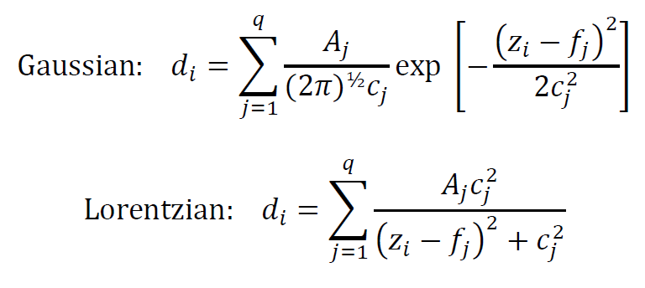
what shape are the peaks?
Notes:
Many spectra have peaks that are either Gaussian or Lorentzian in shape.
Here’s the formula for both.
Ai is area,
f i is position, and
ci is width.
We assume that there are q peaks, and that they just superimpose linearly.

Slide 44
what shape are the peaks?
try both
use F test to test whether one is better than the other
Notes:
We’ll try both fits and use an F-test to test whether one is better than the other.

Slide 45
what shape are the peaks?
3 unknowns
per peak
data
data
3 unknowns
per peak
both cases:
explicit nonlinear problem
Notes:
The problem is non-linear and explicit.
The are a total of 3q model parameters.

Slide 46
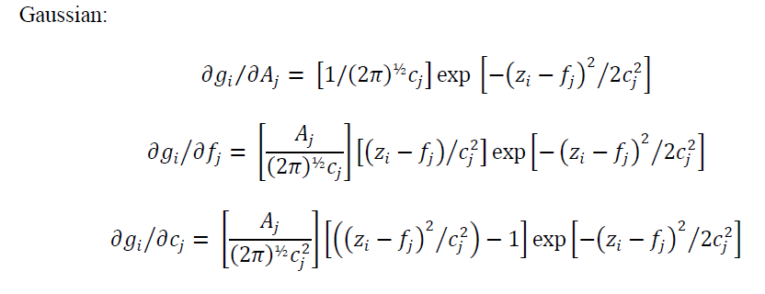
linearize using analytic gradient
Notes:
We’ll use Newtion’s Method, so we need the gradient.
We know the formulas for the peaks analytically,
so with a bit of application of the chain rule,
we can analytically compute the gradient, too.
Here’s the result for the Gaussian.

Slide 47
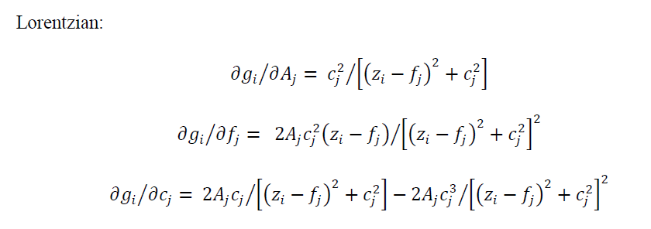
linearize using analytic gradient
Notes:
And here’s the result for the Lorentzian.

Slide 48
issues how to determine number q of peaks trial A_{i} c_{i} f_{i} of each peak
Notes:
Two important issues is how to determine the total number of peaks
and how to determine the trial values used in the first iteration of Newton’s method.

Slide 49
our solution have operator click mouse computer screen to indicate position of each peak
Notes:
Our solution is to have the operator click on the peaks.

Slide 50
MatLab code for graphical input
K=0;
for k = [1:20]
p = ginput(1);
if( p(1) < 0 )
break;
end
K=K+1;
a(K) = p(2)-A;
v0(K)=p(1);
c(K)=0.1;
end
Notes:
The key MatLab function is ginput(),
which activates the cursor
and waits for a mouse click.
We loop over peaks,
terminating the loop when the operator clicks to the right of the graph
to signal that she or he is done.

Slide 51
counts
velocity, mm/s
Lorentzian
Gaussian
Notes:
Here’s the results.
The Lorentzian (blue) seems to fit much better than the Gaussian (green).
Fig .12.16. Example of a fitting the sum of 10 Lorentzian (blue) or Normal (green) curves to Mossbauer spectroscopic data (red). The Lorentzian curves are better able to fit the shape of the curve, with the ratio of estimated variances being about 4. An F-test indicates that null hypothesis that any difference between the two fits can be ascribed to random variation can be rejected to better than 99.99%. Data courtesy of NASA and the University of Mainz. MatLab script gda12_12.

Slide 52
Results of F test
Fest = E_normal/E_lorentzian: 4.230859
P(F<=1/Fest||F>=Fest) = 0.000000
Lorentzian better fit
to 99.9999% certainty
Notes:
That bourn out by the F test.
A F of 4.23 occurs by random change less than 0.0001% of the time
when the two data sets fit equally well
and the difference is due to random fluctuation alone.

