Slide 1


Audio Player
Mix loaded: Bass, Delay Guitar, Drums, Tremolo Guitar
01:24.350
01:58.122

Slide 2
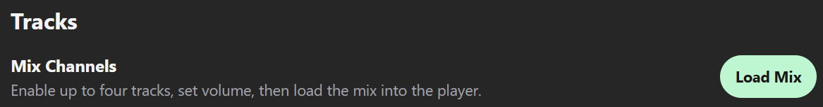
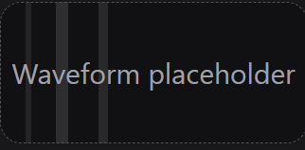
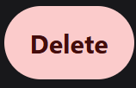

Channel
Name
Volume
Timeline
+2.25 dB
1
Drums
-
+6
8
0
+2.25 dB
2
Bass
-
+6
8
0
+2.25 dB
3
Guitar
-
+6
8
0

