Slide 1

Sorting Algorithms: A Deep Dive into Bubble Sort and Merge Sort
A Visual and Interactive Guide to Understanding Data Organization

Slide 2

What Are Sorting Algorithms?
Definition: Methods used in computer science to arrange data in a specific order
Real-world analogy: Like organizing books by height on a shelf
Purpose: To make data searching and access more efficient
Types: We'll focus on Bubble Sort and Merge Sort

Slide 3

Introduction to Sorting Algorithms
Key Concepts:
Comparison-based sorting
Time complexity
Space complexity
Why Learn Sorting?
Foundation of computer science
Essential for data management
Improves problem-solving skills

Slide 4

Bubble Sort: The Basics
Simple comparison-based algorithm
Works by repeatedly stepping through the list
Compares adjacent elements
Swaps them if they're in the wrong order
Named for how larger elements "bubble" to the top

Slide 5
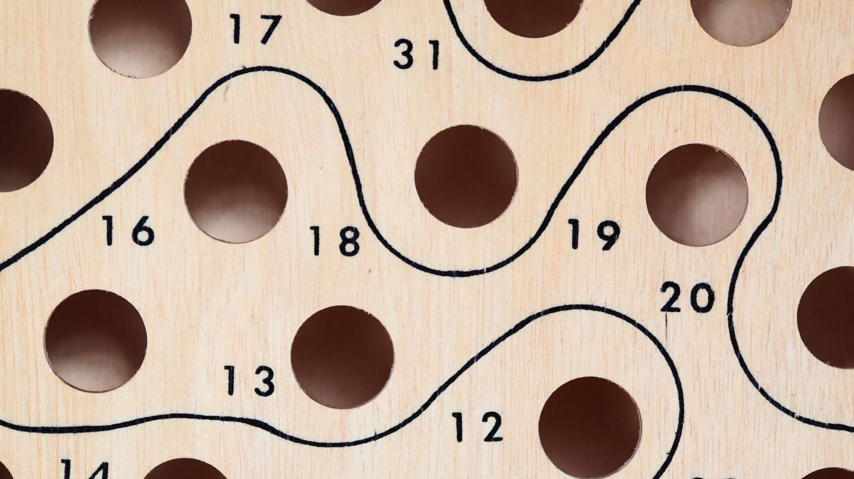
Bubble Sort: Step by Step
Example Array: [29, 10, 14, 37, 13]
Pass 1: [10, 14, 29, 13, 37]
Pass 2: [10, 14, 13, 29, 37]
Pass 3: [10, 13, 14, 29, 37]
Pass 4: [10, 13, 14, 29, 37]

Slide 6
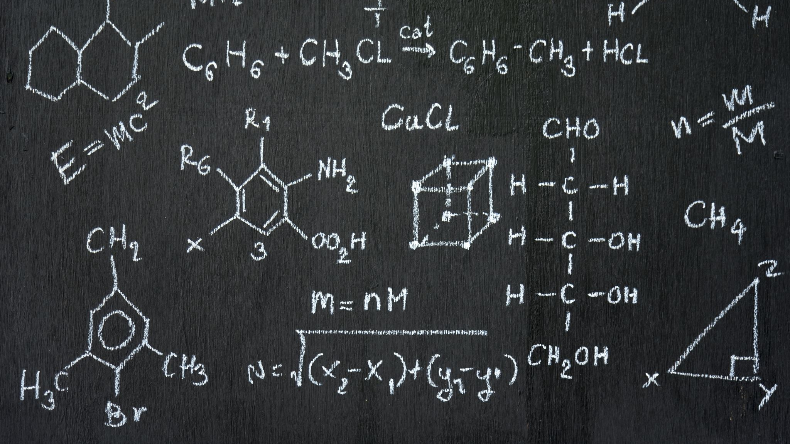
Bubble Sort: Analysis
Time Complexity: O(n²)
Space Complexity: O(1)
Best for: Small datasets
Advantages: Easy to understand and implement
Disadvantages: Inefficient for large datasets

Slide 7
Merge Sort: The Basics
Divide-and-conquer algorithm
Splits list into smaller sublists
Recursively sorts sublists
Merges sorted sublists back together
More efficient than Bubble Sort

Slide 8
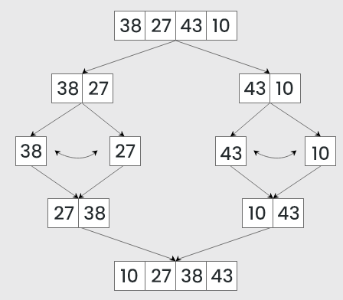
Merge Sort: The Division Phase
Example Array: [38, 27, 43, 10]
Divide:
[38, 27, 43, 10] is divided into [38, 27 ] and [43, 10]
[38, 27] is divided into [38] and [27]
[43, 10] is divided into [43] and [10]
Conquer:
[38] is already sorted.
[27] is already sorted.
[43] is already sorted.
[10] is already sorted.
Merge:
Merge [38] and [27] to get [27, 38]
Merge [43] and [10] to get [10,43]
Merge [27, 38] and [10,43] to get the final sorted list [10, 27, 38, 43]
Therefore, the sorted list is [10, 27, 38, 43]

Slide 9
Merge Sort: Analysis
Time Complexity: O(n log n)
Space Complexity: O(n)
Best for: Large datasets
Advantages: Efficient and stable
Disadvantages: Requires extra memory

Slide 10
Algorithm Comparison
Bubble Sort vs. Merge Sort:
Speed: Merge Sort is faster
Memory: Bubble Sort uses less
Complexity: Bubble Sort is simpler
Scalability: Merge Sort scales better
Implementation: Bubble Sort is easier

Slide 11
Real-World Applications
Database Management Systems
File Organization
Digital Library Systems
Spreadsheet Applications
Search Engines

Slide 12
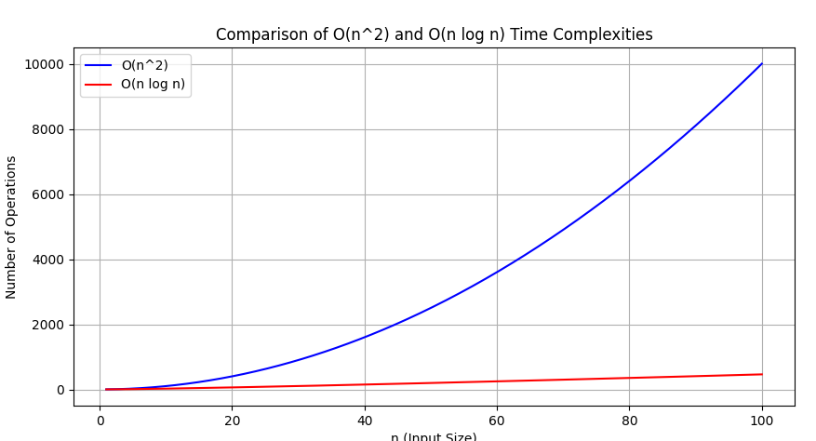
Visualizing Performance
Bubble Sort: Exponential growth
Merge Sort: Logarithmic growth

Slide 13
Practice Problems
Sort [45, 22, 11, 89, 76, 30] using Bubble Sort
Sort [55, 23, 87, 62, 43, 11] using Merge Sort
Compare the number of steps in each method
Identify which algorithm would be better for different scenarios

