Slide 1
Algorithms and Operating Systems
4 -<number>

Slide 2
Basic Problem Solving
Given an array find the second max element
Given a sorted array and an element x find the pair whose sum (a) is x
(b) closest to x
Given a sorted array and an element x ; print all triplets such that their sum is smaller than S
4 -<number>

Slide 3
Basic Problem Solving
Given an array of positive integers (both odd and even), reorganise the array such that
- odd numbers appear before all even numbers
Given an array of positive integers (both odd and even), reorganise the array such that
- odd numbers appear before all even numbers
AND
(a) odd numbers are sorted among themselves in descending order and even number are sorted among themselves in ascending order
(b)H.W odd numbers are sorted among themselves and even numbers are sorted among themselves in ascending order.
(c) odd numbers and even number are in original order as they appear in the input
4 -<number>

Slide 4
Basic Problem Solving
Given is an array of distinct integers (negative and positive). Also given is a sum S.
Print all pairs such that their sum is smaller than S
Given is an array of distinct integers (negative and positive). Also given is a sum S.
Print all triplets such that their sum is smaller than S
4 -<number>

Slide 5
Basic Problem Solving
Given is a sequence of characters where certain characters might repeat in the input. You need reorganise the characters such that you do not place the same character beside each other.
If not possible mention so. If possible give the output.
Example: aabbcadb Output ababcadb
aaab Output: Not possible
4 -<number>

Slide 6
The Divide-and-Conquer Strategy
4 -<number>

Slide 7
A general divide-and-conquer algorithm
Step 1: If the problem size is small, solve this problem directly; otherwise, split the original problem into 2 sub-problems with equal sizes.
Step 2: Recursively solve these 2 sub-problems by applying this algorithm.
Step 3: Merge the solutions of the 2 sub- problems into a solution of the original problem.
4 -<number>

Slide 8
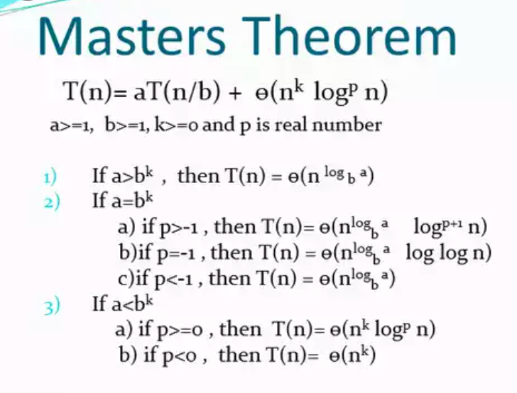
4 -<number>

Slide 9
Problem Set
Binary Search
Merge Sort
Find Skyline points
Closest Pair of points in 2d
Peak Finding
Find the convex hull (H.W)
Strassens Matrix Multiplication (H.W)
Median Finding
4 -<number>

Slide 10
Binary search
e.g. 2 4 5 6 7 8 9
↑
↑
↑
search 7: needs 3 comparisons
time: O(log n)
The binary search can be used only if the elements are sorted and stored in an array.
4 -<number>

Slide 11
Algorithm binary-search
Input: A sorted sequence of n elements stored in an array.
Output: The position of x (to be searched).
Step 1: If only one element remains in the array, solve it directly.
Step 2: Compare x with the middle element of the array.
Step 2.1: If x = middle element, then output it and stop.
Step 2.2: If x < middle element, then recursively solve the problem with x and the left half array.
Step 2.3: If x > middle element, then recursively solve the problem with x and the right half array.
4 -<number>

Slide 12
Merge Sort Example
99 | 6 | 86 | 15 | 58 | 35 | 86 | 4 | 0

Slide 13
Merge Sort Example
99 | 6 | 86 | 15 | 58 | 35 | 86 | 4 | 0
99 | 6 | 86 | 15
58 | 35 | 86 | 4 | 0
99 | 6
86 | 15
58 | 35
86 | 4 | 0
99
6
86
15
58
35
86
4 | 0
4
0

Slide 14
Merge Sort Example
99
6
86
15
58
35
86
0 | 4
Merge
4
0

Slide 15
Merge Sort Example
6 | 99
15 | 86
58 | 35
0 | 4 | 86
99
6
86
15
58
35
86
0 | 4
Merge

Slide 16
Merge Sort Example
6 | 15 | 86 | 99
0 | 4 | 35 | 58 | 86
6 | 99
15 | 86
58 | 35
0 | 4 | 86
Merge

Slide 17
Merge Sort Example
0 | 4 | 6 | 15 | 35 | 58 | 86 | 86 | 99
6 | 15 | 86 | 99
0 | 4 | 35 | 58 | 86
Merge

Slide 18
Merge Sort Example
0 | 4 | 6 | 15 | 35 | 58 | 86 | 86 | 99

Slide 19
Algorithm Merge-Sort
Input: A set S of n elements.
Output: The sorted sequence of the inputs in nondecreasing order.
Step 1: If |S|≤2, solve it directly.
Step 2: Recursively apply this algorithm to solve the left half part and right half part of S, and the results are stored in S₁ and S₂, respectively.
Step 3: Perform the two-way merge scheme on S₁ and S₂.
4 -<number>

Slide 20
Find the number of inversions in an array.
4 -<number>
Notes:
Can use merge sort to do this using divide and conquer

Slide 21
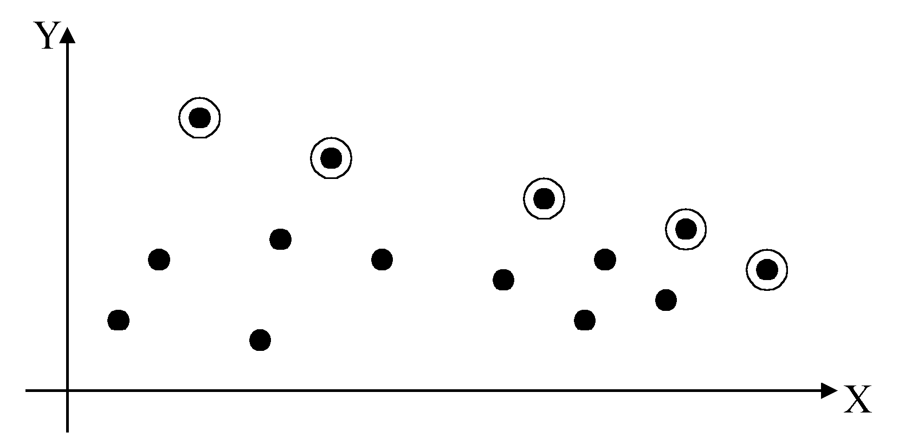
2-D maxima finding problem
Def : A point (x₁, y₁) dominates (x₂, y₂) if x₁ > x₂ and y₁ > y₂. A point is called a maximum if no other point dominates it
Straightforward method : Compare every pair of points.
Time complexity:
C(n,2)=O(n²)
4 -<number>

Slide 22
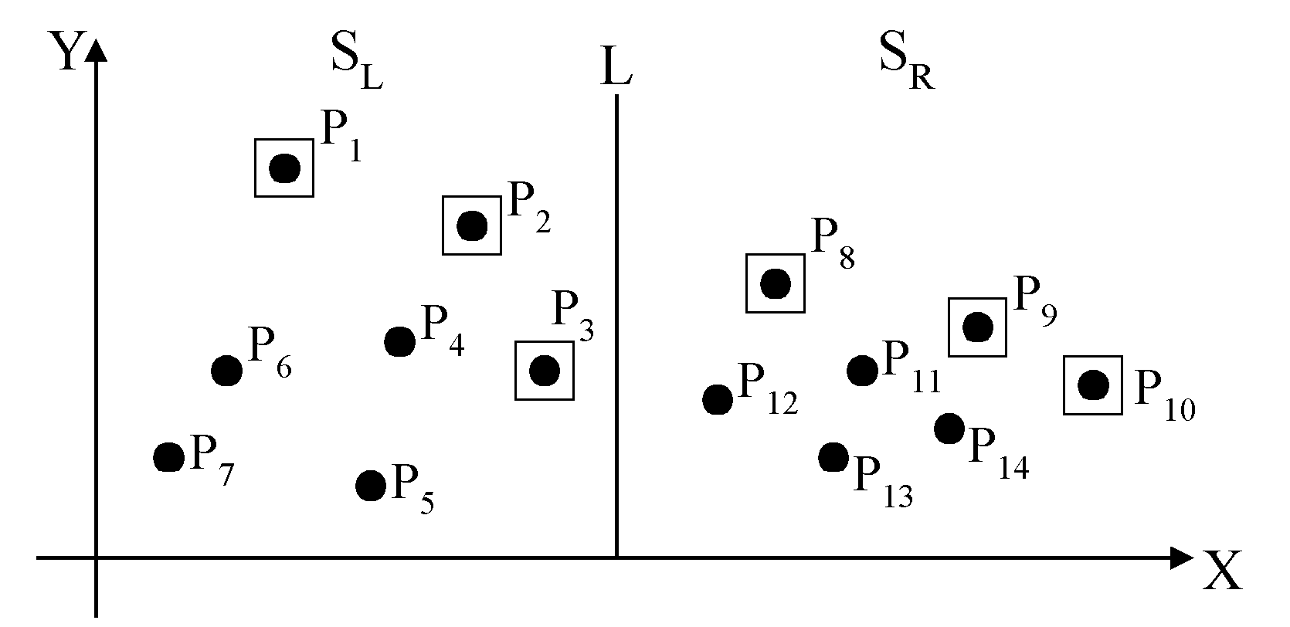
Divide-and-conquer for maxima finding
The maximal points of S_{L} and S_{R}
4 -<number>

Slide 23
The algorithm:
Input: A set S of n planar points.
Output: The maximal points of S.
Step 1: If S contains only one point, return it as the maximum. Otherwise, find a line L perpendicular to the X-axis which separates S into S_{L}and S_{R}, with equal sizes.
Step 2: Recursively find the maximal points of S_{L} and S_{R} .
Step 3: Find the largest y-value of S_{R}, denoted as y_{R}. Discard each of the maximal points of S_{L} if its y-value is less than y_{R}.
4 -<number>

Slide 24
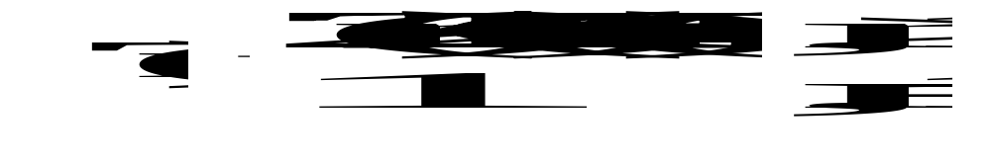
Time complexity: T(n)
Step 1: Sort points by x axis: O(n log n)
Step 2: 2T(n/2)
Step 3: O(n)
Assume n = 2^{k}
T(n) = O(n log n)
4 -<number>

Slide 25
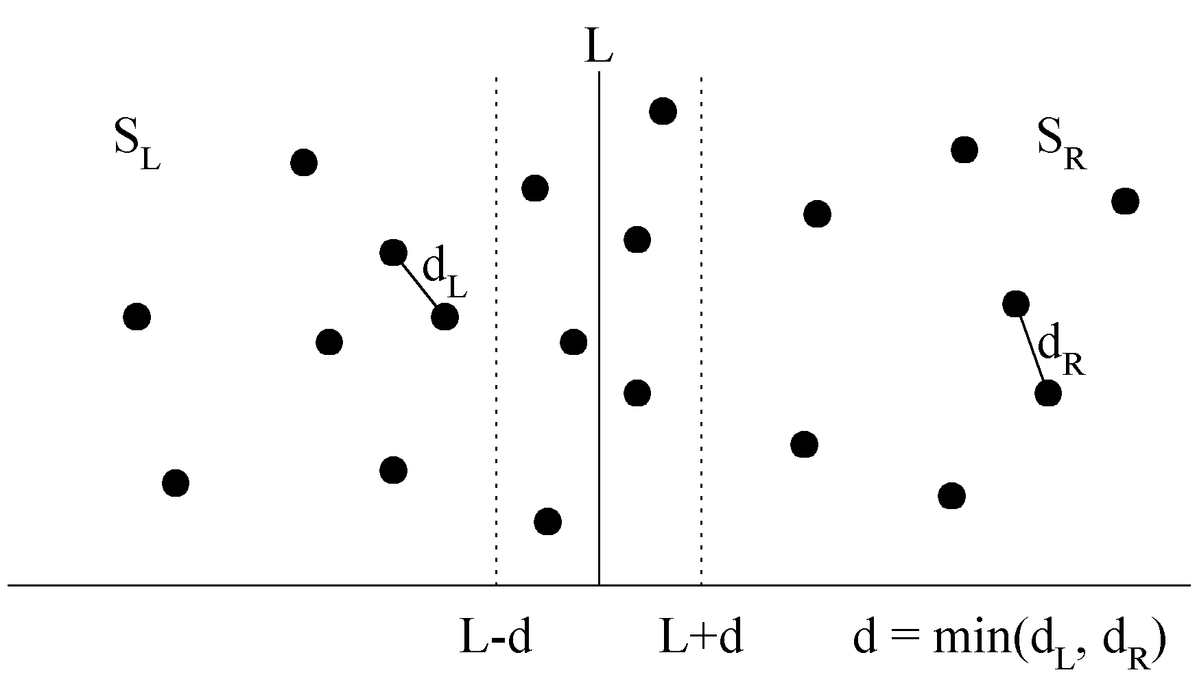
The closest pair problem
Given a set S of n points, find a pair of points which are closest together.
1-D version :
Solved by sorting
Time complexity :
O(n log n)
 2-D version
4 -<number>

Slide 26
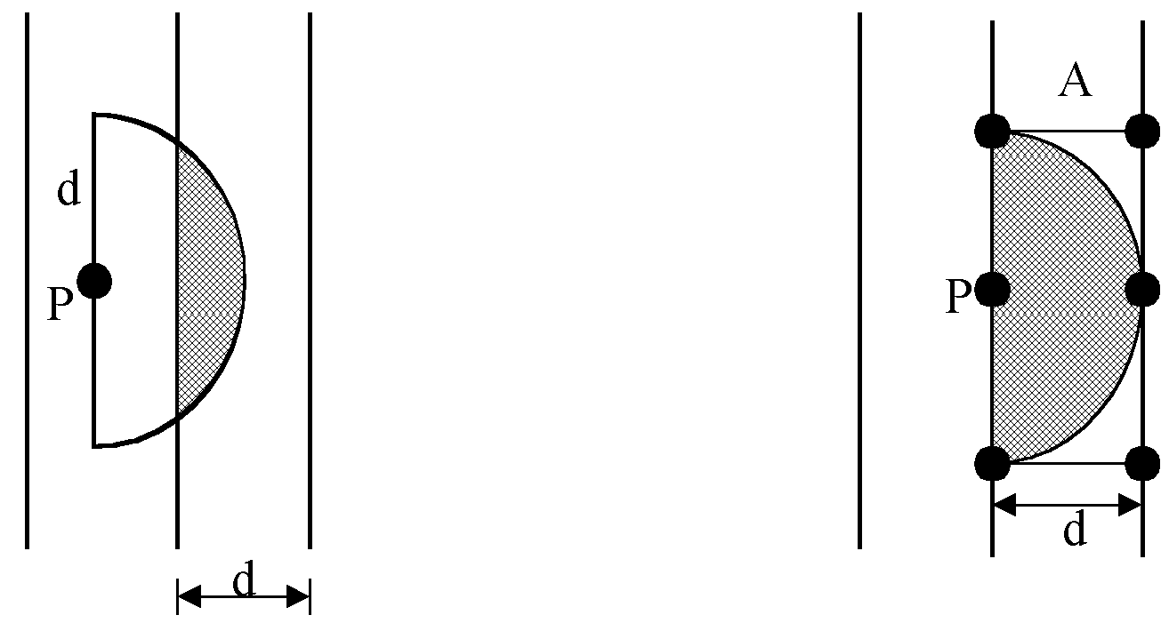
at most 6 points in area A:
4 -<number>

Slide 27
The algorithm:
Input: A set S of n planar points.
Output: The distance between two closest points.
Step 1: Sort points in S according to their y-values.
Step 2: If S contains only one point, return infinity as its distance.
Step 3: Find a median line L perpendicular to the X-axis to divide S into S_{L} and S_{R}, with equal sizes.
Step 4: Recursively apply Steps 2 and 3 to solve the closest pair problems of S_{L} and S_{R}. Let d_{L}(d_{R}) denote the distance between the closest pair in S_{L} (S_{R}). Let d = min(d_{L}, d_{R}).
4 -<number>

Slide 28
STEP 5(Compares points on left of median against the 6 points on the right of the median)
Sort all points in the strip by their y-coordinates, forming q1...qr
Let yi be the y-coordinate of qi
Let X be the x-coordinate of the median
Min=d
For i=1 to r-1
if xi < X
j=i +1
While xj> X and yj-yi< d
If dist(qi,qj)<d ; Min=dist(qi,qj)
j:=j+1
Return Min
4 -<number>
Notes:
You have the points sorted by X axis and also by Y axis. Lets say points x1….xk are first n/2 points in sorted order of x stored in X1 array and remaining in sorted order of X in X2 array. Now scan the array sorted by Y axis. When merging, for points in Y where the X axid lies in +-d of median; store them in sorted order in Y_temp. Now do the temp work given above

Slide 29
Quick Proof
In the rectangle 2d X d , consider squares of size d/2. There are 8 such squares.
The diameter of the square is d/√2
Hence there can be atmost one point in a square of size d/2
Thus there can be atmost 8 points in the rectangle 2dXd
Hence a point needs to be compared with atmost 8 points.
4 -<number>

Slide 30
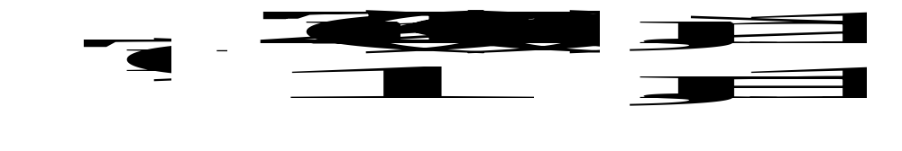
Step 5: For a point P in the half-slab bounded by L-d and L, let its y-value be denoted as y_{P} . For each such P, find all points in the half-slab bounded by L and L+d whose y-value fall within y_{P}+d and y_{P}-d. If the distance d′ between P and a point in the other half-slab is less than d, let d=d′. The final value of d is the answer.
Time complexity: O(n log n)
Step 1: O(n log n)
Steps 2~5:
⇒T(n) = O(n log n)
4 -<number>

Slide 31
Find median of an array --- done on the board
4 -<number>

Slide 32
Assignment problems
Find the convex hull
Strassens Matrix Multiplication
Median Finding
4 -<number>

