Slide 1
String Searching

Slide 2

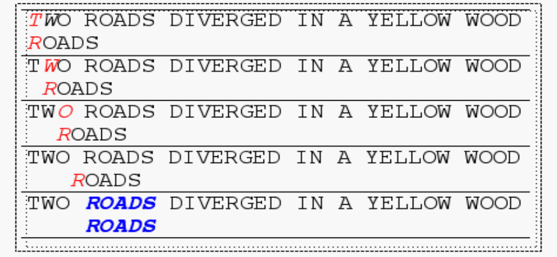
Brute Force
The Brute Force algorithm compares the pattern to the text, one character at a time, until unmatching characters are found
Total number of comparisons: M (N-M+1)
Worst case time complexity: O(MN)

Slide 3
Rabin-Karp
If comparing pattern with text to see if it is the same takes O(1) then brute force would take O(n).
If we knew the integer value of the pattern and integer value of every substring of text of size m then comparing pattern with text substring is O(1).
Issues:
1. What could be the integer representations of strings.
2. The above assumes that finding integer values of substrings is constant time
3. It assumes that strings are short and will give short integers that fit into registers so that comparison operations on the integers are O(1). What if long integers?

Slide 4
Rabin-Karp
Issues:
1 What could be the integer representations of strings.
-If only 10 characters then map each character to a digit 0 till 9 and find corresponding decimal value.
-If b types of characters then use base b.
2 The above assumes that finding integer values of substrings is constant time once integer of pattern and first m length substring of text is found

Slide 5
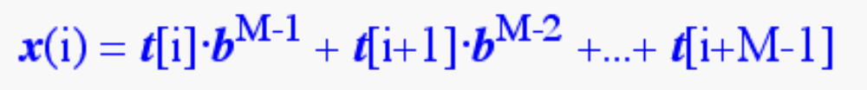
Issue 2
Consider an M-character sequence as an M-digit number in base b, where b is the number of letters in the alphabet. The text subsequence t[i .. i+M-1] is mapped to the number
Intuition: The string ‘12345’ has length 5. The corresponding number would be:
1.10⁴ + 2.10³ + 3.10² + 4.10 + 5

Slide 6
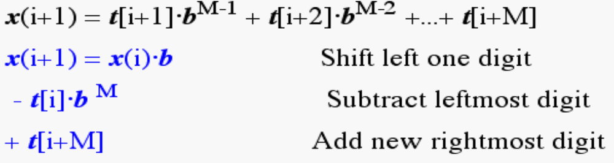
Issue 2-continued
Given x(i) we can compute x(i+1) for the next subsequence t[i+1 .. i+M] in constant time

Slide 7
Issue 3
It assumes that strings are short and will give short integers that fit into registers so that comparison operations on the integers are O(1). What if long integers?
Use a hash function which is mod q for large prime q. This will ensure that integer numbers are small. However, now we don’t have the integer to be unique to a substring. Instead we have a hash value which might be same for two dissimilar substrings.
Different hash values mean substrings are different but similar hash value would need a brute force comparison of pattern with that substring.

Slide 8
-What is the hash function used to calculate values for character sequences?
-What is the cost of calculating the hash function each time
-What is the algorithm complexity”

Slide 9
Rabin-Karp Mods
If M is large, then the resulting value will be enormous. For this reason, we hash the value by taking it mod a prime number q.
Note;
[(x mod q) + (y mod q)] mod q = (x+y) mod q
(x mod q) mod q = x mod q

Slide 10
Earlier:
Now:
h(i)=((t[i]⋅ bM-1 mod q) +(t[i+1]⋅ bM-2 mod q) + ...
+(t[i+M-1] mod q))mod q
Earlier:
Now: h(i+1) =( h(i) ⋅ b mod q
-t[i] ⋅ b^{M} mod q
+t[i+M] mod q ) mod q

Slide 11
Rabin-Karp
The Rabin-Karp string searching algorithm calculates a hash value for the pattern, and for each M-character subsequence of text to be compared.
If the hash values are unequal, the algorithm will calculate the hash value for next M-character sequence.
If the hash values are equal, the algorithm will do a Brute Force comparison between the pattern and the M-character sequence.
In this way, there is only one comparison per text subsequence, and Brute Force is only needed when hash values match.
.

Slide 12
The Knuth-Morris-Pratt Algorithm

Slide 13
Suppose:
T: a a b a a b a b z a a b a a b b b a
P: a a b a a b a a a
Now the fist mismatch is at ‘a’ of pattern which is not matching ‘b’.
Where all do I align the pattern to next?
T: a a b a a b a b z a a b a a b b b a
P: a a b a a b a a a
T: a a b a a b a b z a a b a a b b b a
P: a a b a a b a a a
T: a a b a a b a b z a a b a a b b b a
P: a a b a a b a a a
T: a a b a a b a b z a a b a a b b b a
P a a b a a b a a a

Slide 14
T: a a b a a b a b z a a b a a b b b a FAIL!
P: a a b a a b a a a
For this to match the
first 6 chars of pattern should have matched with 2nd 6 chars of text.
=>first 6 chars of pattern should have matched with 2nd 6 chars of pattern.
=>first 6 chars of pattern should match with last 6 chars of pattern till point of match
=> 6 char suffix = 6 chars of prefix
T: a a b a a b a b z a a b a a b b b a PASS!
P: a a b a a b a a a
T: a a b a a b a b z a a b a a b b b a FAIL!
P: a a b a a b a a a
T: a a b a a b a b z a a b a a b b b a PASS!
P a a b a a b a a a

Slide 15
The KMP Algorithm
Keeps track of information gained from previous comparisons.
T: a b x a b x a b b x c y b ……
P: a b x a b b x c y
Find the largest text suffix matched so far that is same as pattern prefix
Find the longest prefix of the pattern P[0,..,j] that is also a suffix of P[1,..,j]
For each index position of pattern from 1 to j, compute the prefix index position from which one can continue checking.

Slide 16
Prefix array content
0 1 2 ….k …….m …. N-1
n is the total pattern size,
m is the index that we are trying to fill,
Say longest prefix that matches with the suffix ending at m has length k from 0…k-1 then P[m]=k. Such a k indicates
That if a mismatch occurs on comparing P[m+1] with text location ti then compare ti against P[m] which is k.
To conclude: If a mismatch occurs at location m of pattern; compare mismatched text char with P[m-1]

Slide 17
The KMP Algorithm
0 1 2 3 4 5 6 7
A b c d a b c a
0 0 0 0 1 2 3 1
Fill in the values
A a b a a b a a a

Slide 18
The KMP Algorithm
To conclude: If a mismatch occurs at location m of pattern; compare text char with P[m-1]
For each index position of patter from 1 to j, compute the prefix index position from which one can continue checking.
I:0 1 2 3 4 5 6 7 8
a a b a a b a a a
V:0 1 0 1 2 3 4 5 2
0 1 2 3 4 5
a b a c a b
0 0 1 0 1 2

Slide 19
Prefix algorithm intuition
We are trying to fill the value of A[i] which says that if till the ith character the pattern and text match and P[i+1] does not match with text then the mismatched text character should be compared with P[A[i]]. So A[i] gives index with which I should compare text character.
How to fill A[i] ?
I need to know the longest suffix until i that matches with prefix.
That gives the earliest location I need to try matching with so that I don’t miss any pattern.
The longest suffix until i-1 that matches with some prefix (say P[0…..j-1]) is P[i-j………i-1].
1. if P[i]=P[j] then the longest suffix until i to match prefix is P[0….j]. Hence A[i]=j+1

Slide 20
Prefix algorithm intuition
How to fill A[i] ?
I need to know the longest suffix until i that matches with prefix. The longest suffix until i-1 that matches with some prefix (say P[0…..j-1]) is P[i-j………i-1].
2. if P[i]!=P[j], then the longest suffix till i might be the second longest suffix till i-1 with P[i] if the next character of prefix is same as P[i]. Else might be the third longest suffix till i-1 with P[i] if the prefix’s next character is same as p[i] and so on.
How do we find the next longest suffix until i-1 after each failed attempt to see if the next character of the next longest prefix is same as P[i]]

Slide 21
Prefix algorithm intuition
How do we find the next longest suffix until i-1 after each failed attempt to see if the next character of the next longest prefix is same as P[i]]

Slide 22
0 1 2 3 4 5 6 7 8 9 10 11 12 13 a b c a b c d a b c a b c a
0 0 0 1 2 3 0 1 2 3 4 5 6 4
Suffix till i-1 is same as suffix of P[i-j,…..i-1] that is prefix same as suffix of P[0,…..j-1] that is a prefix.
A[j-1] gives you the index right after the suffix of P[0,…..j-1] matches with prefix. If P[A[j-1]]!=P[i] then
We need to look for suffix of P[0,…..j-1] which is prefix.
Same as look for suffix of P[0,……., (A[j-1]-1)] which is prefix and so on.

Slide 23
The KMP Algorithm (contd.)
the KMP string matching algorithm: Pseudo-Code
Algorithm KMPMatch(T,P)
Input: Strings T (text) with n characters and P
(pattern) with m characters.
Output: Starting index of the first substring of T
matching P, or an indication that P is not a
substring of T.

Slide 24
Algorithm
vector<int> PrefixFunction(string S)
{
vector<int> p(S.size());
int j = 0; p[0]=0;
for (int i = 1; i < (int)S.size(); i++)
{ while (j > 0 && S[j] != S[i])
j = p[j-1];
if (S[j] == S[i]) j++;
p[i] = j;
}
return p;
}

Slide 25


Slide 26
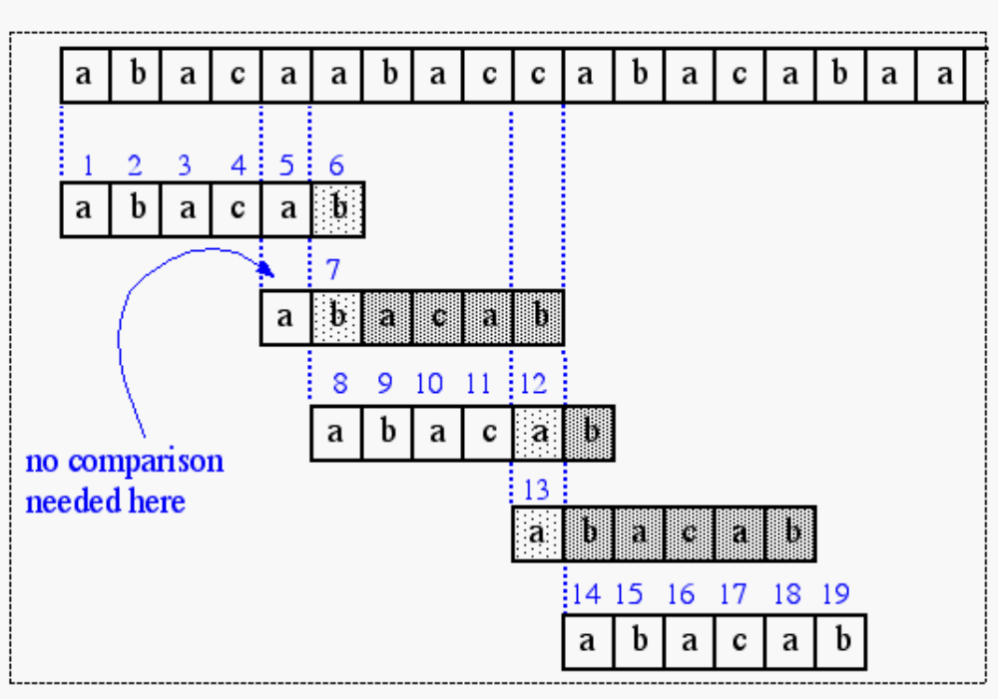
a b a c a b
0 0 1 0 1 2

Slide 29
Algorithm
f ← KMPFailureFunction(P)
i ← 0
j ← 0
while i < n do
if P[j] = T[i] then
if j = m - 1 then
return i - m - 1 {a match}
i ← i + 1
j ← j + 1
else if j > 0 then {no match, but we have advanced}
j ← f(j-1) {j indexes just after matching prefix in P}
else
i ← i + 1
return “There is no substring of T matching P”

Slide 30
The KMP complexity
The inner while loop of the preprocessing algorithm decreases the value of j by at least 1, since b[j] < j. The loop terminates at the latest when j = 0, therefore it can decrease the value of j at most as often as it has been increased previously by j++. Since j++ is executed in the outer loop exactly m times, the overall number of executions of the inner while loop is limited to m. The preprocessing algorithm therefore requires O(m) steps.
https://www.w3spot.com/2020/07/kmp-algorithm-explained-in-plain-english.html
From similar arguments it follows that the searching algorithm requires O(n) steps. The above example illustrates this: the comparisons (green and red symbols) form "stairs". The whole staircase is at most as wide as it is high, therefore at most 2n comparisons are performed.
Since mn the overall complexity of the Knuth-Morris-Pratt algorithm is in O(n).

Slide 31
Boyer Moore Algorithm
Three ideas: Each idea can be used independently
--Scan right to left of pattern
--Bad character rule
--Good suffix rule
Using three together gives better results.

Slide 32
Idea1: right to left scan
T :abcbbdbdebre
P :hearih
Compare from last character of pattern towards left
Naive: For a mismatch shift pattern to right by one jump.

Slide 33
Idea2:Bad Character rule
T: adjaiutnansk T: adjaiutnansk
P: kisudu P: kasudu
--Allign the mismatched character in T (i in T here) with right most occurrence of i to the left of d in P
--If no such occurrence then shift by length of pattern
T: adjaiutnansk T: adjaiutnansk
P: kisudu P: kisudu

Slide 34
Idea 3(a): good suffix rule
Case1: matched portion exist to left of matched area not preceded by the mismatched character.
T: wadssakdcabcajajst
P: dabccabcaabc
--Allign matched part of text with closest left occurrence of matched pattern which is not preceded by mismatch text character.
--If no match go to Case2.
T: wadssakdcabcajajst
P: dabccabcaabc

Slide 35
Idea 3(b): good suffix rule
Case2 : match portion does not exist to left of matched area
T: wadssakdcabcajajst
P: bccccakcaabc
--Find longest prefix of P that matches with suffix of P.
T: wadssakdcabcajajst
P: bccccakcaabc
---If no such prefix then shifted by length of pattern.

Slide 36
Precomputations required
Bad Character Rule:
For each character find its previous occurrence.
Good suffix Rule:
Case1: Find closest left occurrence of matched pattern not preceded by mismatch character
Case2: Compute longest prefix that is suffix of pattern

Slide 37
Precomputations required
Bad Character Rule: For mismatch text character c, find its occurrence in pattern.
--For alphabets in pattern, store rightmost occurrence of each character in R(c).
--Let index denote the index of pattern character that mismatched the text character c
Shift =index-R(c) if R(c)< index
=1 if R(c)> index

Slide 38
Bad Character rule precomputation (m-1-index)
T: adjaiutnansk 012345
P: kisudu kisudu
Characters: k i s u d
0 1 2 5 4
T: adjaiutnsnsk T: adjaiutnsnsk
P: kisudu P: kisudu

Slide 39
Precomputations required
Good suffix Rule:
Case1: Find closest left occurrence of matched pattern not preceded by mismatch character
Homework ☺
How to compute case1 of good suffix rule
What would be the fastest string search algorithm

Slide 40
Which idea to use?
Each idea or rule is complete where each step is independent of the previous.
Hence at each step use the rule that gives maximum shift.

Slide 41
Boyer Moore Horspool
Horspool proposed to use only the bad-character shift of the rightmost character of the window to compute the shifts in the Boyer-Moore algorithm.
The bad-character shift used in BM algorithm is not very efficient for small alphabets, but when the alphabet is large compared with the length of the pattern, as it is often the case with the ASCII table and ordinary searches made under a text editor, it becomes very useful.

