Slide 1
Chapter 6: Process Synchronization

Slide 2
Cooperating Processes
Independent process cannot affect or be affected by the execution of another process
Cooperating process can affect or be affected by the execution of another process
Advantages of process cooperation
  Information sharing (shared file)
  Computation speed-up(parallel execution of subtasks )
  Modularity (constructing the system in a modular fashion)
  Convenience (each user may work on many tasks at the same time; printing, editing, compiling in parallel)

Slide 3
Interprocess Communication (IPC)
Mechanism for processes to communicate and to synchronize their actions is called IPC
Two fundamental models – shared memory and message passing
Shared memory: The memory region to be shared is established. Process exchange information by reading and writing to the shared region.
Message passing: Communication takes place by exchanging messages between processes.
Shared Memory vs Message passing:
-Shared memory is faster since message passing uses system calls which requires kernel invention making it slower.
-For intercomputer communication, message passing is preferred

Slide 4

Communications Models

Slide 5
Shared Memory
Processes establish a region of shared memory.
They can exchange information by reading and writing into the shared memory region.
The form of the data and the location are determined by the processes and are not under the OS’ control
Processes are responsible for ensuring that they are not writing to the same location simultaneously.

Slide 6
Message Passing
Mechanism for processes to communicate and to synchronize their actions
Message system – processes communicate with each other without resorting to shared variables
IPC facility provides two operations:
  send(message) – message size fixed or variable
  receive(message)
If P and Q wish to communicate, they need to:
  establish a communication link between them
  exchange messages via send/receive
Implementation of communication link
  physical (e.g., shared memory, hardware bus)
  logical (e.g., logical properties)

Slide 7
Synchronisation
Concurrent access to shared data may result in data inconsistency
Maintaining data consistency requires mechanisms to ensure the orderly execution of cooperating processes

Slide 8
Example
Code:
NewBalance= Balance + Amount;
Balance= NewBalance;
Saw initially Balance is 1000 and both Jack and Jill are depositing 200 each that should have resulted I 1400
Jack first adds so line 1 executed
NewBalance = 1000+200
Then Jill adds so line 1 executed
NewBalance= 1000 +200 (Note balance had not got updated
Then Jack executes line 2
Balance = 1200
Then Jill executes line 2
Balance=1200

Slide 9

Producer Consumer
while (1)
{
/* produce an item and put in nextProduced
while (count == BUFFER_SIZE)
; // do nothing
buffer [in] = nextProduced;
in = (in + 1) % BUFFER_SIZE;
count++;
}
while (1)
{
while (count == 0)
; // do nothing
nextConsumed = buffer[out];
out = (out + 1) % BUFFER_SIZE;
count--;
/* consume the item in nextConsumed
}

Slide 10
Race Condition
count++ could be implemented as
register1 = count
register1 = register1 + 1
count = register1
count-- could be implemented as
register2 = count
register2 = register2 - 1
count = register2
Consider this execution interleaving with “count = 5” initially:
  S0: producer execute register1 = count {register1 = 5}
  S1: producer execute register1 = register1 + 1 {register1 = 6}
  S2: consumer execute register2 = count {register2 = 5}
  S3: consumer execute register2 = register2 - 1 {register2 = 4}
  S4: producer execute count = register1 {count = 6 }
  S5: consumer execute count = register2 {count = 4}

Slide 11
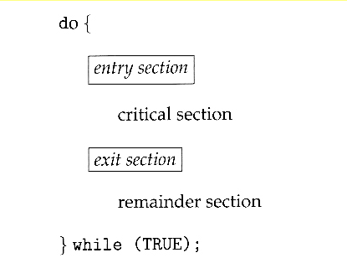
Critical Section Problem

Slide 12
Solution to Critical-Section Problem
1. Mutual Exclusion - If process P_{i} is executing in its critical section, then no other processes can be executing in their critical sections
2. Progress - If no process is executing in its critical section and there exist some processes that wish to enter their critical section, then the selection of the processes that will enter the critical section next cannot be postponed indefinitely
3. Bounded Waiting - A bound must exist on the number of times that other processes are allowed to enter their critical sections after a process has made a request to enter its critical section and before that request is granted
  Assume that each process executes at a nonzero speed
  No assumption concerning relative speed of the N processes

Slide 13
Hypothetical case -1
Two processes P1 and p2.
Initially say turn =1.
Pi
While turn !=i ; //waits for his turn
Critical Section
Turn=j
Will this work?

Slide 14
Hypothetical case -1
Two processes Pi and pj. Say intially turn=j
Pi
While turn !=i ;
Critical Section
Turn=j
Note: While mutual exclusion is guaranteed, progress is not.
Say Pi wants to run and Pj does not. Then Pi waits on a process who is not ready to enter the Critical section. Another case: Pj runs first and then Pi runs. Now Pi wants to run again but turn =j so Pi has to wait till Pj runs again.

Slide 15
Hypothetical case -2
Two processes : flag [k] for pk intialised to 0 for both processes
Pi
While flag[j] do;[ looping ]
Flag[i]=true
Critical Section
Flag[i]=false
Will this work?

Slide 16
Hypothetical case -2
Two processes : for both process flag [k] for pk intialised to 0
Pi
1.While flag[j] do;[ looping ]
2. Flag[i]=true
3. Critical Section
4. Flag[i]=false
Both processes can reach critical if sequence of execution is pi.1, pj.1, pi.2, pi.3, pj.2, pj.3,…
Mutual exclusion is not guaranteed

Slide 17
Hypothetical case -3
Two processes : flag [k] intialised to 0 for both
Pi
1. Flag[i]=true
2. While flag[j] do; // looping
3. Critical Section
4. Flag[i]=false

Slide 18
Hypothetical case -3
Two processes : flag [k] intialised to 0
Pi
1. Flag[i]=true
2. While flag[j] do;[ looping ]
3. Critical Section
4. Flag[i]=false
Both processes keep waiting if Pi.1, Pj.1, Pi.2, Pj.2 …. Bounded waiting not guaranteed

Slide 19
Peterson’s Solution
Two process solution
Assume that the LOAD and STORE instructions are atomic; that is, cannot be interrupted.
The two processes share two variables:
  int turn;
  Boolean flag[2]
The variable turn indicates whose turn it is to enter the critical section.
The flag array is used to indicate a process is interested and hence is ready to enter the critical section. flag[i] = true implies that process P_{i} is ready!

Slide 20
Algorithm for Process P_{i}
do {
flag[i] = TRUE;
turn = j;
while ( flag[j] && turn == j);
CRITICAL SECTION
flag[i] = FALSE;
REMAINDER SECTION
} while (TRUE);

Slide 21
WHAT happens if the below?
do {
flag[i] = TRUE;
turn = i;
while ( flag[j] && turn == j);
CRITICAL SECTION
flag[i] = FALSE;
REMAINDER SECTION
} while (TRUE);

Slide 22
WHAT happens if the below?
do {
flag[i] = TRUE;
turn = i;
while ( flag[j] && turn == j);
CRITICAL SECTION
flag[i] = FALSE;
REMAINDER SECTION
} while (TRUE);
Flag[i]=0 and flag[j]=0
Turn=0 initially
p1.1, p1.2, p1.3
Then p2.1, p2.2, and p2
also enters critical section

Slide 23
Synchronization Hardware
Many systems provide hardware support for critical section code
Uniprocessors – could disable interrupts
  Currently running code would execute without preemption
  Generally too inefficient on multiprocessor systems since message being passed to all processors will be time consuming.
  Modern machines provide special atomic hardware instructions
    Atomic = non-interruptable
  - Either test memory word and set value
  - Or swap contents of two memory words

Slide 24
Structure
{
acquire lock
critical section
release lock
remaining code
}

Slide 25
TestAndndSet Instruction
Definition:
boolean TestAndSet (boolean *target)
{
boolean rv = *target;
*target = TRUE;
return rv:
}

Slide 26
Solution using TestAndSet
Shared boolean variable lock., initialized to false.
Solution:
do {
while ( TestAndSet (&lock ))
; /* do nothing
// critical section
lock = FALSE;
// remainder section
} while ( TRUE);
No bounded waiting.
Some process might starve

Slide 27
Swap Instruction
Definition:
void Swap (boolean *a, boolean *b)
{
boolean temp = *a;
*a = *b;
*b = temp:
}

Slide 28
Solution using Swap
Shared Boolean variable lock initialized to FALSE; Each process has a local Boolean variable key.
Solution:
do {
key = TRUE;
while ( key == TRUE)
Swap (&lock, &key );
// critical section
lock = FALSE;
// remainder section
} while ( TRUE);

Slide 29
Question
Can we just use a queue where a process who will need to enter CS at some point in time; goes into a queue for that resource. The process can start running when the process gets his turn after the resource is available.
Issues: No concurrent running can happen even of the portions that could run concurrently. Instead the process can go into a queue at the point it is next needs the CS. There has to be some code that stops regulates this queue where it puts something into the queue if resource busy and removes an element from the queue when the resource is available. So you now have to write CS code that does if(!Test&Set)push_queue(Pid); //wait on something...
The issue without a lock to enter CS will result in same issues as we saw earlier in the producer consumer problem with the buffer queue.

Slide 30
Bounded waiting mutual exclusion for multiple processes
Initially lock is false
do
{ waiting[i] = true;
key = true;
while (waiting[i] && key)
key = test_and_set(&lock);
waiting[i] = false;
/* critical section */
j = (i + 1) % n;
while ((j != i) && !waiting[j])
j = (j + 1) % n;
if (j == i) lock = false;
else waiting[j] = false;
/* remainder section */
} while (true);
Why not lock=false?

Slide 31
Bounded waiting mutual exclusion for multiple processes
Initially lock is false
do
{ waiting[i] = true;
key = true;
while (waiting[i] && key)
key = test_and_set(&lock);
waiting[i] = false;
/* critical section */
j = (i + 1) % n;
while ((j != i) && !waiting[j])
j = (j + 1) % n;
if (j == i) lock = false;
else waiting[j] = false;
/* remainder section */
} while (true);
Why not lock=false?

Slide 32
Semaphore
Synchronization tool that does not require busy waiting if implemented along with an associated queue where process is queue is woken up when resoure is available.
Semaphore S – integer variable
Two standard operations modify S: wait() and signal()
  Originally called P() and V()
Less complicated
Can only be accessed via two indivisible (atomic) operations
  wait (S) {
  while S <= 0
  ; // no-op
  S--;
  }
  signal (S) {
  S++;
  }

Slide 33
Advantage of Semaphore
It's simple and always have a non-negative Integer value.
Works with many processes.
Can have many different critical sections with different semaphores. Each critical section has unique access semaphores.
Can permit multiple processes into the critical section at once, if desirable

Slide 34
Semaphore as General Synchronization Tool
Counting semaphore – integer value can range over an unrestricted domain. Example: indicate number of commodities in market.
Binary semaphore – integer value can range only between 0
and 1; can be simpler to implement
  Also known as mutex locks
Can implement a counting semaphore S as a binary semaphore

Slide 35
Mutual Exclusion
Semaphore S=1;
  { wait (S);
  Critical Section
  signal (S);
}
  wait (S) {
  while S <= 0
  ; // no-op
  S--;
  }
  signal (S) {
  S++;
  }

Slide 36
Producer Consumer naïve
PRODUCER
send(char c)
{
buf[in]=c
in=(in+1)%N
}
CONSUMER
char rcv()
{ char c;
c=buf[out];
out=(out+1)%N;
return c;
}
/*the buffer*/
Char buf[N];
In =0; out =0;
Need to add below constraints
-Consumer consumes only if atleast one element in buffer
-Producer produces if buffer not full

Slide 37
consume when buffer not empty

Slide 38
consume when buffer not empty
PRODUCER
send(char c)
{
buf[in]=c
in=(in+1)%N
signal(chars)
}
CONSUMER
char rcv()
{ char c;
wait(chars);
c=buf[out];
out=(out+1)%N;
return c;
}
/*the buffer*/
Char buf[N];
In =0; out =0;
Semaphore chars=0;

Slide 39

Produce when buffer not full

Slide 40
Produce when buffer not full
PRODUCER
send(char c)
{
wait(space);
buf[in]=c
in=(in+1)%N
signal(chars)
}
CONSUMER
char rcv()
{ char c;
wait(chars);
c=buf[out];
out=(out+1)%N;
signal(space);
return c;
}
/*the buffer*/
Char buf[N];
In =0; out =0;
Semaphore chars=0, space =N;
consumer produces a space!

Slide 41
Multiple Producers and one consumer

Slide 42
Multiple Producers and one consumer
PRODUCER
send(char c)
{
wait(space);
wait(lock);
buf[in]=c
in=(in+1)%N
signal(lock);
signal(chars)
}
CONSUMER
char rcv()
{ char c;
wait(chars);
c=buf[out];
out=(out+1)%N;
signal(space);
return c;
}
Will two producers
find single space
left in line 1
and both write
into the single
space left?
/*the buffer*/
Char buf[N];
In =0; out =0;
Semaphore chars=0, space =N, lock=1, ;

Slide 43
Multiple Producers and one consumer
PRODUCER
send(char c)
{
wait(space);
wait(lock);
buf[in]=c
in=(in+1)%N
signal(lock);
signal(chars)
}
CONSUMER
char rcv()
{ char c;
wait(chars);
c=buf[out];
out=(out+1)%N;
signal(space);
return c;
}
Will two producers
find single space
left in line 1
and both write
into the single
space left?
No. First producer
Will decrement space
To 0 so second will
wait
/*the buffer*/
Char buf[N];
In =0; out =0;
Semaphore chars=0, space =N, lock=1, ;

Slide 44
Multiple producers and consumers
CONSUMER
char rcv()
{ char c;
wait(chars);
wait(lock)
c=buf[out];
out=(out+1)%N;
signal(lock)
signal(space);
return c;
}
WORKS ??
PRODUCER
send(char c)
{
wait(space);
wait(lock);
buf[in]=c
in=(in+1)%N
signal(lock);
signal(chars)
}
/*the buffer*/
Char buf[N];
In =0; out =0;
Semaphore chars=0, space =N, lock=1, ;

Slide 45
Multiple producers and consumers
PRODUCER
send(char c)
{
wait(space);
wait(lock);
buf[in]=c
in=(in+1)%N
signal(lock);
signal(chars)
}
CONSUMER
char rcv()
{ char c;
wait(chars);
wait(lock)
c=buf[out];
out=(out+1)%N;
signal(lock)
signal(space);
return c;
}
ISSUE ??
Does not permit
Producer and
consumer to
simultaneously
function
/*the buffer*/
Char buf[N];
In =0; out =0;
Semaphore chars=0, space =N, lock=1, ;

Slide 46
Multiple producers and consumers
PRODUCER
send(char c)
{
wait(space);
wait(lock);
buf[in]=c
in=(in+1)%N
signal(lock);
signal(chars)
}
CONSUMER
char rcv()
{ char c;
wait(chars);
wait(lock)
c=buf[out];
out=(out+1)%N;
signal(lock)
signal(space);
return c;
}
If simultaneously
Function not
required then would
this work?
/*the buffer*/
Char buf[N];
In =0; out =0;
Semaphore chars=0, space =N, lock=1, ;

Slide 47
Multiple producers and consumers
PRODUCER
send(char c)
{
wait(space);
wait(lock);
buf[in]=c
in=(in+1)%N
signal(lock);
signal(chars)
}
CONSUMER
char rcv()
{ char c;
wait(chars);
wait(lock)
c=buf[out];
out=(out+1)%N;
signal(lock)
signal(space);
return c;
}
If simultaneously
Function not
required then would
this work? yes
/*the buffer*/
Char buf[N];
In =0; out =0;
Semaphore chars=0, space =N, lock=1, ;

Slide 48
If simultaneously
Function not
required then would
this work?
PRODUCER
send(char c)
{
wait(lock);
wait(space);
buf[in]=c
in=(in+1)%N
signal(chars);
signal(lock)
}
CONSUMER
char rcv()
{ char c;
wait(chars);
wait(lock)
c=buf[out];
out=(out+1)%N;
signal(lock)
signal(space);
return c;
}
/*the buffer*/
Char buf[N];
In =0; out =0;
Semaphore chars=0, space =N, lock=1, ;

Slide 49
If simultaneously
Function not
required then would
this work? No
PRODUCER
send(char c)
{
wait(lock);
wait(space);
buf[in]=c
in=(in+1)%N
signal(chars);
signal(lock)
}
CONSUMER
char rcv()
{ char c;
wait(chars);
wait(lock)
c=buf[out];
out=(out+1)%N;
signal(lock)
signal(space);
return c;
}
Producer got lock (wait lock) so proceed to step 2
Consumer finds he can consume (wait chars) so proceed to step 2
Producer waiting since buffer full (wait space) so waiting at step 2
Consumer wants to proceed to consume but cant get lock(wait lock).
So waiting at step 2.
➔ Both producer and consumer are waiting.

Slide 50
Multiple Producers and consumers
Modify the code
to now work for
simultaneous
working of producer
and consumer
CONSUMER
char rcv()
{ char c;
wait(chars);
wait(lock);
c=buf[out];
out=(out+1)%N;
signal(lock); signal(space); return c;
}
PRODUCER
send(char c)
{
wait(space);
wait(lock);
buf[in]=c
in=(in+1)%N
signal(lock)
signal(chars);
}
/*the buffer*/
Char buf[N];
In =0; out =0;
Semaphore chars=0, space =N, lock=1;

Slide 51
Multiple Producers and consumers
PRODUCER
send(char c)
{
wait(space);
wait(lock_p);
buf[in]=c
in=(in+1)%N
signal(lock_p)
signal(chars);
}
CONSUMER
char rcv()
{ char c;
wait(chars);
wait(lock_c);
c=buf[out];
out=(out+1)%N;
signal(lock_c); signal(space); return c;
}
/*the buffer*/
Char buf[N];
In =0; out =0;
Semaphore chars=0, space =N, lock=1;
Permits a consumer and producer
to simultaneously function!

Slide 52
Counting Semaphores
Can Semaphores be used to allow processes to use multipe copies of an available resource. Eg: 5 printers available to a set of processes.
Say you have a limited number of resources..eg:5 printers. How would you design a users code using semaphores.
If all 5 in use then user cant print. If at least one available then user can use it.

Slide 53
Say you have a limited number of resources..eg:5 printers. How do design a users code using semaphores.
Semaphore P=5;
user(..)
{wait(P);
......
Signal(P);
}

Slide 54
Semaphore Implementation
The big problem with semaphores as described till now is the busy loop in the wait call, which consumes CPU cycles without doing any useful work. This type of lock is known as a spinlock
  An alternative approach:
  -Block a process if waiting and swap it out of the CPU.
  -Each semaphore needs to maintain a list of processes that are blocked waiting for it
  -One of the processes is woken up and swapped back when the semaphore becomes available.

Slide 55
Semaphore Implementation with no Busy waiting
With each semaphore there is an associated waiting queue. Each entry in a waiting queue has two data items:
  value (of type integer)
  pointer to next record in the list
Two operations :
  block – place the process invoking the operation on the appropriate waiting queue.
  wakeup – remove one of processes in the waiting queue and place it in the ready queue.

Slide 56
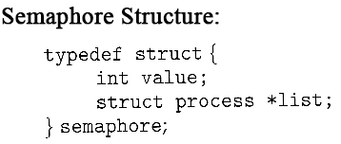
Semaphore Implementation with no Busy waiting (Cont.)
Implementation of wait:
wait (S){
value--;
if (value < 0) {
//add this process to queue
block(); }
}
Implementation of signal:
Signal (S){
value++;
if (value <= 0) {
//remove process P from the queue
wakeup(P); }
}
Value=1//available
Value<=0//in use so
wait in queue
The negative value indicates the number of processer waiting(exclude the one running)

Slide 57
Semaphore Implementation with no Busy waiting (Cont.)
Understanding Wait:
Say you have a printer
Value=1//available
First person to use printer will
Call wait(S) and value now becomes 0. However due to condition
If(value<0) block; the first user is not blocked and uses the printer.
Next user at the end of first line has value=-1 and is blocked.
Hence value =-x indicates that x ppl are waiting.
Vlue>=0 means currently no one is waiting
Implementation of wait:
wait (S){
value--;
if (value < 0) {
//add this process to queue
block(); }
}
Implementation of signal:
Signal (S){
value++;
if (value <= 0) {
//remove process P from the queue
wakeup(P); }
}

Slide 58
Semaphore Implementation with no Busy waiting (Cont.)
Understanding signal
value =-x indicates that x ppl are waiting.
Value>=0 means currently no one is waiting
Signal does a value++ in step 1. Hence in step 2:
Value –x means x+1 ppl are waiting
Value=0 means 1 person is waiting
Value>0 means noone is waiting.
There is no action required if noone is waiting
Thus at value<=0 the first process is woken up
Implementation of wait:
wait (S){
value--;
if (value < 0) {
//add this process to queue
block(); }
}
Implementation of signal:
Signal (S){
value++;
if (value <= 0) {
//remove process P from the queue
wakeup(P); }
}

Slide 59
Semaphore Implementation with no Busy waiting (Cont.)
Signal (S){
value++;
if (value <= 0) {
remove process P from the queue
wakeup(P); }
}
After a process is done, a resource is available. On doing value++, either
value>0 OR value <=0. Note if value=-x, it means x+1 processes’ are waiting
If value >0, it implies that there are no processes waiting so nothing to do.
If value<=0 then there is at least one process waiting. Take one off the wait queue and add it to the ready queue.

Slide 60
Semaphore Implementation w vs w/o Busy waiting
Without busy waiting
wait (S){
value--;
if (value < 0) {
//add this process to queue
block();
}
With busy waiting

Slide 61
Classical Problems of Synchronization
Bounded-Buffer Problem
Readers and Writers Problem
Dining-Philosophers Problem

Slide 62
Readers-Writers Problem
A data set is shared among a number of concurrent processes
  Readers – only read the data set; they do not perform any updates
  Writers – can both read and write.
Problem – allow multiple readers to read at the same time. Only one single writer can access the shared data at the same time.
http://www.cis.upenn.edu/~lee/03cse380/lectures/ln2-ipc-v2.pdf

Slide 63
Constraints
Only one writer writes at a time
If even one reader is reading then, no writing should happen
Multiple readers can read at the same time

Slide 64
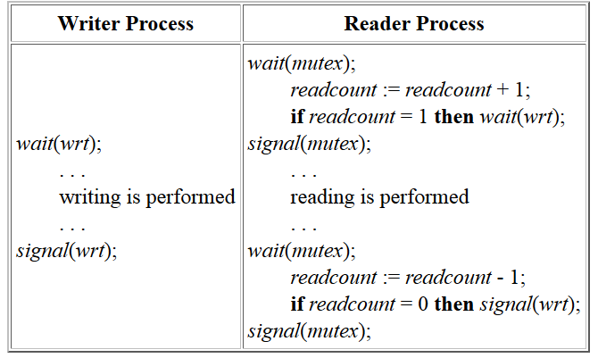
Readers-Writers Problem (Cont.)

Slide 65
Second Readers-Writers Problem
First-readers-writers-problem : Gives preference to readers –no readers will be kept waiting unless writer has got access
Second-readers-writers-problem: Requires writers to be given priority where writers should not be kept waiting. That is, no new reader can gain access if a writer is waiting

Slide 66
Second readers writers
Make sure multiple readers can read
-You hence cant lock the reading part as it restricts another reader reading simultaneously
Make sure more readers don’t join the reading group if a writer expressed interest in writing
-When writer interested lock readers from entering
When a writer writes, no one reads/writes.
-lock while writing
If both reader and writer is waiting, give preference to writer
A)writer should not release lock to reader if another writer is waiting.
B)If first writer is writing, restrict the number of readers who can even show interest so that if a writer enters after first writer relinquishes lock then he does not have to wait for a queue of waiting readers to finish.

Slide 67
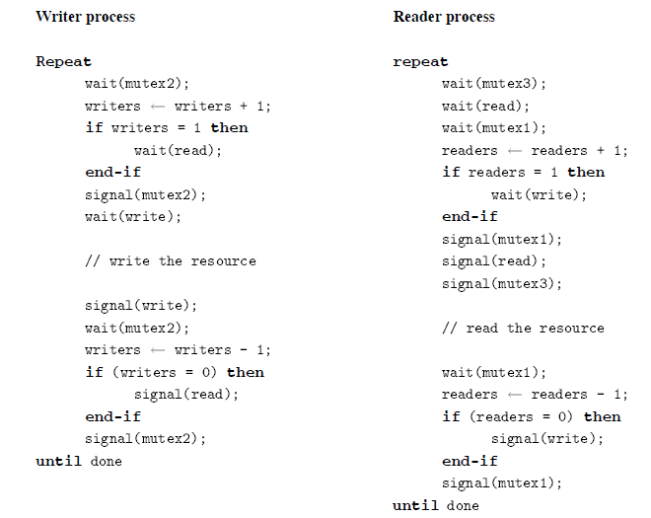
Second Readers-Writers Problem

Slide 68
Mutex 1 and 2 makes sure that reader(writer) increment/decrement is not concurrently attempted by another reader(writer)
Semaphore read: makes sure that reading happens only when writer is not interested in writing. When writer interested then further readers are stopped by wait(read)
Semaphore write: makes sure only one writer writes and no writer writes when someone is still reading
Mutex 3: makes sure that only one reader accummulates when a writer is writing. Other readers even if interested can not join the read queue though they can join mutex3 queue.
Second reader writers problem says that a writer should not be kept waiting.
Say a writer W1 is writing and readers R1,R2,R3,R4 arrive. If writer W2 arrives when W1 is still writing, then all readers wait until W2 is done(semaphore read). If W2 arrives after W1 is over, then W2 waits only for single reader R1 to complete as only R1 joins the read queue(mutex3).

Slide 69
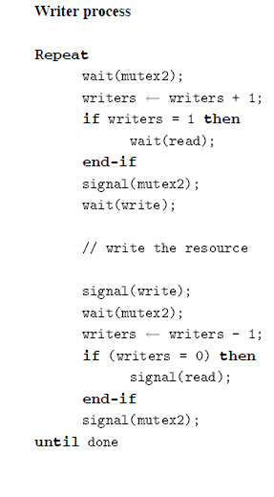
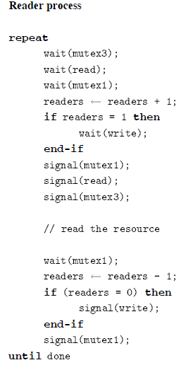
Preference to writer
If more writers join
when one writer is
writing then reader
cant progress as
signal(read) wont
happen unless writer=0.
Meanwhile new writers
will reach uptil
wait(write) even if reader
arrived earlier than the new writers

Slide 70
Preference to writer(2)
Mutex3 limits number of
Waiting readers. Many readers
could otherwise accummulate
making ‘semaphore read’ a
Large negative. If a new writer
joins then he gets stuck in the
Queue until all readers exit
‘Sempahore read’s queue.
However, now atmost one reader
Can accummulate while a writer is
Writing.
Writer starvation could happen in
Case of the busy waiting implementation
Of semaphore.
A reader might always grab the
lock when both a writer and many
Readers are waiting

Slide 71
test
Ok to remove mutex1? Since it is already inside mutex3. Hence two processes wont be contesting for mutex1 anyways.
Can i remove wait(read)? An interesting writer waits at wait(writer)
For the third readers writers problem: Consider that writers code is: “wait(read), wait(write), write, signal(write), signal(read)”.
and readers code is same as 2nd readers writers problem code except that we remove wait and signal mutex3.
Will this work ? If yes are there any inefficiencies. If not, why not?

Slide 72
homework
How would you solve the third readers writers problem.
-Multiple readers can read and only either of read or write can happen. However, order of arrival is given preference.

Slide 73
homework
How would you solve the third readers writers problem.
-Multiple readers can read and only either of read or write can happen. However, order of arrival is given preference.
https://rfc1149.net/blog/2011/01/07/the-third-readers-writers-problem/
http://cs.nyu.edu/~lerner/spring10/MCP-S10-Read04-ReadersWriters.pdf
If writers is “wait(read), wait(write), write, signal(write), signal(read)”
and readers is same except remove wait and signal mutex3
Will this work or not work?

Slide 74
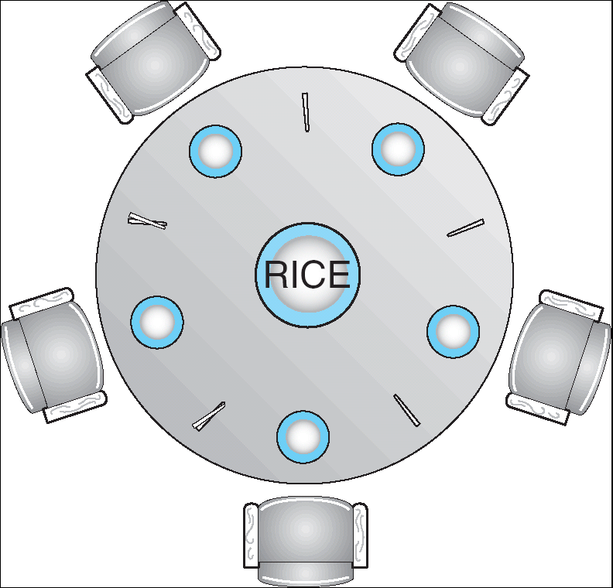
Dining-Philosophers Problem
Shared data
  Bowl of rice (data set)
  Semaphore chopstick [5] initialized to 1

Slide 75
Dining-Philosophers Problem (Cont.)
The structure of Philosopher i:
    Do {
    wait ( chopstick[i] );
    wait ( chopStick[ (i + 1) % 5] );
    // eat
    signal ( chopstick[i] );
    signal (chopstick[ (i + 1) % 5] );
    // think
    } while (true) ;

Slide 76
Dining-Philosophers Problem (Cont.)
The structure of Philosopher i:
    Do {
    wait ( chopstick[i] );
    wait ( chopStick[ (i + 1) % 5] );
    // eat
    signal ( chopstick[i] );
    signal (chopstick[ (i + 1) % 5] );
    // think
    } while (true) ;
Deadlock!- no progress
Each picks
Left fork at same time
And all wait forever

Slide 77
Conductor solution
do
{wait(mutex)
wait(i)
wait((i+1)%5)
signal(mutex)
//eat
signal(i)
signal((i+1)%5)
think
}while(true)

Slide 78
Conductor solution
do
{wait(mutex)
wait(i)
wait((i+1)%5)
signal(mutex)
//eat
signal(i)
signal((i+1)%5)
think
}while(true)
Lets say P1 got both his forks
and is eating.
P2 reaches step 3 after getting
one fork and is waiting for the other
which is being used by P1.
➔P2 is still inside the mutex lock
which does not permit P4 to request forks
though both his forks are idle.
Concurrent execution not
Possible due to mutex lock

Slide 79
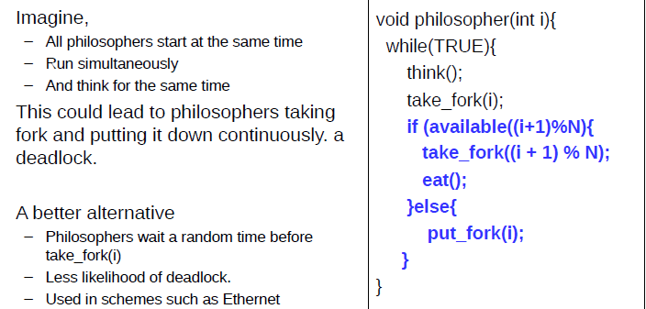
Move with precaution

Slide 80
Move with precaution
All pick fork together to realise other fork is not
available. So all put back fork together. This goees on.

Slide 81
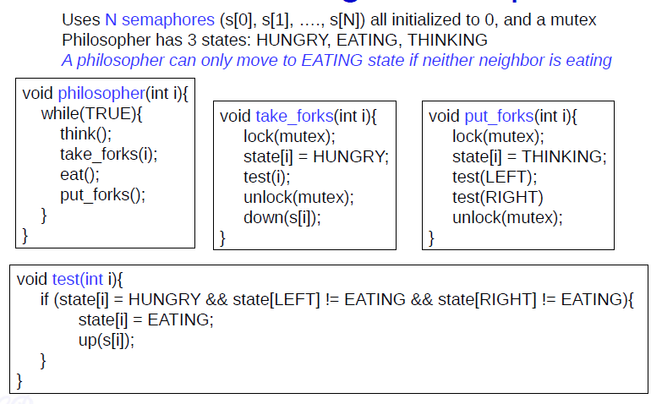
Tannenbaum solution

Slide 82
Done from Robeiro IIT chennais slides (Synchronisation.pdf)
Note on tannebaum solution
Up(fork) is like signal(fork)
Down(fork) is like wait(fork)
wait(fork){ fork --; while (fork <0);}
At take_forks, the i philosopher might be waiting on s[i] if test[i] came out without incrementing s[i]. S[i] will be incremented when i’s neighbor finishes eating and checks if his neighbor i have been waiting.
He then calls test i. At this point test [i] sets S[i] at 1. So the earlier instance that was waiting now succeeds and i enters eating phase.
So philosopher i eats either if his neighbors are not eating or if his neighbor who was eating finished eating and calls test i.

Slide 83
Tannenbaum solution
A philosopher can eat under two conditions
He finds his neighbors not eating so he sets S[i]=1 and this allows him to not block at down(s[i])(same as wait(S[i]). So he goes on to eat
He finds a neighbor eating so exits test[i] with S[i]=0 and thus is kept waiting at wait[S[i]]. For process i to pass the wait statement the value of S[i] should get set as 1. This is done by one of its eating neighbors. Once the neighbor(say i+1) finishes eating, he does a test[i]. If both of i’s neighbors are not eating then S[i] is set to true in the neighbor i+1’s code.
Hence in process i’s code, the process now moves past the wait step and goes on to eat.

Slide 84
Tannenbaum solution-starvation
Imagine that we are trying to starve Philosopher 0. Initially, 2 and 4 are at the table and 1 and 3 are hungry. Imagine that 2 gets up and 1 sits down; then 4 gets up and 3 sits down. Now we are in the mirror image of the starting position.
If 3 gets up and 4 sits down, and then 1 gets up and 2 sits down, we are back where we started. We could repeat the cycle indefinitely and Philosopher 0 would starve.
So, Tanenbaum's solution doesn't satisfy all the requirements.

Slide 85
Chandy Misra solution
For every pair of philosophers contending for a resource, create a fork and give it to the philosopher with the lower ID (n for agent P_{n}). Each fork can either be dirty or clean. Initially, all forks are dirty.
When a philosopher wants to use a set of resources (i.e. eat), he must obtain the forks from his contending neighbors. For all such forks he does not have, he sends a request message.
When a philosopher with a fork receives a request message, he keeps the fork if it is clean, but gives it up when it is dirty. If he sends the fork over, he cleans the fork before doing so.
After a philosopher is done eating, all his forks become dirty. If another philosopher had previously requested one of the forks, he cleans the fork and sends it.
https://ycpcs.github.io/cs420-fall2017/lectures/lecture12_classic_synchronization_problems.pdf

Slide 86
Rules
Initially forks dirty
After eating forks dirty
If someone had requested for your fork when you were eating, then clean and give it after you finish eating
If you have both forks start eating
I need to give a fork on request only if its dirty. I clean it and give it. If the fork is clean it means I have requested and got it and have not eaten yet. In such a case I do not give it up.
Initially the one with lower id gets preference. So if P1 requests forks initially, then he will get both forks. Deadlock situation wont arise.
Starvation wont arise since a philosopher who has eaten has to wait if his neighbors have requested for fork.

Slide 87
Solution discussion
Initially P1 has both forks, P5 has none and rest have one each.
If P2 requests, then P1 has to give it as his forks are dirty. He cleans and gives it to P2. However, before P2 starts eating if P3 requests, then P2 need not give his left fork which is clean but has to give his right fork which is dirty. He cleans and gives it to P3.
Thus a philospher whose neighbors are not wanting to eat gets the fork. If a neighbor wants to eat, he can request a fork that is not got by requesting. A clean fork(fork obtained via request and not used for eating yet) that the neighbor holds can be got only after neighbor has finished his meal which will turn the fork dirty.

Slide 88
1 hungry
3 hungry
5 hungry
3 finishes
2 hungry
3 hungry
What will be the sequence of forks changing hands?

Slide 89
homework
More solutions
--if a philosopher is hungry then check that both neighbors are not eating. Get the forks and eat. Before dropping the forks check if a neighbor is hungry and pass on fork.
--allow only 4 philosphers to eat at once.
-- resource hierarchy
--chandy misra solution

Slide 90
MONITORS

Slide 91
Problems with Semaphores
Correct use of semaphore operations:
  signal (mutex) …. wait (mutex)
  wait (mutex) … wait (mutex)
  Omitting of wait (mutex) or signal (mutex) (or both)

Slide 92
Monitors
A high-level abstraction that provides a convenient and effective mechanism for process synchronization
Only one process may be active within the monitor at a time
    monitor monitor-name
    {
    // shared variable declarations
    procedure P1 (…) { …. }
    …
    procedure Pn (…) {……}
    Initialization code ( ….) { … }
    …
    }
    }

Slide 93

Schematic view of a Monitor

Slide 94
Condition Variables
condition x, y;
Two operations on a condition variable:
  x.wait () – a process that invokes the operation is
  suspended.
  x.signal () – resumes one of processes (if any) tha
  invoked x.wait ()

Slide 95

Monitor with Condition Variables

Slide 96
Solution to Dining Philosophers
monitor DP
{
enum { THINKING; HUNGRY, EATING) state [5] ;
condition self [5];
void pickup (int i) {
state[i] = HUNGRY;
test(i);
if (state[i] != EATING) self [i].wait;
}
void putdown (int i) {
state[i] = THINKING;
// test left and right neighbors
test((i + 4) % 5);
test((i + 1) % 5);
}

Slide 97
Solution to Dining Philosophers (cont)
void test (int i) {
if ( (state[(i + 4) % 5] != EATING) &&
(state[i] == HUNGRY) &&
(state[(i + 1) % 5] != EATING) ) {
state[i] = EATING ;
self[i].signal () ;
}
}
initialization_code() {
for (int i = 0; i < 5; i++)
state[i] = THINKING;
}
}

Slide 98
Deadlock and Starvation
Deadlock – two or more processes are waiting indefinitely for an event that can be caused by only one of the waiting processes
Let S and Q be two semaphores initialized to 1
P₀ P₁
wait (S); wait (Q);
wait (Q); wait (S);
. .
. .
. .
signal (S); signal (Q);
signal (Q); signal (S);
Starvation – indefinite blocking. A process may never
be removed from the semaphore queue in which it is suspended.

Slide 99
Dining philosophers https://www.youtube.com/watch?v=rCiQc3ife90
http://c2.com/cgi/wiki?DiningPhilosophers

Slide 100
Clarity needed
Why not remove wait mutex1 and signal mutex1 in readers writers problem 2 on the top part(before reading) and keep it only in the bottom part(after reading). since wait read and signal read will make sure that only one reader is working on that code at one point in time— ???
Can i remove mutex 3 and replace as wait(mutex1), wait(read) so that only one reader enters when a writer is writing – wont work since mutex1 is used at the end part of reader code as well so you cant have new readers and readers who are done reading waiting on the same queue
In tannenbaum solution can I remove “if(state[i]= hungry) condition that is inside test[i] ? No as test[i] can be called by process i+1 or process i-1 in which case state[i] may or may not be hungry.
http://gateoverflow.in/3498/gate2007-it-56
http://gateoverflow.in/150943/process-synchronization

Slide 101
Petersons not guaranteed to work!
Modern CPUs pre-fetch memory operations and post writes to internal buffers. So there is no guarantee that a write on one CPU will become visible on another CPU immediately, nor that writes that occur in a particular order will be seen in that order on another CPU.
That may cause early entering into the critical section (while it's still in use by another thread) and early exiting from the critical section (when the work with the shared resource hasn't been finished yet).
For this reason one needs to ensure that the order of events occurring inside the CPU is seen the same outside. Memory barriers can ensure this serialization.

