Slide 1
Semaphore
Synchronization tool that does not require busy waiting if implemented along with an associated queue where process is queue is woken up when resoure is available.
Semaphore S – integer variable
Two standard operations modify S: wait() and signal()
  Originally called P() and V()
Less complicated
Can only be accessed via two indivisible (atomic) operations
  wait (S) {
  while S <= 0
  ; // no-op
  S--;
  }
  signal (S) {
  S++;
  }

Slide 2
Advantage of Semaphore
It's simple and always have a non-negative starting Integer value.
Works with many processes.
Can have many different critical sections with different semaphores. Each critical section has unique access semaphores.
Can permit multiple processes into the critical section at once, if desirable

Slide 3
Semaphore as General Synchronization Tool
Counting semaphore – integer value can range over an unrestricted domain. Example: indicate number of commodities in market.
Binary semaphore – integer value can range only between 0
and 1; can be simpler to implement
  Also known as mutex locks
Can implement a counting semaphore S as a binary semaphore

Slide 4
Mutual Exclusion
Semaphore S=1;
  { wait (S);
  Critical Section
  signal (S);
}
  wait (S) {
  while S <= 0
  ; // no-op
  S--;
  }
  signal (S) {
  S++;
  }

Slide 5
Producer Consumer naïve
- for one producer and one consumer
PRODUCER
send(char c)
{
buf[in]=c
in=(in+1)%N
}
CONSUMER
char rcv()
{ char c;
c=buf[out];
out=(out+1)%N;
return c;
}
/*the buffer*/
Char buf[N];
In =0; out =0;
Need to add below constraints
-Consumer consumes only if atleast one element in buffer
-Producer produces if buffer not full

Slide 6
consume when buffer not empty
PRODUCER
send(char c)
{
buf[in]=c
in=(in+1)%N
signal(chars)
}
CONSUMER
char rcv()
{ char c;
wait(chars);
c=buf[out];
out=(out+1)%N;
return c;
}
/*the buffer*/
Char buf[N];
In =0; out =0;
Semaphore chars=0;

Slide 7
Produce when buffer not full
PRODUCER
send(char c)
{
wait(space);
buf[in]=c
in=(in+1)%N
signal(chars)
}
CONSUMER
char rcv()
{ char c;
wait(chars);
c=buf[out];
out=(out+1)%N;
signal(space);
return c;
}
/*the buffer*/
Char buf[N];
In =0; out =0;
Semaphore chars=0, space =N;
consumer produces a space!

Slide 8
Multiple Producers and one consumer
PRODUCER
send(char c)
{
wait(space);
wait(lock);
buf[in]=c
in=(in+1)%N
signal(lock);
signal(chars)
}
CONSUMER
char rcv()
{ char c;
wait(chars);
c=buf[out];
out=(out+1)%N;
signal(space);
return c;
}
Will two producers
find single space
left in line 1
and both write
into the single
space left?
/*the buffer*/
Char buf[N];
In =0; out =0;
Semaphore chars=0, space =N, lock=1, ;

Slide 9
Multiple Producers and consumers
Modify the code
to now work for
simultaneous
working of producer
and consumer
CONSUMER
char rcv()
{ char c;
wait(chars);
wait(lock);
c=buf[out];
out=(out+1)%N;
signal(lock); signal(space); return c;
}
PRODUCER
send(char c)
{
wait(space);
wait(lock);
buf[in]=c
in=(in+1)%N
signal(lock)
signal(chars);
}
/*the buffer*/
Char buf[N];
In =0; out =0;
Semaphore chars=0, space =N, lock=1;

Slide 10
Counting Semaphores
Can Semaphores be used to allow processes to use multipe copies of an available resource. Eg: 5 printers available to a set of processes.
Say you have a limited number of resources..eg:5 printers. How would you design a users code using semaphores.
If all 5 in use then user cant print. If at least one available then user can use it.

Slide 11
Say you have a limited number of resources..eg:5 printers. How do design a users code using semaphores.
Semaphore P=5;
user(..)
{wait(P);
......
Signal(P);
}

Slide 12
Semaphore Implementation
The big problem with semaphores as described till now is the busy loop in the wait call, which consumes CPU cycles without doing any useful work. This type of lock is known as a spinlock
  An alternative approach:
  -Block a process if waiting and swap it out of the CPU.
  -Each semaphore needs to maintain a list of processes that are blocked waiting for it
  -One of the processes is woken up and swapped back when the semaphore becomes available.

Slide 13
Semaphore Implementation with no Busy waiting
With each semaphore there is an associated waiting queue. Each entry in a waiting queue has two data items:
  value (of type integer)
  pointer to next record in the list
Two operations :
  block – place the process invoking the operation on the appropriate waiting queue.
  wakeup – remove one of processes in the waiting queue and place it in the ready queue.

Slide 14
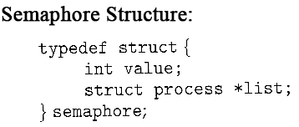
Semaphore Implementation with no Busy waiting (Cont.)
Implementation of wait:
wait (S){
value--;
if (value < 0) {
//add this process to queue
block(); }
}
Implementation of signal:
Signal (S){
value++;
if (value <= 0) {
//remove process P from the queue
wakeup(P); }
}
Value=1//available
Value<=0//in use so
wait in queue
The negative value indicates the number of processer waiting(exclude the one running)

Slide 15
Classical Problems of Synchronization
Bounded-Buffer Problem
Readers and Writers Problem
Dining-Philosophers Problem

Slide 16
Readers-Writers Problem
A data set is shared among a number of concurrent processes
  Readers – only read the data set; they do not perform any updates
  Writers – can both read and write.
Problem – allow multiple readers to read at the same time. Only one single writer can access the shared data at the same time.
http://www.cis.upenn.edu/~lee/03cse380/lectures/ln2-ipc-v2.pdf

Slide 17
Constraints
Only one writer writes at a time
If even one reader is reading then, no writing should happen
Multiple readers can read at the same time

Slide 18
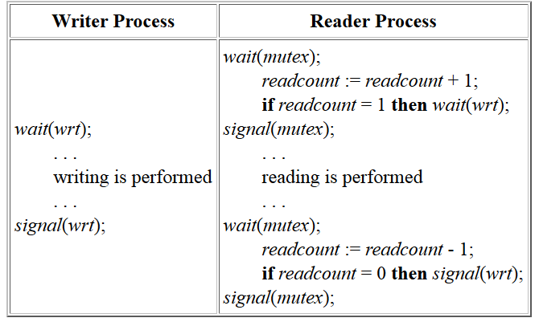
Readers-Writers Problem (Cont.)

Slide 19
Second Readers-Writers Problem
First-readers-writers-problem : Gives preference to readers –no readers will be kept waiting unless writer has got access
Second-readers-writers-problem: Requires writers to be given priority where writers should not be kept waiting. That is, no new reader can gain access if a writer is waiting

Slide 20
Second readers writers
Make sure multiple readers can read
-You hence cant lock the reading part as it restricts another reader reading simultaneously
Make sure more readers don’t join the reading group if a writer expressed interest in writing
-When writer interested lock readers from entering
When a writer writes, no one reads/writes.
-lock while writing
If both reader and writer is waiting, give preference to writer
A)writer should not release lock to reader if another writer is waiting.
B)If first writer is writing, restrict the number of readers who can even show interest so that if a writer enters after first writer relinquishes lock then he does not have to wait for a queue of waiting readers to finish.

Slide 21
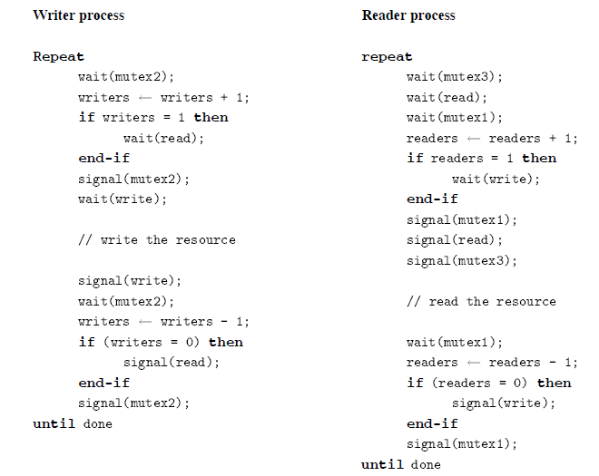
Second Readers-Writers Problem

Slide 22
Mutex 1 and 2 makes sure that reader(writer) increment/decrement is not concurrently attempted by another reader(writer)
Semaphore read: makes sure that reading happens only when writer is not interested in writing. When writer interested then further readers are stopped by wait(read)
Semaphore write: makes sure only one writer writes and no writer writes when someone is still reading
Mutex 3: makes sure that only one reader accummulates when a writer is writing. Other readers even if interested can not join the read queue though they can join mutex3 queue.
Second reader writers problem says that a writer should not be kept waiting.
Say a writer W1 is writing and readers R1,R2,R3,R4 arrive. If writer W2 arrives when W1 is still writing, then all readers wait until W2 is done(semaphore read). If W2 arrives after W1 is over, then W2 waits only for single reader R1 to complete as only R1 joins the read queue(mutex3).

