Slide 1
Deep Learning for Biomedical Science · Group Project
Twelve to One
Lead-robust deep learning for multi-label ECG diagnosis and wearable triage on PTB-XL
PTB-XL v1.0.3 · 21,388 ECGs · 6 lead sets · 3 architectures · 4 training strategies · external validation on 34,815 ECGs
Presented by
[Author names, Matric No.]
BS6204 · Nanyang Technological University · October 2026
Notes:
Good morning. Our project asks a simple question: a hospital ECG has twelve leads, a smartwatch has one. How much of a deep model's diagnostic ability survives when we go from twelve leads to one, and which diagnoses could a wearable still screen for?

Slide 2
PROBLEM & MOTIVATION
Diagnosis needs 12 leads; a smartwatch has one
Where the ECG sits
Why it matters
1
Clinic: 12 leads
twelve views of the heart; the basis for infarction, ST/T change, conduction block, hypertrophy
19.8 M
2
deaths from cardiovascular disease in 2022, about 32% of all deaths [1]
Wrist: lead I only
proven for rhythm such as atrial fibrillation, which can be read in any lead
A wearable that could screen would decide who needs a 12-lead ECG; one that cannot gives false reassurance.
3
The gap
structural and ischaemic diagnoses depend on spatial information a single lead may not carry
Key point. The question is not how accurate lead I is on average, but which diagnoses survive the step from twelve leads to one.
[1] WHO, Cardiovascular diseases fact sheet (2025)
2
Notes:
Cardiovascular disease is the leading cause of death, about 19.8 million deaths in 2022. The clinical 12-lead ECG gives twelve views of the heart; diagnoses like infarction or hypertrophy rely on that. A smartwatch records only lead I. It works well for rhythm, because rhythm can be read in any lead. For structural and ischaemic diagnoses it is unknown. So the real question is which diagnoses survive the step from twelve leads to one.

Slide 3
RESEARCH QUESTIONS
Three questions and one rule fixed in advance
RQ1
RQ2
RQ3
Screen rule
Which architecture works best on 12 leads, and how far ahead of traditional baselines?
How much is lost as leads are removed, and which diagnoses can a reduced set still screen for?
Does it hold for triage, under noise, with fewer labels, and in another hospital?
A reduced lead set can replace 12 leads for a diagnosis only if both hold:
1 95% CI lower bound of ΔAUROC ≥ −0.02
2 sensitivity ≥ 0.80 at 90% specificity
one met: conditional · none: not replaceable
Key point. An average AUROC cannot say whether a lead set can replace 12 leads; a rule written before seeing the results can.
Twelve to One · BS6204
3
Notes:
We asked three questions. RQ1: which architecture is best on 12 leads, and how big is the gap to classical baselines. RQ2, the core: how much is lost as leads are removed, and which diagnoses can still be screened. RQ3: does it hold for triage, noise, fewer labels and another hospital. Before seeing any reduced-lead result we fixed a screen rule: the AUROC drop must be non-inferior, its confidence-interval lower bound above minus 0.02, and sensitivity must reach 0.80 at 90 percent specificity.

Slide 4
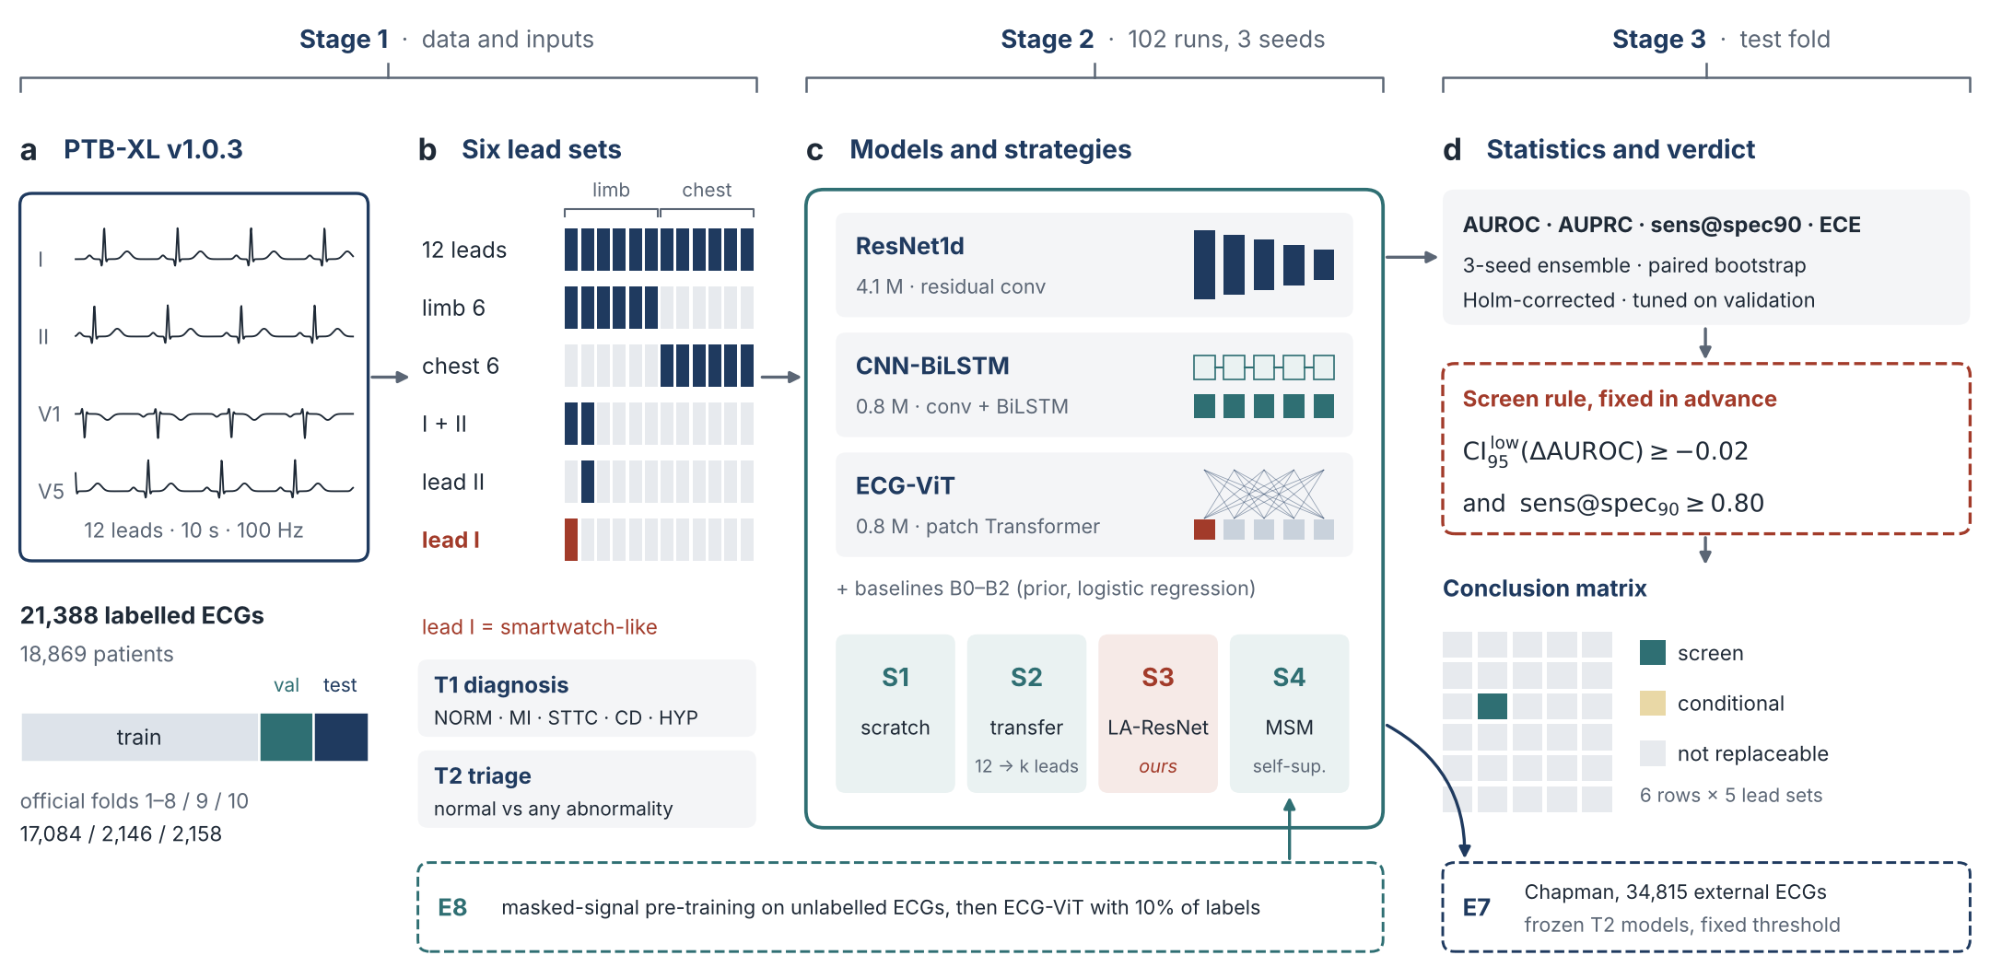
STUDY DESIGN
One protocol from raw ECG to verdict
Figure 1. Study design. Every model shares one training recipe and three seeds. Test-fold metrics feed a screen rule written before any result; E7 reports external metrics only and does not enter the rule.
Twelve to One · BS6204
4
Notes:
This is the whole pipeline in four panels. a: PTB-XL with the official patient-level folds. b: six lead sets from twelve leads down to lead I, the smartwatch-like lead. c: three architectures with different inductive biases and four training strategies, including our lead-agnostic LA-ResNet. All 102 runs share one recipe and three seeds. d: test metrics, paired bootstrap with Holm correction, and the screen rule that produces the conclusion matrix. Two branches: self-supervised pre-training with ten percent labels, and external validation on 34,815 ECGs from another hospital.

Slide 5
DATA, TASKS & MODELS
Same data and recipe, three inductive biases
21,388
6
102
34,815
labelled PTB-XL ECGs
lead sets, 12 → I
training runs, 3 seeds
external Chapman ECGs
Tasks
Architectures
Strategies
T1 five superclasses, multi-label: NORM, MI, STTC, CD, HYP
T2 triage: normal vs any abnormality
ResNet1d local morphology, 4.1 M
CNN-BiLSTM beat-to-beat sequence, 0.8 M
ECG-ViT global attention over 200 ms patches, 0.8 M
S1 scratch · S2 transfer from 12 leads
S3 LA-ResNet (ours): signal + lead mask, one model for all sets
S4 masked-signal pre-training
official patient-level folds 17,084 / 2,146 / 2,158
Twelve to One · BS6204
5
Notes:
The numbers: 21,388 labelled PTB-XL ECGs, six lead sets, 102 training runs with three seeds, and 34,815 external ECGs. Two tasks: five-class multi-label diagnosis and normal-versus-abnormal triage. Three architectures with different inductive biases: a residual CNN for local morphology, a CNN-BiLSTM for beat-to-beat sequence, and a Vision Transformer with global attention. Four strategies: scratch, transfer from the 12-lead model, our LA-ResNet that takes a lead mask so one model handles every lead set, and masked-signal self-supervised pre-training.

Slide 6
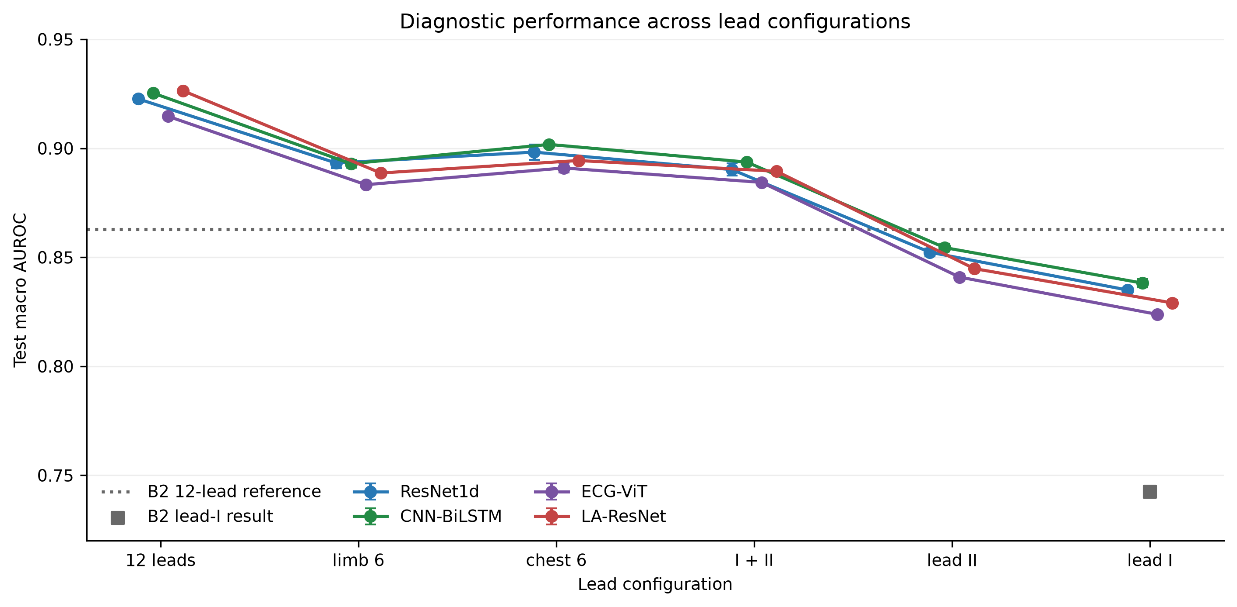
RESULTS · RQ1 & RQ2
Twelve to one costs 0.09 AUROC
How to read it
0.92
all three models on 12 leads, matching the PTB-XL benchmark (0.921–0.930); B2 features 0.86
−0.090
12 leads → lead I (ResNet1d ensemble, 95% CI 0.081–0.100)
Six or two leads cost 0.02–0.03; the big step is to a single lead.
Key point. Every architecture follows the same curve, so the loss comes from the input, not from the model choice.
Mean ± SD over 3 seeds; paired bootstrap, Holm-corrected
6
Notes:
On 12 leads all three models reach about 0.92 macro AUROC, matching the published PTB-XL benchmark, and clearly beat the traditional feature baseline at 0.86. ResNet and CNN-BiLSTM are statistically tied; the Transformer is slightly lower. Six or two leads cost 0.02 to 0.03. The big step is to a single lead: lead I loses 0.09 AUROC, with a confidence interval from 0.08 to 0.10. Every architecture follows the same curve, so the loss comes from the input, not from the model.

Slide 7
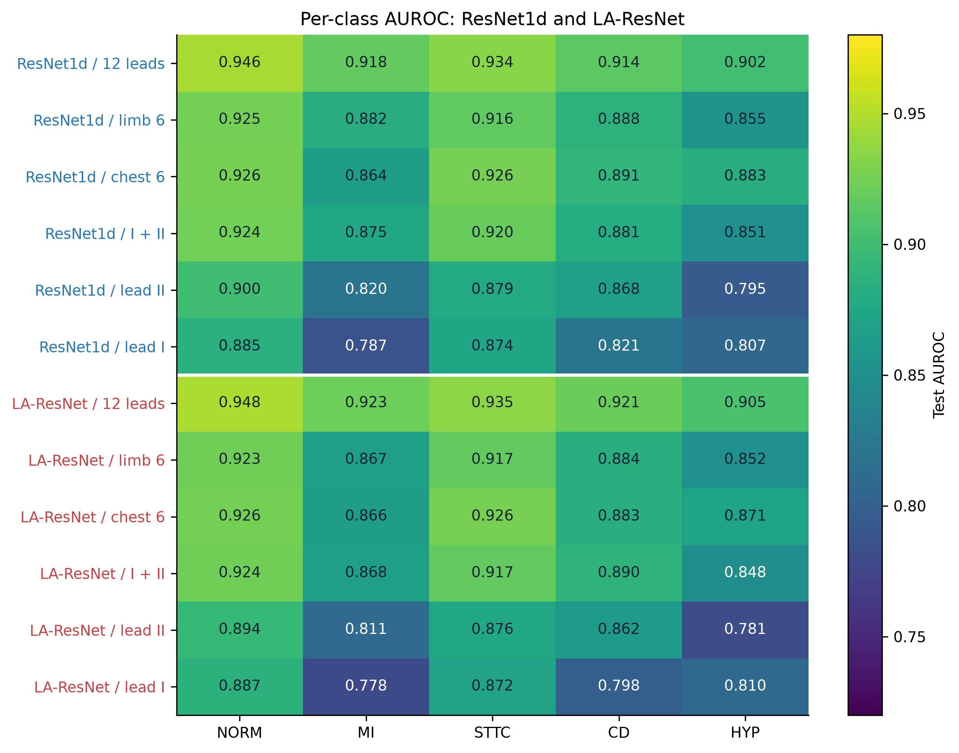
RESULTS · RQ2
Infarction loses most, ST/T change least
1
MI: 0.918 → 0.787 with lead I
inferior (II, III, aVF) and anterior (V1–V4) changes lie mostly outside lead I
2
STTC: 0.926 with chest leads only
almost the 12-lead value of 0.934
3
HYP: chest 0.883 vs limb 0.855
hypertrophy criteria rely on precordial voltages
Key point. The average hides very different losses per diagnosis; anatomy explains the pattern, though we did not test it directly.
ResNet1d values, mean over 3 seeds
7
Notes:
The average hides very different stories per diagnosis. Myocardial infarction suffers most: with lead I its AUROC drops from 0.92 to 0.79. That fits anatomy: inferior infarcts show in II, III and aVF, anterior ones in V1 to V4, which lead I does not see. ST/T changes survive with the six chest leads almost unchanged. Hypertrophy is better preserved by chest leads than by limb leads, consistent with precordial voltage criteria. These are plausible explanations, not something we tested.

Slide 8
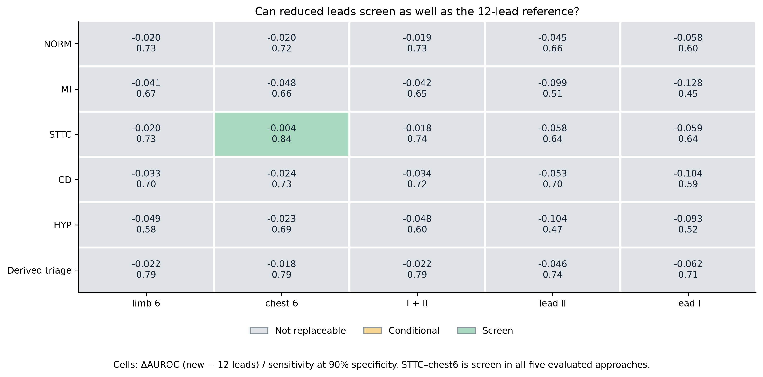
RESULTS · RQ2 · CONCLUSION MATRIX
Only one cell can replace twelve leads
29 / 30
cells not replaceable
STTC
with chest leads: screen in all 5 approaches
0
diagnoses screenable from lead I
Key point. Lead I fails even on non-inferiority (MI ΔAUROC −0.128); a margin of 0.01 or 0.03 adds no screen cell.
Primary approach CNN-BiLSTM, chosen on validation · cells: ΔAUROC / sensitivity at 90% specificity
8
Notes:
This is our main result. We apply the pre-specified rule to every diagnosis and lead set. Of 30 cells, 29 are not replaceable. The only one that passes is ST/T change with the six chest leads: the AUROC drop is 0.004 and sensitivity is 0.84. This holds for all five approaches, so it is not an artefact of picking one model. With lead I, nothing passes; myocardial infarction is worst, minus 0.13, with sensitivity 0.45. A stricter or looser margin creates no new screen cell. The rule is demanding: even the 12-lead model reaches only about 0.74 sensitivity for MI.

Slide 9
RESULTS · TRAINING STRATEGIES
Transfer does not recover the loss
ΔAUROC vs dedicated ResNet1d (seed ensemble)
S3 LA-RESNET (OURS)
Lead set | S2 fine-tune | S3 LA-ResNet | Holm p (S3)
limb 6 | −0.0003 | −0.0044 | 0.064
chest 6 | +0.0022 | −0.0054 | 0.018
I + II | +0.0011 | −0.0033 | 0.462
lead II | −0.0017 | −0.0095 | < 0.001
lead I | −0.0023 | −0.0080 | < 0.001
One model, six lead sets
Input = 12 leads with missing ones zeroed + a 12-channel lead mask.
12 leads: 0.926 vs 0.923 dedicated. Reduced sets: 0.003–0.010 lower.
S2 fine-tune: no comparison significant after Holm (adjusted p 0.73–1.00). S2 frozen, lead I: −0.0078.
Key point. Training tricks do not bring back information; LA-ResNet trades a small loss for one deployable model.
Paired seed-ensemble bootstrap; Holm correction over 29 comparisons
9
Notes:
Can training tricks win the loss back? Transfer from the 12-lead model barely moves AUROC, at most 0.002 either way, and nothing is significant after correction. Freezing the backbone is worse. Our LA-ResNet takes the lead mask as input, so one set of weights serves all six lead sets. On 12 leads it is as good as the dedicated model; on reduced sets it pays 0.003 to 0.010, significant for chest 6, lead II and lead I. For a device whose available leads vary, that is an attractive trade.

Slide 10
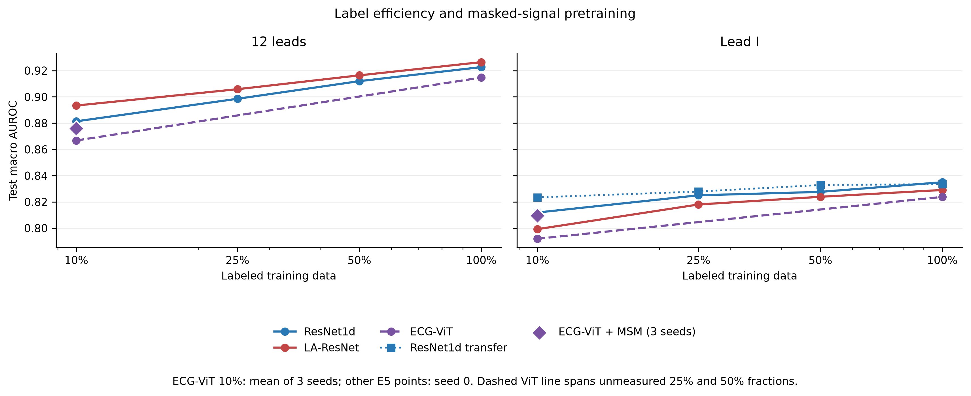
RESULTS · RQ3 · LABELS, PRE-TRAINING, NOISE
The bottleneck is information, not data
10× labels: +0.023
Self-supervised: +0.015
Noise flips the ranking
on lead I; 12 leads with 10% of labels (0.881) beat lead I with all (0.835)
ECG-ViT, lead I, 10% labels (95% CI +0.009 to +0.021); levels with ResNet1d, does not beat it
lead I at 0 dB: ResNet1d 0.759, CNN-BiLSTM 0.686 (clean: 0.835 vs 0.838)
Label-efficiency points seed 0; ECG-ViT 10% points mean of 3 seeds
10
Notes:
Is lead I just short of data? No. Going from 10 to 100 percent of the labels gains only 0.023 on lead I, and a 12-lead model trained on 10 percent of the labels still beats a lead-I model trained on all of them. So the limit is the information in one lead. Self-supervised masked-signal pre-training helps the Transformer when labels are scarce, plus 0.015 on lead I, though it only brings it level with the CNN. And under severe noise the ranking changes: at 0 dB ResNet keeps 0.76 while CNN-BiLSTM drops to 0.69.

Slide 11
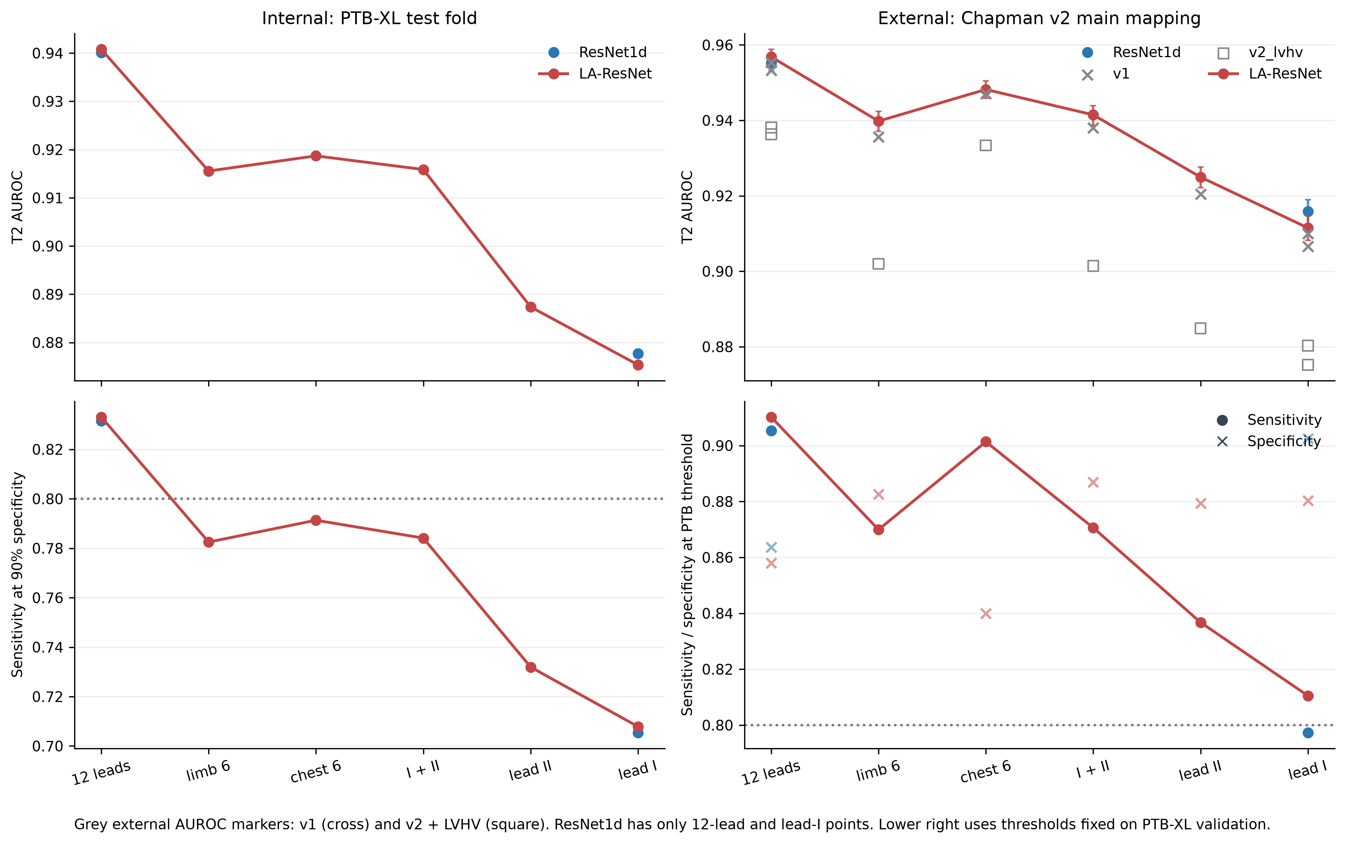
RESULTS · RQ3 · TRIAGE AND EXTERNAL HOSPITAL
Triage travels; thresholds need recalibration
1
Lead I triage: AUROC 0.88
sensitivity 0.71 at 90% specificity, below the 0.80 needed to screen
2
Chapman, 34,815 ECGs
frozen models 0.955 (12 leads) and 0.916 (lead I); 0.936–0.957 and 0.875–0.916 across label mappings
3
Thresholds shift
PTB-XL thresholds gave 86–90% external specificity
Key point. Higher external AUROC reflects a stricter external label set, not better generalisation; deployment needs local calibration.
External target: strict sinus-rhythm negatives, mapped diagnoses only (v2 mapping)
11
Notes:
Triage is the realistic use for a wearable. With lead I, normal versus abnormal reaches AUROC 0.88, but sensitivity at 90 percent specificity is 0.71, short of a stand-alone screen. We ran the frozen models, without retraining, on 34,815 records from a hospital in China. Discrimination held: 0.955 with 12 leads and 0.916 with lead I. We do not claim better generalisation: the external label set is stricter, and when borderline voltage-only findings count as abnormal the values fall back to the internal level. Thresholds also shifted, so deployment would need local calibration.

Slide 12
CONCLUSION
Twelve to one is too far for diagnosis
1
A rule, not an average
2
One model, six lead sets
pre-specified screen rule per diagnosis: 29 of 30 cells fail; only STTC with chest leads passes
LA-ResNet with lead masks costs only 0.003–0.010 AUROC
3
Information is the bottleneck
4
Limitations and next steps
transfer and 10× labels barely help lead I; self-supervision helps the Transformer
clinical lead I, not a watch; one training set at 100 Hz; synthetic noise. Next: paired watch and 12-lead recordings
Key point. A single lead can support triage, but cannot replace the 12-lead ECG for these five diagnoses.
Thank you · questions welcome
12
Notes:
To conclude: twelve to one is too far for diagnosis. First, judged by a rule fixed in advance rather than an average, 29 of 30 cells fail and only ST/T change with chest leads passes. Second, one lead-agnostic model serves six lead sets at a small cost. Third, the bottleneck is information: transfer and ten times more labels barely help lead I. Limitations: our lead I comes from clinical recordings, we trained on one dataset at 100 Hz, and the noise was synthetic. Next we would test paired watch and 12-lead recordings. A single lead can support triage, but cannot replace the 12-lead ECG. Thank you.

Slide 13
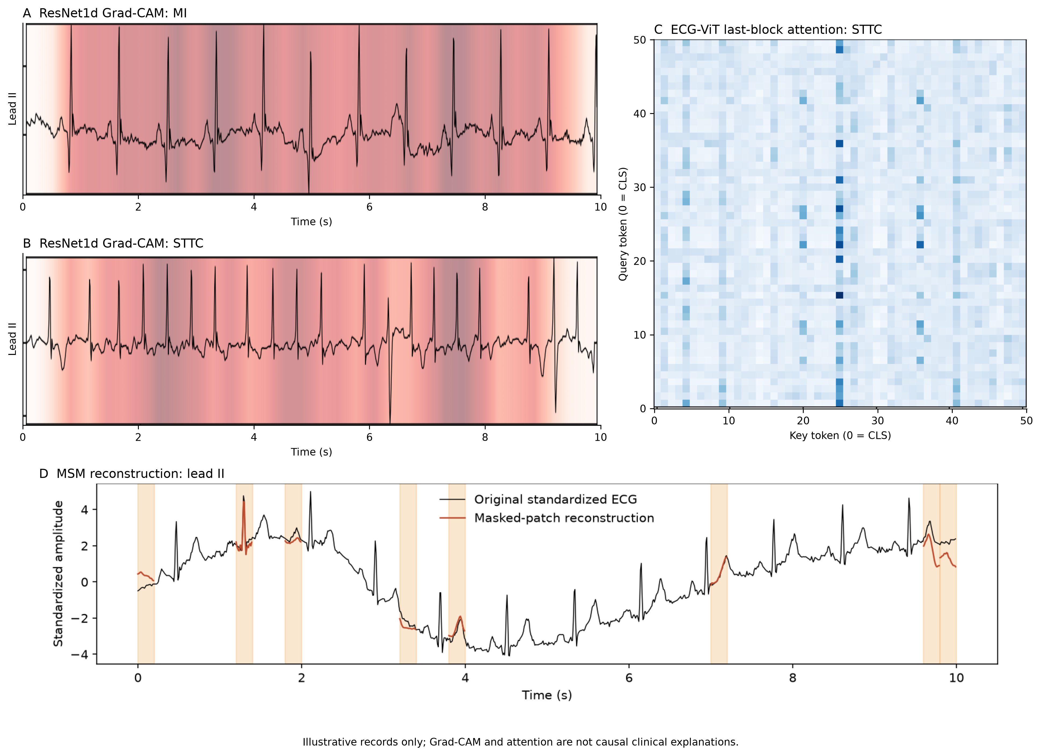
BACKUP · INTERPRETABILITY
What the models look at, with caveats
Grad-CAM is coarse
receptive field 1,291 samples > input 1,000, so maps mark broad regions, not single waves
Attention stripe
one key token draws most attention: likely an attention sink, not physiology
Illustrative only
not causal clinical explanations
Backup · Grad-CAM (L8), hand-written attention (L6–L7)
13
Notes:
Backup slide for interpretability questions. Grad-CAM of the ResNet is broad because its receptive field is longer than the whole recording, so it shows regions rather than single waves. The Transformer's last-block attention has a strong stripe on one token, which looks like an attention sink. We present these only as illustrations, not clinical explanations.

Slide 14
BACKUP · QUESTIONS
Likely questions, short answers
Question | Short answer
Is the screen rule arbitrary? | Fixed before results; margins 0.01 and 0.03 add no screen cell
Why CNN-BiLSTM as primary? | Chosen on validation (0.0001 ahead); STTC-chest6 passes in all 5 approaches
Any data leakage? | Official patient-level folds; scaler, thresholds and temperature from train/val only
Why is external AUROC higher? | Stricter external labels and a different case mix; with LVHV it falls to the internal level
Why did B1 fail? | Raw time samples are not aligned across records; shift-invariant B2 reaches 0.863
Why 100 Hz? | PTB-XL benchmark setting; keeps 100+ runs feasible on one GPU
Backup · full numbers in the report
14
Notes:
Backup slide with short answers to the questions we expect.

