Slide 1

Lesson 7
Fragments
Victor Matos
Cleveland State University
Portions of this page are reproduced from work created and shared by Google and used according to terms
described in the Creative Commons 3.0 Attribution License.

Slide 2
Fragments
Android is a multitasking OS and its hardware specs allow for real parallelism. However, at any given time only one activity per app can be ‘visible’ and ‘active’. This fact is rather limiting considering the extensive screen area offered by larger devices (tablets, phablets, TV sets, etc). Fragments offer an escape solution.
The Fragment class produces visual objects that can be dynamically attached to designated portions of the app’s GUI. Each fragment object can expose its own views and provide means for the users to interact with the application.
Fragments must exist within the boundaries of an Activity that acts as a ‘home-base’ or host.
A host activity’s GUI may expose any number of fragments. In this GUI each fragment could be visible and active.
6 - 2

Slide 3
Fragments
Fragments behave as independent threads, usually they cooperate in achieving a common goal; however each can run its own I/O, events and business logic.
Fragments could access ‘global data’ held in the main activity to which they belong. Likewise, they could send values of their own to the main activity for potential dissemination to other fragments.
Fragments have their own particular Life-Cycle, in which the onCreateView method does most of the work needed to make them.
Fragments were first introduced in the Honeycomb SDK (API 11).
6 - 3

Slide 4
Fragments
ACTIVITY (Main Host Container)
Fragment1 (View 1)
Fragment3
(View 3)
Fragment2 (View 2)
A possible arrangement of Fragments attached to the main GUI of an app.
6 - 4

Slide 5
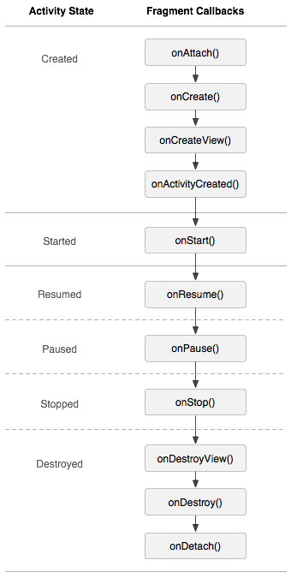
Fragment’s Lifecycle
onAttach() Invoked when the fragment has been connected to the host activity.
onCreate() Used for initializing non-visual components needed by the fragment.
onCreateView() Most of the work is done here. Called to create the view hierarchy representing the fragment. Usually inflates a layout, defines listeners, and populates the widgets in the inflated layout.
onPause() The session is about to finish. Here you should commit state data changes that are needed in case the fragment is re-executed.
onDetach() Called when the inactive fragment is disconnected from the activity.
6 - 5

Slide 6
Fragments
Inter-Fragment Communication
All Fragment-to-Fragment communication is done in a centralized mode through the home-base Activity.
As a design principle; two Fragments should NEVER communicate directly.
The home-base Activity and its fragments interact through listeners and events.
When a fragment has some data for another fragment, it sends it to a listener in the main which in turn dispatches to a listener of the second fragment.
Activity
Listener(s) & Dispatcher(s)
Fragment1 Event-send-msg Event-receive-msg
Fragment2
Event-send-msg Event-receive-msg
6 - 6

Slide 7
Fragments
Integrating the Home Activity and its Fragments
In general fragments appear on their enclosing Activity’s GUI using one of the following attachment approaches
Dynamic Binding
The main activity defines a particular place on its GUI for fragments to be plugged in (or attached). Occupancy of designated areas is not permanent. Later on, the hosting Activity may replace a fragment with another (see Example-1)
Static Binding
The Activity’s GUI declares a portion of its layout as a <fragment> and explicitly supplies a reference to the first type of fragment to be held there using the “android:name=fragmentName” clause. This simple association does not required you to call the constructors (or pass initial parameters). A static binding is permanent, fragments cannot be replaced at run time (see Example-2)
Multiple Fragments
The hosting activity may simultaneously expose any number of fragments using a combination of the strategies describe above. Fragments may interact with each other using the enclosing activity as a central store-and-forward unit (Example-3).
6 - 7

Slide 8
Fragments
Fragment-Activity: Dynamic Binding
Fragments must be created inside a secure FragmentTransaction block.
You may use the method add() to aggregate a fragment to the activity. Optionally any view produced by the fragment is moved into an UI container of the host activity.
When you use the replace method to refresh the UI, the current view in the target area is removed and the new fragment is added to the activity’s UI.
A faceless fragment may also be added to an activity without having to produce a view hierarchy.
STEPS
1. Obtain a reference to the FragmentManager, initiate a transaction
FragmentTransaction ft = getFragmentManager().beginTransaction();
2. Create an instance of your fragment, supply arguments if needed.
FragmentBlue blueFragment = FragmentBlue.newInstance("some-value");
3. Place the fragment’s view on the application’s GUI.
ft.replace(R.id.main_holder_blue, blueFragment);
4. Terminate the transaction.
ft.commit();
6 - 8

Slide 9
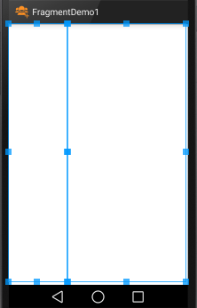
Fragments
Integrating the Home Activity and its Fragments
Example of dynamic binding. Instances of the FragmentRed and FragmentBlue classes are created at run-time and set to replace the left and right portions of the app’s GUI.
// create a new BLUE fragment - show it
ft = getFragmentManager().beginTransaction();
blueFragment = FragmentBlue.newInstance("new-blue");
ft.replace(R.id.main_holder_blue, blueFragment);
ft.commit();
// create a new RED fragment - show it
ft = getFragmentManager().beginTransaction();
redFragment = FragmentRed.newInstance("new-red");
ft.replace(R.id.main_holder_red, redFragment);
ft.commit();
main_holder_red
main_holder_blue
6 - 9

Slide 10
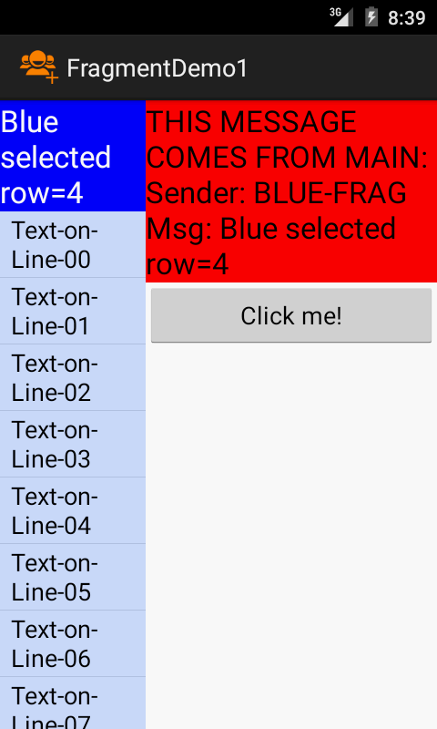
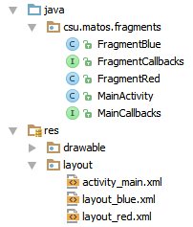
Example 1 – Dynamic Activity-Fragment Binding
This example shows a master-detail design. It is based on three classes:
MainActivity (host),
FragmentBlue (master) and
FragmentRed (detail)
The master portion (on the left) presents a list of items. When the user selects one of them, a message is sent to the host MainActivity which in turn forwards the message to the detail fragment (on the right).
The detail fragment echoes the value of the selected row.
The interfaces FragmentCallbacks and MainCallbacks define the methods used to pass messages from the MainActivity to fragments and from fragments to MainActivity respectively.
6 - 10

Slide 11
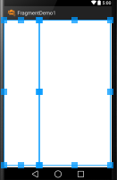
Example 1 – Dynamic Activity-Fragment Binding
XML LAYOUT: activity_main.xml
<?xml version="1.0" encoding="utf-8"?>
<LinearLayout xmlns:android="http://schemas.android.com/apk/res/android"
android:layout_width="match_parent"
android:layout_height="match_parent"
android:baselineAligned="false"
android:orientation="horizontal" >
<FrameLayout
android:id="@+id/main_holder_blue"
android:layout_width="0dp"
android:layout_height="match_parent"
android:layout_weight="1"
android:orientation="vertical" />
<FrameLayout
android:id="@+id/main_holder_red"
android:layout_width="0dp"
android:layout_height="match_parent"
android:layout_weight="2"
android:orientation="vertical" />
</LinearLayout>
6 - 11

Slide 12
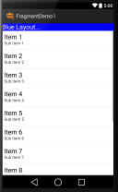
Example 1 – Dynamic Activity-Fragment Binding
XML LAYOUT: layout_blue.xml
<?xml version="1.0" encoding="utf-8"?>
<LinearLayout xmlns:android="http://schemas.android.com/apk/res/android"
android:id="@+id/layout_blue"
android:layout_width="match_parent"
android:layout_height="match_parent"
android:orientation="vertical" >
<TextView
android:id="@+id/textView1Blue"
android:layout_width="match_parent"
android:layout_height="wrap_content"
android:text="Blue Layout..."
android:textColor="#ffffffff"
android:background="#ff0000ff"
android:textAppearance="?android:attr/textAppearanceLarge" />
<ListView
android:id="@+id/listView1Blue"
android:layout_width="match_parent"
android:layout_height="wrap_content" >
</ListView>
</LinearLayout>
6 - 12

Slide 13
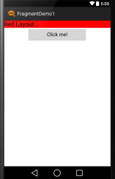
Example 1 – Dynamic Activity-Fragment Binding
XML LAYOUT: layout_red.xml
<?xml version="1.0" encoding="utf-8"?>
<LinearLayout xmlns:android="http://schemas.android.com/apk/res/android"
android:id="@+id/layout_red"
android:layout_width="match_parent"
android:layout_height="match_parent"
android:orientation="vertical">
<TextView
android:id="@+id/textView1Red"
android:layout_width="match_parent"
android:layout_height="wrap_content"
android:background="#ffff0000"
android:text="Red Layout..."
android:textAppearance="?android:attr/textAppearanceLarge" />
<Button
android:id="@+id/button1Red"
android:layout_width="wrap_content"
android:layout_height="wrap_content"
android:layout_gravity="center"
android:ems="10"
android:text="Click me!" />
</LinearLayout>
6 - 13

Slide 14
Example 1 – Dynamic Binding - MainActivity 1 of 3
//-----------------------------------------------------------------------
// GOAL: This example shows an Activity that includes two fragments.
// Fragments inflate layouts and then get attached to their corresponding
// layouts in the UI. The example includes two interfaces MainCallbacks
// and FragmentCallbacks. They implement inter-process communication from
// Main-to-fragments and from Fragments-to-Main.
// -----------------------------------------------------------------------
public class MainActivity extends Activity implements MainCallbacks {
FragmentTransaction ft;
FragmentRed redFragment;
FragmentBlue blueFragment;
@Override
protected void onCreate(Bundle savedInstanceState) {
super.onCreate(savedInstanceState);
setContentView(R.layout.activity_main);
// create a new BLUE fragment - show it
ft = getFragmentManager().beginTransaction();
blueFragment = FragmentBlue.newInstance("first-blue");
ft.replace(R.id.main_holder_blue, blueFragment);
ft.commit();
// create a new RED fragment - show it
ft = getFragmentManager().beginTransaction();
redFragment = FragmentRed.newInstance("first-red");
ft.replace(R.id.main_holder_red, redFragment);
ft.commit();
}
6 - 14

Slide 15
Example 1 – Dynamic Binding - MainActivity 2 of 3
// MainCallback implementation (receiving messages coming from Fragments)
@Override
public void onMsgFromFragToMain(String sender, String strValue) {
// show message arriving to MainActivity
Toast.makeText(getApplication(),
" MAIN GOT>> " + sender + "\n" + strValue, Toast.LENGTH_LONG)
.show();
if (sender.equals("RED-FRAG")) {
// TODO: if needed, do here something on behalf of the RED fragment
}
if (sender.equals("BLUE-FRAG")) {
try {
// forward blue-data to redFragment using its callback method
redFragment.onMsgFromMainToFragment("\nSender: " + sender
+ "\nMsg: " + strValue);
} catch (Exception e) {
Log.e("ERROR", "onStrFromFragToMain " + e.getMessage());
}
}
}
}
6 - 15

Slide 16
Example 1 – Dynamic Binding - MainActivity 3 of 3
COMMENTS
Each fragment is safely created inside a TRANSACTION frame demarcated by: beginTransaction … commit.
An invocation to the special newInstance constructor is used to supply any arguments a fragment may need to begin working.
Once created, the new fragment is used to replace whatever is shown at a designated area of the GUI (as defined in the activity_main.xml layout).
The method onMsgFromFragToMain implements the MainCallbacks interface. It accepts messages asynchronously sent from either redFragment or blueFragment to the enclosing MainActivity.
In our example, the row number selected from the blueFragment is forwarded to the redFragment using the fragment’s callback method onMsgFromMainToFragment.
6 - 16

Slide 17
Example 1 – Dynamic Binding - FragmentBlue 1 of 3
public class FragmentBlue extends Fragment {
// this fragment shows a ListView
MainActivity main;
Context context = null;
String message = "";
// data to fill-up the ListView
private String items[] = { "Text-on-Line-00", "Text-on-Line-01",
"Text-on-Line-02", "Text-on-Line-03", "Text-on-Line-04",
"Text-on-Line-05", "Text-on-Line-06", "Text-on-Line-07",
"Text-on-Line-08", "Text-on-Line-09", "Text-on-Line-10", };
// convenient constructor(accept arguments, copy them to a bundle, binds bundle to fragment)
public static FragmentBlue newInstance(String strArg) {
FragmentBlue fragment = new FragmentBlue();
Bundle args = new Bundle();
args.putString("strArg1", strArg);
fragment.setArguments(args);
return fragment;
}
@Override
public void onCreate(Bundle savedInstanceState) {
super.onCreate(savedInstanceState);
try {
context = getActivity(); // use this reference to invoke main callbacks
main = (MainActivity) getActivity();
} catch (IllegalStateException e) {
throw new IllegalStateException(
"MainActivity must implement callbacks");
}
}
6 - 17

Slide 18
Example 1 – Dynamic Binding - FragmentBlue 2 of 3
@Override
public View onCreateView(LayoutInflater inflater, ViewGroup container,
Bundle savedInstanceState) {
// inflate res/layout_blue.xml to make GUI holding a TextView and a ListView
LinearLayout layout_blue = (LinearLayout) inflater.inflate(R.layout.layout_blue, null);
// plumbing – get a reference to textview and listview
final TextView txtBlue = (TextView) layout_blue.findViewById(R.id.textView1Blue);
ListView listView = (ListView) layout_blue.findViewById(R.id.listView1Blue);
listView.setBackgroundColor(Color.parseColor("#ffccddff"));
// define a simple adapter to fill rows of the listview
ArrayAdapter<String> adapter = new ArrayAdapter<String>(context,
android.R.layout.simple_list_item_1, items);
listView.setAdapter(adapter);
// show listview from the top
listView.setSelection(0);
listView.smoothScrollToPosition(0);
// react to click events on listview’s rows
listView.setOnItemClickListener(new OnItemClickListener() {
@Override
public void onItemClick(AdapterView<?> parent, View v, int position, long id) {
// inform enclosing MainActivity of the row’s position just selected
main.onMsgFromFragToMain("BLUE-FRAG", "Blue selected row=" + position);
txtBlue.setText("Blue selected row=" + position);
}
});
// do this for each row (ViewHolder-Pattern could be used for better performance!)
return layout_blue;
}// onCreateView
}// class
6 - 18

Slide 19
Example 1 – Dynamic Binding - FragmentBlue 3 of 3
COMMENTS
The Class.newInstance(…) construction is a reflective method commonly used for creating instances of classes (regardless of the number of parameters).
Creating an Android fragment begins with the making of a new Bundle in which each of the supplied arguments is stored as a <key,value> entry. Then the bundle is bound to the fragment trough the .setArguments(…) method. Finally the newly created fragment is returned.
In our example, the onCreate method verifies that the MainActivity implements the Java Interface defining methods needed to send data from the fragment to the MainActivity.
Fragments do most of their work inside of onCreateView. In this example, the predefined layout_blue.xml is inflated and plumbing is done to access its internal widgets (a TextView and a ListView).
A simple ArrayAdapter is used to fill the rows of the ListView.
An event handler is set on the ListView, so when the user clicks on a row its position is sent to the MainActivity’s listener onMsgFromFragToMain.
6 - 19

Slide 20
Example 1 – Dynamic Binding - FragmentRed 1 of 3
public class FragmentRed extends Fragment implements FragmentCallbacks {
MainActivity main;
TextView txtRed;
Button btnRedClock;
public static FragmentRed newInstance(String strArg1) {
FragmentRed fragment = new FragmentRed();
Bundle bundle = new Bundle();
bundle.putString("arg1", strArg1);
fragment.setArguments(bundle);
return fragment;
}// newInstance
@Override
public void onCreate(Bundle savedInstanceState) {
super.onCreate(savedInstanceState);
// Activities containing this fragment must implement interface: MainCallbacks
if (!(getActivity() instanceof MainCallbacks)) {
throw new IllegalStateException( " Activity must implement MainCallbacks");
}
main = (MainActivity) getActivity(); // use this reference to invoke main callbacks
}
@Override
public View onCreateView(LayoutInflater inflater, ViewGroup container,
Bundle savedInstanceState) {
// inflate res/layout_red.xml which includes a textview and a button
LinearLayout view_layout_red = (LinearLayout) inflater.inflate(
R.layout.layout_red, null);
// plumbing - get a reference to widgets in the inflated layout
txtRed = (TextView) view_layout_red.findViewById(R.id.textView1Red);
6 - 20

Slide 21
Example 1 – Dynamic Binding - FragmentRed 2 of 3
// show string argument supplied by constructor (if any!)
try {
Bundle arguments = getArguments();
String redMessage = arguments.getString("arg1", "");
txtRed.setText(redMessage);
} catch (Exception e) {
Log.e("RED BUNDLE ERROR - ", "" + e.getMessage());
}
// clicking the button changes the time displayed and sends a copy to MainActivity
btnRedClock = (Button) view_layout_red.findViewById(R.id.button1Red);
btnRedClock.setOnClickListener(new OnClickListener() {
@Override
public void onClick(View v) {
String redMessage = "Red clock:\n" + new Date().toString();
txtRed.setText(redMessage);
main.onMsgFromFragToMain("RED-FRAG", redMessage);
}
});
return view_layout_red;
}
@Override
public void onMsgFromMainToFragment(String strValue) {
// receiving a message from MainActivity (it may happen at any point in time)
txtRed.setText("THIS MESSAGE COMES FROM MAIN:" + strValue);
}
}// FragmentRed
6 - 21

Slide 22
Example 1 – Dynamic Binding - FragmentRed 3 of 3
COMMENTS
This is very similar to the previous snipped describing the composition of FragmentBlue.
As before, newInstance is invoked to create an instance of this class.
The FragmentRed class uses onCreate to verify the MainActivity has implemented the mehods needed to send messages to it.
Observe that FragmentRed asynchronously receives messages from the MainActivity by means of its onMsgFromMainToFragment listener.
In our example the position of the row selected by the blueFragment is accepted. This could be used to properly respond to that event, for instance providing details for the given selection.
6 - 22

Slide 23
Example 1 – Dynamic Binding - CallBacks
// method(s) to pass messages from fragments to MainActivity
public interface MainCallbacks {
public void onMsgFromFragToMain (String sender, String strValue);
}
// method(s) to pass messages from MainActivity to Fragments
public interface FragmentCallbacks {
public void onMsgFromMainToFragment(String strValue);
}
These Java Interfaces are used to enforce a formal Inter-Process-Communication behavior between the Fragments and the MainActivity. During their onCreate method each participant can check that the other has implemented the required listeners.
6 - 23

Slide 24
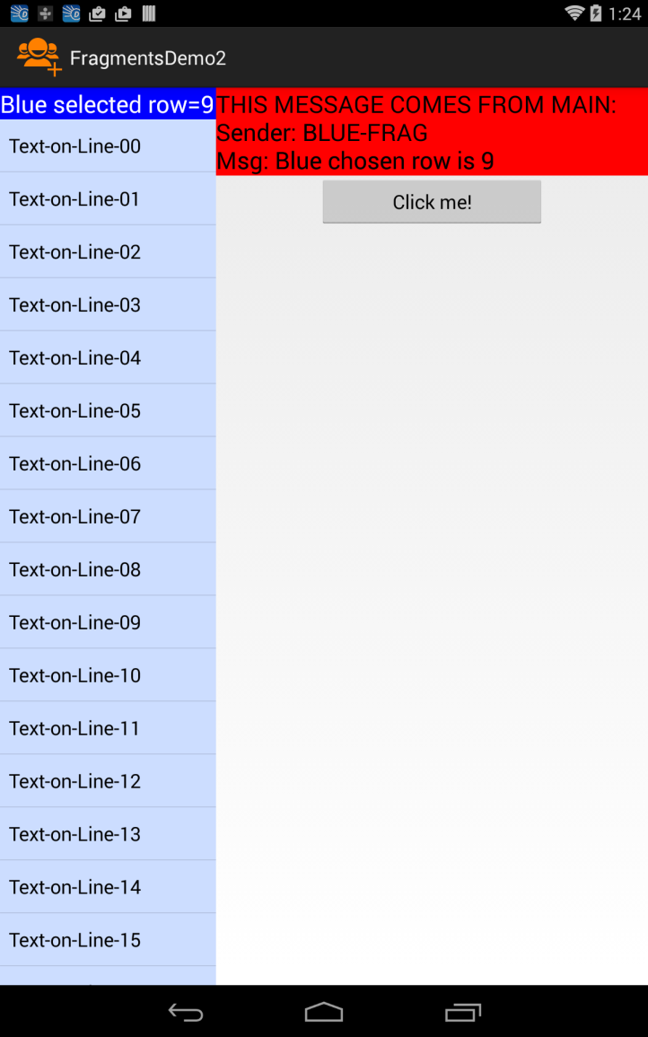
Example 2 – Static Activity-Fragment Binding
This example shows the same master-detail design introduced in the previous example. Like before, it is based on three classes:
MainActivity (host),
FragmentRed (master) and
FragmentBlue (detail)
The main difference between Example1 and Example2 stems from the way the GUI defined by Example2’s MainActivity statically ties the screen to particular Fragments.
The next pages will show the new activity_main.xml layout and the MainActivity. All the other components remain exactly the same.
Later on, you may break the GUI-Fragment bound. Just define a new Fragment instance and replace the appropriated GUI portion you want to modify.
6 - 24

Slide 25
Example 2 – Static Activity-Fragment Binding
Static binding is simple and requires less programming than dynamic binding.
This approach is appropriate for apps in which the interface retains the same fragment(s) for their entire session.
Statically attached fragments cannot be removed (however other fragments can be added to the interface).
The Activity’s layout file uses the <fragment> element to mark the position and size of the area on which a fragment instance is to be injected.
The following attributes can be used to identify the fragment in case it needs to be restarted (if none is provided the fragment is identified by the system’s id of the fragment’s container id)
android:name="AppPackageName.FragmentClassName"
android:id="@id+/uniqueName" or android:tag="string"
6 - 25

Slide 26
Example 2 – Static Activity-Fragment Binding
XML LAYOUT: activity_main.xml
<?xml version="1.0" encoding="utf-8"?>
<LinearLayout xmlns:android="http://schemas.android.com/apk/res/android"
android:layout_width="match_parent"
android:layout_height="match_parent"
android:orientation="horizontal" >
<fragment
android:id="@+id/main_holder_blue"
android:name="csu.matos.fragments.FragmentBlue"
android:layout_width="0dp"
android:layout_height="match_parent"
android:layout_weight="1" />
<fragment
android:id="@+id/main_holder_red"
android:name="csu.matos.fragments.FragmentRed"
android:layout_width="0dp"
android:layout_height="match_parent"
android:layout_weight="2" />
</LinearLayout>
6 - 26

Slide 27
Example 2 – Dynamic Binding - MainActivity 1 of 3
public class MainActivity extends Activity implements MainCallbacks {
FragmentRed redFragment;
FragmentBlue blueFragment ;
@Override
protected void onCreate(Bundle savedInstanceState) {
super.onCreate(savedInstanceState);
setContentView(R.layout.activity_main);
// NOTHING to do, fragments will be automatically created and added to the GUI
}
@Override
public void onAttachFragment(Fragment fragment) {
super.onAttachFragment(fragment);
// get a reference to each fragment attached to the GUI
if (fragment.getClass() == FragmentRed.class ){
redFragment = (FragmentRed) fragment;
}
if (fragment.getClass() == FragmentBlue.class ){
blueFragment = (FragmentBlue) fragment;
}
}
6 - 27

Slide 28
Example 2 – Dynamic Binding - MainActivity 1 of 3
@Override
public void onMsgFromFragToMain(String sender, String strValue) {
Toast.makeText(getApplication(), " MAIN GOT MSG >> " + sender
+ "\n" + strValue, Toast.LENGTH_LONG).show();
if (sender.equals("RED-FRAG")){
//TODO: do here something smart on behalf of BLUE fragment
}
if (sender.equals("BLUE-FRAG")) {
redFragment.onMsgFromActivity("\nSender: " + sender + "\nMsg: " + strValue);
}
}//onMsgFromFragToMain
}
6 - 28

Slide 29
Example 2 – Static Binding - MainActivity 3 of 3
COMMENTS
In this example the onCreate method has nothing to do. Moreover, onCreateView is not even called, observe that the XML-layout clause android:name="csu.matos.fragments.FragmentXYZ"
defines the specific fragment to be plugged in the activity’s screen.
When a fragment is moved to the screen the onAttachFragment method is executed. This event is used here to keep a reference to the redFragment and the blueFragment.
Messages sent by the blueFragment to the MainActivity are caught in the onMsgFromFragToMain listener. As in the previous example, blueFragment messages are forwarded to the redFragment.
6 - 29

Slide 30
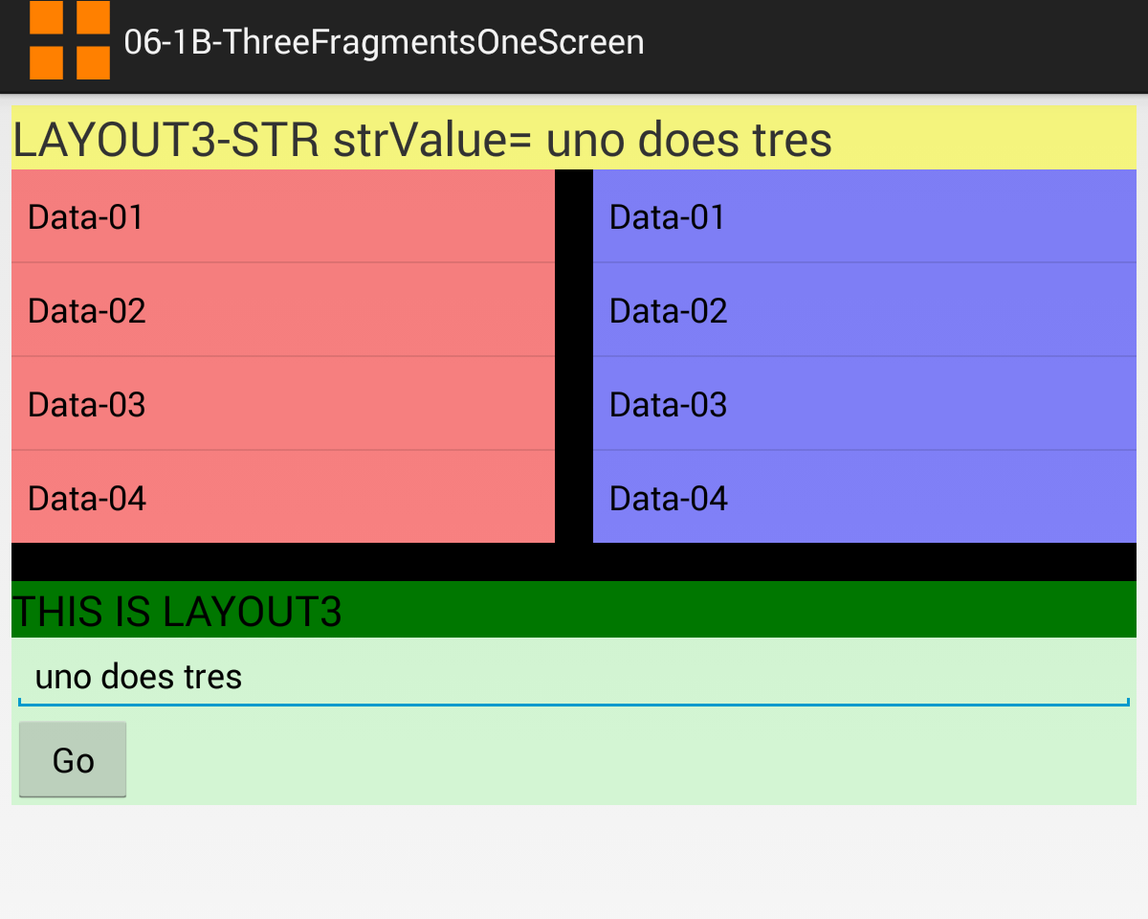
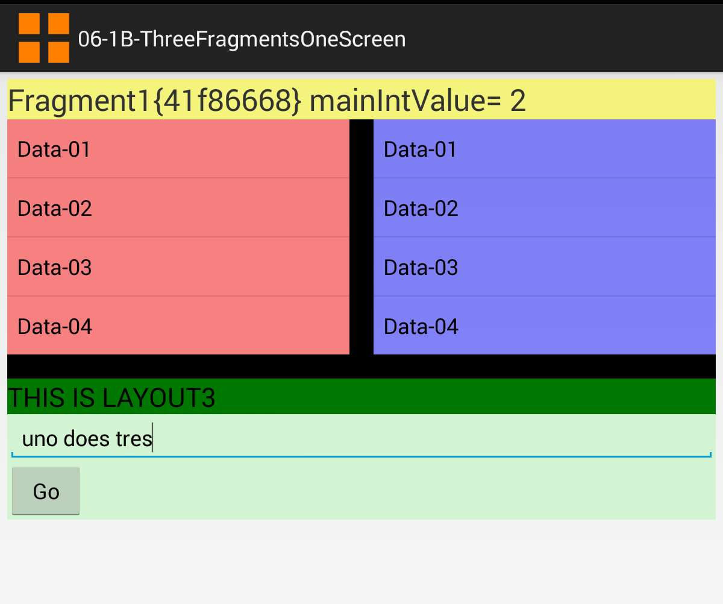
Example 3 – Multiple-Fragments-One-Screen
This example is a minor variation of Example1. The MainActivity displays a screen simultaneously showing three independent fragments.
All fragments are visible and active, providing multiple points of interaction with the user. There are two instances of a ListView fragment, and a bottom layout showing a design containing a TextView and a Button.
6 - 30

Slide 31
Example 3 – Multiple-Fragments-One-Screen 1 of 2
XML LAYOUT: activity_main.xml
<LinearLayout xmlns:android="http://schemas.android.com/apk/res/android"
xmlns:tools="http://schemas.android.com/tools"
android:id="@+id/linearLayoutMain"
android:layout_width="match_parent"
android:layout_height="match_parent"
android:orientation="vertical"
android:padding="6dp" >
<TextView
android:id="@+id/txtMsgMain"
android:layout_width="match_parent"
android:layout_height="wrap_content"
android:background="#77ffff00"
android:textSize="25sp" />
<LinearLayout
android:layout_width="match_parent"
android:layout_height="wrap_content"
android:orientation="horizontal" >
<LinearLayout
android:id="@+id/home1"
android:layout_width="wrap_content"
android:layout_height="wrap_content"
android:layout_weight="1"
android:background="#77ff0000"
android:orientation="vertical" />
Only the main layout is shown as the code for this example is literally the same from Example1.
6 - 31

Slide 32
Example 3 – Multiple-Fragments-One-Screen 2 of 2
XML LAYOUT: activity_main.xml
<View
android:layout_width="20dp"
android:layout_height="match_parent"
android:background="#ff000000" />
<LinearLayout
android:id="@+id/home2"
android:layout_width="wrap_content"
android:layout_height="wrap_content"
android:layout_weight="1"
android:background="#770000ff"
android:orientation="vertical" />
</LinearLayout>
<View
android:layout_width="match_parent"
android:layout_height="20dp"
android:background="#ff000000" />
<LinearLayout
android:id="@+id/home3"
android:layout_width="match_parent"
android:layout_height="wrap_content"
android:orientation="vertical" />
</LinearLayout>
Only the main layout is shown as the code for this example is literally the same from Example1.
6 - 32

Slide 33
Example 4 – Saving Fragment State
A regular practice before leaving a fragment is to override its onSaveInstanceState method to persist any state data inside a system’s managed bundle named outState.
Later, you may test for the existence of the saved state bundle and its contents inside any of the following the methods: onCreate , onCreateView , onViewCreated, or onViewStateRestored. This is know as a warm-start.
Observe that a fresh cold-start execution passes to the fragment a null bundle. Unlike Activities, Fragments do to have an onRestoreInstanceState method.
@Override
public void onCreate(Bundle savedInstanceState) {
...
stateData = getArguments().getString("arg1", "cold-start");
if (savedInstanceState != null){
stateData = savedInstanceState.getString("arg1","warm-default");
}
}//onCreate
...
@Override
public void onSaveInstanceState(Bundle outState) {
...
outState.putString("arg1", stateData);
super.onSaveInstanceState(outState);
}//onSavedInstanceState
6 - 33

Slide 34
Operations on Fragments
There are various operations that affect the presence and visibility of fragments dynamically bound to an activity. Those operations must be applied inside the scope of a FragmentTransaction object.
add() Add a fragment to an activity (generally showing a view). If the activity is re-started due to a configuration-change, previously created fragments that appeared on the UI via add() can be reused (better performance, no need to re-create the fragment).
remove() Remove a fragment from the activity. Fragment is destroyed (unless it was also added to the BackStack).
replace() A fragment currently on the UI is destroyed and replace by another fragment.
show() / hide() Shows a previously hidden fragment (hidden but not destroyed).
attach() / detach() Attaches a fragment previously separated (detached) from the UI. Detached fragments are invisible but not destroyed.
6 - 34

Slide 35
Operations on Fragments
Consider the following code sample on which a sequence of opposite operations is applied to display a fragment.
FragmentTransaction ft = getFragmentManager().beginTransaction();
redFragment = FragmentRed.newInstance(intValue);
ft.add(R.id.main_holder, redFragment, "RED-TAG");
ft.hide(redFragment);
ft.show(redFragment);
ft.detach(redFragment);
ft.attach(redFragment);
ft.commit();
6 - 35

Slide 36
Using the BackStack to Recreate State
Android-OS introduced a special stack to help fragments keep state when the user navigates from one UI to the other.
The artifact is called the BackStack and allows push/pop operations to manage FragmentTransactions. The BackStack mirrors the behavior of the activity stack within a single activity
Remember that all Android devices include a Back button. When this button is pressed in succession the app transitions to the previous screen shown by the app until it ends. This mechanism provides a natural historical navigation (also known as Back-Navigation). Another important pattern of navigation known as Child-to-HighAncestor is discussed later.
Why should BackStack be used?
When the BackStack is used, the retrieved fragment is re-used (instead of re-created from scratch) and its state data transparently restored (no need for input/output state bundles). This approach leads to simpler and more efficient apps.
6 - 36

Slide 37
Using the BackStack to Recreate State
A typical sequence to create a fragment and add it to the BackStack follows:
A typical sequence to create a fragment and add it to the stack follows:
FragmentTransaction ft = getFragmentManager().beginTransaction();
Fragment redFragment = FragmentRed.newInstance(intParameterValue);
ft.replace(R.id.main_holder, redFragment, "RED-FRAG");
ft.addToBackStack("RED_UI");
ft.commit();
In this example a fragment transaction (ft) adds a redFragment to the main activity’s UI. The fragment uses the optional tag/alias “RED-FRAG”, as an alternative form of identification. Later, we may inspect the app’s UI, and find the ‘alias’ of the fragment held inside the main_holder container.
Before the transaction commits, the statement
ft.addToBackStack("RED_UI");
pushes a reference of the current transaction’s environment in the BackStack including the optional identification tag: “RED_UI”. Later on, we may search through the BackStack looking for an entry matching the tag value. When found and popped, it resets the UI to the state held by that transaction.
6 - 37

Slide 38
Using the BackStack to Recreate State
Navigation
Retrieving entries from the BackStack can be done in various ways, such as:
Pressing the Back button to trigger a historical navigation exposing in succession the previous User-Interfaces.
Invoking the method .popBackStackImmediate(…) to selectively restore any particular BackStackEntry holding an UI already shown to the user.
// Remove current fragment’s UI and show its previous screen
try {
FragmentTransaction ft = getFragmentManager().beginTransaction();
android.app.FragmentManager fragmentManager = getFragmentManager();
int bsCount = fragmentManager.getBackStackEntryCount();
String tag = fragmentManager.getBackStackEntryAt(bsCount-1).getName();
int id = fragmentManager.getBackStackEntryAt(bsCount-1).getId();
Log.e("PREVIOUS Fragment: ", "" + tag + " " + id);
fragmentManager.popBackStackImmediate(id, 1); //supply: id or tag
ft.commit();
} catch (Exception e) {
Log.e("REMOVE>>> ", e.getMessage() );
}
1
2
3
6 - 38

Slide 39
Using the BackStack to Recreate State
Navigating Through the BackStack
In the previous transaction we reproduce the behavior of the Back key when used for historical navigation.
The size of the BackStack is determined (getBackStackEntryCount)
The top element of the stack is inspected. First we obtain its tag and later its numerical id by calling the method: fragmentManager.getBackStackEntryAt(bsCount-1).getId().
The .popBackStack(id, 1) method removes BackStackEntries from the top of the BackStack until it finds the entry matching the supplied id. At this point the app’s UI is updated showing the screen associated to the matching transaction previously held in the stack.
6 - 39

Slide 40
Using the BackStack to Recreate State
Navigating Through the BackStack
The following code clears the current BackStack. All fragment transactions pushed by calling the method ft.addToBackStack(…) are deleted. The app’s UI is updated, removing all screens shown by fragments that put a reference to themselves in the BackStack.
This approach could be used to provide Child-to-HighAncestor navigation.
try {
FragmentTransaction ft = getFragmentManager().beginTransaction();
android.app.FragmentManager fragmentManager = getFragmentManager();
fragmentManager.popBackStackImmediate(null,
FragmentManager.POP_BACK_STACK_INCLUSIVE);
ft.commit();
} catch (Exception e) {
Log.e("CLEAR-STACK>>> ", e.getMessage() );
}
6 - 40

Slide 41
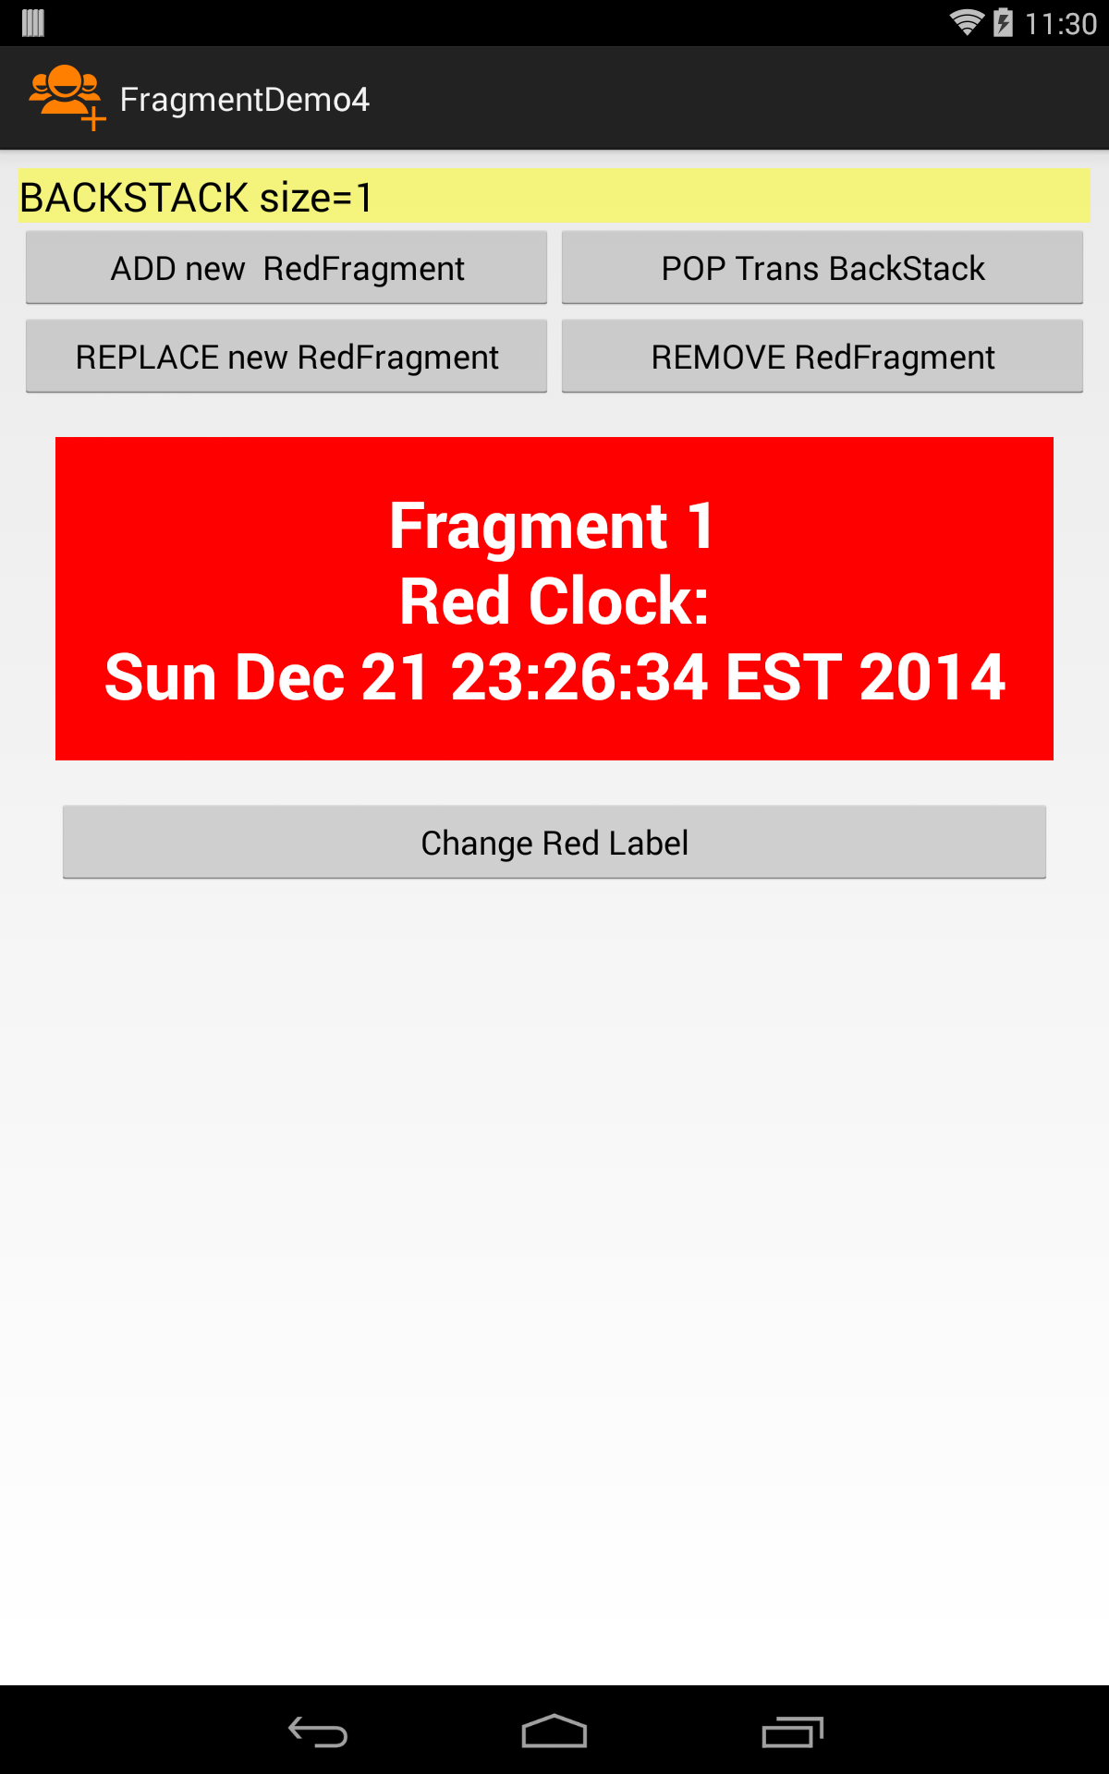
Example 5 - Using the BackStack 1 of x
A new redFragment is created. Its view is attached to the activity’s UI using the add( ) method. Finally its enclosing transaction is pushed on the BackStack.
As above, however; the fragment’s view is attached to the activity’s UI using the replace() method (old view is destroyed). The current transaction is also added to the BackStack.
Popping an entry from the BackStack removes the current app’s UI and navigates back to the previously stored fragment’s view. State data (if any) is shown as it was before leaving the view. The size of BackStack is reduced by one.
3
1
2
4
The “Remove” button activates a findFragmentByTag search. This first searches through fragments that are currently added to the manager's activity; if no such fragment is found, then all fragments currently on the back stack are searched. In our example, the current view is retired from the UI using remove() and the historically previous UI is presented.
6 - 41

Slide 42
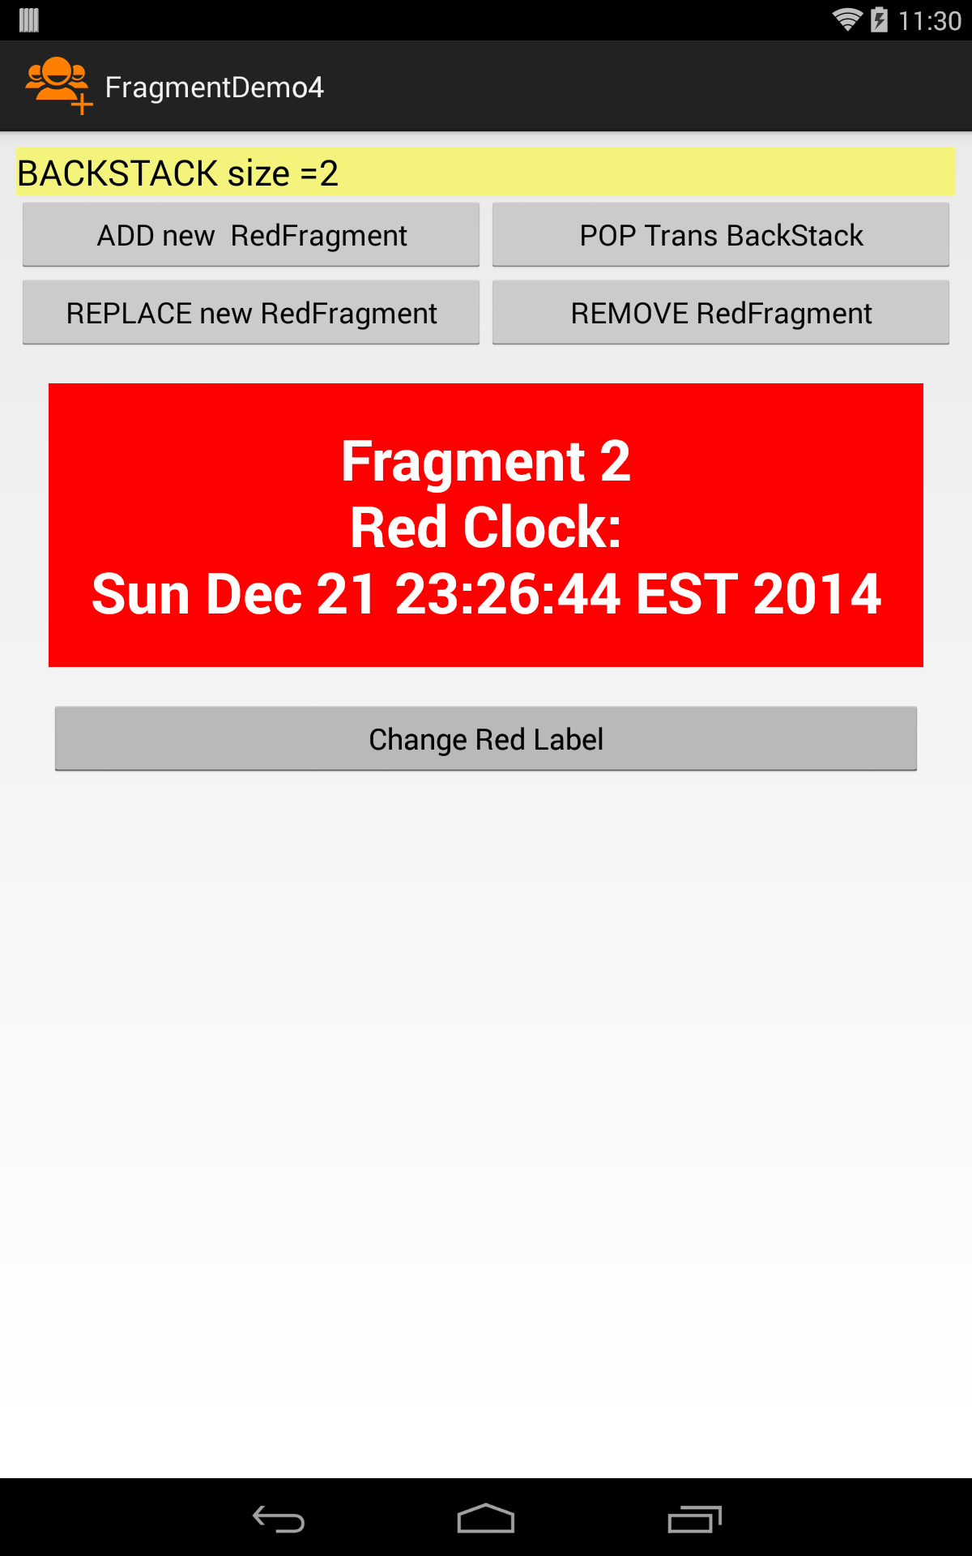
Example 5 - Using the BackStack 1 of x
A new redFragment is created and its enclosing transaction is added to the BackStack.
Pressing the Back button removes the current fragment from the UI and Back-Navigates to the previous fragment. Its state is preserved, so you do not need to refill its widgets.
6 - 42

Slide 43
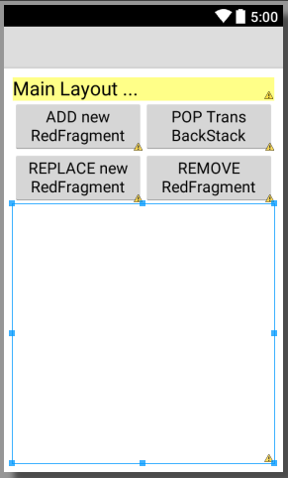
Example 5. LAYOUT: activity_main.xml 1 of 3
<?xml version="1.0" encoding="utf-8"?>
<LinearLayout xmlns:android="http://schemas.android.com/apk/res/android"
android:layout_width="match_parent"
android:layout_height="match_parent"
android:baselineAligned="false"
android:orientation="vertical"
android:padding="10dp" >
<TextView
android:id="@+id/textView1Main"
android:layout_width="match_parent"
android:layout_height="wrap_content"
android:background="#77ffff00"
android:text="Main Layout ..."
android:textAppearance="?android:attr/textAppearanceLarge" />
<LinearLayout
android:layout_width="match_parent"
android:layout_height="wrap_content"
android:baselineAligned="false"
android:orientation="horizontal" >
<Button
android:id="@+id/button1MainShowRed"
android:layout_width="150dp"
android:layout_height="wrap_content"
android:layout_weight="1"
android:text="ADD new RedFragment" />
6 - 43

Slide 44
Example 5. LAYOUT: activity_main.xml 2 of 3
<Button
android:id="@+id/button2MainPop"
android:layout_width="150dp"
android:layout_height="wrap_content"
android:layout_weight="1"
android:text="POP Trans BackStack" />
</LinearLayout>
<LinearLayout
android:layout_width="match_parent"
android:layout_height="wrap_content"
android:baselineAligned="false"
android:orientation="horizontal" >
<Button
android:id="@+id/button4MainReplace"
android:layout_width="150dp"
android:layout_height="wrap_content"
android:layout_weight="1"
android:text="REPLACE new RedFragment" />
<Button
android:id="@+id/button3MainRemove"
android:layout_width="150dp"
android:layout_height="wrap_content"
android:layout_weight="1"
android:text="REMOVE RedFragment" />
</LinearLayout>
6 - 44

Slide 45
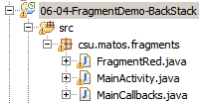

Example 5. LAYOUT: activity_main.xml 3 of 3
<FrameLayout
android:id="@+id/main_holder"
android:layout_width="match_parent"
android:layout_height="wrap_content"
android:layout_weight="2"
android:orientation="vertical" />
</LinearLayout>
MainCallbacks
package csu.matos.fragments;
// method(s) to pass messages from fragments to MainActivity
public interface MainCallbacks {
public void onMsgFromFragToMain ( String sender, String strValue);
}
6 - 45

Slide 46
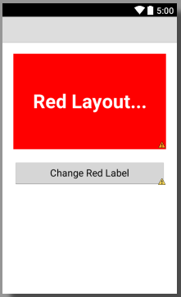
Example 5. LAYOUT: layout_red.xml 3 of 3
<?xml version="1.0" encoding="utf-8"?>
<LinearLayout xmlns:android="http://schemas.android.com/apk/res/android"
android:id="@+id/layout_red"
android:layout_width="match_parent"
android:layout_height="match_parent"
android:orientation="vertical" >
<TextView
android:id="@+id/textView1Red"
android:layout_width="match_parent"
android:layout_height="175dp"
android:layout_margin="20dp"
android:background="#ffff0000"
android:gravity="center"
android:text="Red Layout..."
android:textColor="@android:color/white"
android:textSize="35sp"
android:textStyle="bold" />
<Button
android:id="@+id/button1Red"
android:layout_width="match_parent"
android:layout_height="wrap_content"
android:layout_marginLeft="20dp"
android:layout_marginRight="20dp"
android:text="Change Red Label" />
</LinearLayout>
6 - 46

Slide 47
Example 5. MainActivity 1 of 4
public class MainActivity extends Activity implements MainCallbacks, OnClickListener {
FragmentTransaction ft;
FragmentRed redFragment;
TextView txtMsg;
Button btnAddRedFragment;
Button btnReplaceRedFragment;
Button btnPop;
Button btnRemove;
int serialCounter = 0; //used to enumerate fragments
String redMessage;
@Override
protected void onCreate(Bundle savedInstanceState) {
super.onCreate(savedInstanceState);
setContentView(R.layout.activity_main);
txtMsg = (TextView) findViewById(R.id.textView1Main);
btnAddRedFragment = (Button) findViewById(R.id.button1MainShowRed);
btnReplaceRedFragment = (Button) findViewById(R.id.button4MainReplace);
btnPop = (Button) findViewById(R.id.button2MainPop);
btnRemove = (Button) findViewById(R.id.button3MainRemove);
btnAddRedFragment.setOnClickListener(this);
btnReplaceRedFragment.setOnClickListener(this);
btnPop.setOnClickListener(this);
btnRemove.setOnClickListener(this);
}
6 - 47

Slide 48
Example 5. MainActivity 2 of 4
// CallBack (receiving messages coming from Fragments)
@Override
public void onMsgFromFragToMain(String sender, String strValue) {
// show message arriving to MainActivity
txtMsg.setText( sender + "=>" + strValue );
}
// ----------------------------------------------------------------------------------
public void onClick(View v) {
if(v.getId() == btnAddRedFragment.getId() ){
addRedFragment(++serialCounter);
}
if(v.getId() == btnReplaceRedFragment.getId() ){
replaceRedFragment(++serialCounter);
}
if(v.getId() == btnPop.getId() ){
FragmentManager fragmentManager = getFragmentManager();
int counter = fragmentManager.getBackStackEntryCount();
txtMsg.setText("BACKSTACK old size=" + counter);
if(counter>0) {
// VERSION 1 [ popBackStack could be used as opposite of addBackStack() ]
// pop takes a Transaction from the BackStack and a view is also deleted
fragmentManager.popBackStackImmediate();
txtMsg.append("\nBACKSTACK new size=" + fragmentManager.getBackStackEntryCount() );
}
}//Pop
6 - 48

Slide 49
Example 5. MainActivity 3 of 4
if(v.getId() == btnRemove.getId() ){
FragmentManager fragmentManager = getFragmentManager();
int counter = fragmentManager.getBackStackEntryCount();
txtMsg.setText("BACKSTACK old size=" + counter);
// VERSION 2 -------------------------------------------------------
// Removes an existing fragment from the fragmentTransaction.
// If it was added to a container, its view is also removed from that
// container. The BackStack may remain the same!
Fragment f1 = fragmentManager.findFragmentByTag("RED-TAG");
fragmentManager.beginTransaction().remove(f1).commit();
txtMsg.append("\nBACKSTACK new size=" + fragmentManager.getBackStackEntryCount() );
// VERSION 3 -------------------------------------------------------
// Fragment f1 = fragmentManager.findFragmentById(R.id.main_holder);
// fragmentManager.beginTransaction().remove(f1).commit();
// txtMsg.append("\nBACKSTACK new size=" + fragmentManager.getBackStackEntryCount() );
}//Remove
}//onClick
@Override
public void onBackPressed() {
super.onBackPressed();
int counter = getFragmentManager().getBackStackEntryCount();
txtMsg.setText("BACKSTACK size=" + counter);
}
6 - 49

Slide 50
Example 5. MainActivity 4 of 4
public void addRedFragment(int intValue) {
// create a new RED fragment, add fragment to the transaction
FragmentTransaction ft = getFragmentManager().beginTransaction();
redFragment = FragmentRed.newInstance(intValue);
ft.add(R.id.main_holder, redFragment, "RED-TAG");
ft.addToBackStack("MYSTACK1");
ft.commit();
// complete any pending insertions in the BackStack, then report its size
getFragmentManager().executePendingTransactions();
txtMsg.setText("BACKSTACK size =" + getFragmentManager().getBackStackEntryCount() );
}
public void replaceRedFragment(int intValue) {
// create a new RED fragment, replace fragments in the transaction
FragmentTransaction ft = getFragmentManager().beginTransaction();
redFragment = FragmentRed.newInstance(intValue);
ft.replace(R.id.main_holder, redFragment, "RED-TAG");
ft.addToBackStack("MYSTACK1");
ft.commit();
// complete any pending insertions in the BackStack, then report its size
getFragmentManager().executePendingTransactions();
txtMsg.setText("BACKSTACK size =" + getFragmentManager().getBackStackEntryCount() );
}
}
6 - 50

Slide 51
Example 5. FragmentRed 1 of 2
public class FragmentRed extends Fragment {
MainActivity main;
TextView txtRed;
Button btnRedClock;
int fragmentId;
String selectedRedText = "";
public static FragmentRed newInstance(int fragmentId) {
FragmentRed fragment = new FragmentRed();
Bundle bundle = new Bundle();
bundle.putInt("fragmentId", fragmentId);
fragment.setArguments(bundle);
return fragment;
}// newInstance
@Override
public void onCreate(Bundle savedInstanceState) {
super.onCreate(savedInstanceState);
// Activities containing this fragment must implement MainCallbacks
if (!(getActivity() instanceof MainCallbacks)) {
throw new IllegalStateException(
">>> Activity must implement MainCallbacks");
}
main = (MainActivity) getActivity();
fragmentId = getArguments().getInt("fragmentId", -1);
}
6 - 51

Slide 52
Example 5. FragmentRed 2 of 2
@Override
public View onCreateView( LayoutInflater inflater, ViewGroup container,
Bundle savedInstanceState) {
LinearLayout view_layout_red = (LinearLayout) inflater.inflate(
R.layout.layout_red, null);
txtRed = (TextView) view_layout_red.findViewById(R.id.textView1Red);
txtRed.setText( "Fragment " + fragmentId );
btnRedClock = (Button) view_layout_red.findViewById(R.id.button1Red);
btnRedClock.setOnClickListener(new OnClickListener() {
@Override
public void onClick(View v) {
selectedRedText = "\nRed Clock:\n" + new Date().toString();
txtRed.append(selectedRedText);
// main.onMsgFromFragToMain("RED-FRAG", selectedRedText );
}
});
return view_layout_red;
}
}// FragmentRed
6 - 52

Slide 53
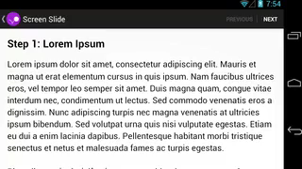
ViewPager2 + Fragment
ViewPager2 được sử dụng thay thế cho ViewPager để tạo hiệu ứng trượt giữa các trang (fragment) trong một màn hình (activity).
ViewPager2 sử dụng RecyclerView nên hỗ trợ nhiều kiểu layout khác nhau, hoạt động nhanh và hiệu quả hơn.
6 - 53

Slide 54
ViewPager2 + Fragment
Cách sử dụng ViewPager2 kết hợp với Fragment
Bước 1: Thêm thư viện ViewPager2 vào project
implementation 'androidx.viewpager2:viewpager2:1.0.0'
Bước 2: Tạo mới và thiết kế giao diện cho đối tượng fragment, được sử dụng để hiển thị các trang.
Bước 3: Khai báo ViewPager2 trong file xml của activity
6 - 54

Slide 55
ViewPager2 + Fragment
Bước 4: Khai báo adapter
private class SlidePageAdapter extends FragmentStateAdapter {
public SlidePageAdapter(@NonNull FragmentActivity fragmentActivity) {
super(fragmentActivity);
}
@NonNull
@Override
public Fragment createFragment(int position) {
return PageFragment.newInstance(pages.get(position));
}
@Override
public int getItemCount() {
return pages.size();
}
}
6 - 55

Slide 56
ViewPager2 + Fragment
Bước 5: Thiết lập view pager trong acvitity
List<String> pages;
Faker faker;
@Override
protected void onCreate(Bundle savedInstanceState) {
super.onCreate(savedInstanceState);
setContentView(R.layout.activity_second);
faker = new Faker();
pages = new ArrayList<>();
for (int i = 0; i < 10; i++)
pages.add(faker.lorem.paragraph());
ViewPager2 viewPager = findViewById(R.id.view_pager);
SlidePageAdapter pageAdapter = new SlidePageAdapter(this);
viewPager.setAdapter(pageAdapter);
}
6 - 56

Slide 57
ViewPager2 + Fragment
Bước 6: Xử lý sự kiện khi page được chọn
viewPager.registerOnPageChangeCallback(new ViewPager2.OnPageChangeCallback() {
@Override
public void onPageSelected(int position) {
super.onPageSelected(position);
// TODO:
}
});
Di chuyển đến page xác định:
viewPager.setCurrentItem(8);
6 - 57

Slide 58
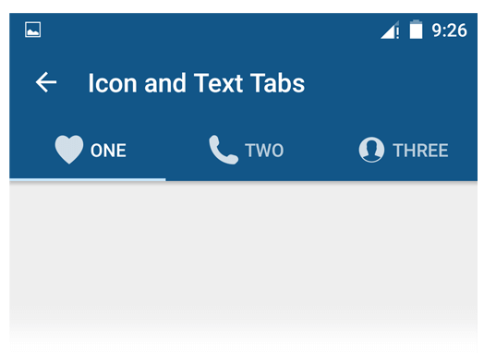
TabLayout + ViewPager2 + Fragment
TabLayout tạo giao diện thẻ để chọn các trang hiển thị trong cùng một màn hình (activity).
TabLayout có thể được sử dụng kết hợp với ViewPager để tạo giao diện chọn trang hiển thị nhanh chóng.
6 - 58

Slide 59
TabLayout + ViewPager2 + Fragment
Cách sử dụng TabLayout kết hợp với ViewPager2 và Fragment
Bước 1: Thêm thư viện ViewPager2 vào project
implementation 'androidx.viewpager2:viewpager2:1.0.0'
implementation 'com.google.android.material:material:1.2.0-alpha06'
Bước 2: Khai báo TabLayout và ViewPager2 trong file xml của activity
<?xml version="1.0" encoding="utf-8"?>
<LinearLayout xmlns:android="http://schemas.android.com/apk/res/android"
android:layout_width="match_parent"
android:layout_height="match_parent"
android:orientation="vertical">
<com.google.android.material.tabs.TabLayout
android:id="@+id/tab_layout"
android:layout_width="match_parent"
android:layout_height="wrap_content"/>
<androidx.viewpager2.widget.ViewPager2
android:id="@+id/view_pager"
android:layout_width="match_parent"
android:layout_height="match_parent"/>
</LinearLayout>
6 - 59

Slide 60
TabLayout + ViewPager2 + Fragment
Bước 3: Khai báo adapter cho ViewPager2
private class ViewPagerAdapter extends FragmentStateAdapter {
public ViewPagerAdapter(@NonNull FragmentActivity fragmentActivity) {
super(fragmentActivity);
}
@NonNull
@Override
public Fragment createFragment(int position) {
switch (position) {
case 0:
return new RedFragment();
case 1:
return new GreenFragment();
default:
return new BlueFragment();
}
}
@Override
public int getItemCount() {
return 3;
}
}
6 - 60

Slide 61
TabLayout + ViewPager2 + Fragment
Bước 4: Thiết lập TabLayout và ViewPager2 trong activity
@Override
protected void onCreate(Bundle savedInstanceState) {
super.onCreate(savedInstanceState);
setContentView(R.layout.activity_third);
ViewPager2 viewPager = findViewById(R.id.view_pager);
ViewPagerAdapter adapter = new ViewPagerAdapter(this);
viewPager.setAdapter(adapter);
TabLayout tabLayout = findViewById(R.id.tab_layout);
new TabLayoutMediator(tabLayout, viewPager,
new TabLayoutMediator.TabConfigurationStrategy() {
@override public void onConfigureTab(@NonNull TabLayout.Tab tab, int position) {
switch (position) {
case 0:
tab.setText("Home");
tab.setIcon(R.drawable.ic_home);
break;
case 1:
tab.setText("Mail");
tab.setIcon(R.drawable.ic_mail);
break;
default:
tab.setText("Train");
tab.setIcon(R.drawable.ic_train);
}
}
}).attach();
}
6 - 61

Slide 62
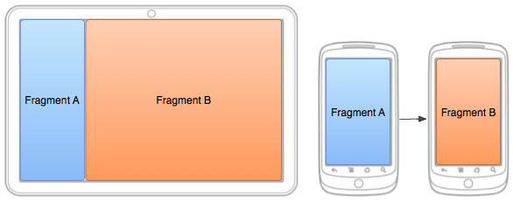
Build a flexible UI
When designing your application to support a wide range of screen sizes, you can reuse your fragments in different layout configurations to optimize the user experience based on the available screen space.
For example, on a handset device it might be appropriate to display just one fragment at a time for a single-pane user interface. Conversely, you may want to set fragments side-by-side on a tablet which has a wider screen size to display more information to the user.
6 - 62

Slide 63
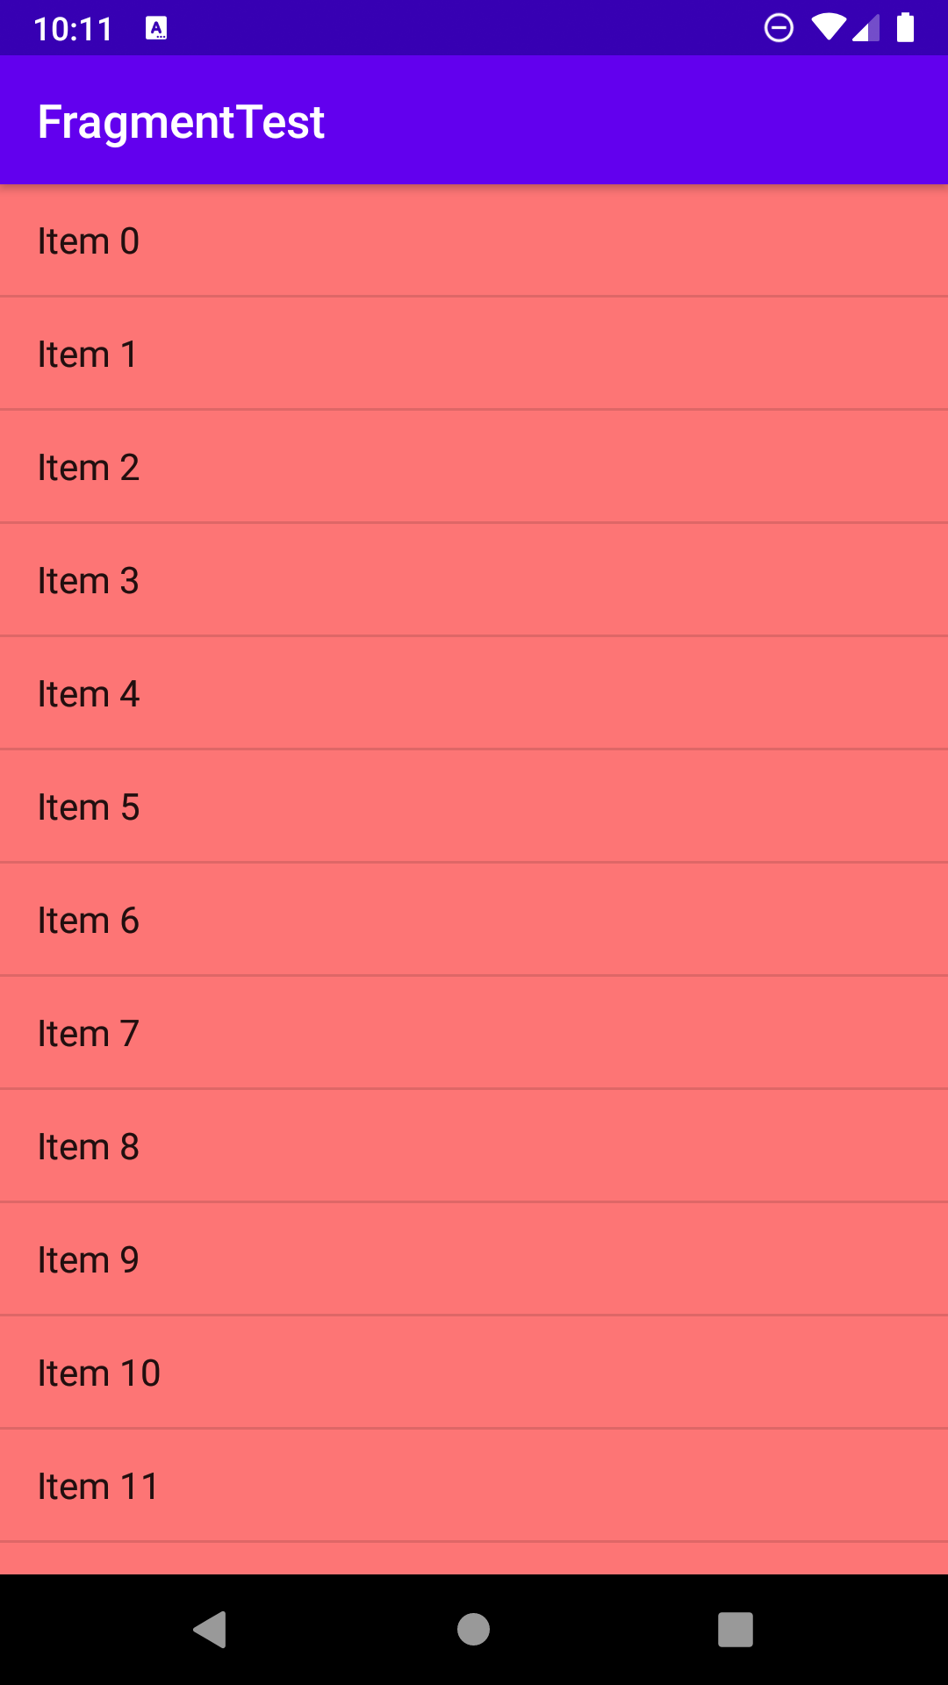
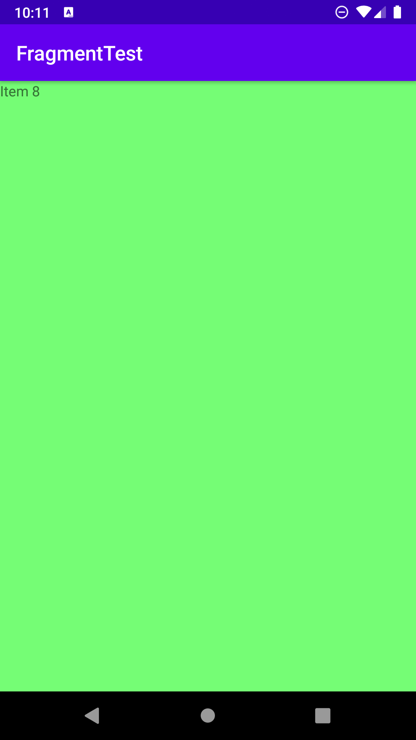
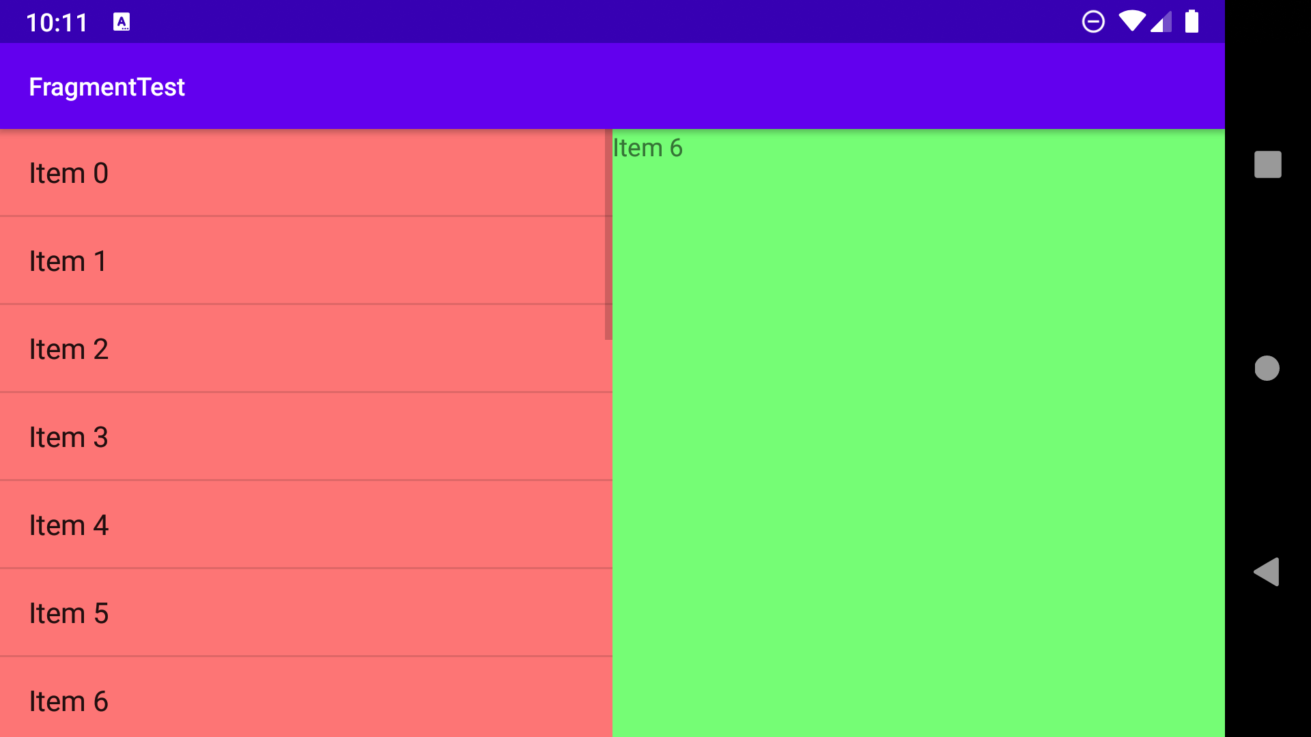
Build a flexible UI
Example 6. Master-detail app on portrait and landscape mode

Slide 64
Build a flexible UI
Example 6. Create layout for portrait and landscape orientation
<?xml version="1.0" encoding="utf-8"?>
<FrameLayout xmlns:android="http://schemas.android.com/apk/res/android"
xmlns:app="http://schemas.android.com/apk/res-auto"
xmlns:tools="http://schemas.android.com/tools"
android:layout_width="match_parent"
android:layout_height="match_parent">
<FrameLayout
android:id="@+id/master_frame"
android:layout_width="match_parent"
android:layout_height="match_parent"/>
</FrameLayout>
Layout of activity in portrait orientation (default mode in layout folder).

Slide 65
Build a flexible UI
Example 6. Create layout for portrait and landscape orientation
<?xml version="1.0" encoding="utf-8"?>
<LinearLayout xmlns:android="http://schemas.android.com/apk/res/android"
android:layout_width="match_parent"
android:layout_height="match_parent">
<FrameLayout
android:id="@+id/master_frame"
android:layout_width="0dp"
android:layout_height="match_parent"
android:layout_weight="1"/>
<FrameLayout
android:id="@+id/detail_frame"
android:layout_width="0dp"
android:layout_height="match_parent"
android:layout_weight="1"/>
</LinearLayout>
Layout of activity in landscape orientation. This layout file is stored in layout-land folder and has the same name with the portrait layout file.
Also add android:screenOrientation="fullSensor" property for the activity in AndroidManifest file.

Slide 66
Build a flexible UI
Example 6. Create layout for master fragment
<?xml version="1.0" encoding="utf-8"?>
<FrameLayout xmlns:android="http://schemas.android.com/apk/res/android"
xmlns:tools="http://schemas.android.com/tools"
android:layout_width="match_parent"
android:layout_height="match_parent"
tools:context=".MasterFragment"
android:background="#8F00">
<ListView
android:id="@+id/list_view"
android:layout_width="match_parent"
android:layout_height="match_parent" />
</FrameLayout>

Slide 67
Build a flexible UI
Example 6. Create master fragment
public class MasterFragment extends Fragment {
OnShowDetailListener listener;
public MasterFragment() {
// Required empty public constructor
}
public void setShowDetailListener(OnShowDetailListener listener) {
this.listener = listener;
}
@Override
public void onCreate(Bundle savedInstanceState) {
super.onCreate(savedInstanceState);
}

Slide 68
Build a flexible UI
Example 6. Create master fragment
List<String> items;
@Override
public View onCreateView(LayoutInflater inflater, ViewGroup container,
Bundle savedInstanceState) {
View view = inflater.inflate(R.layout.fragment_master, container, false);
items = new ArrayList<>();
for (int i = 0; i < 20; i++)
items.add("Item " + i);
ArrayAdapter<String> adapter = new ArrayAdapter<>(getContext(), android.R.layout.simple_list_item_1, items);
final ListView listView = view.findViewById(R.id.list_view);
listView.setAdapter(adapter);
listView.setOnItemClickListener(new AdapterView.OnItemClickListener() {
@Override
public void onItemClick(AdapterView<?> adapterView, View view, int i, long l) {
if (listener != null)
listener.showDetail(items.get(i));
}
});
return view;
}
interface OnShowDetailListener {
void showDetail(String text);
}
}

Slide 69
Build a flexible UI
Example 6. Create layout for detail fragment
<?xml version="1.0" encoding="utf-8"?>
<FrameLayout xmlns:android="http://schemas.android.com/apk/res/android"
xmlns:tools="http://schemas.android.com/tools"
android:layout_width="match_parent"
android:layout_height="match_parent"
tools:context=".DetailFragment"
android:background="#80F0">
<TextView
android:id="@+id/text_view"
android:layout_width="match_parent"
android:layout_height="match_parent"
android:text="@string/hello_blank_fragment" />
</FrameLayout>

Slide 70
Build a flexible UI
Example 6. Create detail fragment
public class DetailFragment extends Fragment {
TextView textView;
public DetailFragment() {
// Required empty public constructor
}
@Override
public void onCreate(Bundle savedInstanceState) {
super.onCreate(savedInstanceState);
}
@Override
public View onCreateView(LayoutInflater inflater, ViewGroup container,
Bundle savedInstanceState) {
View view = inflater.inflate(R.layout.fragment_detail, container, false);
textView = view.findViewById(R.id.text_view);
Bundle bundle = getArguments();
if (bundle == null)
textView.setText("");
else
textView.setText(bundle.getString("selected"));
return view;
}
public void updateText(String text) {
if (textView != null)
textView.setText(text);
}
}

Slide 71
Build a flexible UI
Example 6. Create main activity
public class FourthActivity extends AppCompatActivity implements MasterFragment.OnShowDetailListener {
MasterFragment masterFragment;
DetailFragment detailFragment;
@Override
protected void onCreate(Bundle savedInstanceState) {
super.onCreate(savedInstanceState);
setContentView(R.layout.activity_fourth);
masterFragment = new MasterFragment();
detailFragment = new DetailFragment();
masterFragment.setShowDetailListener(this);
FragmentTransaction ft = getSupportFragmentManager().beginTransaction();
ft.replace(R.id.master_frame, masterFragment);
ft.commit();
if (findViewById(R.id.detail_frame) != null) {
ft = getSupportFragmentManager().beginTransaction();
ft.replace(R.id.detail_frame, detailFragment);
ft.commit();
}
}

Slide 72
Build a flexible UI
Example 6. Create main activity
@Override
public void showDetail(String text) {
if (findViewById(R.id.detail_frame) == null) {
Bundle bundle = new Bundle();
bundle.putString("selected", text);
detailFragment.setArguments(bundle);
FragmentTransaction ft = getSupportFragmentManager().beginTransaction();
ft.replace(R.id.master_frame, detailFragment);
ft.addToBackStack("detail");
ft.commit();
} else {
detailFragment.updateText(text);
}
}
}

Slide 73
Fragments
Questions ?

