Slide 1
The Web/Local Boundary Is Fuzzy A Security Study of Chrome’s Process-based Sandboxing
Yaoqi Jia, Zheng Leong Chua, Hong Hu,
Shuo Chen, Prateek Saxena, Zhenkai Liang
National University of Singapore
Microsoft Research

Slide 2
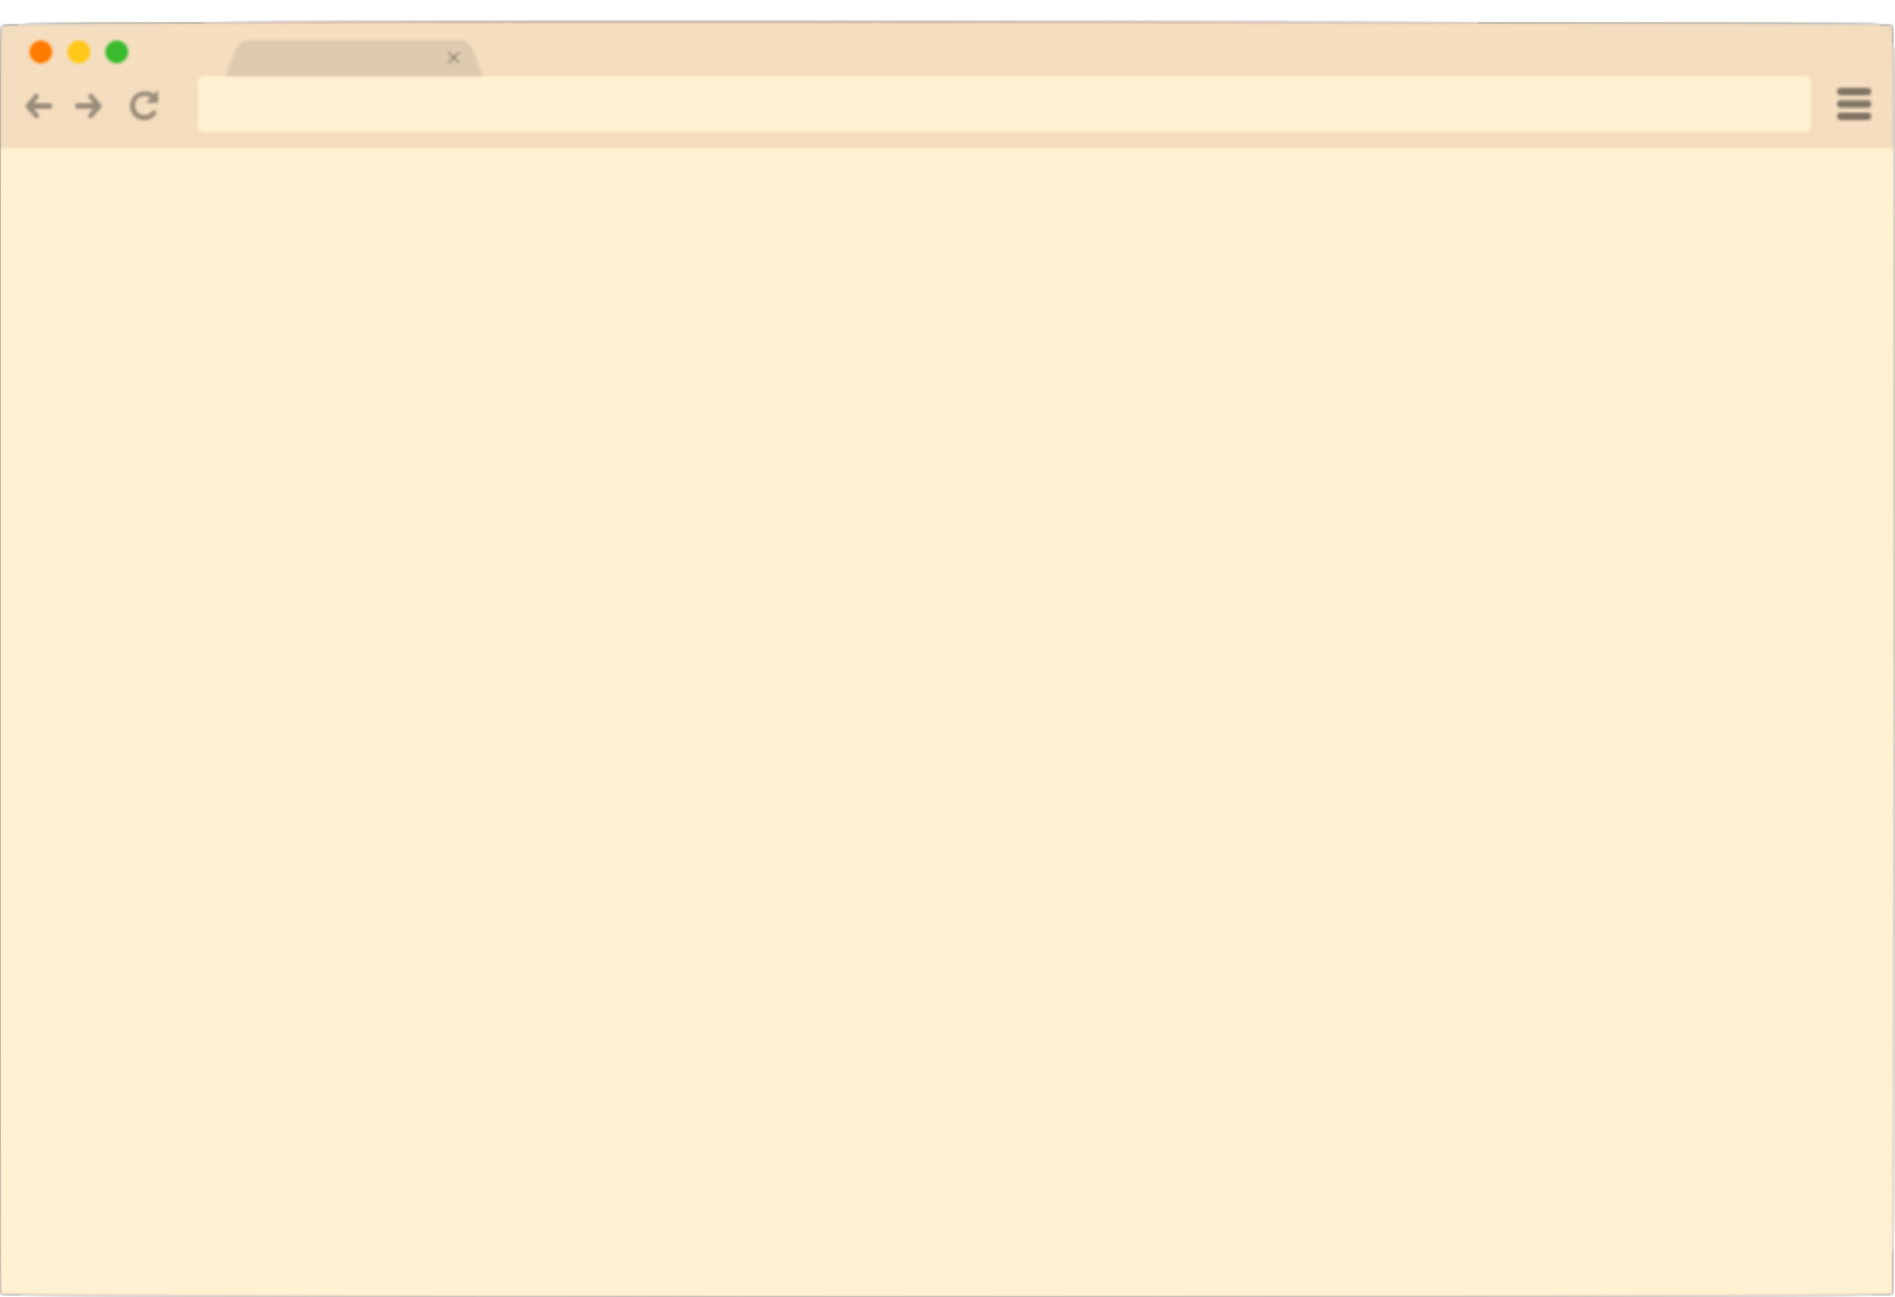








Monolithic Browser Design
Web Page
EXE
Local System
Files
Apps
Sensors

Slide 3
2nd Generation Browser: Process-based Isolation
Process-based sandboxing – process boundary
Web Page
Web/Local
Boundary
Browser kernel
Local System

Slide 4


Is the Web/Local Boundary Sufficient?
Used by most modern browsers
Web Page A
Web Page B
Web/Local
Boundary
Browser kernel
Local System
Stress testing, bug bounty,
fuzzing …

Slide 5
Contributions
The Web/Local Boundary is Fuzzy !
Concrete
Attacks
Access local files, system control
Use 1 bug in renderer process
Attack
Details
Bypass in-memory protections using data-oriented attacks
Solutions
Imperfect existing solutions
Our light-weight mitigation

Slide 6

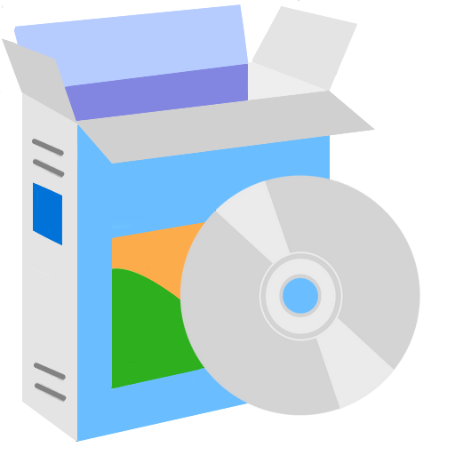
The Web/Local Boundary is Fuzzy
Landscape changes --- Rise of the cloud services
Before
2016
Web Page
Fuzzy
Cloud
Web/Local
Boundary
A new path to
access local system
Browser Kernel
Local System
Client

Slide 7
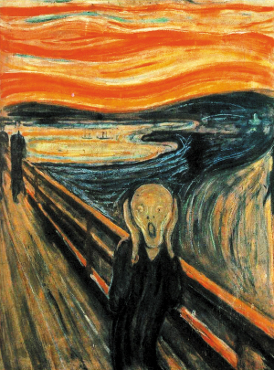
Attacks due to Fuzzy Web/Local Boundary

Slide 8

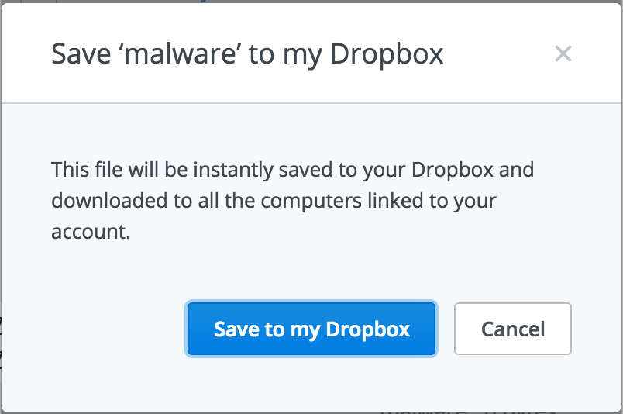


Attack Example 1: Drop a Malware
www.evil.com
Dropbox Cloud
Browser Kernel
Local System
Dropbox
Client

Slide 9
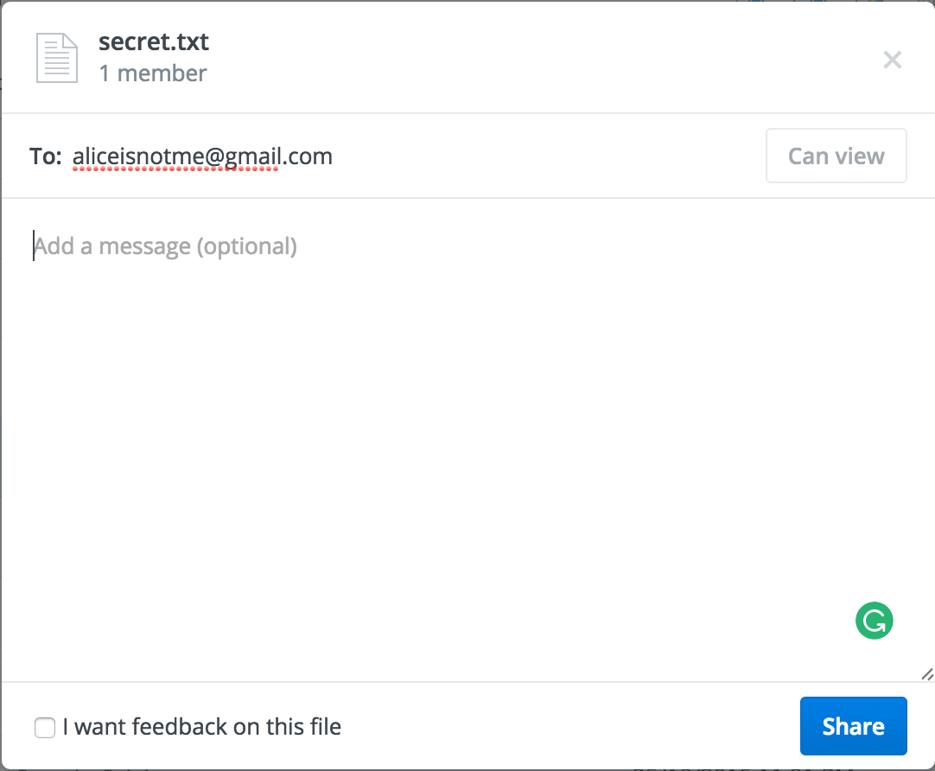

Example 2: Steal a Local File
www.evil.com
Dropbox Cloud
Browser Kernel
Local System
Dropbox
Client

Slide 10
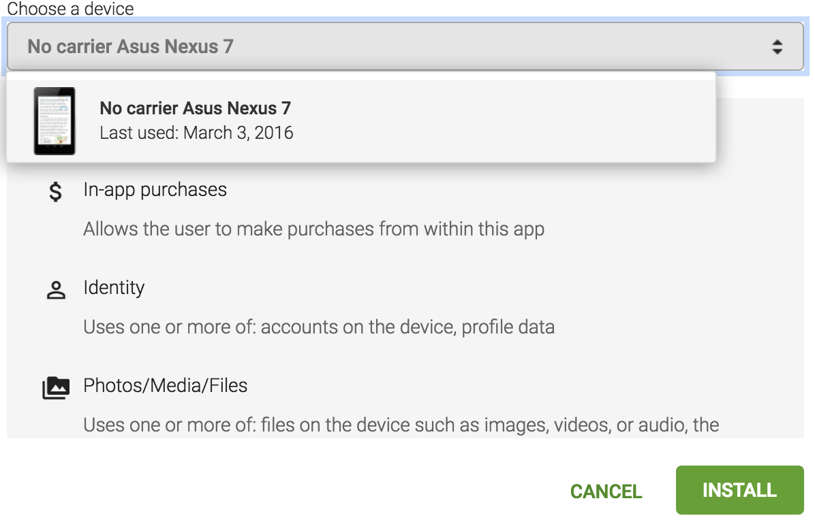

Example 3: Install Malware
www.evil.com
Google Play Server
Browser Kernel
Local System (Android)
Google Play

Slide 11

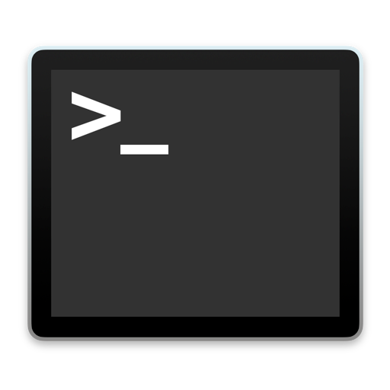

Example 4: Remote System Control
www.evil.com
rm -rf /
OpenStack Server
Browser Kernel
Local System (VM)
OpenStack

Slide 12
But … Chrome’s Protections
Same-Origin Policy (SOP)
Control-Flow Integrity (CFI) on the way
In-Memory Partitioning
Internal Randomization

Slide 13

SOP Enforcement in Chrome
www.evil.com
bool SecurityOrigin::canAccess() {
if (m_universalAccess)
return true;
if (this == other)
return true;
......
return canAccess;}
SOP
Checks
www.dropbox.com
Various SOP checks for cross-origin read/write: contentDocument, frames, etc.

Slide 14
Control-Flow Integrity
CFI: control flows cannot be modified (on the way)
<func1>
…
lea func2, %eax
…
jmp *%eax
…
<func2>
push %ebx
…
Check1
Check2
Check3

Slide 15
Bypass SOP & CFI
Corrupt critical data
Not modify control flow
Bypass SOP checks
bool SecurityOrigin::canAccess() {
if (m_universalAccess)
return true;
if (this == other)
return true;
......
return canAccess;
}
Check1
True
True
Check2
When m_universalAccess is true, the check always passes
Check3
True

Slide 16
In-Memory Partitioning
Separate different types of objects in 4 partitions
Surrounded by inaccessible guard pages
Different Objects
Guard Page
Node
Layout
Buffer
General

Slide 17
Cross-Partition References to Bypass Partitioning
Link objects in one partition to another
Pervasive & often under the control of scripts
Dereference pointers to cross partition boundaries
General
Buffer
Layout
Node

Slide 18
Partition-based Randomization
Randomize the base address of each partition
Guard pages cannot be read/written
Node
Layout
Buffer
General

Slide 19
Fingerprinting Technique to Bypass ASLR & Find Critical Data
Special pattern for security monitor objects
Linearly scan memory
class PLATFORM_EXPORT SecurityOrigin
{ ......
String m_protocol;
String m_host;
String m_domain;
String m_suboriginName;
unsigned short m_port;
bool m_isUnique;
bool m_universalAccess;
bool m_domainWasSetInDOM;
bool m_canLoadLocalResources;
bool m_blockLocalAccessFromLocalOrigin;
bool m_needsDatabaseIdentifierQuirkForFiles;
};
……
B9 BB 88 20
B9 CC 91 10
B9 CC 91 10
00 00 00 00
00 00 00 00
00 00 00 00
……
protocol
Match the pattern
host
domain
suborigin
01
m_universalAccess

Slide 20
Find the Address of Vulnerable Array
Create a predictable “fingerprinting” object
Linearly scan memory to find the object’s location
……
B9 DD 11 10
……
41 41 41 41
41 41 41 41
……
B9 DD 22 30
B9 DD 22 30
B9 DD 22 30
B9 DD 22 30
……
Count the offset when finding the pattern
Vulnerable Array
Offset
Fingerprinting Object
Most frequent data is the address of fingerprinting object
Object Pointer
… …
Object Pointer
Addr_{base} = Addr_{obj}- Offset

Slide 21


Bypass SOP & In-Memory Protections
SOP
Data-oriented attacks
Seems difficult to bypass
CFI
Data-oriented attacks
In-memory partitioning
Cross-partition references
Internal ASLR
Fingerprinting technique

Slide 22





Attack Implementation
Work on proper memory error vulnerabilities
POC: CVE 2014-1705 heap overflow in V8 (Chrome 33)
Over 10 SOP-related flags (Chrome 45)
End-to-end attacks
Access files on the local system
Dropbox, Google Drive
Interact with local system
OpenStack, Google Play
Misuse system sensors
Fitbit, Runkeeper

Slide 23

Protections against Web/Local Attacks

Slide 24
Web Browser-Side Protection
Memory safety
Huge code base, e.g., +5 million LOC for Chrome
Software-based fault isolation (SFI)
Cross-partition references
General
Buffer
Layout
Node

Slide 25
Light-Weight Mitigation
Identify critical data
ASLR to hide the address of critical data
Address of the critical data is not saved in user space
Average 3.8% overhead
Raise the bar of Web/Local attacks
General
Buffer
Layout
Node

Slide 26
Disclosure to Google
Fine-grained process-based isolation
Chrome’s Out-of-Process iframes
Performance overhead and massive refactoring
www.evil.com
www.evil.com
www.dropbox.com
www.dropbox.com

Slide 27

Cloud Service-Side Protection
Distinguish requests of its site from client
Restrict the privileges for the web interface
Require the user’s consent
Web Page
Cloud
Web/Local
Boundary
Browser Kernel
Local System
Client

Slide 28


Conclusion
Concrete Attacks on Web/Local Boundary
Access local files, system control
Using 1 bug in renderer process
Attack Details
Bypass in-memory protections
Solutions
Imperfect existing solutions
Open to researchers
Video at https://youtu.be/fIHaiQ4btok
POC at https://github.com/jiayaoqijia/Web-Local-Attacks

Slide 29
Thanks
Yaoqi Jia
(Graduating in 2017)
jiayaoqi@comp.nus.edu.sg
http://www.comp.nus.edu.sg/~jiayaoqi/

