Slide 1


Where Does It Go? Refining Indirect-Call Targets with Multi-Layer Type Analysis
Kangjie Lu Hong Hu

Slide 2
What is an indirect call?

Slide 3
Example, purpose, and commonness
void foo(int a) {
printf("a = %d\n", a);
}
typedef void (*fptr_t)(int);
// Take the address of foo() and
// assign to function pointer fptr
fptr_t fptr = &foo;
...
// Indirect call to foo()
fptr(10);

Slide 4
Example, purpose, and commonness
void foo(int a) {
printf("a = %d\n", a);
}
typedef void (*fptr_t)(int);
// Take the address of foo() and
// assign to function pointer fptr
fptr_t fptr = &foo;
...
// Indirect call to foo()
fptr(10);

Slide 5
Example, purpose, and commonness
Purpose
To support dynamic behaviors
Common scenarios
Interface functions
Virtual functions
Callbacks
Commonness
Linux: 58K
Firefox: 37K
void foo(int a) {
printf("a = %d\n", a);
}
typedef void (*fptr_t)(int);
// Take the address of foo() and
// assign to function pointer fptr
fptr_t fptr = &foo;
...
// Indirect call to foo()
fptr(10);

Slide 6
Example, purpose, and commonness
Purpose
To support dynamic behaviors
Common scenarios
Interface functions
Virtual functions
Callbacks
Commonness
Linux: 58K
Firefox: 37K
void foo(int a) {
printf("a = %d\n", a);
}
typedef void (*fptr_t)(int);
// Take the address of foo() and
// assign to function pointer fptr
fptr_t fptr = &foo;
...
// Indirect call to foo()
fptr(10);
Indirect calls are essential and common

Slide 7
Indirect call is however a major roadblock in security
Couldn’t construct a precise call-graph!

Slide 8
Indirect call is however a major roadblock in security
Couldn’t construct a precise call-graph!
All inter-procedural static analyses and bug detection require a global call-graph!
Otherwise, path explosion and inaccuracy
Effectiveness of control-flow integrity (CFI) depends on it!

Slide 9
Indirect call is however a major roadblock in security
Couldn’t construct a precise call-graph!
All inter-procedural static analyses and bug detection require a global call-graph!
Otherwise, path explosion and inaccuracy
Effectiveness of control-flow integrity (CFI) depends on it!
Identifying indirect-call targets is foundational to security!

Slide 10
How can we identify them?

Slide 11
Two approaches: Point-to analysis vs. Type analysis
Point-to Analysis
Whole-program analysis to find all possible targets
Cons
Precise analysis can’t scale
Suffers from soundness or precision issues
Itself requires a call-graph

Slide 12
Two approaches: Point-to analysis vs. Type analysis
Point-to Analysis
Whole-program analysis to find all possible targets
Cons
Precise analysis can’t scale
Suffers from soundness or precision issues
Itself requires a call-graph
(First-Layer) Type Analysis
Matching types of functions and function pointers (FLTA)
Cons
Over-approximate
Worse precision in larger programs

Slide 13
Two approaches: Point-to analysis vs. Type analysis
Point-to Analysis
Whole-program analysis to find all possible targets
Cons
Precise analysis can’t scale
Suffers from soundness or precision issues
Itself requires a call-graph
(First-Layer) Type Analysis
Matching types of functions and function pointers (FLTA)
Cons
Over-approximate
Worse precision in larger programs
Practical and used by CFI techniques

Slide 14
Our intuition:
Function addresses are often stored to structs layer by layer.
Layered type matching is much stricter.

Slide 15
Our intuition:
Function addresses are often stored to structs layer by layer.
Layered type matching is much stricter.
MLTA: Multi-Layer Type Analysis

Slide 16
Illustrate MLTA
// Assign address of foo to a nested field
1. a->b->c->fptr = &foo;
2. d->b->c->fptr = &bar;
... // Complicated data flow
3. a->b->c->fptr(10); // Indirect call to foo() not bar()

Slide 17
Illustrate MLTA
// Assign address of foo to a nested field
1. a->b->c->fptr = &foo;
2. d->b->c->fptr = &bar;
... // Complicated data flow
3. a->b->c->fptr(10); // Indirect call to foo() not bar()
&foo
fptr
c
b
a

Slide 18
Illustrate MLTA
// Assign address of foo to a nested field
1. a->b->c->fptr = &foo;
2. d->b->c->fptr = &bar;
... // Complicated data flow
3. a->b->c->fptr(10); // Indirect call to foo() not bar()
&foo
fptr
c
b
Complicated data flow
a

Slide 19
Illustrate MLTA
// Assign address of foo to a nested field
1. a->b->c->fptr = &foo;
2. d->b->c->fptr = &bar;
... // Complicated data flow
3. a->b->c->fptr(10); // Indirect call to foo() not bar()
&foo
fptr()
fptr
fptr
c
c
b
b
Complicated data flow
a
a

Slide 20
Illustrate MLTA
// Assign address of foo to a nested field
1. a->b->c->fptr = &foo;
2. d->b->c->fptr = &bar;
... // Complicated data flow
3. a->b->c->fptr(10); // Indirect call to foo() not bar()
Layered type
&foo
fptr()
fptr_t
fptr
fptr
struct C
c
c
struct B
b
b
Complicated data flow
struct A
a
a

Slide 21
Illustrate MLTA
// Assign address of foo to a nested field
1. a->b->c->fptr = &foo;
2. d->b->c->fptr = &bar;
... // Complicated data flow
3. a->b->c->fptr(10); // Indirect call to foo() not bar()
Layered type
&foo
fptr()
Only functions whose addresses are ever stored to the layered type can be valid targets
fptr_t
fptr
fptr
struct C
c
c
struct B
b
b
Complicated data flow
struct A
a
a

Slide 22
Results comparison of approaches
// Assign address of foo to a nested field
1. a->b->c->fptr = &foo;
2. d->b->c->fptr = &bar;
... // Complicated data flow
3. a->b->c->fptr(10); // Indirect call to foo() not bar()
Approach | MLTA | FLTA | 2-Layer
Matched targets | foo() | foo(), bar() | foo(), bar()

Slide 23
Advantages of the MLTA approach
Most function addresses are stored to structs
88% in the Linux kernel
Being elastic
When a lower layer is unresolvable, fall back
Avoid false negatives
MLTA should be always better than FLTA
No expensive or error-prone analysis

Slide 24
“This is very intuitive; what are the challenges?”
“Fine-grained control-flow integrity for kernel software” (EuroSP’16)
by Xinyang Ge, Nirupama Talele, Mathias Payer, Trent Jaeger.

Slide 25
Research questions and challenges
To what extent can MLTA refine the targets?
Can MLTA guarantee soundness?
No false negatives
Can MLTA also support C++?
Virtual functions and tables
Can MLTA scale to large and complex programs?
How can MLTA benefit static analysis and bug finding?

Slide 26
Our technical contributions
Multiple techniques to ensure effectiveness and soundness
With an elastic design and formal analysis
Support C++
Extensive evaluation (OS kernels and a browser)
35 new kernel security bugs

Slide 27
Realize MLTA: Overview of the TypeDive system
Layered
type analysis
Maintained
data structures
Targets resolving
Confinement analysis
LLVM
Bitcode
files
Indirect-call targets
Type-function map
Iterative & elastic resolving algorithm
Propagation analysis
Type-propa. map
Escaped types
Escaping analysis
Phase I: Layered type analysis
Three analysis techniques and three data structures
Phase II: Indirect-call targets resolving
An iterative and elastic algorithm

Slide 28
Analyze type-function confinements
Purpose
To identify which types have been assigned with which functions
We say type A confines foo(), if &foo is stored to an A object
Inputs
Address-taking and -storing operations
Global object initializers
Output
The type-function confinement map

Slide 29
Analyze type-function confinements
Purpose
To identify which types have been assigned with which functions
We say type A confines foo(), if &foo is stored to an A object
Inputs
Address-taking and -storing operations
Global object initializers
Output
The type-function confinement map
1. a->fptr = &foo;
...
2. fptr1 = &bar;

Slide 30
Analyze type-function confinements
Purpose
To identify which types have been assigned with which functions
We say type A confines foo(), if &foo is stored to an A object
Inputs
Address-taking and -storing operations
Global object initializers
Output
The type-function confinement map
Type | Function set
fptr_t | foo(), bar()
struct A_{fptr_t} | foo()
1. a->fptr = &foo;
...
2. fptr1 = &bar;

Slide 31
Analyze type propagations
Purpose
To capture propagation of addresses from one type to another
Inputs
Type casts and non-address-taking object stores
Output
The type-propagation map

Slide 32
Analyze type propagations
Purpose
To capture propagation of addresses from one type to another
Inputs
Type casts and non-address-taking object stores
Output
The type-propagation map
1. a = (struct A*)b;
...
2. c->a = a;

Slide 33
Analyze type propagations
Purpose
To capture propagation of addresses from one type to another
Inputs
Type casts and non-address-taking object stores
Output
The type-propagation map
Destination type | Source type
struct A | struct B
struct C_{A} | struct A
1. a = (struct A*)b;
...
2. c->a = a;

Slide 34
Analyze type propagations
Purpose
To capture propagation of addresses from one type to another
Inputs
Type casts and non-address-taking object stores
Output
The type-propagation map
Destination type | Source type
struct A | struct B
struct C_{A} | struct A
1. a = (struct A*)b;
...
2. c->a = a;
Only for non-confinement stores

Slide 35
Identify escaped types
Purpose
To identify types that may hold undecidable functions
Discard such types to avoid false negatives
What conditions result in an escaped type?
Unsupported type:
General pointer (e.g., char *) and integer types or
Types with arithmetically computed object pointers
A type is escaping if:
It is cast from an unsupported type or
It is cast to an unsupported type

Slide 36
Examples of escaping cases
// Case 1
void * ptr = ...;
...
c->a = (struct A*)ptr;
// Case 2
void *ptr = (void *)c->a;

Slide 37
Resolve indirect-call targets
Targets resolving
Maintained
data structures
Type-function map
Type-propa. map
Escaped types

Slide 38
Resolve indirect-call targets
Targets resolving
For each indirect call, do initialization
Maintained
data structures
Type-function map
Type-propa. map
Escaped types

Slide 39
Resolve indirect-call targets
Targets resolving
For each indirect call, do initialization
Maintained
data structures
Get current layered type
Type-function map
Type-propa. map
Escaped types

Slide 40
Resolve indirect-call targets
Targets resolving
For each indirect call, do initialization
Maintained
data structures
Get current layered type
Type-function map
Escaped type?
Type-propa. map
Escaped types

Slide 41
Resolve indirect-call targets
Targets resolving
For each indirect call, do initialization
Maintained
data structures
Get current layered type
Type-function map
Escaped type?
Type-propa. map
No
Get next layer?
Escaped types

Slide 42
Resolve indirect-call targets
Targets resolving
For each indirect call, do initialization
Maintained
data structures
Get current layered type
Type-function map
Escaped type?
Type-propa. map
No
Get next layer?
Escaped types
Yes

Slide 43
Resolve indirect-call targets
Targets resolving
For each indirect call, do initialization
Maintained
data structures
Get current layered type
Type-function map
Escaped type?
Type-propa. map
No
Yes
Get next layer?
Go prev layer
Escaped types
Yes

Slide 44
Resolve indirect-call targets
Targets resolving
For each indirect call, do initialization
Maintained
data structures
Get current layered type
Type-function map
Escaped type?
Type-propa. map
No
Yes
Get next layer?
Go prev layer
Escaped types
Yes
No

Slide 45
Resolve indirect-call targets
Targets resolving
For each indirect call, do initialization
Maintained
data structures
Get current layered type
Type-function map
Escaped type?
Type-propa. map
No
Yes
Get next layer?
Go prev layer
Escaped types
Yes
No
Indirect-call targets
Recursively resolve targets for the layered type

Slide 46
Resolve indirect-call targets
Targets resolving
For each indirect call, do initialization
Maintained
data structures
Get current layered type
Type-function map
Escaped type?
Type-propa. map
No
Yes
Get next layer?
Go prev layer
Escaped types
Yes
No
Indirect-call targets
Recursively resolve targets for the layered type
The recursive resolving algorithm queries type-function and type-propagation maps to collect all targets

Slide 47
Support C++
Problem: VTable pointers are always cast to unsupported-type pointers
Identified as escaped types
Cannot benefit from MLTA at all
Our solution: Directly map virtual functions to class types by skipping VTable pointers
Also support multiple inheritances

Slide 48
Implementation
Based on LLVM
Supported types: struct, vector, and function type
Field-sensitive, but flow-insensitive and context-insensitive
Hashing type information to reduce memory overhead

Slide 49
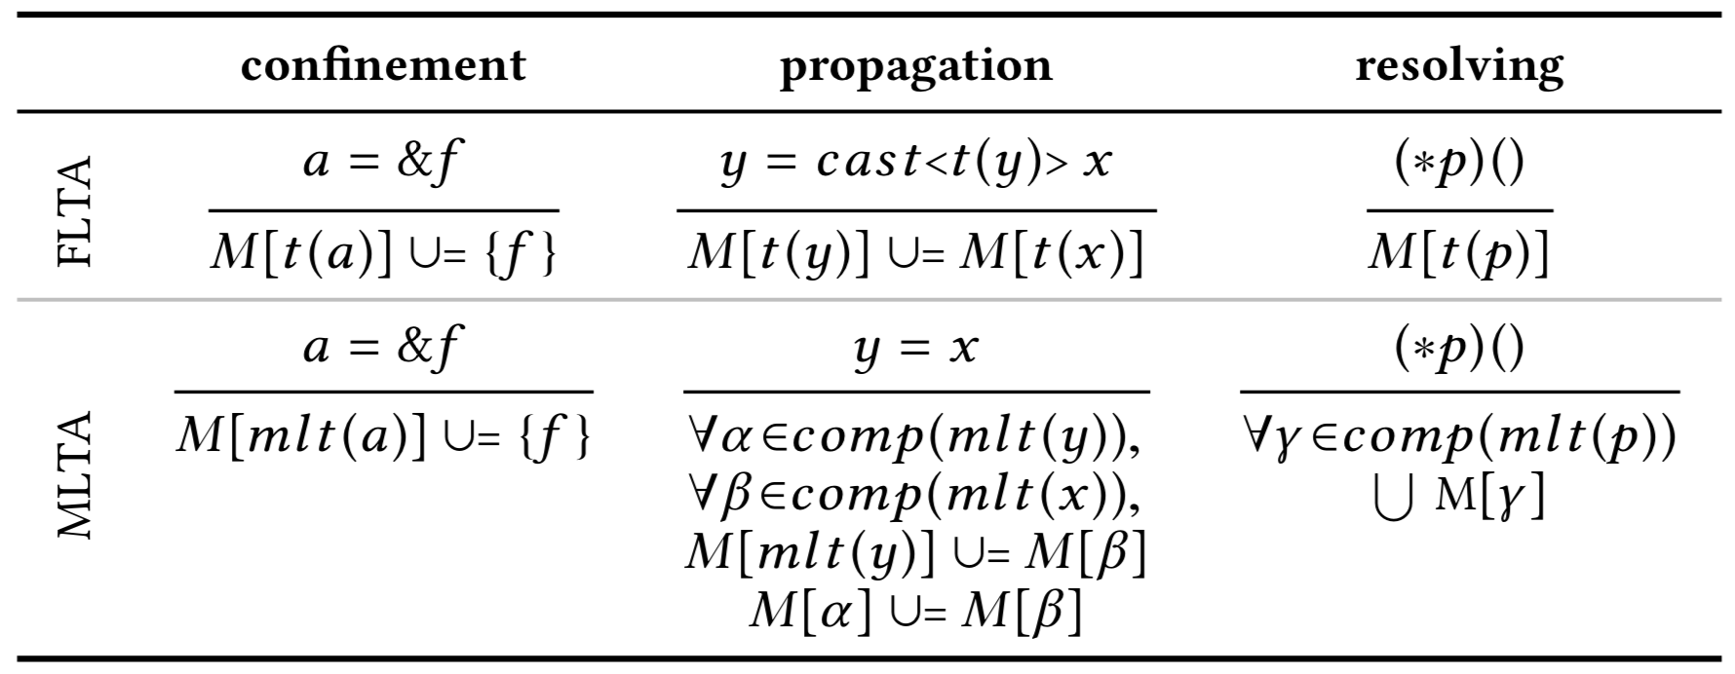
Formal analysis of effectiveness and soundness
We prove:
MLTA has fewer FPs than FLTA (effectiveness)
FLTA may have FNs, but MLTA does not introduce extra FNs (soundness)
Details in the paper

Slide 50
Evaluate MLTA
Evaluation goals
Scalability, effectiveness, soundness, and use cases
Experimental setup
The Linux kernel, the FreeBSD kernel, and the Firefox browser
64GB RAM and Intel CPU (3.20 GHz, 8 cores)
System | Modules | SLoC | Loading Time | Analysis Time
Linux | 17,558 | 10,330K | 2m 6s | 1m 40s
FreeBSD | 1,481 | 1,232K | 6s | 6s
Firefox | 1,541 | 982K | 27s | 1m 25s

Slide 51
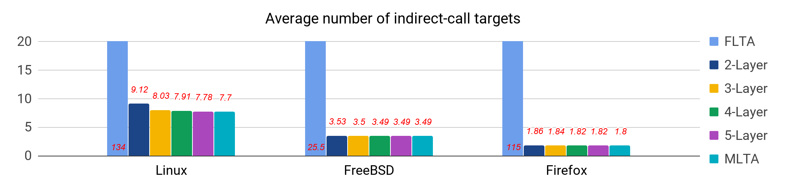
Reduction of indirect-call targets: Average number
MLTA-eligible indirect calls: 81%, 64%, 63%
MLTA achieves 94%, 86%, 98% further reduction over FLTA
The second layer achieves the most reduction
More layers keep reducing the number
5 layers suffice

Slide 52
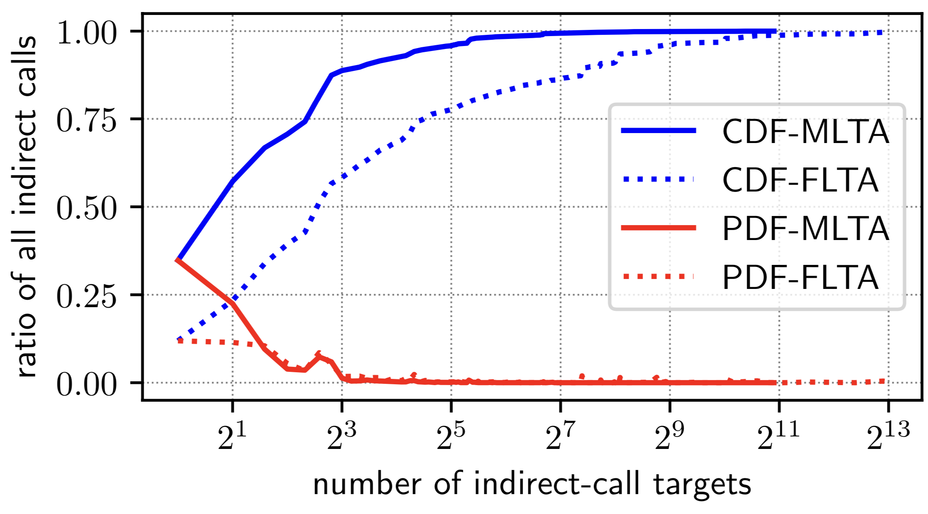
Reduction of indirect-call targets: Distribution (Linux)
<8 targets: MLTA 89%, FLTA 58%
Largest number: MLTA 1,914 targets, FLTA 7,983 targets

Slide 53
False-negative analysis
Trace execution to collect “ground-truth” targets
Instrument Firefox with PTWRITE via LLVM pass
Dump source & destination for each indirect call
50k pairs of <indirect call, callee>
Run Linux in QEMU and hook indirect calls
Hook __x86_indirect_thunk_rax
3,566 pairs of <indirect call, callee>
Several FNs caused by FLTA or lacking source

Slide 54
False-negative analysis
Trace execution to collect “ground-truth” targets
Instrument Firefox with PTWRITE via LLVM pass
Dump source & destination for each indirect call
50k pairs of <indirect call, callee>
Run Linux in QEMU and hook indirect calls
Hook __x86_indirect_thunk_rax
3,566 pairs of <indirect call, callee>
Several FNs caused by FLTA or lacking source
The MLTA approach does not introduce
extra false negatives than FLTA

Slide 55
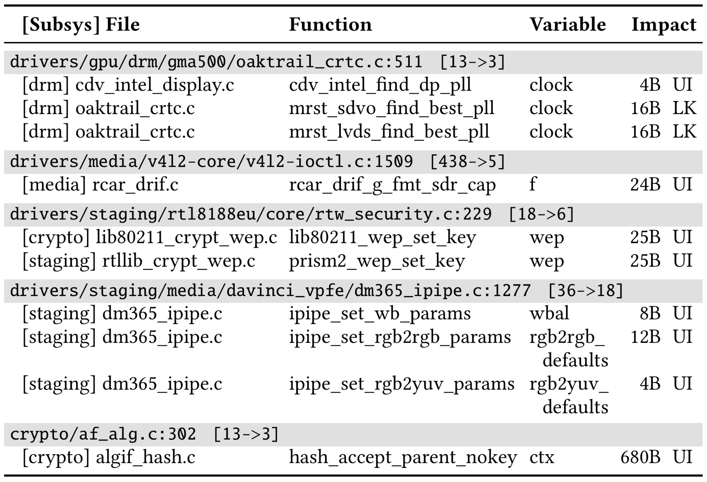
Benefit static-analysis and bug-finding
10 uninitialization bugs (see the left table) - FLTA #func → MLTA #func - MLTA helps save efforts
25 missing-check bugs (see the paper)

Slide 56
Conclusions
MLTA can dramatically refine indirect-call targets
Multiple new techniques and formal analysis
86%-98% further reduction over FLTA
Scale to large systems and support C/C++
No extra false negatives
A building block for static analysis and CFI
Precise indirect-call targets can serve as peers for detecting deep bugs
Identify deviating operations

