Slide 1
Kuali Mobility Enterprise (KME)
Webinar
2011-08-24
By: Brian McGough

Slide 2
Today’s Agenda
The Project
  The Mobile Web Core (phase I complete, more work)
  The institutional integrations (nearing phase I complete, more work remains as we do implementations_x0013_)
  The Mobile Tools (phase I complete, more remain)
  The community clearinghouse (still in queue, priority)
The Timelines
  Phase I – wrapping up
  Phase II – starting with Dev kickoff on 9/12
  Following sustainment or a phase III

Slide 3
Today’s Agenda
The Partners
  Current partners (IU, uMich, Cornell, Cambridge, HTC, Vivantech)
  Partner opportunities – the time is now
The value propositions to investors
  Pace of Mobile evolution on your campus
  Common Solutions
  Common Skillsets
  Support from the Commercial affiliates and the community

Slide 4
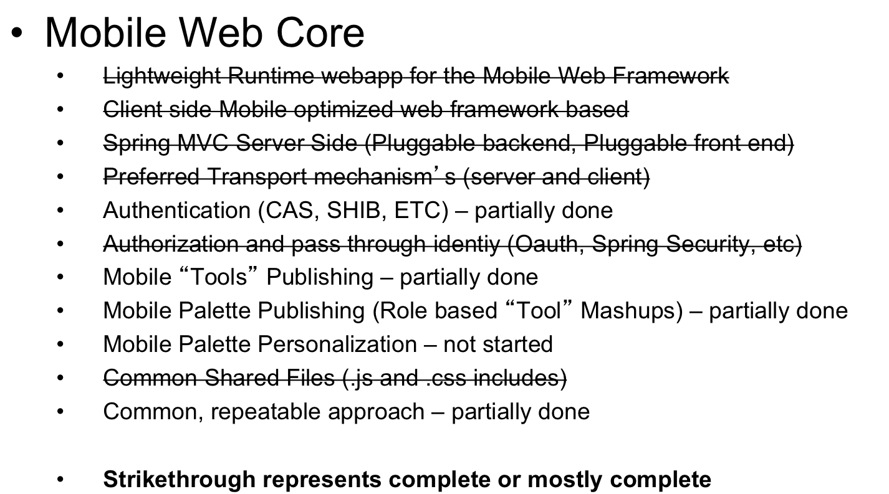
Project: Mobile Web Core

Slide 5
Project: Mobile Tools
  My Classes (LMS and SIS)
  News
  Campus Maps
  Campus Tours
  Athletics
  Events
  People
  Computer Labs
  Personal Calendar
  Knowledge Base answers
  Ask your Campus
  Blue denotes at least partial done, black not started
Dining Service
Campus Card
Emergency Contacts
Email (w/SSO)
Kuali Action List
Kuali Transaction Handler
Bursar balances
Washers & Dryers
Parking
Student Rec Centers
Course Bulletin
Schedule of Classes

Slide 6
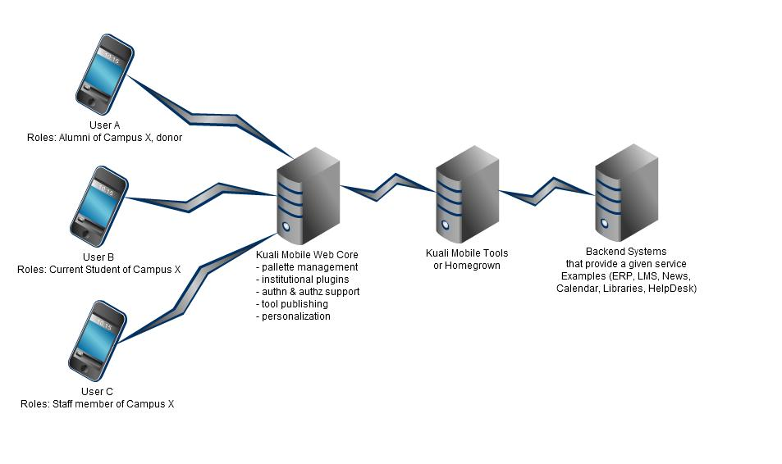
Project: Conceptual Architecture

Slide 7
Project: Institutional Integrations
An institution looking to adopt the KME needs to determine:
    How many Palette’s are needed (customized by roles of individuals. Applicant, admitted, enrolled, alum, donor, friend, etc…all become generalizations about the tools that should be exposed to that constituency)
      Some options and combinations that could exist
      (Maybe 1 unauth view)
    (Maybe 1 unauth and 1 auth view)
    (Maybe 1 per campus/role combination)
    (Maybe infinitely deeper by allowing targeted publishing of tools all the way down to the campus, school, and department level – include chapters from Alum Associations, and potentially many more publishing and provision hierarchies)_x0013_

Slide 8
Project: Institutional Integrations
An institution looking to adopt the KME
  Needs to determine:
    Which tools will be implemented, and is implementation of a tool feasible for the institution
    How those tool interfaces would be connected to backend systems at the institution if their institution used a tool that didn’t already have a supporting KME interface implementation written for it
    Options to plug in the backend for persons, users, groups, permissions at the institution. This needs to flex enough to allow for any system, and likely would have out of the box implementations for Kuali Rice, and maybe uPortal.

Slide 9
Project: Mobile Tools
Building and deploying a tool
  Local runtime (Mobile Core & Container)
    Typically SOA integration through rest web services **
    Always a generalized service layer. Example:
    “For LMS, think that we would do one set of services, for which we would write connectors to fulfill those service contracts from both Moodle and from Sakai.”
    Typically deployed alongside the Mobile Web Core
  Remote (other servers, other depts., cloud apps)
    Typically runs on alternative servers
    Integrated to the core through publishing
    Control of requests handed off to remote servers through redirection
    Common JavaScript and CSS includes on all pages
    Must leverage SSO if representing a restricted service

Slide 10
Project: Community Clearinghouse
A core value proposition for the project is that through aligning mobile web frameworks, we can more easily share common mobile tools with one another. Kuali Mobility will formalize that process and provide the clearinghouse of contributed Tools, such that member school A need not have a relationship with member school B to be able to share code.
  Through standards for technical approach to building a mobile tool
  Through alignment on an underlying toolset working across devices
  Through a formal peer reviewed process for accepting tools into the main codebase.
  Through trials and merits of each Tool, the community will be able to rank and recommend tools, as a community vetting process

Slide 11
Timeline: Phase I
Phase I == Heads down Sprint
  Primary outcomes: most of the mobile web core, many of the tools with at least one implementation, and some of the documentation, formation of governance structure, partnerships and MOU’s
  Dates: 6/13/2011 – 8/31/2011
  Software Outcome: KME version 1.0

Slide 12
Timeline: Phase II
Phase II == finish out initial scope, and generalize the product
  Primary outcomes: finish mobile web core, continue with tools, broaden backend implementations for tools (at least 2 reference implementations of tools against popular back end systems), round out documentation, quick start reference implementation, new set of priorities formed for phase III or go to sustainment mode
  Dates: 9/1/2011 – 12/31/2011
  Software outcomes: KME version 2.0

Slide 13
Phase III == based on progress, either continue rapid clip on scope or pivot to sustaining partnership
  Primary outcomes: finish any core or tool work identified in the original charter, ensure ongoing sustaining resources committed to the foundation, looking for many local implementations to help iterate the next generation of tools and requirements
  Dates: 1/1/2012 – 6/30/2012 (or ongoing)
  Software outcomes: KME version 2.1, 2.2, 2.3, etc

Slide 14
The Partners
  Still looking for additional investing and sustaining partners
  Founding: IU, Cornell, Cambridge, uMich, HTC, Vivantech
  Phase II commitments
    Pivot partners to cash or equivalent FTE contribution models
    Expand new investing partners further into functional council and board roles for appropriate project governance, governed by the investors in the project
  Phase III commitments
    Unclear at this point who will commit what, however the project will need enough resources to run the projects priorities and manage the contribution clearinghouse process actively. Also sustaining partners will be looked to for providing regional marketing at the regional educause venue or other venues around the world
  Getting involved now as an investor is key for dividends
    Why?
      Onboarding of new devs on 9/12
      Services council starts to define collective priorities in 9/2011
      Bringing the model to your campus is greatly aided by investing

Slide 15
Value Proposition
Through pooling of resources working in a directed development project we will:
  Increase the pace of mobile evolution on all partner school’s campuses more quickly than we can alone.
  Create common solutions for necessary mobile web tools, and be able to share the code for those easily across institutions
  Create common backend Connectors for these solutions and share those easily across institutions
  Avail of the community and commercial affiliates for expedited rollouts, building of a custom tool, or other types of support questions

Slide 16
Today’s update variant
Update from Governance perspective
  Services Council being staffed
    Charter is here
  Technical Council being staffed
    Charter is here
  Still seeking additional partners on the project, joining now rather than later has advantages for input into the councils and helping shape priorities for phase II

Slide 17
Kuali Mobility Enterprise (KME)
Questions???
2011-07-13
By: Brian McGough
bmcgough AT indiana DOT edu

