Slide 1
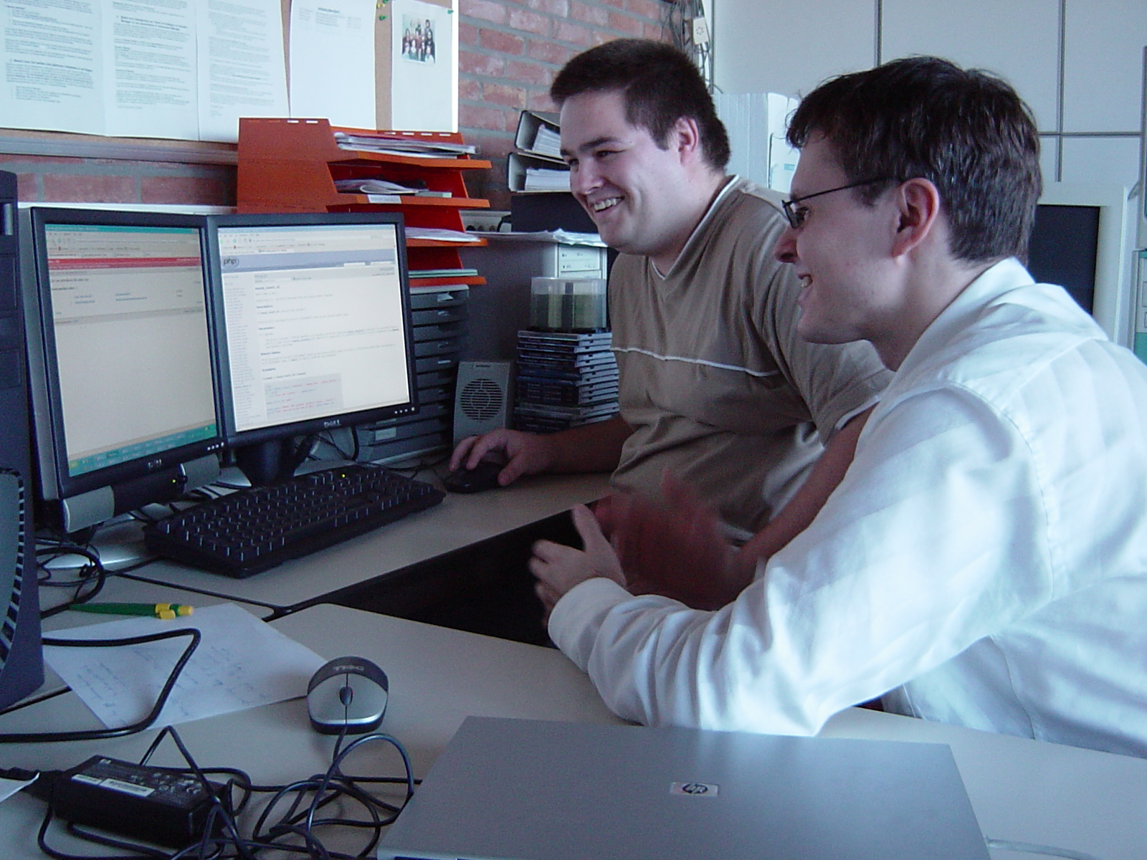

Migration to an open e-learning environment
Kris Steenhaut
Jan Driesen
www.icto.be

Slide 2
Outline
Erasmushogeschool Brussel
Change & implementation strategy for Dokeos
Technical issues
  coupling to LDAP-server
  coupling to student and lecturer administration
  adjustment of Dokeos code for EhB
  server configuration
Pedagogical: e-learning in Dokeos
The future

Slide 3
Erasmushogeschool Brussel
Fusion of the official higher education institutes in and around Brussels
9 departments, more than 4000 students
  Royal Conservatory of Music
  Audio-visual arts and technology
  Engineering and computer science
  Applied Language studies
  Landscape architecture and environmental sciences
  Hotel and Tourism
  Teacher training/ Health Care
  Social Sciences
  Communications

Slide 4
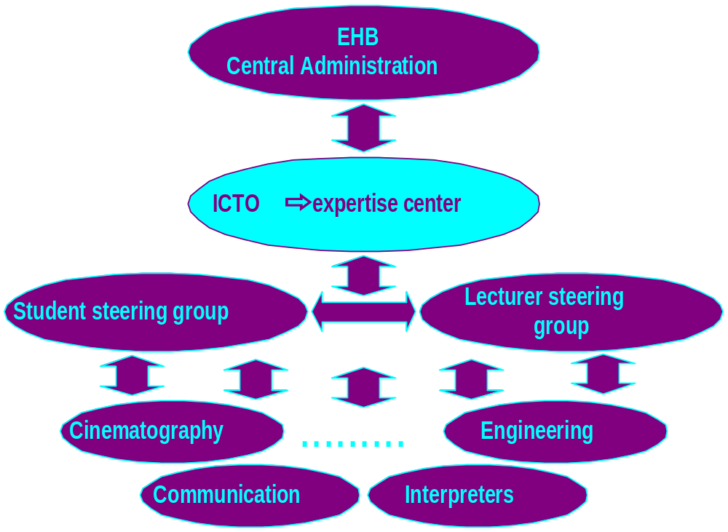
ICTO in the EhB structure

Slide 5


Spring 2000: Introduction of Bb and Perception

Slide 6
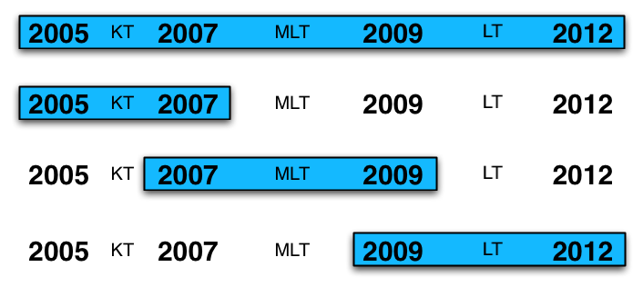
Planning the future

Slide 7
Preparation spring 2005
18/01: ICTO steering group: migration to Dokeos positively welcomed
01/02: Visit Hogeschool Gent and Artevelde Hogeschool
17/02: Open Source day, migration to Dokeos seen as positive
24/02: Talks with IT department: installation LDAP server
03/03: Study day e-Portfolio
04/03: First version of Dokeos report handed in for approval
15/03: Start online course E-learning on Dokeos server (EhB/VUB)

Slide 8
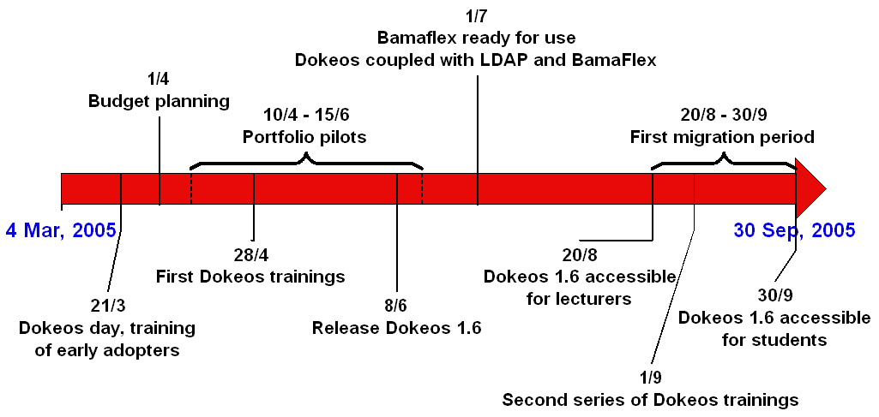
Short term planning

Slide 9
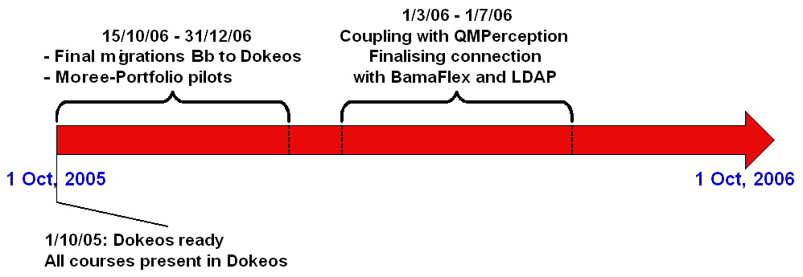
Short term planning

Slide 10
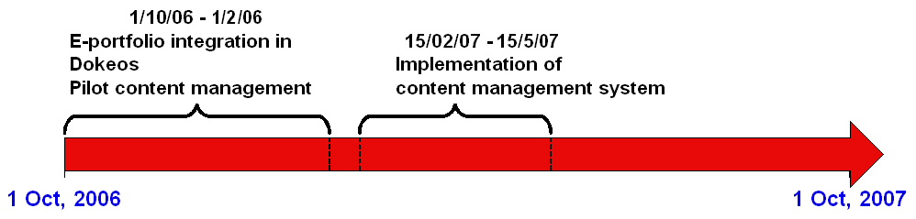
Short term planning

Slide 11
Expenses 2006-2008
2006
2007
2008
Cost in 3 years
Blackboard basic
10 000.00 €
(licence)
10 000.00 €
(licence)
10 000.00 €
(licence)
30 000.00 €
Blackboard full
37 500.00 € -
59 500.00 €
(licence + bridge QMPerception + consultancy + 0.25 FTE)
18 000.00 € - 40 000.00 €
(licence)
18 000.00 € -
40 000.00 €
(licence)
73 500.00 € - 139 500.00 €
Dokeos
16 500.00 €
(0.50 FTE + bridge QMPerception + support)
1 500.00 €
(support)
1 500.00 €
(support)
19 500.00 €

Slide 12
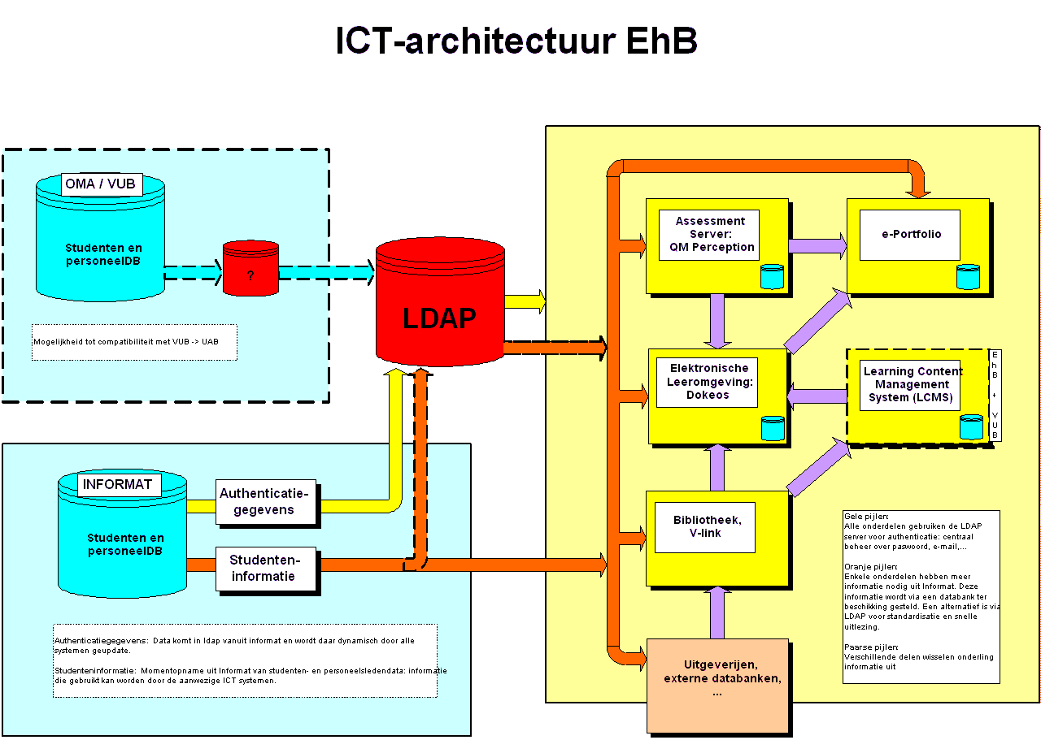
ICT Architecture

Slide 13
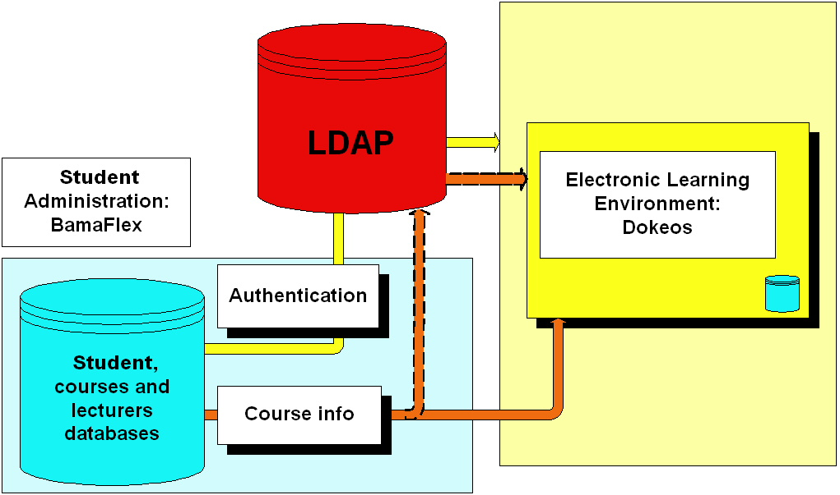
Resolving coupling problems

Slide 14
LDAP coupling problems
Late
Administrative personnel not in LDAP
Only username and password (no names, ...)
Adapt Dokeos to link with LDAP and with separate accounts for administrative personnel and externals (VLIR PhD students and VUB PhD students)

Slide 15
Problems BamaFlex coupling
Late
Late entry of coupling between lecturers and courses
Coupling based on name of lecturer (instead of using UNIQUE identifier) -> partly manual coupling
Some courses taught by 3 lecturers → 3 courses in DOKEOS
Some courses taught in different study programs →
multiple entries in Dokeos

Slide 16
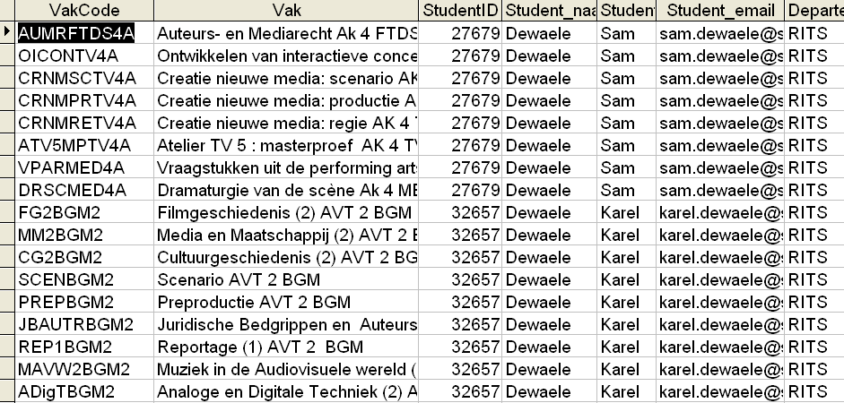
BamaFlex view

Slide 17
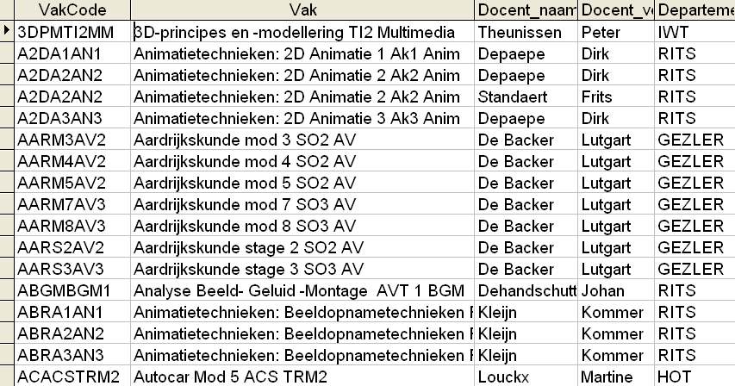
Bamaflex

Slide 18
Server problems
random crashes
load problems -> finding a good configuration
backups!

Slide 19
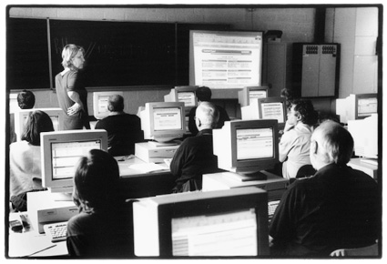
Dokeos training sessions

Slide 20
Questions?

