Slide 1
PHPMyWMS - an Open Source based, SVG oriented Framework for extended Web Map Services
Prof. Dr.-Ing. Franz-Josef Behr
University of Applied Sciences Stuttgart,
Department of Geomatics, Computer Science and Mathematics, Schellingstraße 24, D-70174 Stuttgart

Slide 2
Overview
Architecture
Overview over OGC‘s Web Map Service (WMS)
Key features of Scalable Vector Graphics (SVG)
Server side implementation
Client Implementations
Conclusion and Outlook

Slide 3
Architecture
Data preparation
GIS
(MapInfo, GeoMedia)
Visualization
Client
"User Agent"
Webserver
Document root
Static
Documents
http
Internet
http
XML / SVG
XML / SVG
SVG Viewer
CGI protocol
Server side Programs
Dynamic Generation of SVG documents
DBMS

Slide 4
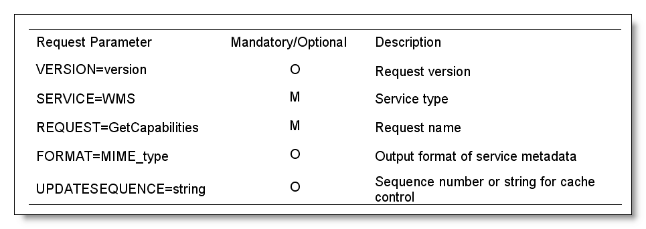
GetCapabilities request
http://www.gis-news.de/wms/getmapcap.php?VERSION=1.1.1&SERVICE=WMS&REQUEST=GetCapabilities

Slide 5
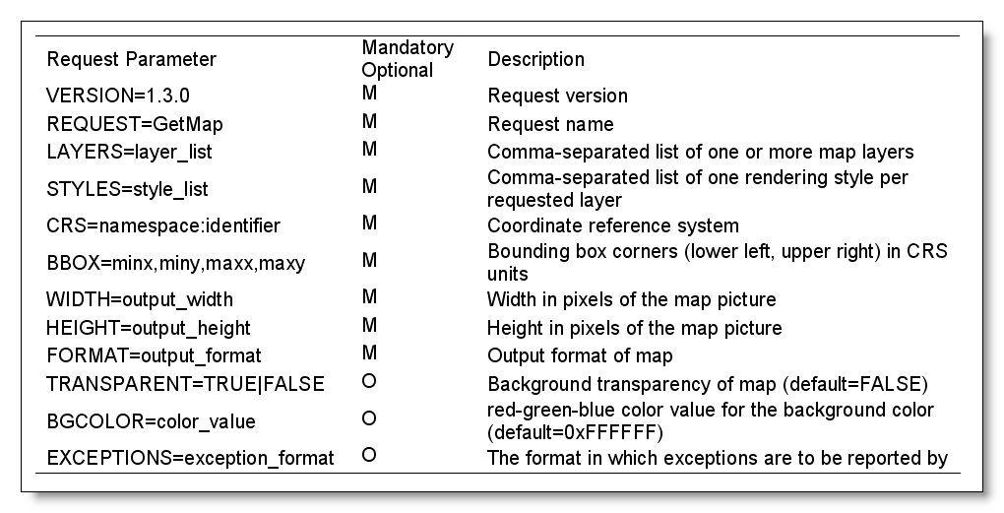
GetMap request
http://www.gis-news.de/wms/getmapcap.php?VERSION=1.1.1&BBOX=189775.33,4816305.37,761662.27,5472414.18&LAYERS=airports,ctybdpy2&STYLES=,,&REQUEST=GetMap&style=&SRS=EPSG:26715&4340&WIDTH=800&HEIGHT=600&FORMAT=image/svg+xml&EXCEPTIONS=application/vnd.ogc.se_xml

Slide 6
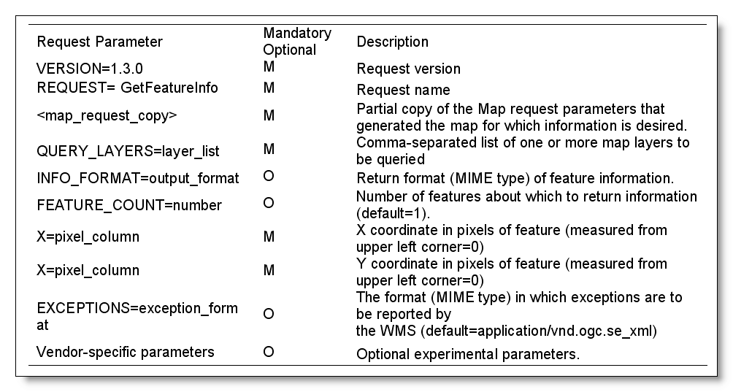
GetFeatureInfo request

Slide 7
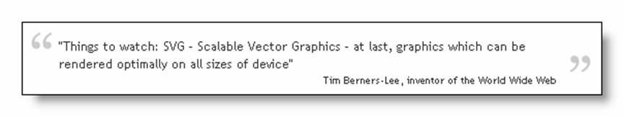
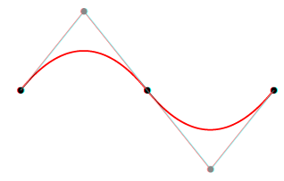
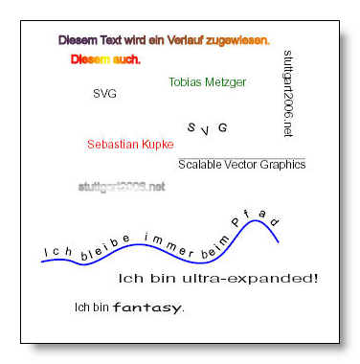
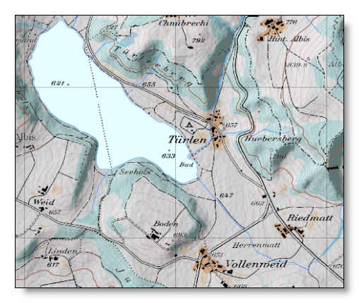
Scalable Vector Graphics: Cartographic application
http://www.carto.net/papers/svg/tuerlersee/
Notes:
rectangle <rect ...
circle: <circle ...
ellipse: <ellipse cx="200" cy="135" rx="50" ry="20" />
Line: <line ...
Polyline : <polyline points="160,200 180,230 200,210 234,220" />
Polygon: <polygon points="350,75 379,161 569,111 397,215 423,301 350,250 277,301" />
Path: <path...
Text: <text...

Slide 8
Scalable Vector Graphics: Key features and benefits
Recommendation of World Wide Web Consortium (w3.org)
Several profiles, including mobile profiles SVG Tiny (SVGT) and SVG Basic
Advantages
  XML based,
    combination with other XML technologies like XLink
    True geo-data, used as visualization for GML
    conformant to DOM, analysis & modification using JavaScript
  Outstanding graphical quality – very attractive!
  Accessibility and searchability
Notes:
SVG 1.1 is a W3C Recommendation since 2003 and forms the core of current SVG developments. SVG 1.2 is the specification currently being developed and exists as W3C Working Draft since April 2005.
SVG, more and more supported by modern browsers, has the following advantages:
• Graphical quality: SVG provides excellent graphics. Users can locally magnify their view of an image without sacrificing sharpness, detail, or clarity or additional server requests. The graphic is no more limited by fixed pixel sizes or degradation due to compression.
• Use on mobile devices: Because of the many advantages of SVGT, more and more mobile phones begin to support this format. For example, more than 130 SVG-enabled phones are currently listed at http://svg.org/special/svg_phones.
• Accessibility: Authors of well-structured SVG files can provide meaningful title and description elements as an extension to graphical object for supporting accessibility for people with disabilities (Campin 2003, Bulatov 2004). Screen readers can speak the title when objects are selected. For visually impaired users a tactile copy of the SVG display can be created by printing to a tactile device which provides haptic effects. Blind users can locate features and listen to the titles.
• Performance: SVG is suitable for applications that require continuous map updates and/or high level of interactivity at the client. Map updates can be achieved using Ajax technology, interactivity is supported locally using ECMAScript. Furthermore some authors mention the reduced file size compared to raster files, an important factor for restricted network bandwidth.
• True geo-data: Supporting XML format, the server’s output is not only a “portrayal of geographic information”, but can be used additionally to deliver the geo-data itself, comparable to an operation of the Web Features Service (Kettemann and Zhu 2005).
• XML technology: As an XML based grammar SVG enables combination with other technologies like XLink and SMIL and communication between applications on different platforms. In particular this format can be used in context of Asynchronous JavaScript and XML (Ajax) which is relevant for nowadays Internet mapping solution. As well known, Google® map (amongst others) uses such techniques.

Slide 9
Scalable Vector Graphics: Key features and benefits II
Increasing Browser support (Firefox, Opera)
Plug-ins and Stand-alone viewer applications
Mobile viewers
Conversion from many GIS formats / systems

Slide 10
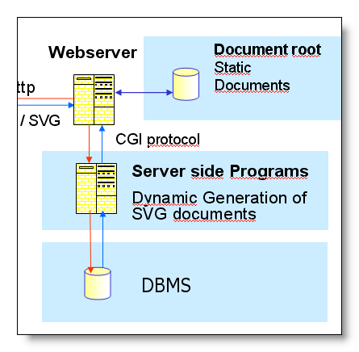
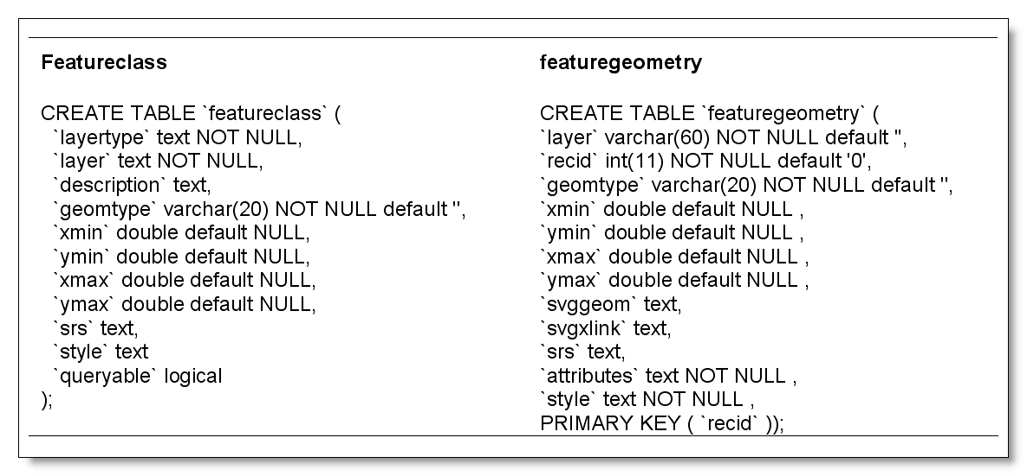
The WMS Server Tier
Main components:
  PHP based applications
  Geo-Database (currently MySQL)
extents
extents
GetCapabilities
GetMap, GetFeatureInfo

Slide 11
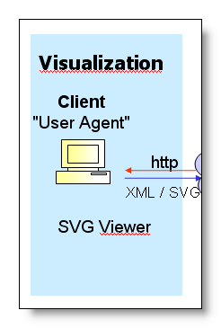
The Client Tier
Standard browsers (SVG enabled)
browser based WMS client (JavaScript based GUI)
Mobile client

Slide 12
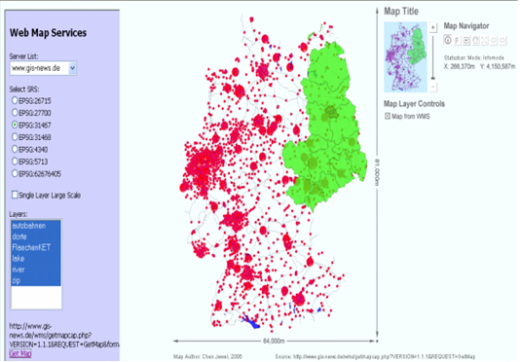
Browser based WMS client
JavaScript based GUI
Uses Asynchronous JavaScript and XML (AJAX) technology
- asynchronous progress of data exchanging with servers as background process

Slide 13
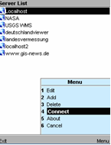
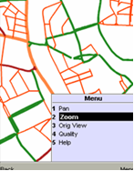
Mobile client
WMS client for mobile devices implemented based on SVGT and Java 2 Micro Edition (J2ME).
Mobile WMS clients provides a graphical user interface
typical functions for exploration of the map obtained from the WMS server
  Server selection
  zoom
  Pan
See PS III-1: Mobile GIS Technology

Slide 14
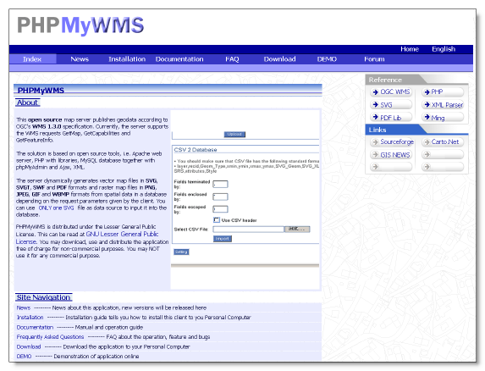
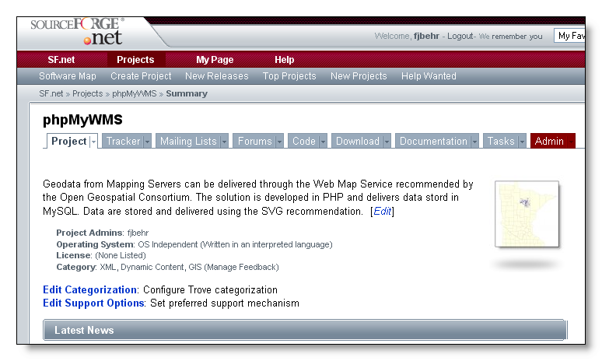
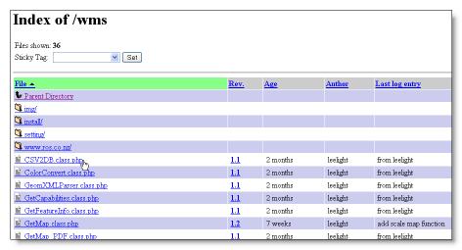
PHPMyWMS on the Web
Supports SVG format as well as raster formats and SWF and PDF
Open Source
Homepage: http://www.easywms.com
Additionally hosted at sourceforge.net
CVS repository

Slide 15
Conclusion and Outlook
Prove of concept: SVG is well suited for storing, transforming, displaying and transferring geo-data.
Possible improvements :
  Support of Styled Layer Descriptor (SLD) specification or user-defined symbolization.
  Extension to cascading server.
  LBS extension: User support like GSM-based positioning techniques, or GPS support would be helpful.
  Extending browser based client
  Adding additional services (like better GetFeature support based on geo-coordinates)
  Better sample data in the geo-database.
Notes:
An SVG-oriented framework for a Web Map Service environment has been implemented consisting of software to convert geo-data into SVG format and to upload it into a database and a WMS server application supporting the WMS operations GetCapabilities, GetMap, and GetFeatureInfo by providing service metadata, map data and attribute information for selected features. Besides SVG format the server also supports raster formats as well as SWF and PDF format. Map output can be displayed in standard browsers, SVG enabled browsers, and in two developed WMS viewer prototypes, one for ordinary browsers, another for mobile devices based on J2ME. This client, implemented as a MIDlet, can be ported to any smartphone (or even legacy phone) as long as the phone is Java-enabled.

Slide 16
Literature

