Slide 1
Haloalkanes and Haloarenes

Slide 2
CLASS OBJECTIVES
Recap
Chemical Properties of haloarenes
Uses of Polyhalogen compounds

Slide 3

Recapitulation
1. What are the three types of reactions , shown by haloalkanes?
2. The reaction of haloalkanes with sodium is called ______________________
3. Why we cannot use Wurtz reaction to prepare alkanes containing odd number of
C- atoms or methane ?
4. What is the name of the reagent obtained on reacting haloalkanes with magnesium
metal? What is the polarity on the C-atom attached to magnesium ?
5. Why is Grignard reagent to be prepared under anhydrous conditions ?
6. What are ambident nucleophiles? Explain with the help of examples.
7. What are nucleophilic substitution reactions ?

Slide 4
Recapitulation
8. Which compound in each of the following pairs will react faster in S_{N}2 reaction with –OH? (i) CH₃Br or CH₃I (ii) (CH₃)₃CCl or CH₃Cl
9. Predict the order of reactivity of the following compounds in S_{N}1 and S_{N}2 reactions:
(i) C₆H₅CH₂Br, C₆H₅CH(C₆H₅ )Br, C₆H₅CH(CH₃ )Br, C₆H₅C(CH₃)(C₆H₅)Br

Slide 5
Reactions of Haloalkanes
NUCLEOPHILIC SUBSTITUTION REACTIONS
SUMMARY OF OF S_{N}1 and S_{N}2 MECHANISMS
S_{N}1 MECHANISM | S_{N}2 MECHANISMS
Substitution nucleophilic unimolecular | Substitution nucleophilic bimolecular
The rate of reaction depends only on the concentration of alkyl halide | The rate of reaction depends on the concentration of both alkyl halide and the nucleophile
Two step reaction | One step reaction
Leads to racemisation | Leads to inversion of configuration
Order of reactivity: 3⁰ > 2⁰ > 1⁰ > methyl halide | Order of reactivity: 3⁰ < 2⁰ < 1⁰ < methyl halide
Order of reactivity: R-I > R-Br > R-Cl > R-F | Order of reactivity: R-I > R-Br > R-Cl > R-F

Slide 6
Reactions of Haloarenes
Haloarenes are the compounds formed by substitution of hydrogen of benzene ring by halogen atoms.
Haloarene are considered to be different from haloalkanes by virtue of chemical reactions;
Haloarenes have characteristics to undergo electrophilic substitution reactions whereas haloalkanes towards nucleophilic substitution reactions.
Haloarenes are less reactive towards nucleophilic substitution reactions due to the following reasons:

Slide 7
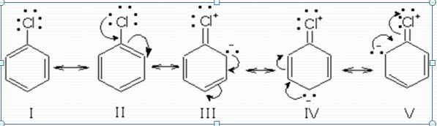
Reactions of Haloarenes
Haloarenes are less reactive towards nucleophilic substitution reaction due to
A . Resonance Effect:
The partial double bond character between C-Cl makes the bond stronger and difficult to remove.
B Difference in hybridisation of carbon-halogen bond:
The hybridisation of carbon atom in haloalkanes is sp³ –hybrid carbon but in haloarenes it is sp² hybrid orbital due to which C-X bond in haloarene is shorter and stronger and difficult to break.

Slide 8
Reactions of Haloarenes
C . Instability of Phenyl Cation:
In case of haloarenes, the phenyl cation formed as a result of self –ionisation will not be stabilised by resonance therefore SN1 mechanism is ruled out.
D. Electronic Repulsions :Since haloarene are electron rich due to
Pi electrons, they repel nucleophiles.

Slide 9
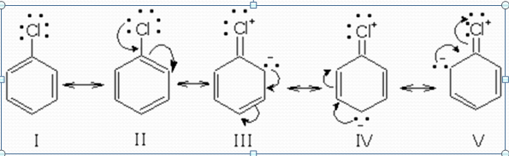
Nucleophilic Substitution Reactions of Haloarenes
Haloarenes undergo nucleophilic substitutions reactions in presence of strong nucleophiles and under high temperature conditions. In haloarenes , the electron pairs on the halogen atom are in conjugation with the pi π electrons of the ring and the following resonating structures are possible:
As a result of resonance haloarene , there is delocalisation of C− X bond which acquires a partial double bond character.Bond cleavage is difficult in haloarenes and hence they are less reactive towards nucleophilic substitution reactions.

Slide 10
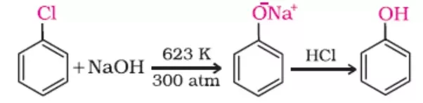
Nucleophilic Substitution Reactions of Haloarenes
On heating the chlorobenzene with aqueous solution of NaOH at 623 K and under pressure (300 atm), the halogen atom is replaced by hydroxyl group forming phenol. In the first stage sodium phenoxide is formed which on acidification gives phenol.
This reaction is called a Dow’s Process.

Slide 11
Effect of substituents on the reactivity of haloarenes towards nucleophlic Substitution Reactions
Nucleophilic Substitution Reactions of Haloarenes
The presence of certain groups at certain positions of the ring markedly effect the reactivity of haloarenes. It has been observed that the presence of electron withdrawing groups such as − NO₂, − CN, − COOH etc at o- and p- positions to the halogen atom greatly activates the halogen group towards nucleophilic substitution reactions. Further ,greater the number of EWG present at o- and p- positions w.r.t. the hlogen, more reactive will the haloarene.

Slide 12
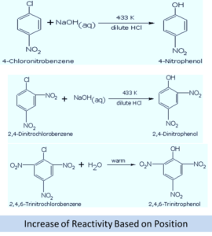
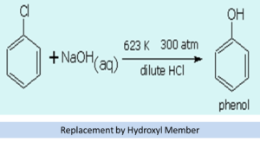
Effect of substituents on the reactivity of haloarenes towards nucleophlic Substitution Reactions

Slide 13
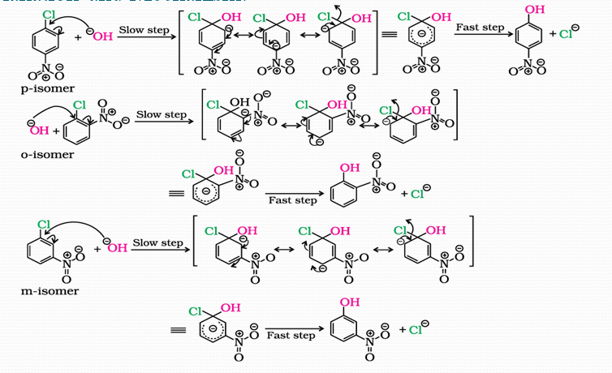
Explanation and Mechanism:

Slide 14
Why does - NO₂ Group shows it effect only at ortho and para position not at meta position?
The presence of NO₂ at ortho and para positions withdraws electron density from the benzene ring and therefore ,felicitates the attack of the nucleophiles on haloarenes.
In case of o- & p -chloronitrobenzenes, resonating structures carries a negative charge carbon atom bearing on the NO₂ group.Hence these carbanions are stabilized by NO₂ group as well as by the π –electrons of benzene ring.
In case of m – chloronitrobenzenes, there is no such structure in which negative charge on carbon atom bearing NO₂ group.So in case of m – chloronitrobenzenes, carbanion is not stablised by the NO₂ group but is stablised by π -electrons of the benzene ring.

Slide 15
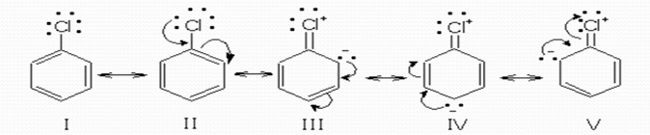
Electrophilic Substitution Reactions of Haloarenes
Haloarenes undergo electrophilic substitutions reactions in the benzene ring. The halogen atom is o- and p- directing towards electrophilic substitution reactions and therefore, substitution reactions takes place at o- and p-positions.
The ortho and para directing effect of the halogen atom can be understood if we consider the resonance structures of the chlorobenzene as shown below:
It can be seen that in structures III, IV and V , the ortho and para positions get negatively charged or the electron density is relatively more at ortho and para positions and consequently, the incoming electrophile is more likely to attack at these positions.

Slide 16
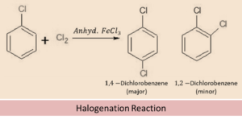
Electrophilic Substitution Reactions of Haloarenes
This reaction takes place by reacting haloarenes with halogens in presence of ferric salt as catalyst.
Chlorination: The chlorination of chlorobenzene will give 1,4-Dichlrobenzene (major) and 1,2-Dichlrobenzene (minor) products.

Slide 17
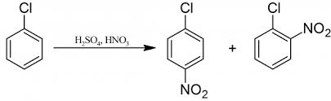
Electrophilic Substitution Reactions of Haloarenes
Nitration
This reaction results in introduction of NO₂ group at ortho and para positions to the haloarene.
This reaction is carried out by heating haloarenes with conc HNO₃ in the presence of Conc H₂SO₄ .

Slide 18
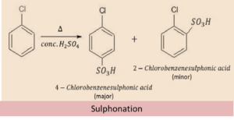
Electrophilic Substitution Reactions of Haloarenes
Sulphonation: This reaction is carried out by heating haloarene with Conc. H₂SO_{4.}
The products are 4- Chlorobenzene sulphonic acid (major) and 2- Chlorobenzene sulphonic acid (minor) .

Slide 19
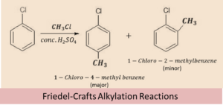
Electrophilic Substitution Reactions of Haloarenes
Friedel- Crafts reaction : The reaction known as Friedel- Crafts reaction , is carried out by treating haloarene with alkyl chloride in the presence of anhydrous AlCl₃ reacting as a Catalyst.
Friedel- Crafts alkylation reaction: This reaction introduces alkyl group at o- and p- positions on haloarenes.

Slide 20
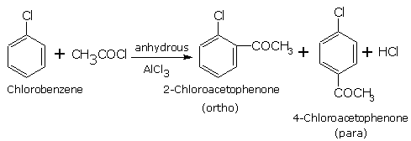
Electrophilic Substitution Reactions of Haloarenes
Friedel- Crafts acylation reaction: This reaction introduces acyl group(CH₃CO-) at o- and p- positions on haloarenes.
This reaction is carried out by reacting Acetyl chloride in presence of anhydrous AlCl₃ reacting as a Catalyst.
4- chloroacetophenone (major) and 2- chloroacetophenone (minor) are the products.

Slide 21
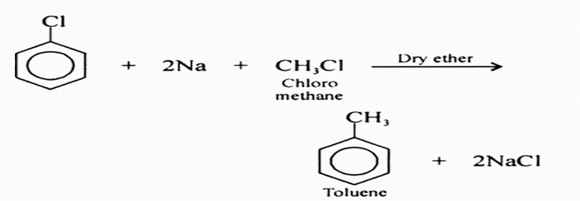
Reactions With Metals
Wurtz Fittig reaction: On reacting haloarene with alkyl halides in presence of sodium in ethernal solution , to form alkyl derivatives of benzene.

Slide 22
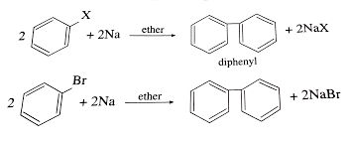
Reactions With Metals
Haloarenes react with metals in different ways to form the products. These are the reactions besides electrophilc and nucleophilic substitution reactions.These reactions are as:
Fittig Reaction: When only haloarenes are treated with sodium, diaryls are formed. When haloarene reacts with Na in ethernal solution ,it forms diphenyl .Reaction is shown as:

Slide 23
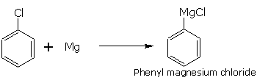
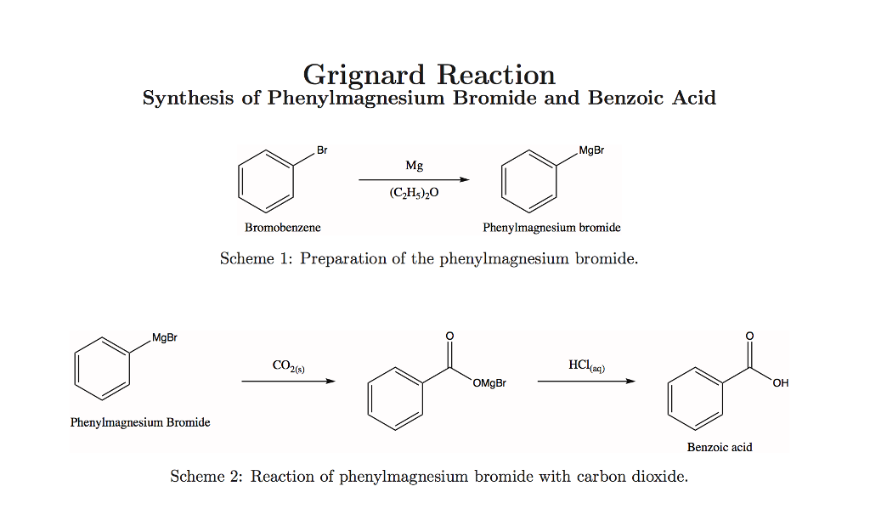
Reactions With Metals
Reaction with Magnesium: In this reaction Bromo- and Iodoarenes form grignard reagent when their ethernal solution is treated with magnesium turnings.
This reaction is very helpful to introduce carboxylic group to phenyl ring. shown as:

Slide 24
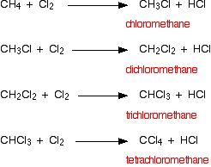
Polyhalogen Compounds
These are the compounds which are formed by the halogenation reaction of alkanes , alkanes undergoes substituion of hydrogen by halogens . Some compounds are shown:
Some more examples are iodoform, freons and DDT.

Slide 25
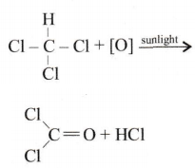
Polyhalogen Compounds
CHCl₃ (Chloroform) : This is a colourless mobile liquid which has sickly sweet smell and burning taste which is sparingly soluble in water but dissolves in alcohol and ether.
Chemical Properties:
a. Acidic nature: The H-atom in CHCl₃ is slightly acidic due to –I effect of chlorine atoms.
b. Oxidation :Chloroform is slowly oxidized by air in presence of light to form an extremely poisonous gas ,carbonyl chloride, popularly called phosgene.

Slide 26
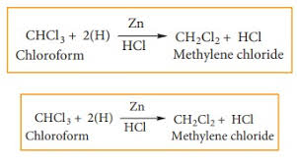
Polyhalogen Compounds
It is , therefore,stored in closed dark colured bottles completely filled to the brim to exclude air. It is mixed with alcohol which destroys traces of phosgene that may be formed during storage.
Reduction: Reduction with zinc and HCl gives Methylene chloride .
whereas reduction with zinc dust and water gives methane.

Slide 27
Polyhalogen Compounds
Uses:
a . It is used as a solvent for resins and rubbers etc.
b. Used in the production of freon refrigerant.
c.Used as a preservative for anatomical specimens.
Physiological effects: It was once used as a general anesthetic agent in surgery, but has been replaced by less toxic and safer anesthetic agent such as ether.

Slide 28
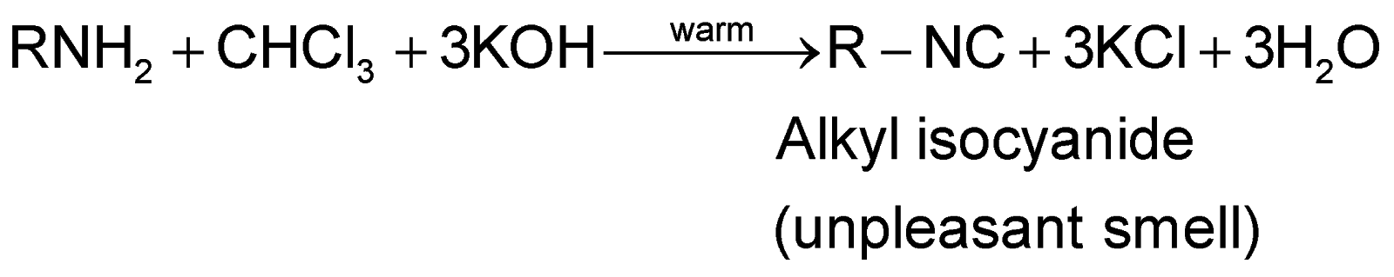
Polyhalogen Compounds
Carbylamine Reaction (Isocyanide Test): Chloroform on warming with a suitable aromatic or aliphatic primary amine and alcohlic potash gives corresponding isocyanide or carbylamine which has extremely unpleasant smell.This reaction can be used as a distinguish test between primary aliphatic or aromatic amines with secondary and tertiary amines.

Slide 29
Iodoform
Polyhalogen Compounds
CHI₃(Triiodomethane) :Iodoform can be prepared by heating ethanol or acetone with NaOH and I₂ or Na₂CO₃ and I_{2.}
Physical Properties: pale yellow solid, m.p. 392K, having a characteristic odour. It is insoluble in water but dissolves in alcohol.
Uses:
a.Iodoform is used as antiseptic for dressing wound. Its antiseptic properties are due to the liberation of iodine.
b. The unpleasant smell in hospitals is due to iodoform where it is used as disinfectant

Slide 30
Freons
Polyhalogen Compounds
Chlorofluro compounds of methane and ethane in which all the H-atoms are replaced by the halogen atoms are collectively called freons. They are classified on the basis of number of fluorine atoms present in them.i.e. CF₄, CF₃Cl ,CF₂Cl₂, CFCl₃ .
Physical Properties: Freon is a odourless, non-corrosive , non toxic gas which is stable at high temperature and pressure.
It has low b.p., low specific heat and can be easily liquefied by applying pressure at room temperature.
Uses: It is widely used as a refrigerant in refrigerators and air conditioners.

Slide 31
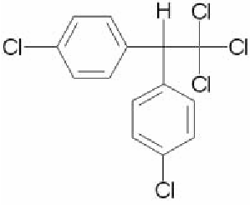
DDT
Polyhalogen Compounds
DDT is also named as 2,2- bis(4-chlorophenyl)-1,1,1-trichloroethane.
Structure :

Slide 32
DDT
Polyhalogen Compounds
Side effects Of DDT:
a. Many insects developed resistance to DDT and it was also discovered to have high toxicity towards fish.
b. It is not completely biodegradable.
c. It gets deposited and stored in fatty tissues.
d . It can cause bad effects in reproduction system of animals.

Slide 33
Quiz Link
https://forms.office.com/Pages/ResponsePage.aspx?id=dqBGjZPQbUGle4aSzeE7-AVCUd84pGlCirnJ0RMKW6BUNktVN1RMQjc1N05DTTJKMVJHRjRTUkI0US4u

Slide 34
Home work
Questions:
Q1. Why do the haloarenes undergo electrophilic substitution at ortho and para positions?
Q2. Arrange the following in increasing ease towards nucleophilicsubstitution reaction.
4- chloronitrobenzene, chlorobenzene, 2,4,6- trinitrochlorobenzene , 2,4,- dinitrochlorobenzene
Q3.The presence of electron withdrawing group at ortho and para positions increases the reactivity of haloarene towards nucleophilic substitution reaction?
Q4. Why do the haloarenes undergo hydrolysis less readily than alkyl halides?
Q5. Give one test to distinguish between:
a . Chloroform and carbon tetrachloride
b. Chlorobenzene and benzyl chloride

Slide 35
Hints
Ans 5: Distinguish between
a. chloroform and carbon tetrachloride
Chloroform can be distinguished from other polyhalogen compounds, alkyl halides by Isocyanide test.
b. chlorobenzene and benzyl chloride
chlorobenzene does not form Cl⁻ ions due to resonance whereas benyl chloride on hydrolysis with dil NaOH form free Cl⁻ and it will undergo qualitative test of cl- by adding dil. HNO₃ and AgNO_{3 .}

Slide 36
THANK YOU STUDENTS
KEEP LEARNING
STAY SAFE

