Slide 1
Chapter 1
Introduction

Slide 2
Learning Objectives
Define and describe the basics of econometrics
Describe how to do an econometric study

Slide 3
Step 1: What Do We Want to Do?
The first step in doing econometrics is to define the purpose of the modeling. It is easy to skip this step, but doing so means your analysis is unlikely to be useful.
Your purpose should be concrete and concise.
Often, if you can state your purpose in the form of a question, you will see whether you have defined it adequately.

Slide 4
Example: Do Good Teachers Produce Better Student Outcomes?
https://www.aeaweb.org/articles?id=10.1257/aer.104.9.2593

Slide 5
YES! Good Teachers Raise Future Income
Replacing an average teacher with a teacher in top 5% would increase students’ earnings later in life by 2.8%.
The average 12 year old in the United States can expect lifetime earnings of $522,000.
2.8% earnings bump is worth about $14,500 per student.
Multiply that by 20 kids per classroom and an excellent teacher is really valuable.

Slide 6
Example: Does the Law of Demand Hold for Electricity?
https://www.aeaweb.org/articles?id=10.1257/aer.104.4.1417

Slide 7
YES! Law of Demand Holds for Electricity – but only if people know how much they’re using

Slide 8
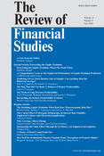
Example: Is it Possible to Forecast Stock Returns?
https://academic.oup.com/rfs/article/21/4/1455/1565737

Slide 9
No! Stock Market Prediction Models are Unreliable?
Negative means that prediction model is worse than historical mean.
IS means “in-sample”. OOS means “out-of-sample”.

Slide 10
Step 2: Formulate Your Research Design and Specify the Econometric Model
Take your abstract objective from step 1 and convert it into an econometric model with data that can answer your questions.
Requires some economic theory, common sense and a little cleverness.
Making a good choice about which data to collect and use determines whether you will be able to meet your objective.

Slide 11
Step 2 Example: Do Good Teachers Produce Better Student Outcomes?
Who is a good teacher?
Can’t just measure test scores. Some teachers may get high test scores because they are easy graders or because smart students take their class.
Answer: a good teacher raises test scores more than average
With this “value added” measure of teacher quality, Chetty, Friedman and Rockoff can estimate using econometrics whether students who took classes from high VA teachers earn more later in life.

Slide 12
Step 2 Example: Does the Law of Demand Hold for Electricity?
Everyone wants to use their AC on hot days
Electricity is more expensive on hot days because demand is high on those days
To test law of demand, you could give some people a high price and others a low price on the same day
Jessoe and Rapson convinced an electric utility to let them raise prices for a random subset of customers
Then they estimated using econometrics how consumers responded to the high prices

Slide 13
Step 2 Example: Is it Possible to Forecast Stock Returns?
Everyone is a stock market expert after the fact
(or a bitcoin market expert)
Example: historically, the stock market did better in January.
Does this mean that the stock market will do better in future Januarys?
Hint: no.
Welch and Goyal build econometric models of stock returns using historical data and then see whether those models predict future returns.

Slide 14
Step 3: Apply Statistical Theory
The Power of Statistics:
Statistics lets us make statements of probability about an unobserved population using data from a single sample.
Econometrics is challenging because it integrates all three fields—economics, mathematics, and statistics—into one.

Slide 15
How Does Poverty Affect Student Performance in California Schools?
To answer this question, we first need to measure “student performance” and “poverty.”
Academic performance index (API)
The California state government uses it to measure school performance
Constructed from students’ scores on state-wide standardized tests
Ranges from 200 to 1000.
We can use the API as our measure of average student performance at each California school
We do not know the household incomes for each student at each school
But U.S. National School Lunch Program provides free lunches to school children from low-income households
We know the share of students eligible for free lunches at each school
We can use free lunch eligibility (FLE) as an indicator of the share of students from households with incomes below the poverty line at each school.

Slide 16
Table 1.1 Academic Performance Index (API) and Free Lunch Eligibility (FLE) at 20 Randomly Chosen California Elementary Schools in 2013 (from Total Population of 5,765 Schools)
Source: California Department of Education; http://www.cde.ca.gov/ta/ac/ap/apidatafiles.asp

Slide 17
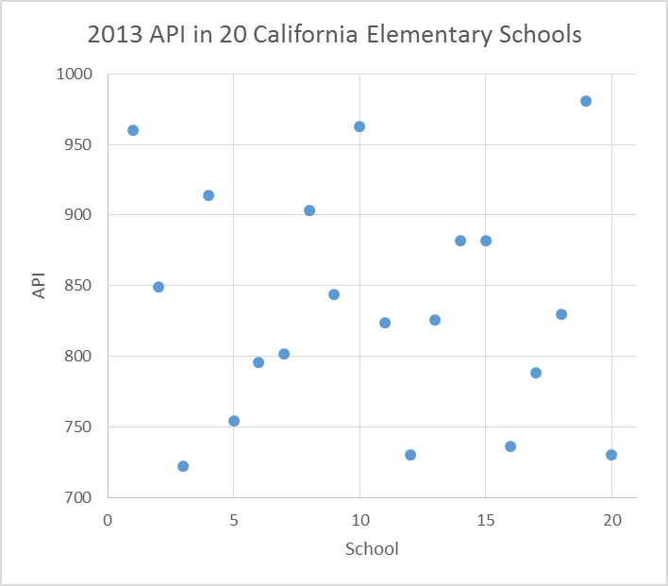
Figure 1.1 2013 API in 20 California elementary schools. Academic performance varies widely across these 20 schools.
Mean API for this sample = 835.80.
Repeat for many random samples, and on average you would get μ, the mean API of all schools. But μ almost certainly does not equal 835.80!
(BYAM: It’s 813.70. But we don’t know that yet!)

Slide 18
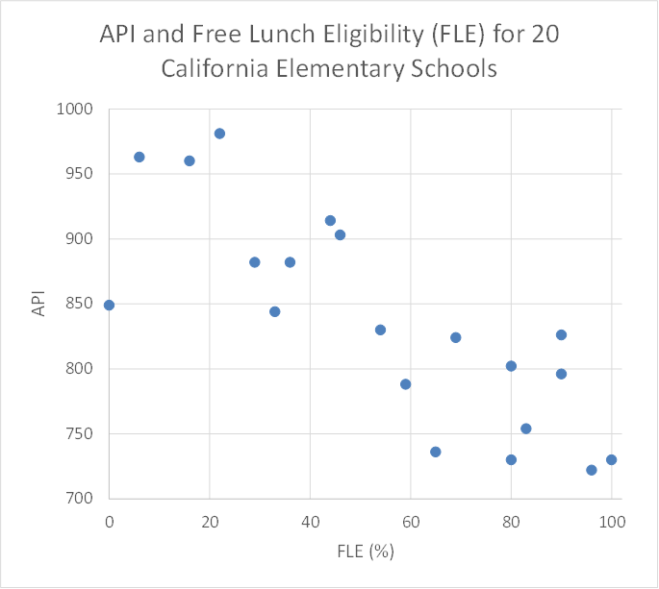
Let Free School Lunch Eligibility “Proxy” for Poverty in School Districts
Figure 1.5. It sure looks like API decreases with FLE.
What we can learn from FLE to help predict API?
Begin by estimating a linear model in which FLE is the only variable explaining API; that is:
Error, how much we miss by if we use FLE to predict API for school i
Mean=836
API of school i
FLE of school i

Slide 19
What We Learned
Econometrics is about making sense of economic data.
Three steps to conducting econometric analysis.
State the purpose of the analysis.
Formulate the research design and specify the econometric model.
Apply statistical theory.

