Slide 1
Building Block View
Software Architecture

Slide 2
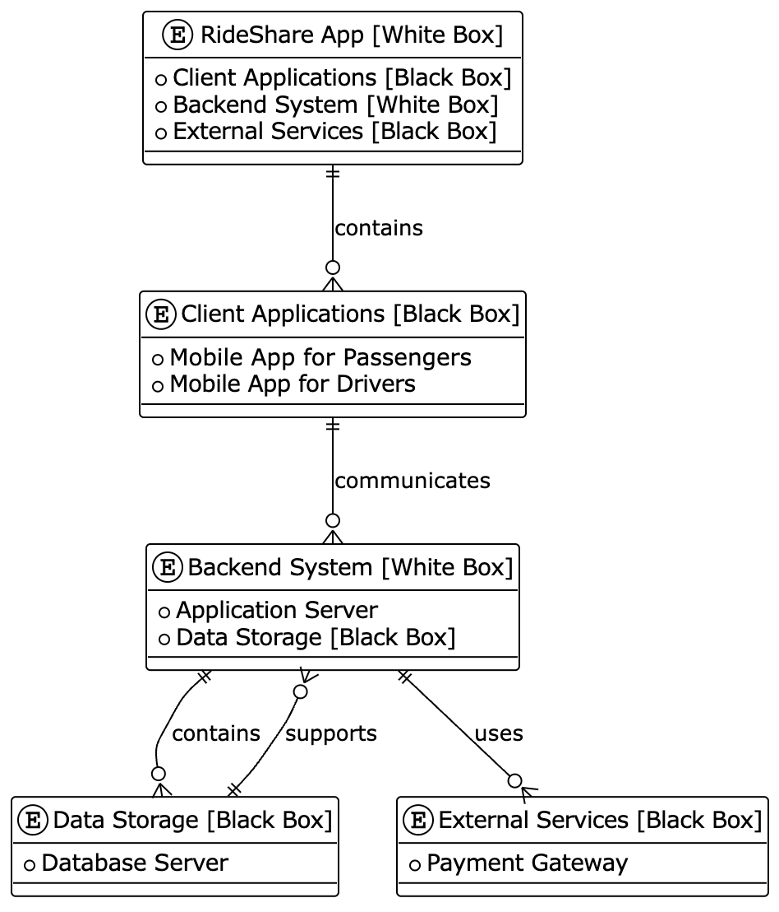
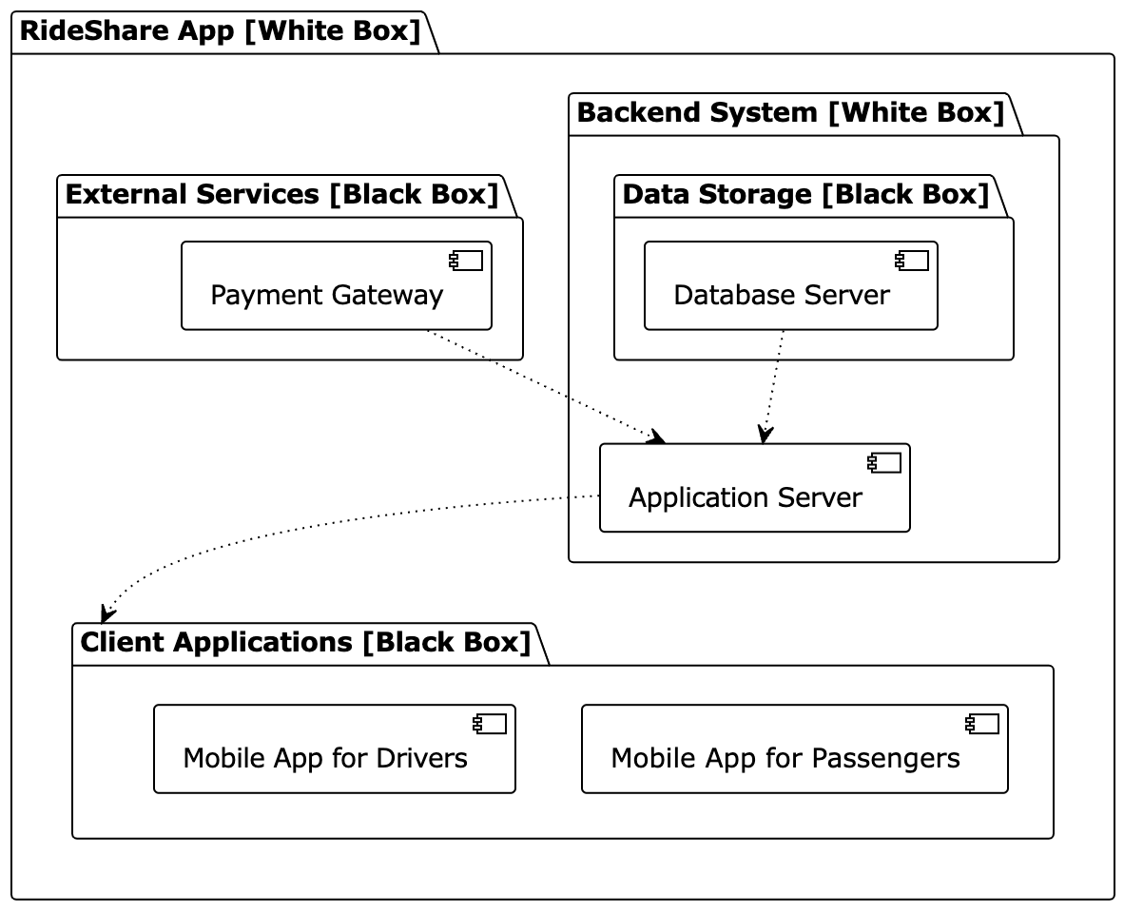
Level 1

Slide 3
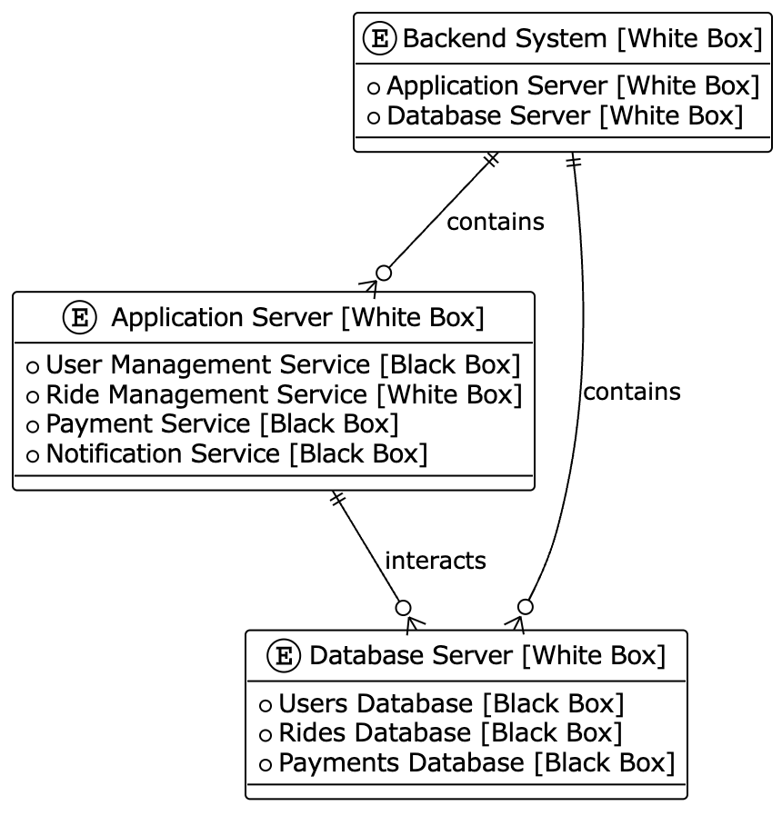

Level 2

Slide 4


Level 3

