Slide 1
Runtime View
Software Architecture

Slide 2
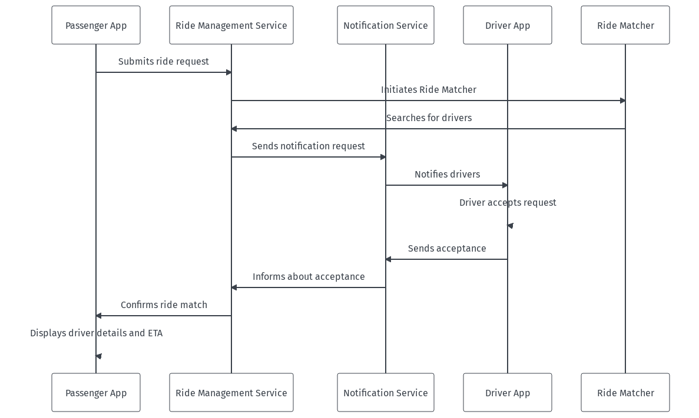
Passenger requests a ride
This diagram illustrates the sequence of events from a passenger requesting a ride to a driver accepting the request

Slide 3
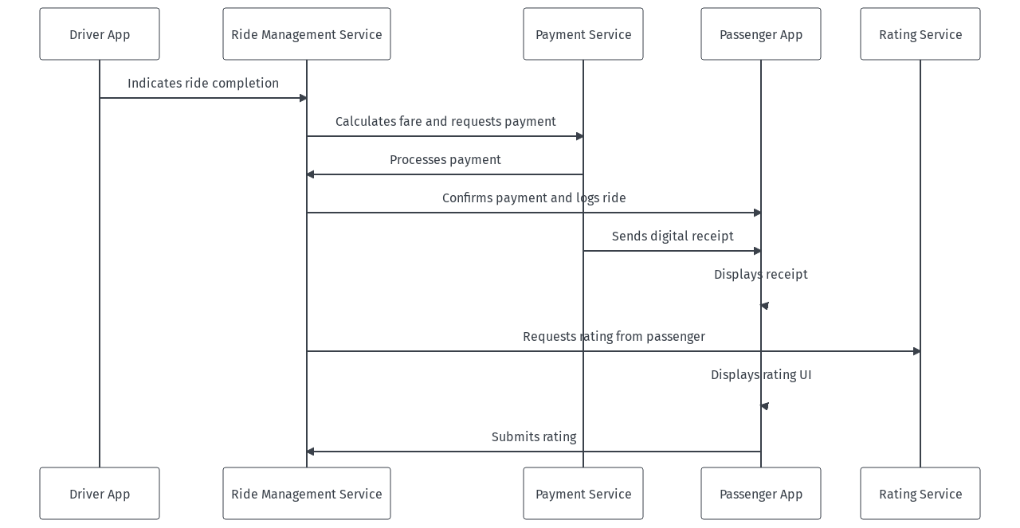
Completing a ride and processing payment
This diagram shows the steps involved from the completion of a ride to the processing of the payment and rating submission

