Slide 1
Deployment view
Software Architecture

Slide 2
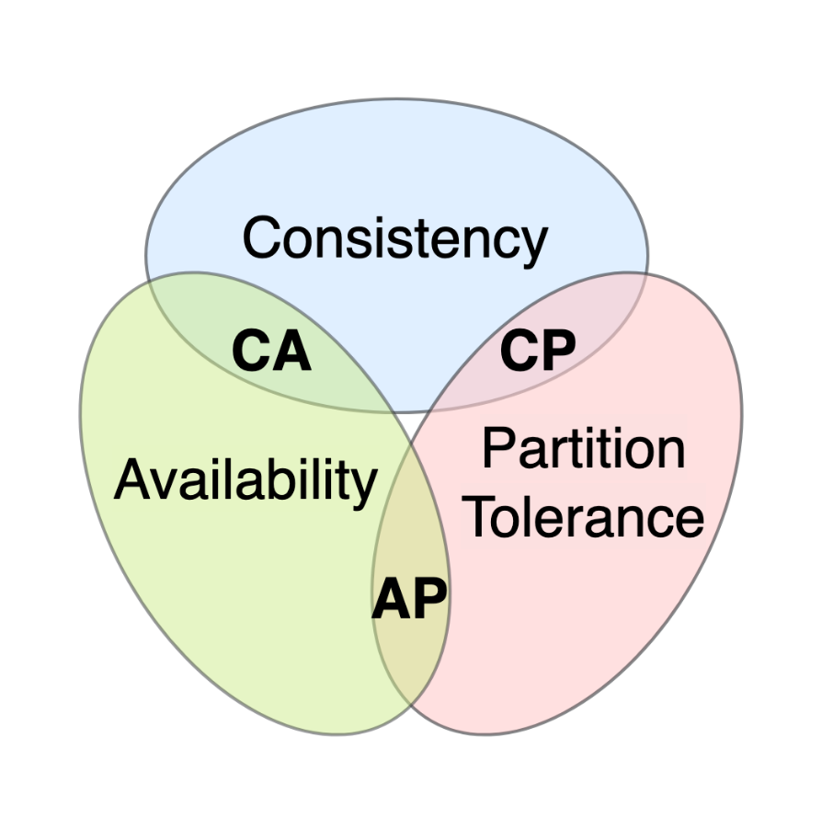
CAP theorem
Consistency: Every read receives the most recent write or an error.
Availability: Every request receives a response, without the guarantee that it contains the most recent write.
Partition Tolerance: The system continues to operate despite an arbitrary number of messages being dropped or delayed by the network between nodes.

Slide 3
CAP theorem
Consistency: In a rideshare application, consistency is important for ensuring that drivers and passengers have accurate information. For instance, when a ride is booked, both the driver and the passenger need to see the same ride details. However, absolute consistency might not be as critical as availability or partition tolerance, since slight delays in data propagation might be acceptable (e.g., a small delay in status updates).

Slide 4
CAP theorem
Availability: This is crucial for a rideshare application because the service involves real-time user interactions. Drivers need to receive ride requests as soon as they are made, and passengers expect to see available rides immediately. If the system is down, users cannot book or offer rides, which could lead to a loss of revenue and user trust.

Slide 5
CAP theorem
Partition Tolerance: Given the nature of a mobile app that depends on internet connectivity, which can be unstable or unavailable, the system must be tolerant of partitions. Drivers or passengers may lose connection due to poor signal areas or other network issues. The system needs to handle these scenarios gracefully, ensuring that the app remains functional as much as possible and can recover once the network is restored.

Slide 6
CAP theorem - Conclusion
Given these considerations, it would seem that for the RideShare app, prioritizing Availability and Partition Tolerance (AP) could be the most suitable approach. While the app would strive for consistency, it might allow for eventual consistency, where the system ensures that the data will become consistent over time. In practice, this could mean that during a network partition, users can still make ride requests (availability), and once the partition is resolved, the system reconciles and updates the ride details across the network to achieve consistency.
In an AP system, during a partition or network failure, the rideshare system could allow drivers to continue accepting ride requests based on the last known state, and then update the central system once the partition is resolved. This decision would favor the business model, which relies on the continuous operation of the service and user satisfaction through immediate responsiveness.

Slide 7
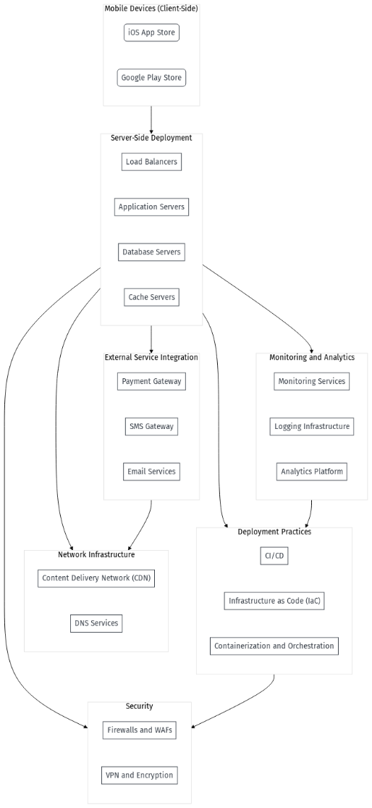
uses
is supported by
is connected to
relies on
is enabled by
is secured by
relies on
is enabled by
is secured by

