Slide 1
The Battle of the neighborhoods

Slide 2
Background and Business Problem
I want to open a tea shop in Toronto
There are many coffee shops in Toronto
Coffee drinkers are potential tea drinkers

Slide 3
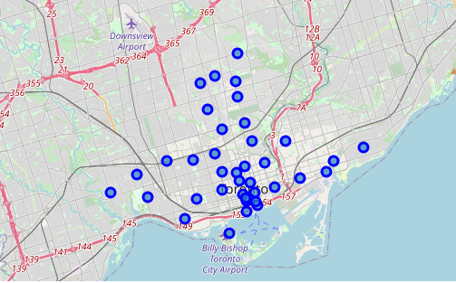
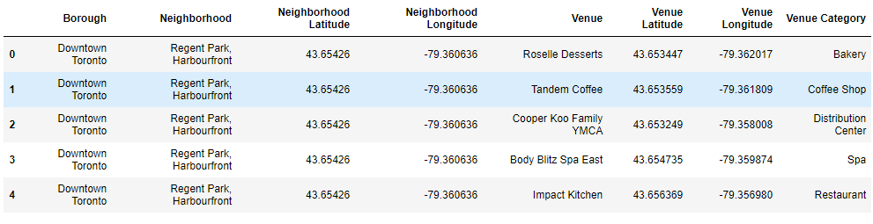
Data acquisition and clean
Neighborhood data comes from https://en.wikipedia.org/wiki/List_of_postal_codes_of_Canada:_M Geographic data data of Neighborhood comes from “Geospatial_Coordinates.csv”
In total, 180 rows for origin neighborhood data which contains 38 rows for Toronto. 77 rows are cleaned due to “Not assigned” Borough.
Venues data comes from Foursquare
Filtering out “Coffee shop” and
The original neighborhoods distribution in Toronto and the Venue information are as follow:

Slide 4
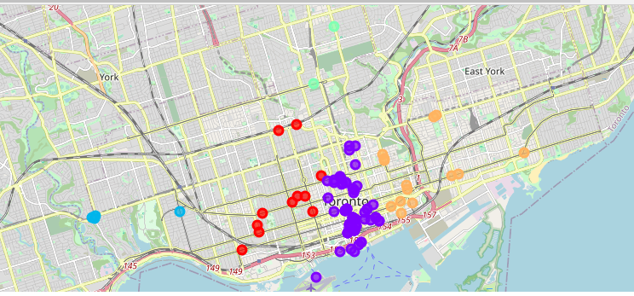
Coffee shops clustering
Filtering out coffee shops and cluster to 5 groups with radius 500.
The purple cluster is the best choice since it contains more shops and high density.

Slide 5
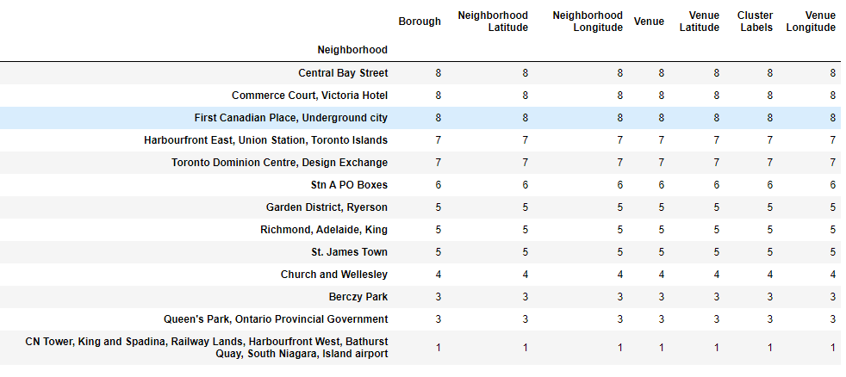
Conclusion:Target Neighborhoods
As we can see from the below table, the best choice of location should be in:
Central Bay Street
Commerce Court, Victoria Hotel
First Canadian Place, Underground city

