Slide 1
java8
---Joyce

Slide 2
Outline
1.Function programming in java
2.Stream
3.Optional
4.Joda Time
5.Analyze Stream Source

Slide 3
Thinking functionally
1.Side-effect free
Our guideline is that to be regarded as functional style, a function or method can mutate only local variables. In addition, objects it references should be immutable. By this we mean all fields are final, and all fields of reference type refer transitively to other immutable objects

Slide 4
Thinking functionally
2. Declarative programming
There are two ways of thinking about implementing a system by writing a program. One way centers on how things are done: “first do this, then update that, then ....The other way centers instead on what’s to be done.
ex: stream.PerformanceCompare

Slide 5
1.1 Passing code to methods with behavior parameterization

Slide 6
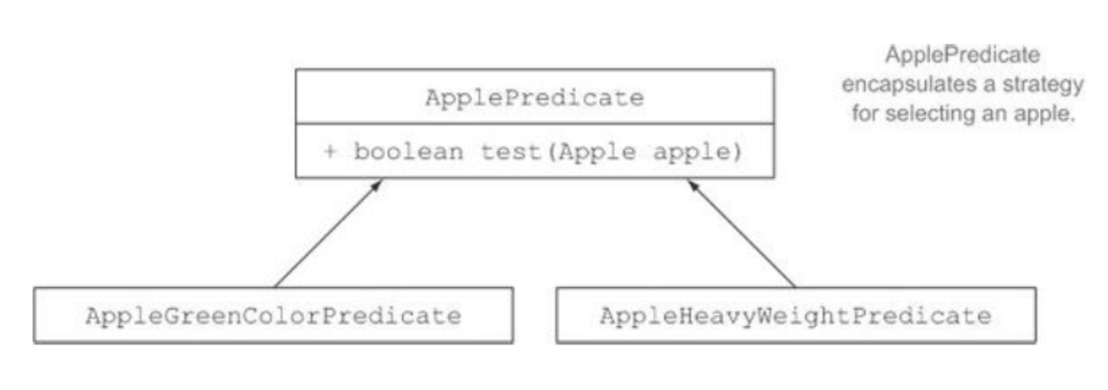
1.1 Passing code to methods with behavior parameterization
Strategy design pattern
Java anonymous inner class

Slide 7
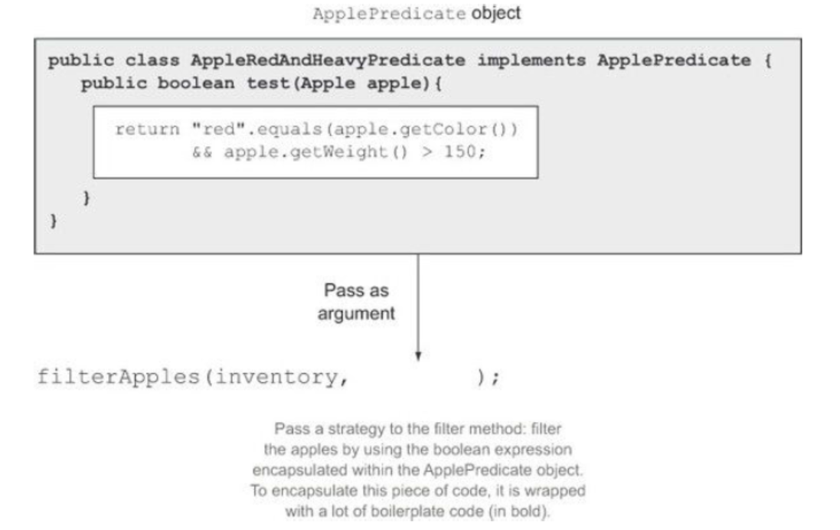
1.1 Passing code to methods with behavior parameterization

Slide 8
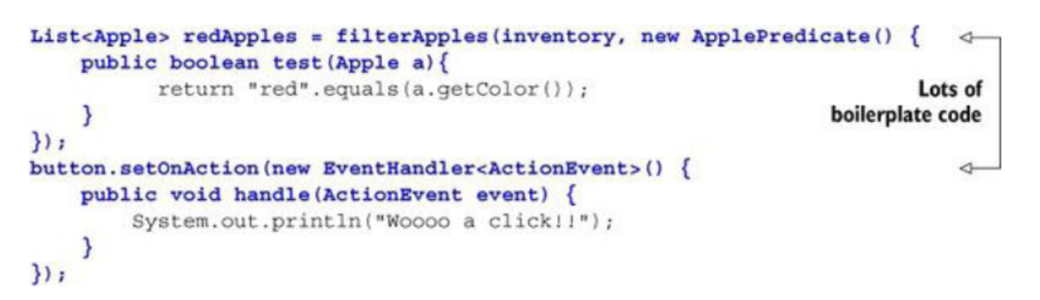
1.1 Passing code to methods with behavior parameterization

Slide 9
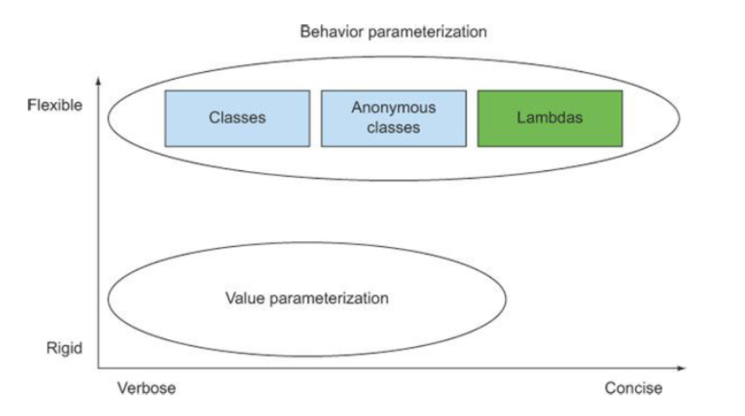
1.1 Passing code to methods with behavior parameterization

Slide 10
1.2 Lamada
Anonymous、Function、Passed around、Concise:
A list of parameters— In this case it mirrors the parameters of the compare method of a Comparator—two Apples.
An arrow— The arrow -> separates the list of parameters from the body of the lambda.
The body of the lambda— Compare two Apples using their weights. The expression is considered the lambda’s return value.

Slide 11
1.3 FunctionalInterface
a functional interface has exactly one abstract method. Since default
methods have an implementation, they are not abstract. If an interface
declares an abstract method overriding one of the public methods of
Object, that also does not count toward the interface's abstract method
count since any implementation of the interface will have an implementation
from Object or elsewhere.
ex: example1.FunctionInterfaceTest

Slide 12
1.4 Default Method
Default methods are added to Java 8 largely to support library designers by enabling them to write more evolvable interfaces.Few programmers will need to write default methods themselves and because they facilitate program evolution rather than helping write any particular program.

Slide 13
1.5 Function
Supplier
Consumer
Function
Predicate
Example1. BasicFunctionTest

Slide 14
1.6 Method Reference
Ex:
Methodreference. MethodReferenceTest

Slide 15
2. Stream
How would you process a large collection of elements To gain
performance you’d need to process it in parallel and leverage multicore
architectures. But writing parallel code is complicated in comparison
to working with iterators. In addition, it’s no fun to debug!

Slide 16
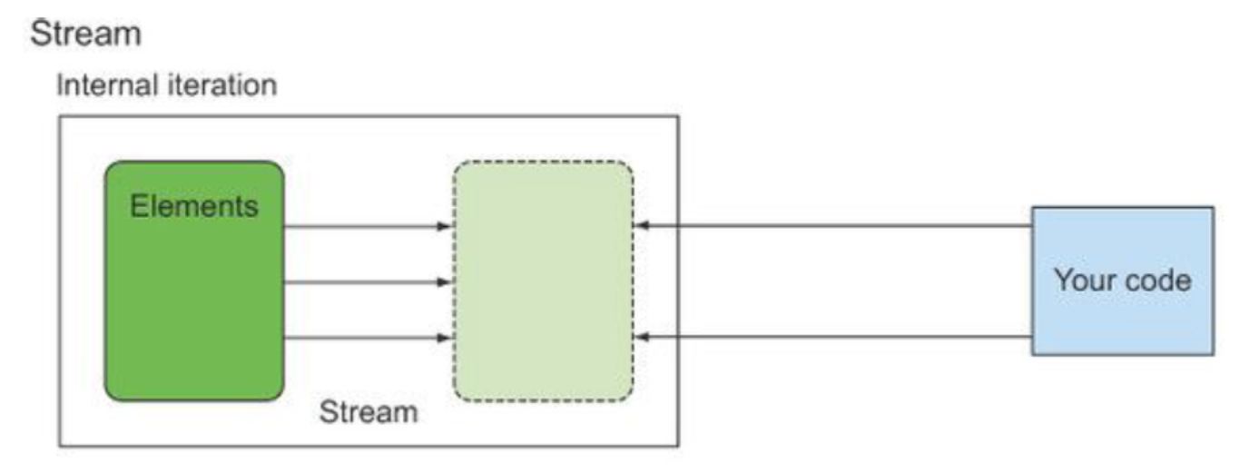
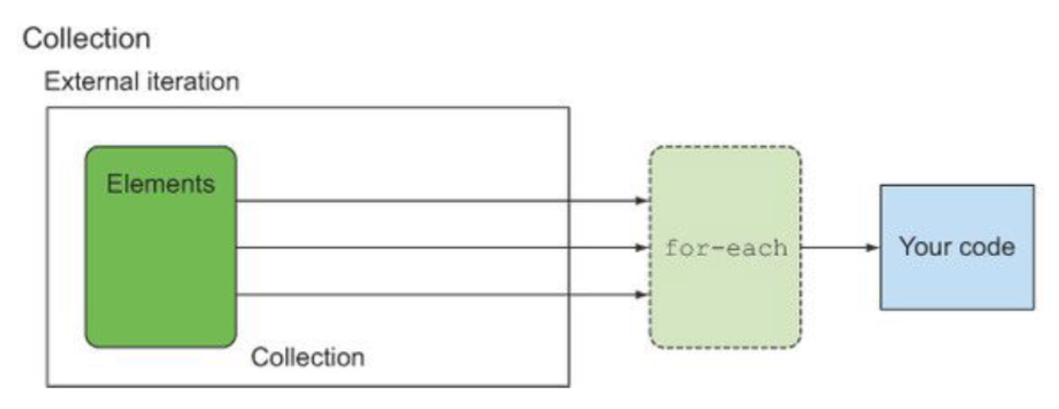
Collection VS Stream

Slide 17
Stream Operation
1.introduction
Stream.SimpleExample
Stream.SecondExample
2.compare map with flatmap
Stream.MapAndFlatMap
3.comparator
Stream.ComparatorTest

Slide 18
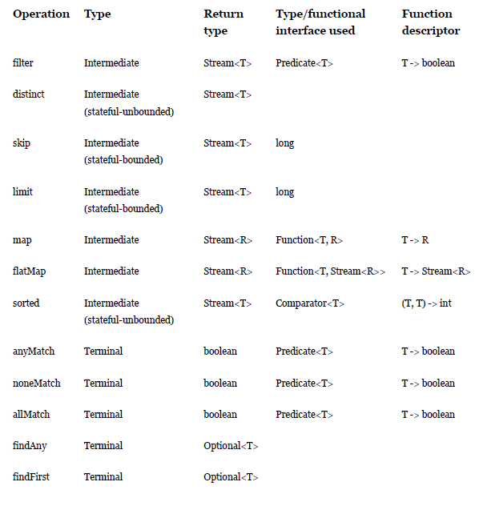
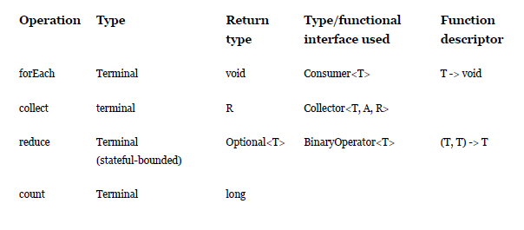
Intermediate and terminal operations

Slide 19
Collect
Collector
supplier
accumulator
combiner
finisher
characteristics
Collectors
CollectorImpl
reducing
ex:Stream.Collect

Slide 20
implementation
Stream.CollectionsTest

Slide 21
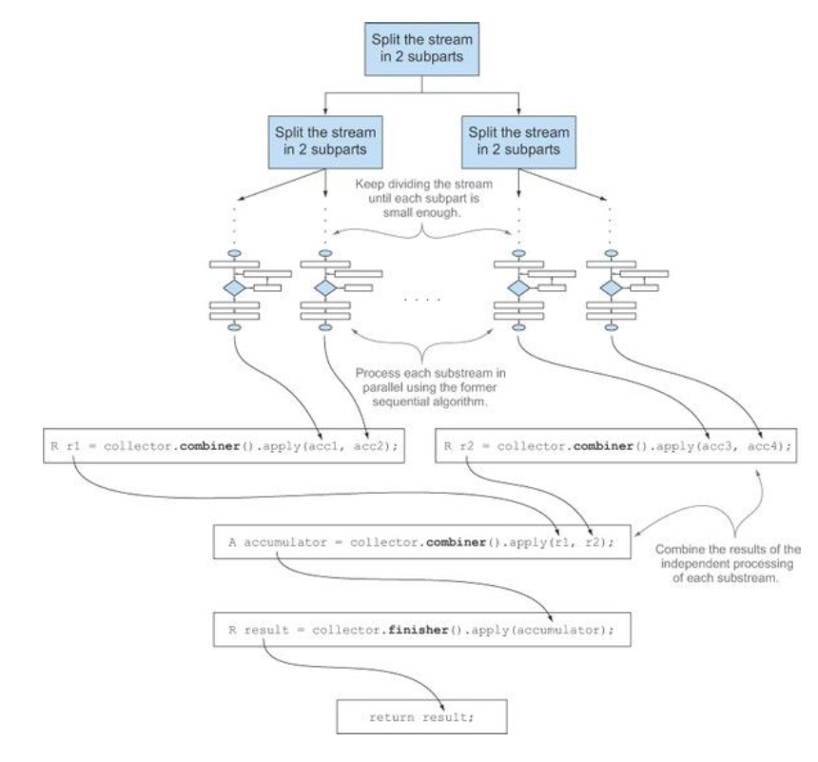
Custom Collector:
stream.MyCustomCollector
stream.MyCustomCollector2

Slide 22
Performance
serialization or parallelism
ex:stream.PerformanceCompare

Slide 23
3.Optional
A container object which may or may not contain a non-null value. If a
value is present, isPresent() will return true and get() will return the value.
ex:
example1.Optionaltest
example1.Optionaltest2

Slide 24
4.Joda data
http://www.joda.org/
ex:
joda.JodaTest1
joda.JodaTest2

Slide 25
Analyze Stream Source Code

Slide 26
Thanks!
Any questions?

