Slide 1

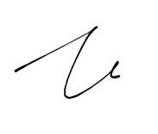



CERTIFICATE
OF
  APPRECIATION
presented to
Name
In gratitude for your dedicated service in our Monthly Food Distribution Programme - 448 Movement with 448 Foodbank Johor.
Your kindness has made a meaningful change in our community.
Date of service:
July 18, 2026
Certificate No.
26/06/3705
ERIC LIM SOON YANG
PRESIDENT
TEE TIAM YONG
REGISTERED SOCIAL WORKER
(21/2013 Life)

