Slide 1
Introduction
to the
International Function Point
Users Group
(IFPUG)
© Copyright 1999. International Function Point User Group 1999

Slide 2
Introduction
to the
International Function Point
Users Group
(IFPUG)
Credits:
We would like to thank the following individuals and companies for their contributions to this presentation:
  Mick Burn-Murdoch - Software Measurement Services, Ltd.
  Carol Dekkers - Quality Plus Technologies, Inc.
  Sheila Dennis - DFAS
  David Garmus - David Consulting Group
  Scott Goldfarb - Q/P Management Group, Inc.
  Cindy Woodrow - First Citizens Bank
© Copyright 1999. International Function Point User Group 1999

Slide 3
Agenda
Introduction
Why use Function Points
  Managing Your Software
  Managing Your Organization
  Function Points vs. Lines of Code
How to Count Function Points
IFPUG History
IFPUG Structure
IFPUG Committees and Affiliates
How Can Your Organization Benefit from IFPUG
Questions
© Copyright 1999. International Function Point User Group 1999

Slide 4
IFPUG Mission Statement
The mission of the International Function Point Users Group is to be a recognized leader in promoting and encouraging the effective management of application software development and maintenance activities through the use of Function Point Analysis and other software measurement techniques.
The International Function Point Users Group serves to facilitate the exchange of knowledge and ideas for improved software measurement techniques and seeks to provide a composite environment that stimulates the personal and professional development of its members.
Taken from Vision Plan 2005 IFPUG’s strategic plan
© Copyright 1999. International Function Point User Group 1999

Slide 5
Objectives of Function Point Analysis
Measures software by quantifying the functionality requested by and provided to the customer based primarily on logical design
Measures software development and maintenance independently of technology used for implementation
Measures software development and maintenance consistently across all projects and organizations
© Copyright 1999. International Function Point User Group 1999

Slide 6
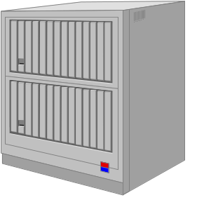
Function Points are a Unit of Measure
External
Interface Files
External Input
Application Being Considered
External Output
Internal
Logical
File
External Input
External Inquiry
External Output
Other
Applications
External Inquiry
Functionality as viewed from the user’s perspective
© Copyright 1999. International Function Point User Group 1999

Slide 7
Why Use Function Points
Managing Your Software
© Copyright 1999. International Function Point User Group 1999

Slide 8
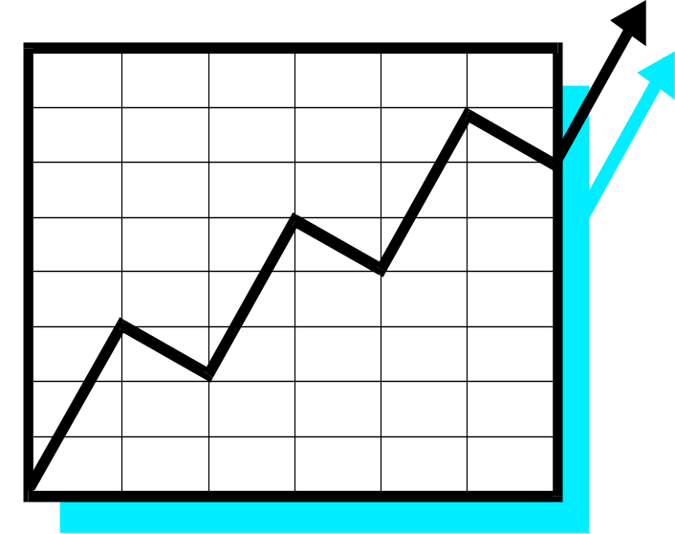
Software Development Challenges
Size of Requirements
Changes to Requirements
Estimation Based on Requirements
Measuring and Improving Productivity and Quality
© Copyright 1999. International Function Point User Group 1999

Slide 9

Size of Requirements
Requirements
  Complete
  Business Terms
  Mutual Understanding
  Document Assumptions
  Size
© Copyright 1999. International Function Point User Group 1999

Slide 10

Changes to Requirements
Changes to Requirements
  Change Inevitable
  Trade-offs
  Customer Definition of Quality
  Size
© Copyright 1999. International Function Point User Group 1999

Slide 11

Changes to Requirements
Delivered Application
Requirements
Functional
Design
Detail
Design
100 FPs
120 FPs
130 FPs
135 FPs
State code input screen changed (3 FPs)
Interface to N&A file added (10 FPs)
N&A inquiry and state code inquiry added (7 FPs)
New regulatory table added (10 FPs)
Summary report added (5 FPs)
Impact
Effort
Schedule
Cost
+ 1 month
+ 2 weeks
+ $5 K
+ .5 month
+ 1 week
+ $2.5 K
+ .25 month
+ 2.5 days
+ $1.25 K
© Copyright 1999. International Function Point User Group 1999

Slide 12
Estimation Based on Requirements
Estimation Based on Requirements
  Multiple Models
  Weighted Inputs:
    Language
    Skills
    Methodology
    Risk Factors
    Size
  Historical Base
© Copyright 1999. International Function Point User Group 1999

Slide 13
Estimating Examples
Project Estimate Based on Historical Data and/or Vendor Tool
Effort = 5 months
Schedule = 3 months
Cost (@ $5K) = $25,000
KLOC = 6
Delivered Defects = 25
Productivity Rate = 20 FP/Month.
Effort = 20 months
Schedule = 6 months
Cost (@ $5K) = $100,000
KLOC = 10
Delivered Defects = 100
Productivity Rate = 5 FP/Month
Function Point Size
Project A – 100 FPs
Project B – 100 FPs
Project Variables
On-line/database
New development
C++
Highly experienced development staff
Batch
Enhancement
Cobol
Average experienced development staff
© Copyright 1999. International Function Point User Group 1999

Slide 14
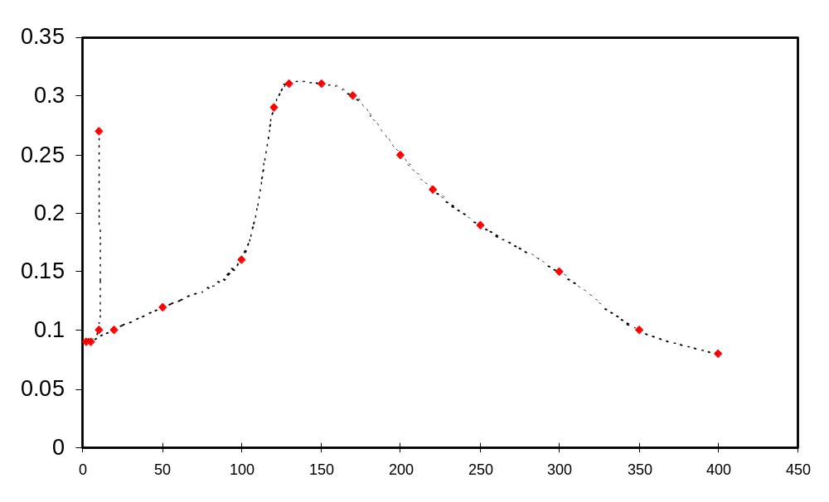
Measuring and Improving Productivity
FP/Hour
Project Function Point Size
Every organization has an optimum size/productivity range
© Copyright 1999. International Function Point User Group 1999

Slide 15
Why Use Function Points
Managing Your Organization
© Copyright 1999. International Function Point User Group 1999

Slide 16
Asset Management
Application Portfolio
Size = 50,000 Function Points
Replacement Cost = $300,000,000
Growth = 7% per year
Support Cost = $20,000,000 per year
Systems
A
B
C
D
E
F
G
H
I
J
K
L
© Copyright 1999. International Function Point User Group 1999

Slide 17
Function Points and the CMM
Function Points are the metric of choice for many of the activities required in the SEI CMM Level 2
With the next release of the CMM, metrics becomes a Key Process Area in its own right
SEI Capability Maturity Model
5. OPTIMIZING
Process control
4. MANAGED
Process measurement
3. DEFINED
Process definition
2. REPEATABLE
Basic management control
Process Maturity Levels
1. INITIAL
Ad hoc
© Copyright 1999. International Function Point User Group 1999

Slide 18

Improving Customer Relations
Predictable Time scales
Predictable Costs
Predictable Functionality
© Copyright 1999. International Function Point User Group 1999

Slide 19


Organizational Improvement
Process Measurement
Project Management Metrics
  Estimates
  Productivity
  Defect Densities
  etc.
Benchmarking
© Copyright 1999. International Function Point User Group 1999

Slide 20
Why Use Function Points
Function Points vs. Lines of Code
© Copyright 1999. International Function Point User Group 1999

Slide 21
Function Points not Lines of Code
Technology and platform independence
Available from early requirements phase
Consistent and objective unit of measure throughout the life cycle
Objectively defines software application from the customer perspective
Objectively defines a series of software applications from the customer’s, not the technician’s perspective
Is expressed in terms that users can readily understand about their software
© Copyright 1999. International Function Point User Group 1999

Slide 22
What is Wrong with Lines of Code?
There is no standard for a line of code
Lines of Code measure components not completed products
  Don't measure the panels produced; measure the number of cars assembled
Measuring lines of code
  Rewards profligate design
  Penalizes tight design
Positively misleading?
© Copyright 1999. International Function Point User Group 1999

Slide 23
Classic Productivity Paradox
Lines of Code 10,000 3,000
Function Points 25 25
Total Months effort 25 15
Total Costs $125,000 $75,000
Cost per Source Line $12.50 $25.00
Lines per Person month 400 200
FPs per Person month 1.2 2
Cost per FP $5,000 $3,000
Lines of Code 10,000 3,000
Function Points 25 25
Total Months effort 25 15
Total Costs $125,000 $75,000
Cost per Source Line $12.50 $25.00
Lines per Person month 400 200
FPs per Person month 1.2 2
Cost per FP $5,000 $3,000
© Copyright 1999. International Function Point User Group 1999

Slide 24
How to Count Function Points
© Copyright 1999. International Function Point User Group 1999

Slide 25

How to Count Function Points
Displays
Reports
Master Files
Size
Control Files
Reference Files
Signals
© Copyright 1999. International Function Point User Group 1999

Slide 26
Steps in FP Counting
Determine Type of Count
Identify Counting Scope and Application Boundary
Count Data Functions
Count Transactional Functions
Determine Unadjusted Function Point Count
Determine Value Adjustment Factor
Calculate Adjusted Function Point Count
© Copyright 1999. International Function Point User Group 1999

Slide 27
FP Overview: What Is Counted
EI
P1
Update Master File
ILF
P2
EO
Weekly Summary Report
Master
Produce Weekly Report
File
System
Key
Boundary
P3
Reference
Master File
File
EIF
Details
Details
on
another
System
EQ
© Copyright 1999. International Function Point User Group 1999

Slide 28
Data Storage
Internal Logical File (ILF)
  Logical group of data maintained by the application (e.g., Employee file)
External Interface File (EIF)
  Logical group of data referenced but not maintained (e.g., Global state table)
© Copyright 1999. International Function Point User Group 1999

Slide 29
Transactions
External Input (EI)
  Maintains ILF or passes control data into the application
External Output (EO)
  Formatted data sent out of application with added value (e.g., calculated totals)
External Query (EQ)
  Formatted data sent out of application without added value
© Copyright 1999. International Function Point User Group 1999

Slide 30
Functional Size
(Unadjusted Function Size)
Function Type Low Average High
EI x 3 x 4 x 6
EO x 4 x 5 x 7
EQ x 3 x 4 x 6
ILF x 7 x 10 x 15
EIF x 5 x 7 x 10
© Copyright 1999. International Function Point User Group 1999

Slide 31

Value Adjustment Factor
Based on 14 General System Characteristics (User Business Constraints Independent of Technology)
  Examples: data communications, response times, end user efficiency, multiple sites and flexibility
Adjusts FP count by up to + / - 35%
© Copyright 1999. International Function Point User Group 1999

Slide 32
IFPUG History
© Copyright 1999. International Function Point User Group 1999

Slide 33
History - Early Days
1979 Function Points introduced by Alan Albrecht
1984 First formal Function Point Guidelines
1986 IFPUG elects first Board of Directors
1990 Function Point as Assets Manual
1991 Certification for training materials
IFPUG Hotline established
1993 Certified Practitioners
Participation in ISO/IEC
© Copyright 1999. International Function Point User Group 1999

Slide 34
History - Modern
1994 CPM release 4.0
Participation in International Software Benchmarking Standards Group (ISBSG)
1995 Guidelines to Software Measurement
IFPUG Home Page Introduced
1996 Case Study 3 released
1997 10th Anniversary Celebration!
1999 CPM release 4.1
© Copyright 1999. International Function Point User Group 1999

Slide 35
IFPUG Structure
© Copyright 1999. International Function Point User Group 1999

Slide 36
Management Structure
President
Vice President
Immediate
Past-President
Board of Directors
Committees
Executive
© Copyright 1999. International Function Point User Group 1999

Slide 37
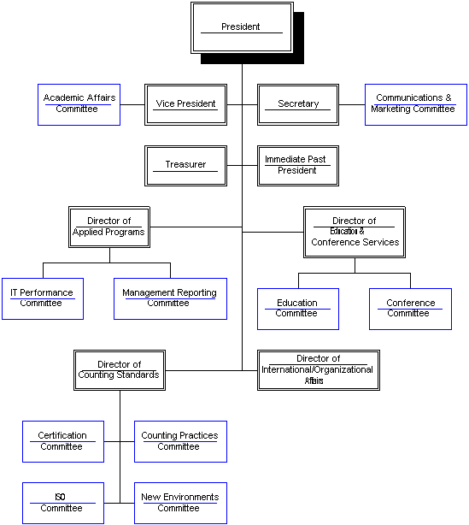
© Copyright 1999. International Function Point User Group 1999

Slide 38
IFPUG Committees and Affiliates
© Copyright 1999. International Function Point User Group 1999

Slide 39
IFPUG Committees
Academic Affairs
Communications and Marketing
IT Performance Committee
Management Reporting
Education Services
Counting Practices
New Environments
Conference
Certification
International Standards Organization
© Copyright 1999. International Function Point User Group 1999

Slide 40

Academic Affairs
Increase academic awareness of software measurement and Function Point Analysis
Support and promote graduate studies regarding FPA
© Copyright 1999. International Function Point User Group 1999

Slide 41

Communications and Marketing
MetricViews
Metrics Source
Monthly E-mail Update
Road show
Website
© Copyright 1999. International Function Point User Group 1999

Slide 42

IT Performance
Database of measurements from organizations worldwide
Compare against your organization’s results
© Copyright 1999. International Function Point User Group 1999

Slide 43

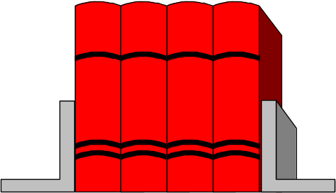
Management Reporting
Management reporting workshops
Publications to assist in using FP metrics for management reporting
Published Guidelines to Software Measurement
© Copyright 1999. International Function Point User Group 1999

Slide 44
Education Services
Basic Training
Advanced Practices
Management Courses
© Copyright 1999. International Function Point User Group 1999

Slide 45


Counting Practices
Publish Counting Practices Manual
Update Counting Practices Manual
Make Rulings on areas of Ambiguity
© Copyright 1999. International Function Point User Group 1999

Slide 46

New Environments
Links to new development techniques
  Investigate
  Hypothesize
  Test link
  Promulgate
For Example OO
© Copyright 1999. International Function Point User Group 1999

Slide 47


Conference
Presentations from Industry “Gurus”
Presentations from Practitioners
Networking opportunity
Workshops
© Copyright 1999. International Function Point User Group 1999

Slide 48

Certification
Tests for Conformance to Counting Practices Manual
  Counters
  Training courses
  Software support tools
IFPUG
Seal of Approval
© Copyright 1999. International Function Point User Group 1999

Slide 49

ISO
Represent IFPUG at ISO working group meetings
Review developing ISO standards
© Copyright 1999. International Function Point User Group 1999

Slide 50

Affiliations
48 Countries
Corporate, Academia and Government Members
Regional Chapters in Northeast, Rocky Mountain Area, and the Midwest
© Copyright 1999. International Function Point User Group 1999

Slide 51
How Can Your Organization Benefit from IFPUG?
© Copyright 1999. International Function Point User Group 1999

Slide 52
IFPUG Benefits
Free copies of IFPUG standards manuals
Case Studies at member discounted rates
Member directory
Publications MetricViews, Metrics Source
IFPUG E-Mail List Serve & Private Home Page
Reduced rates for conference & workshops
Ability to participate on Committees
Networking, Professional Development
© Copyright 1999. International Function Point User Group 1999

Slide 53
How to Contact Us
International Function Point Users Group
5008-28 Pine Creek Drive
Westerville, OH 43081-4899
Phone: (614) 895-7130
Fax: (614) 895-3466
E-mail: ifpug@ifpug.org
Web: www.ifpug.org
© Copyright 1999. International Function Point User Group 1999

Slide 54

How May We Help You?
Questions????
Comments!!!
Suggestions!?!?!?
© Copyright 1999. International Function Point User Group 1999

