Slide 1
风险管理与PERT技术
主讲人：王辉
wangh@stdu.edu.cn

Slide 2
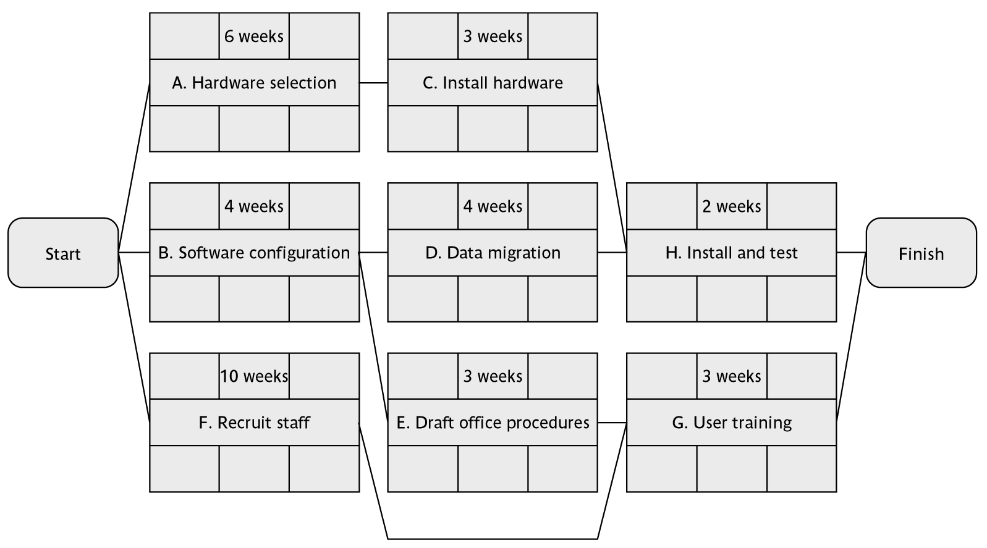
复习：向前遍历（活动节点）
0
6
6
9
0
4
4
8
9
11
0
13
0
10
4
7
10
13

Slide 3
复习：向后遍历（活动节点）
0
6
6
9
2
8
8
11
0
4
4
8
9
11
3
7
7
11
11
13
0
13
0
10
4
7
10
13
0
10
7
10
10
13

Slide 4
复习：缓冲期（活动节点）
0
6
6
9
2
2
8
8
2
11
0
4
4
8
9
11
3
3
7
7
3
11
11
2
13
0
13
0
10
4
7
10
13
0
0
10
7
3
10
10
0
13

Slide 5
复习：关键路径（活动节点）
0
6
6
9
2
2
8
8
2
11
0
4
4
8
9
11
3
3
7
7
3
11
11
2
13
0
13
0
10
4
7
10
13
0
0
10
7
3
10
10
0
13

Slide 6
复习：缓冲期的分类
总缓冲期：LS - ES (LF - EF)，分为空闲(free)缓冲期和干预(interfering)缓冲期
  空闲缓冲期：一个活动最早的完成日期与后续活动最早的开始日期之间的差，不影响后续的活动
  干预缓冲期：总缓冲期与空闲缓冲期的差，影响了后续的活动，但是不影响项目的最终进度

Slide 7
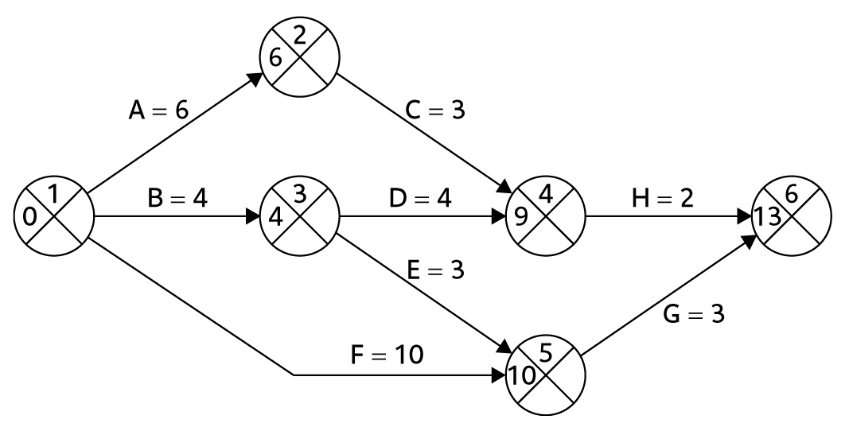
复习：正向遍历（活动箭头）

Slide 8
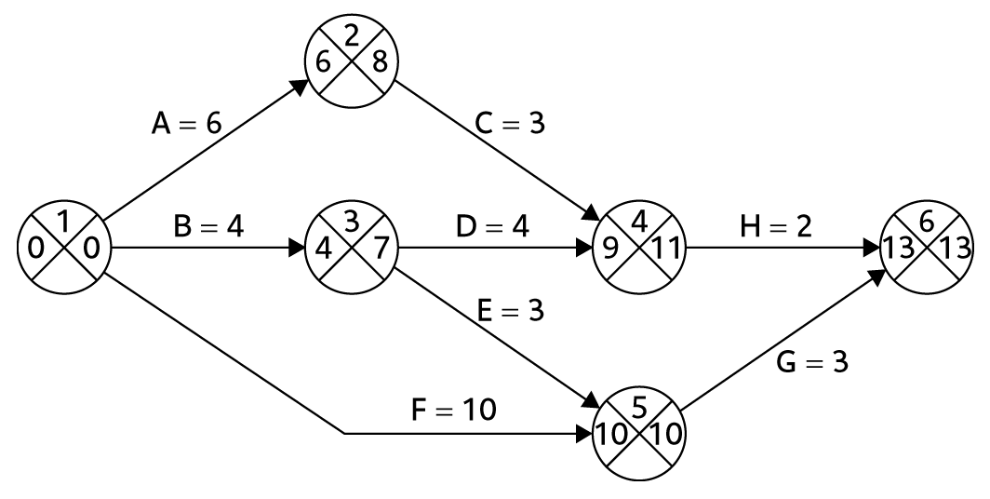
复习：逆向遍历（活动箭头）

Slide 9
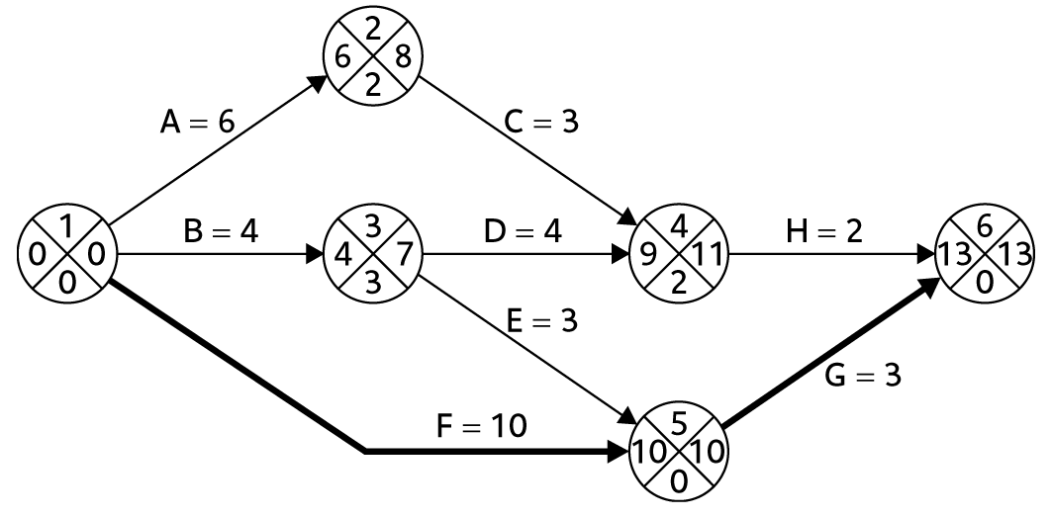
复习：关键路径（活动箭头）

Slide 10
风险管理
风险的定义
风险的分类方法
风险管理
  风险的识别– what are the risks to a project?
  风险的分析和优先级– which ones are really serious?
  风险的策划– what shall we do?
  风险的监控– has the planning worked?

Slide 11
Risk management
Definition of ‘risk’
Some ways of categorizing risk
Risk management
  Risk identification – what are the risks to a project?
  Risk analysis and prioritization– which ones are really serious?
  Risk planning – what shall we do?
  Risk monitoring – has the planning worked?

Slide 12
PM-BOK 风险定义
一个不确定的事件或者情况，若其一旦发生，会对项目的目标，例如，范围、进度、成本和质量，产生积极或消极的影响。
  风险是未来可能发生的问题，而不是当前已经发生的事情
  风险的产生一般是有原因的，例如，开发人员离职导致项目延期

Slide 13
PM-BOK definition of risk
'An uncertain event or condition that, if it occurs, has a positive or negative effect on a project’s objectives such as scope, schedule, cost, and quality’ PM-BOK
  Risks relate to possible future problems, not current ones
  They involve a possible cause and its effect(s) e.g. developer leaves > task delayed

Slide 14
风险的三要素
事件
事件发生的概率
事件的影响

Slide 15
风险的基本性质
风险的客观性
风险的不确定性
风险的不利性
风险的可变性
风险的相对性
风险同利益的对称性

Slide 16
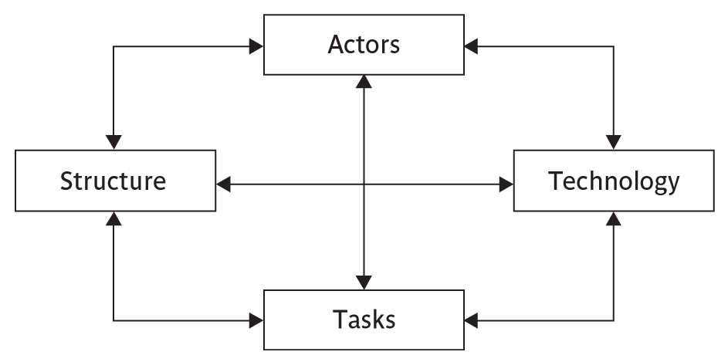
Categories of Risk
风险的分类

Slide 17
风险的分类
Actors (参与者) relate to all those involved in the project including both developers, users and managers e.g. a risk could be that high staff turnover leads to information of importance to the project being lost.
Technology (技术)– both that used to implement the project and that embedded in the project deliverables – risk could be that the technologies selected are not in fact appropriate.

Slide 18
Categories of Risk
Structure (结构) – this includes management procedures, risk here is that a group who need to carry out a particular project task are not informed of this need because they are not part of the project communication network.
Tasks (任务) – the work to be carried out. A typical risk is that the amount of effort needed to carry out the task is underestimated.

Slide 19
风险管理的框架
The risk management includes these steps:
Risk identification (风险识别) – what risks might there be?
Risk analysis and prioritization (风险分析与优先级排序) – which are the most serious risks?
Risk planning (风险策划) – what are we going to do about them?
Risk monitoring (风险监督) – what is the current state of the risk?
Notes:
Section 7.4 Page 166

Slide 20
风险管理的框架
风险识别
风险分析
风险策划
风险监督

Slide 21
Risk identification
Approaches to identifying risks include:
Use of checklists (使用检查单) – usually based on the experience of past projects
Brainstorming (头脑风暴) – getting knowledgeable stakeholders together to pool concerns. 由奥斯本于1939年首创
德尔菲方法 (专家调查法)：起源于20世纪40年代末期，由美国德兰公司首先使用

Slide 22
Boehm’s top 10 development risks
Risk | Risk reduction techniques
Personnel shortfalls | Staffing with top talent; job matching; teambuilding; training and career development; early scheduling of key personnel
Unrealistic time and cost estimates | Multiple estimation techniques; design to cost; incremental development; recording and analysis of past projects; standardization of methods
Developing the wrong software functions | Improved software evaluation; formal specification methods; user surveys; prototyping; early user manuals
Developing the wrong user interface | Prototyping; task analysis; user involvement

Slide 23
Boehm’s top 10 development risks
Gold plating | Requirements scrubbing, prototyping, design to cost
Late changes to requirements | Change control, incremental development
Shortfalls in externally supplied components | Benchmarking, inspections, formal specifications, contractual agreements, quality controls
Shortfalls in externally performed tasks | Quality assurance procedures, competitive design etc
Real time performance problems | Simulation, prototyping, tuning
Development technically too difficult | Technical analysis, cost-benefit analysis, prototyping , training

Slide 24
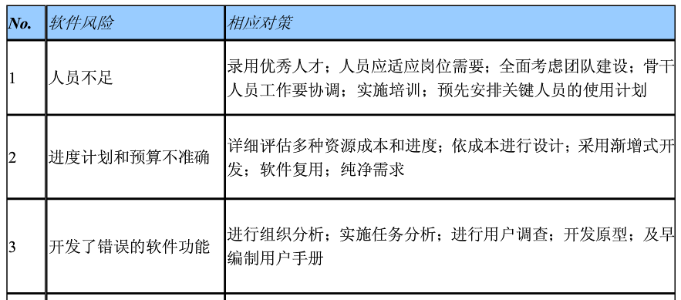
软件项目常见十大风险

Slide 25
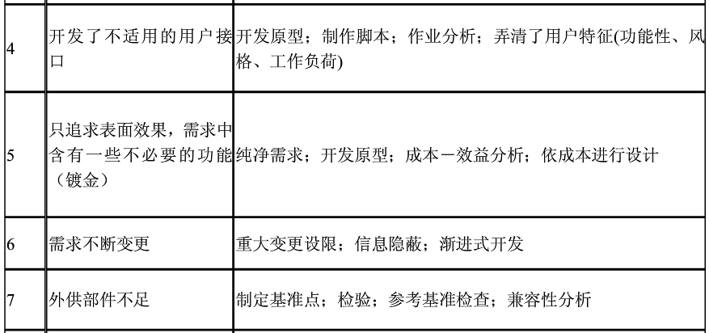
软件项目常见十大风险

Slide 26
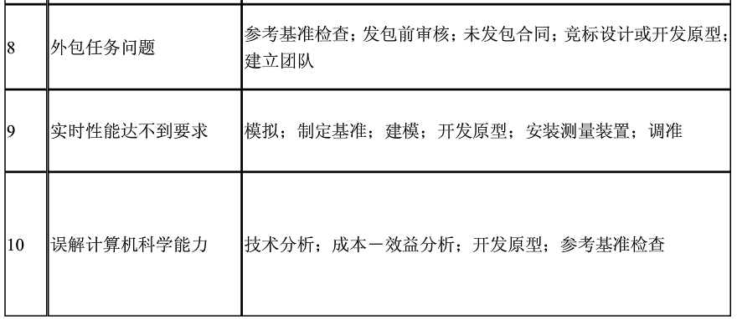
软件项目常见十大风险

Slide 27
德尔菲法
德尔菲法（Delphi method），是采用背对背的通信方式征询专家小组成员的预测意见，经过几轮征询，使专家小组的预测意见趋于集中，最后做出最终的预测。

Slide 28
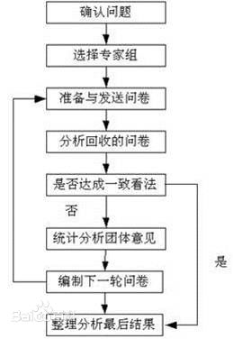
德尔菲法

Slide 29
风险分析的方法
Quantitative (定量的)
  Money
  Time
  Other measurement
Qualitative (定性的)
  Probability impact matrix

Slide 30
Quantified by Money
风险影响 = (可能的危害)×(发生概率)
例如，软件项目延期损失100万，延期的概率为1%，那么项目延期风险的影响为
100万 * 1% = 1万

Slide 31
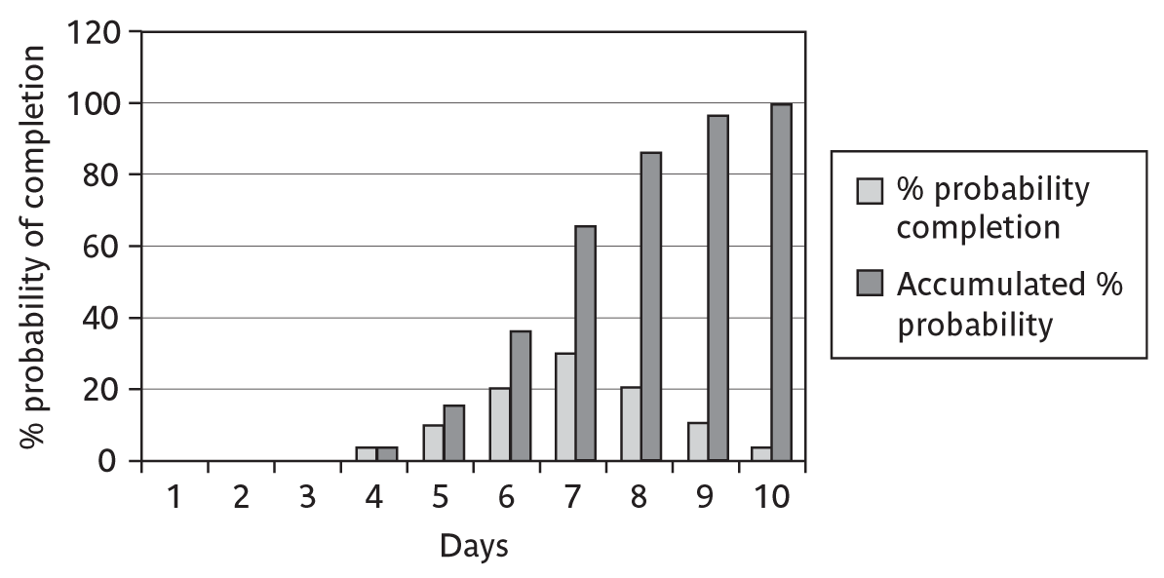
Quantified by Time

Slide 32
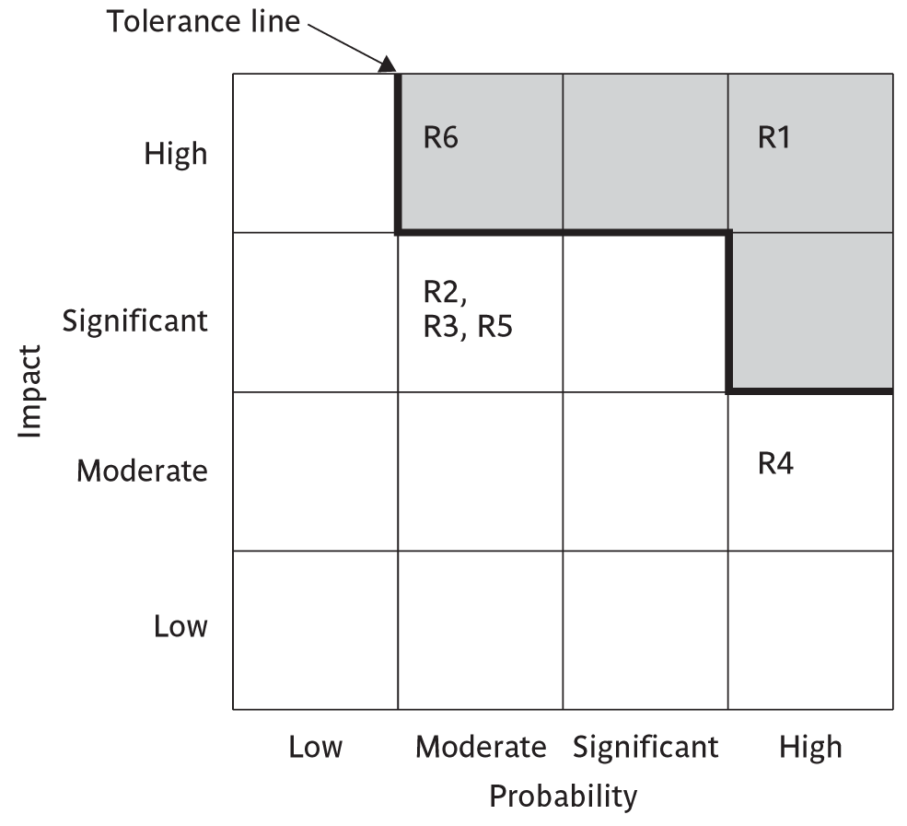
Probability impact matrix

Slide 33
Risk probability: descriptors
Probability level | Range
High | Greater than 50% chance of happening
Significant | 30-50% chance of happening
Moderate | 10-29% chance of happening
Low | Less than 10% chance of happening
Notes:
Managers would be happier identifying an approximate range rather than a precise probability.

Slide 34
Qualitative descriptors of impact on cost and associated range values
Impact level | Range
High | Greater than 30% above budgeted expenditure
Significant | 20 to 29% above budgeted expenditure
Moderate | 10 to 19% above budgeted expenditure
Low | Within 10% of budgeted expenditure
Notes:
Similar tables can be produced for the impact on project duration and on the quality of project deliverables.
The problem with the qualitative approach is how do you combine the judgements about probability and impact – you can’t multiply them together.

Slide 35
风险计划
Risk acceptance(接受风险): the cost of avoiding the risk may be greater than the actual cost of the damage that might be inflicted.

Slide 36
风险计划
Risk avoidance(规避风险): avoid the environment in which the risk occurs.
例如，采用新技术有风险，那么就放弃采用新技术

Slide 37

风险计划
Risk reduction(降低风险): the risk is accepted but actions are taken to reduce its likelihood, e.g. prototypes ought to reduce the risk of incorrect requirements.

Slide 38
风险计划
Risk transfer(转移风险): the risk is transferred to another person or organization.
例如，外包中间产品，买保险

Slide 39
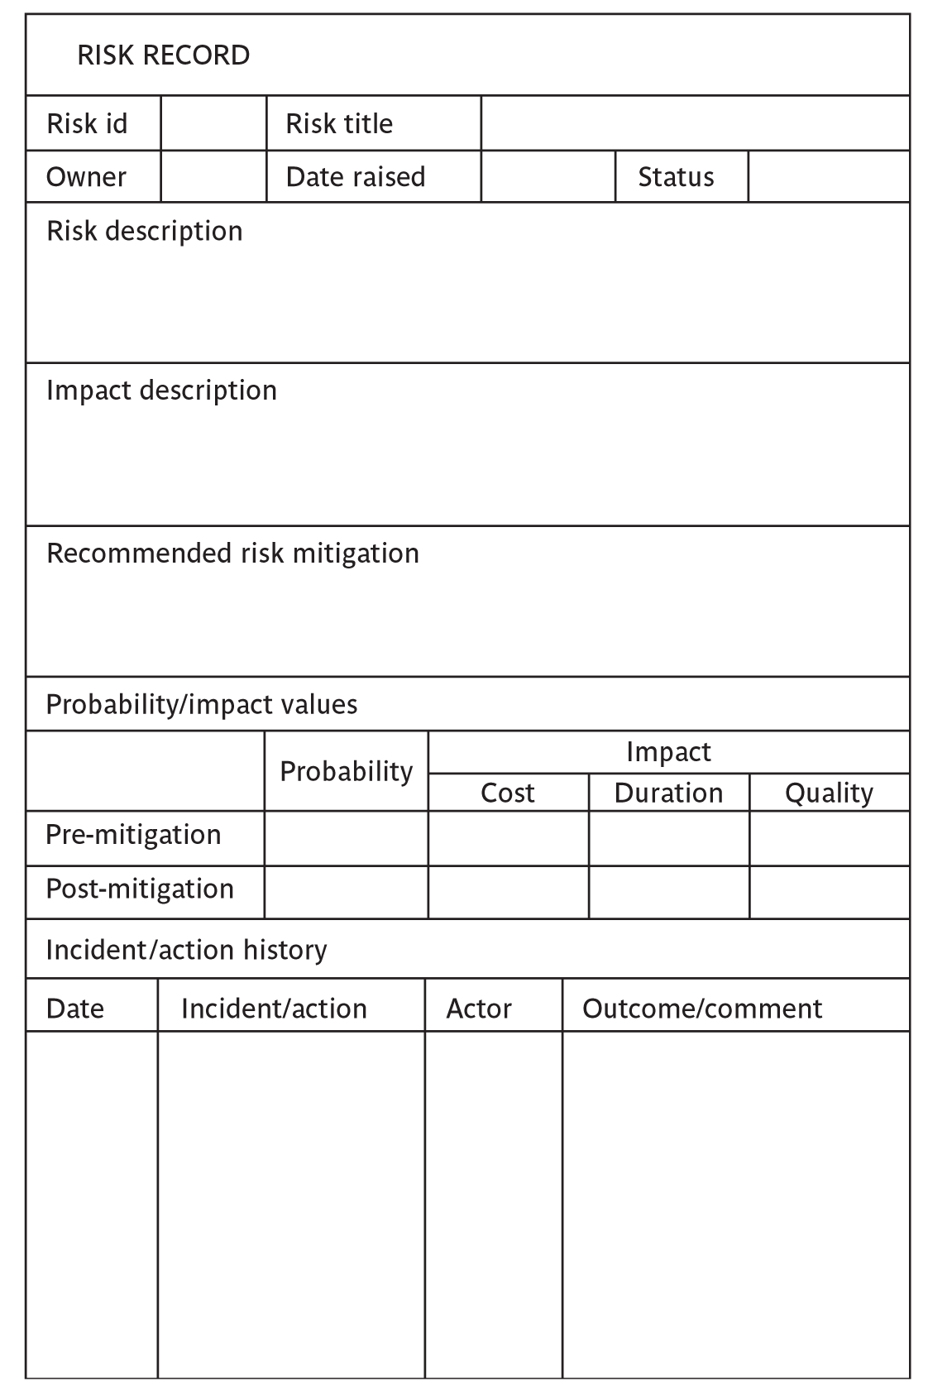
Risk management: 风险记录单

Slide 40
PERT技术
进度风险？

Slide 41
复习：关键路径法(CPM)的缺点?
关键路径法中的活动周期是确定的，固定不变的，这与现实不太符合
PERT技术是CPM的一种改进

Slide 42
PERT技术简介
Program/Project Evaluation and Review Technique (PERT, 工程评估评审技术)
发展于1958年，并用于美国海军北极星导弹开发项目中，取得了不错的效果
类似于关键路径法 (Critical Path Method, CPM)
CPM, PERT, CCPM (关键链项目管理)是进度管理的主要方法

Slide 43
PERT与CPM的区别
考虑到了进度管理中的风险，将不确定性引入到了进度管理中
对活动的周期进行了三次估计，不再是CPM中的确定值

Slide 44
PERT技术的步骤
估计每个活动的最可能的时间，乐观的时间，悲观的时间，计算活动的期望周期与标准偏差；
正向遍历得到期望达到事件的日期；
满足目标的可能性。

Slide 45
1. 活动的三个估计时间
最可能的时间：正常情况下所花的时间,m表示
乐观的时间：期望完成任务的最短时间,a表示
悲观的时间：最坏可能时间,b表示

Slide 46
1. 活动的期望周期与标准偏差
期望周期：
t_{e} = (a + 4m + b) / 6
标准偏差：
s = (b - a) / 6

Slide 47
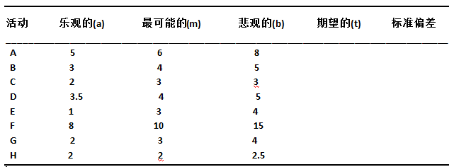
1. 活动的期望周期与标准偏差
计算下表每个活动的期望周期与标准偏差
6.17
4.00
2.83
4.08
2.83
10.5
3.00
2.08
0.5
0.33
0.17
0.25
0.50
1.17
0.33
0.08

Slide 48
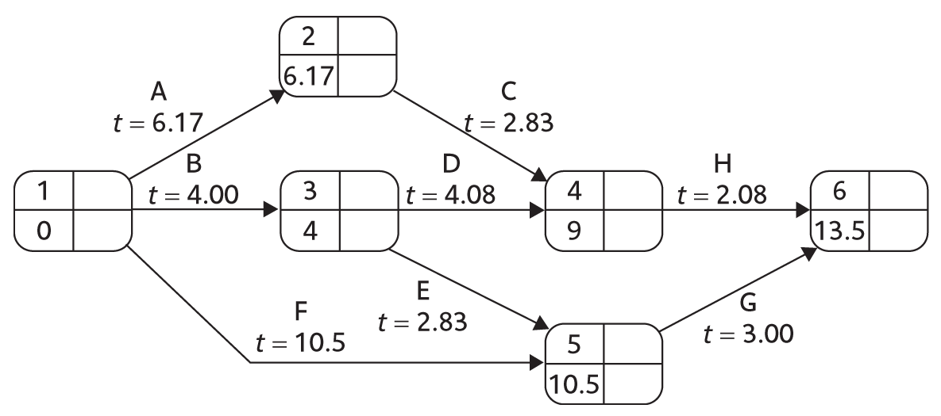
2. 使用期望周期做正向遍历
期望在……之前完成项目

Slide 49
3. 满足目标的可能性
3.1 计算每个项目事件的标准偏差
3.2 计算有目标日期的每个事件的z值
3.3 转化z值为概率

Slide 50
3.1 计算项目事件的标准偏差
每条路径的标准偏差为路径上所有活动的标准偏差的平方和的开根号
事件的标准偏差为到达其路径的标准偏差中的最大值

Slide 51
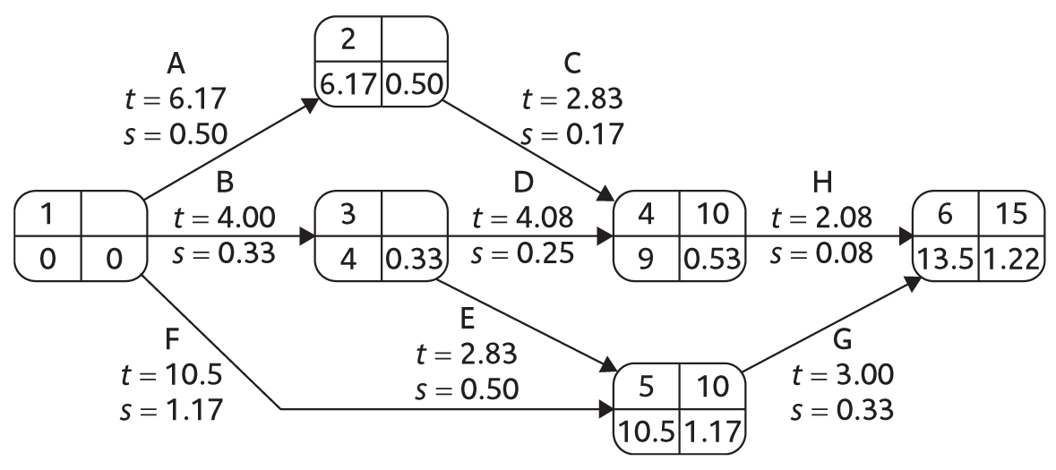
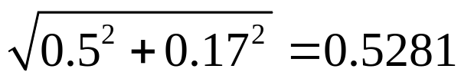
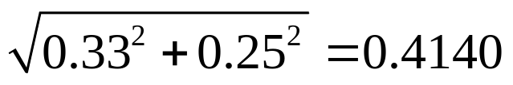
3.1 计算项目事件的标准偏差

Slide 52
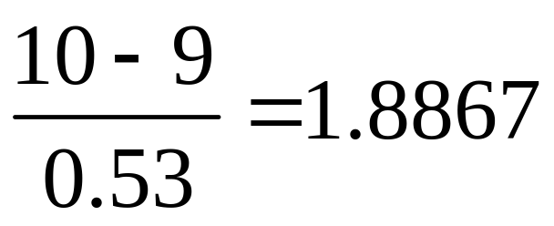
3.2 计算z值
将目标日期T转化为z值（非标准正态分布的标准化过程）
z = (T - t_{e}) / s
事件4：10周完成的z值为

Slide 53
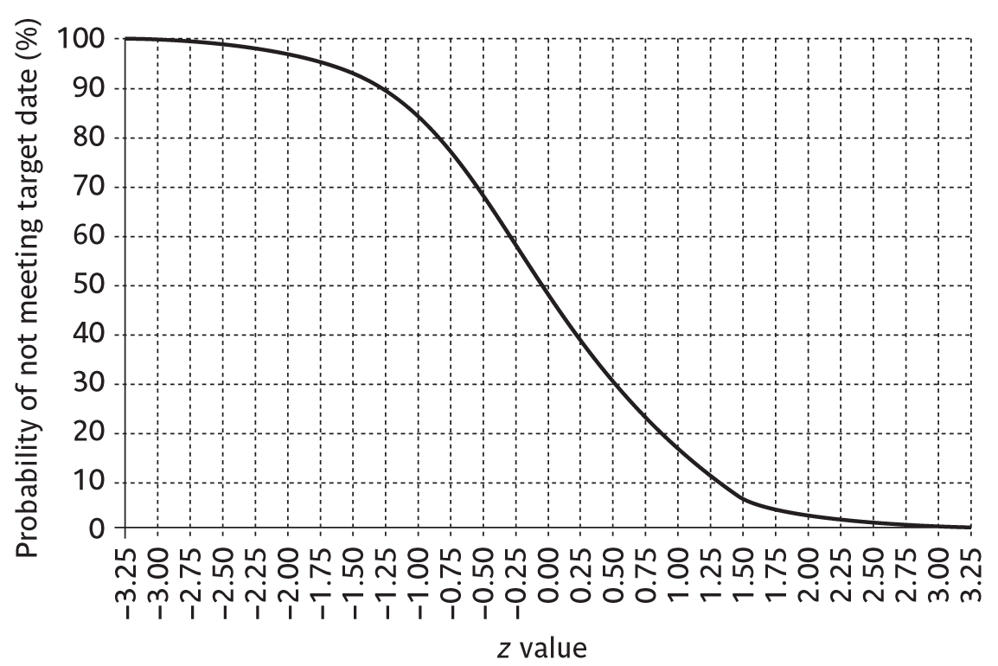
3.3 转化z值为概率
不满足目标日期的概率，即超过目标日期的概率

Slide 54
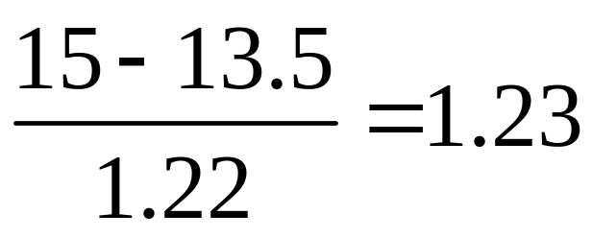
练习
项目15周之内完成的z值？

Slide 55
练习
项目15周之内完成的概率？
90%

Slide 56
作业
1.事件6的标准偏差为何是1.22？写出计算公式
2.项目14周完成的概率？
3.事件5: 10周完成的概率？

Slide 57
PERT技术的优点
活动的标准差是风险的一种度量
可以估计项目事件完成日期的概率

Slide 58
小结
风险管理
PERT技术

