Slide 1
Motivation & Background: Customer Churn Prediction in Telecommunications
Business Challenge:
Acquiring new customers costs 5-20× more than retaining existing ones
Telecommunications industry faces ~30% annual churn rates
Proactive prediction enables targeted retention interventions
Academic Context:
Vafeiadis et al. (2015): Ensemble methods outperform single classifiers
Ahmad et al. (2019): XGBoost achieved 93.3% AUC with big data platforms
Brandusoiu et al. (2016): Neural networks capture nonlinear relationships
Lalwani et al. (2022): Feature selection improves accuracy and efficiency
Project Significance:
Compare traditional vs. modern machine learning approaches
Balance model complexity with interpretability for business deployment
Provide actionable insights for retention strategy design

Slide 2
Research Questions & Objectives
Primary Research Question:
Which classification model provides the most accurate and reliable prediction of customer churn in the telecommunications industry?
Specific Objectives:
Develop and train four distinct classification models:
  Generalized Linear Model (Logistic Regression)
  Random Forest
  XGBoost
  Deep Learning Neural Network
Compare model performance using multiple metrics (accuracy, sensitivity, specificity, AUC)
Identify key drivers of customer churn behavior
Evaluate trade-offs between model complexity and interpretability
Expected Outcomes:
Recommendation for optimal model for business deployment
Actionable insights for customer retention strategies

Slide 3
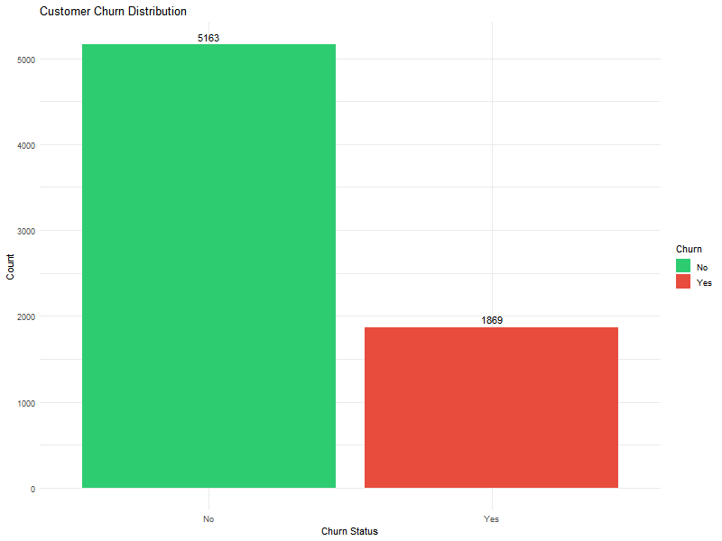
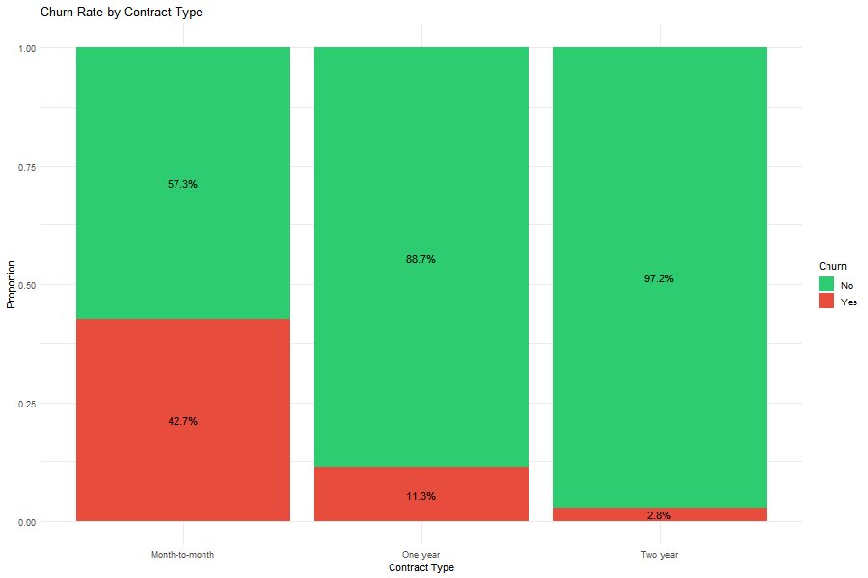
Data Overview: Telco Customer Churn Dataset
Data Source:
Telco Customer Churn dataset from Kaggle
7,043 customer records (7,032 after cleaning)
Publicly available benchmark dataset for churn prediction research
Dataset Characteristics:
Target variable: Churn (Yes/No) - 26.6% churn rate (class imbalance)
19 predictor variables across four categories:
  Demographics: gender, senior citizen, partner, dependents
  Services: phone, internet type, add-ons (security, backup, streaming)
  Account: tenure, contract type, payment method, billing
  Financial: monthly charges, total charges
Data Quality:
Missing values: 0.16% (11 observations removed)
Train/test split: 80/20 (5,626/1,406) with stratified sampling
Key Initial Findings:
Strong relationship between contract type and churn (42.7% vs. 2.8%)
New customers (0-10 months) at highest risk

Slide 4
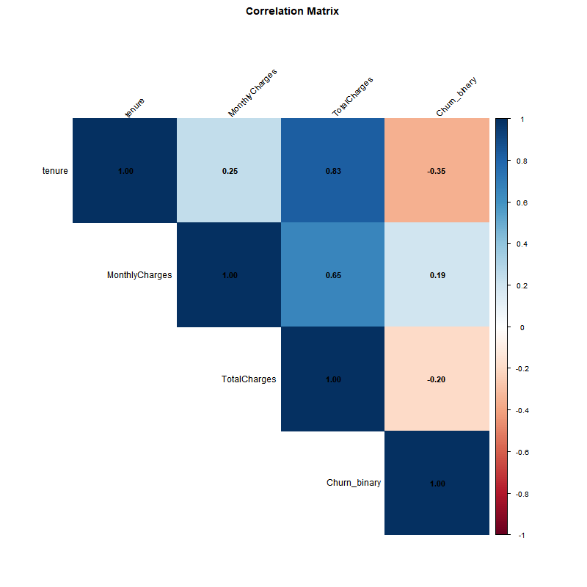
Methodology: Four Classification Approaches
1. Logistic Regression (GLM):
Baseline statistical model with logit link function
Advantage: Interpretable coefficients, easy deployment
2. Random Forest:
Ensemble of 500 decision trees with bootstrap sampling
Advantage: Handles nonlinear relationships, feature importance rankings
3. XGBoost:
Gradient boosting with regularization (max_depth=6, eta=0.3)
Advantage: Effective for structured data, prevents overfitting
4. Deep Learning Neural Network:
Architecture: 31 → 64 → 32 → 16 → 1 (ReLU + dropout)
Trained for 50 epochs with Adam optimizer
Advantage: Learns hierarchical representations
Evaluation Metrics:
Accuracy, Sensitivity (Recall), Specificity
AUC-ROC for threshold-independent assessment
Business focus: Minimize false negatives (missed churners)

Slide 5
Results: Model Performance & Comparison with Classical Methods
Key Findings:
Winner: Logistic Regression - Best overall performance despite being simplest
Simpler model outperforms complex algorithms (XGBoost, Deep Learning)
Linear relationships dominate this dataset
Comparison with Classical Methods:
Logistic Regression represents classical statistical approach
Random Forest improves on classical decision trees
XGBoost and Deep Learning represent modern alternatives
Trade-off: Complexity vs. interpretability vs. performance
Business Insights:
Contract type is strongest predictor (2-year contracts reduce churn by 78%)
Tenure negatively correlates with churn (-0.35)
Recommend Logistic Regression for deployment (interpretable + accurate)
Model | Accuracy | Sensitivity | Specificity | AUC
Logistic Regression | 0.827 | 0.573 | 0.916 | 0.861
Random Forest | 0.814 | 0.501 | 0.923 | 0.848
XGBoost | 0.795 | 0.512 | 0.894 | 0.825
Deep Learning | 0.812 | 0.543 | 0.905 | 0.846

