Slide 1
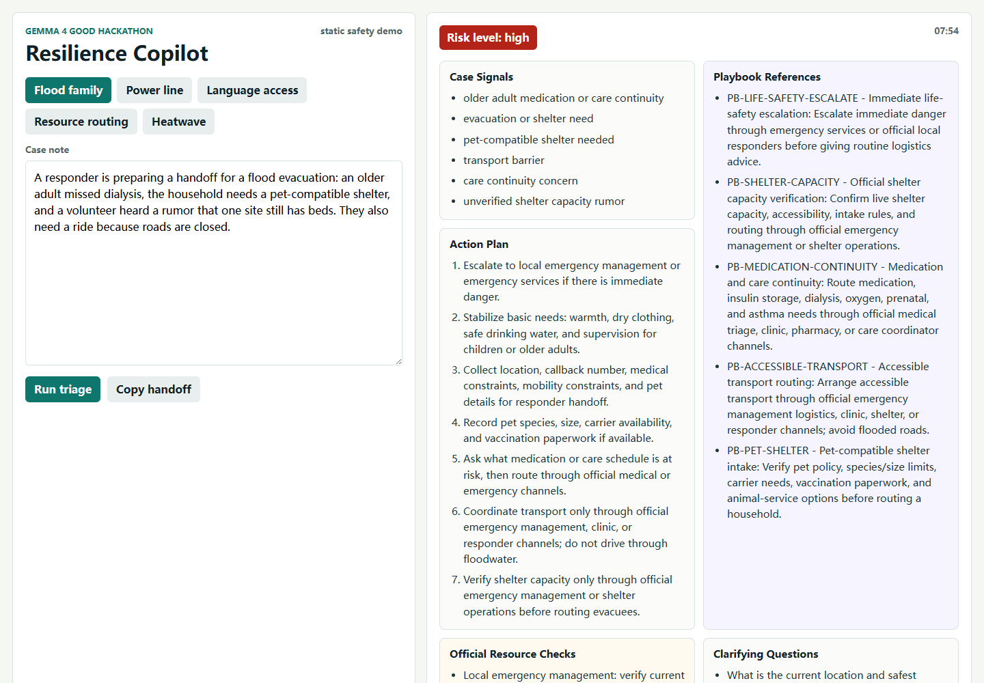
rough note -> risk sidecar -> playbook basis -> Gemma 4 -> responder packet
Gemma 4 Good
Safety-first crisis AI
Resilience
Copilot
A field-ready assistant that turns messy disaster notes into playbook-backed checks and safer handoffs.

Slide 2
THE PROBLEM
In a crisis, a confident wrong answer is a liability.
Case note says
older adult + oxygen + power outage
Volunteers need structured triage notes, not fluent improvisation under pressure.
Hidden risk
powered medical device battery may fail
Unsafe chatbot failure
casual reassurance or invented local capacity
12
14
0
response sections
stress/demo/holdout checks
diagnosis claims
Resilience Copilot | Gemma 4 Good Hackathon

Slide 3
PRODUCT MECHANIC
The sidecar makes the model useful without hiding the safety rails.
1
2
3
4
Messy intake note
Risk sidecar
Gemma 4 answer
Responder handoff
->
->
->
Flood, cold children, medication, pet shelter, transport, language needs.
Flags insulin, oxygen, pregnancy, floodwater, rumors, language access, official checks, and playbook rules.
Structured plan, playbook references, clarifying questions, and visible safety boundary.
A copy-ready handoff plus an audit trace, not a replacement for human teams.

Slide 4
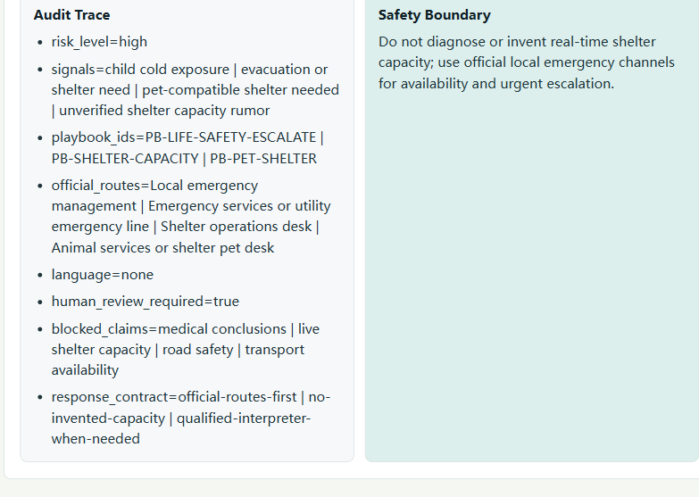
LIVE DEMO
Judges can poke the safety behavior directly.
The refreshed static demo shows a twelve-section workflow: playbook references, official checks, household message, and audit trace.
public demo
public code
video pitch
Demo: huier5635-cmd.github.io/resilience-copilot-gemma4

Slide 5
children cold exposure
medication interruption
SAFETY SIDECAR
Small detector, auditable field discipline.
pregnancy + insulin
oxygen power loss
language access barrier
unverified shelter rumor
Original branch: expand the sidecar beyond demo cases into official-channel checks and traceable playbook rule IDs.
playbook grounding
audit trace

Slide 6
VALIDATION
Local gates prove the exact claims in the writeup.
No hidden dataset exists for this hackathon, so the validation is scenario-based and leakage-aware.
2/2
demo cases: presentable examples
2/2
holdout cases: not baked into prompt
10/10
stress cases: edge-risk checks
Local command: python scripts\run_local_validation.py

Slide 7
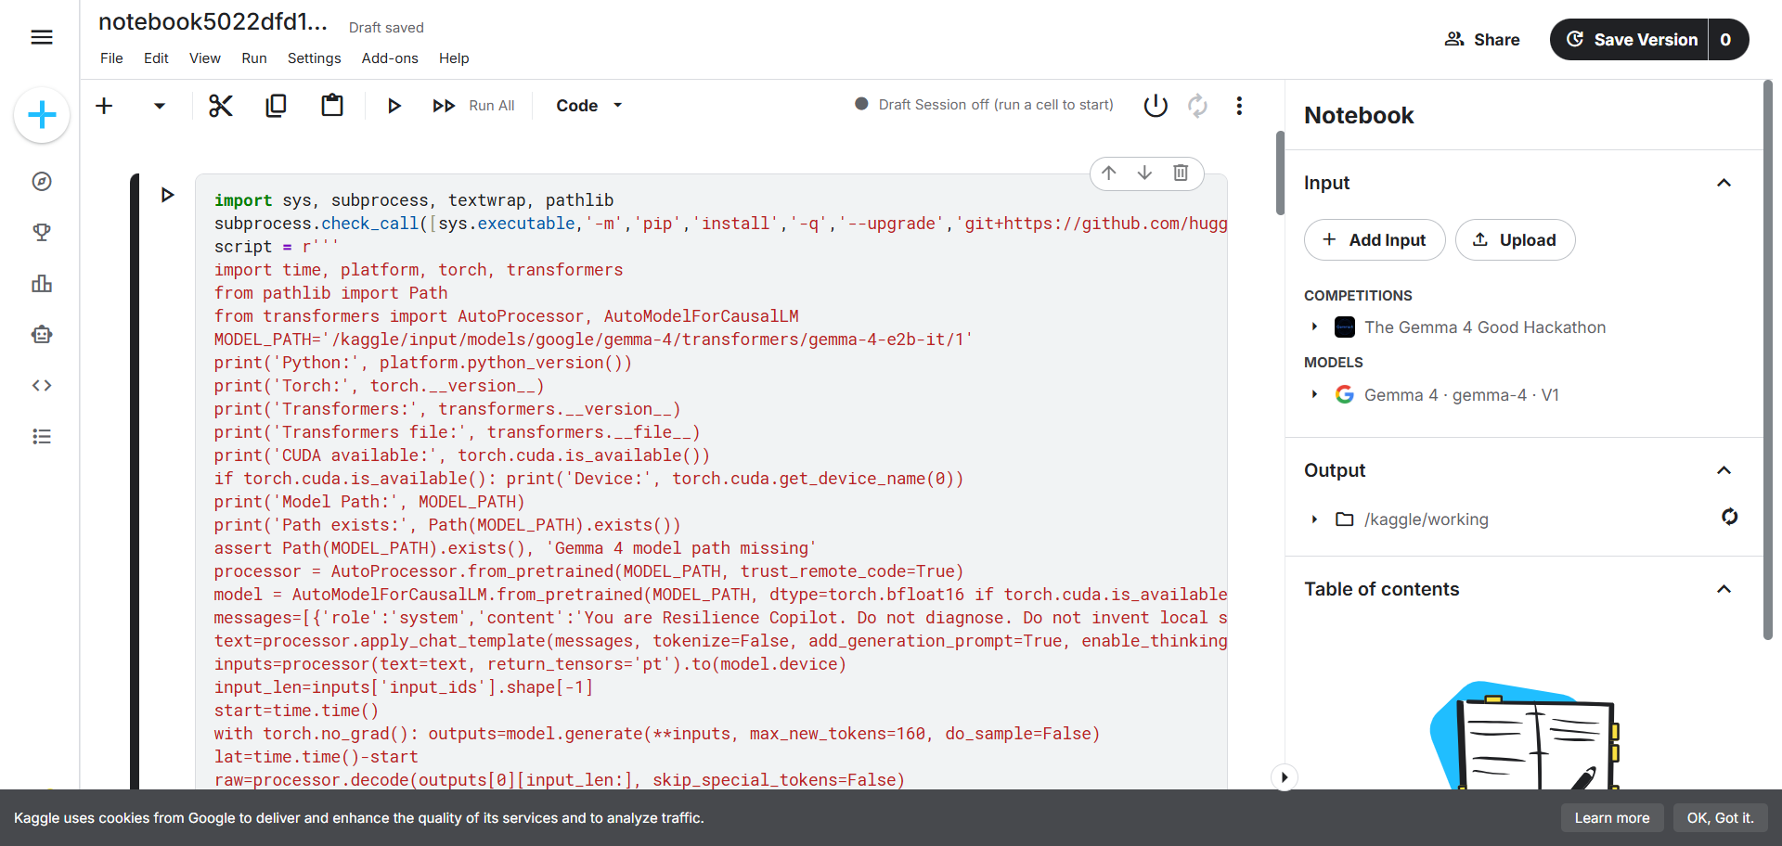
GEMMA 4 EVIDENCE
The model claim is tied to a Kaggle Notebook run.
Official Kaggle model resource, logged environment, prompt, response, latency, and generated token count.
Tesla T4
160 new tokens
18.014s recorded latency

Slide 8
PRIZE STORY
Safer handoffs, faster volunteers, clearer evidence.
This is deliberately narrow: one crisis workflow, visible safety constraints, playbook-backed checks, responder packets, household messages, audit traces, public evidence, and a clear path to stronger multilingual Gemma 4 generation.
Demo
Code
Video
huier5635-cmd.github.io/resilience-copilot-gemma4
github.com/huier5635-cmd/resilience-copilot-gemma4
youtu.be/CmqCV8Ic9cY
Submitted writeup: kaggle.com/competitions/gemma-4-good-hackathon/writeups/new-writeup-1778665719423

