Slide 1

Gemma 4
Safety-bounded agent
EXP-029
Resilience
Copilot
Rescue Command Center demo: turning chaotic disaster calls into safer, auditable responder handoffs.
2/2
2/2
15/15
53
demo validation
holdout validation
stress validation
bounded memory records

Slide 2
WHY IT MATTERS
A phone call can become a safety-critical triage problem.
The dangerous failure mode is not silence. It is fluent confidence: inventing shelter capacity, casual reassurance, or medical-adjacent advice when responders need verified constraints.
LIVE CALL
Incoming case note
Older adult uses oxygen. Power is out. Backup battery is nearly empty. Family asks if they can wait until morning. A social post claims a shelter has beds, but transport is unavailable.
oxygen
power outage
rumor
transport barrier
Design goal: let Gemma 4 write clearly, while deterministic safety systems decide what cannot be claimed.

Slide 3
SYSTEM ARCHITECTURE
Rescue Command Center: bounded agent loop.
->
->
Planner
Coordinator
Specialists
Chooses the analysis route and assigns specialist checks.
Combines case note, playbook, memory, and output contract.
Risk, language access, rumor, medical-power, transport.
->
->
Memory + Skills
Gemma 4
Safety Contract
Retrieves validation experience and reusable tactics.
Drafts responder-facing phrasing under constraints.
Blocks unsupported claims and exports audit trace.
Autonomy is bounded: route selection, memory retrieval, skill selection, and reflection. No emergency calls, diagnosis, booking, or live capacity promises.

Slide 4
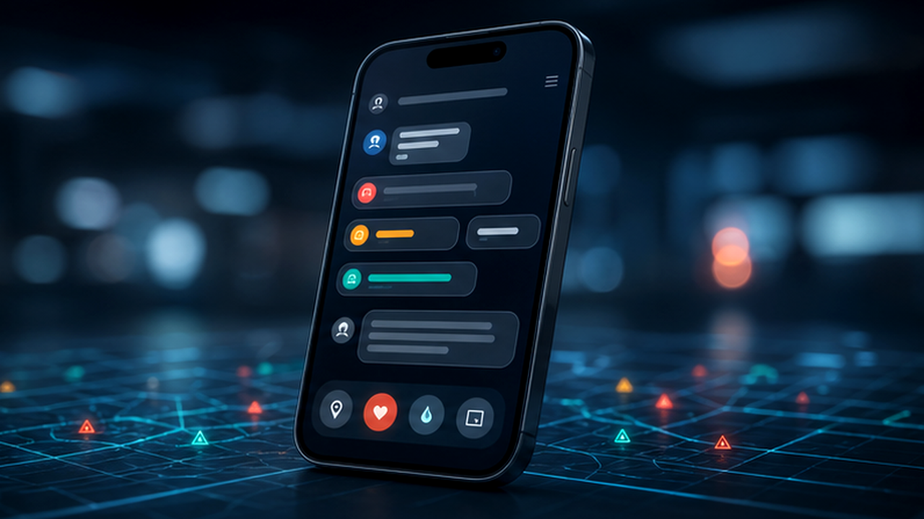
CASE FLOW 1/5
Incoming Call / Case Note
CALL INTAKE
Oxygen device. Power out. Battery low. Shelter rumor. No transport.
The first decision is not what to say. It is what must be treated as risky before generation begins.
1. CALL
2. SIGNALS
3. MEMORY
4. TOOLS
5. BRIEF

Slide 5
CASE FLOW 2/5
Risk Signal Detection
The deterministic sidecar turns ambiguous prose into explicit risk labels, review reasons, and forbidden claim classes.
HIGH RISK
Power-dependent oxygen + battery depletion.
Human review
Medical-adjacent danger; responder routing required.
Rumor quarantine
Social-media shelter claim cannot be treated as verified.
Blocked claims
No wait-until-morning reassurance; no invented transport.
1. CALL
2. SIGNALS
3. MEMORY
4. TOOLS
5. BRIEF

Slide 6

CASE FLOW 3/5
Memory + Skill Retrieval
Experience ledger
The learning layer remembers validation outcomes and retrieves human-reviewed skills. It suggests tactics; it does not silently rewrite emergency policy.
Case fingerprint, signals, local score, failure mode.
Validation memory
Similar oxygen-outage cases retrieved for safer routing.
Skill library
Medical-power escalation, rumor quarantine, transport barrier handling.
Strategy reflection
Produces next-round policy suggestions for human review.
1. CALL
2. SIGNALS
3. MEMORY
4. TOOLS
5. BRIEF

Slide 7
CASE FLOW 4/5
Playbook + Tool Sandbox
PB-MEDICAL-POWER
Powered medical-device risk.
The system can choose approved checks, but every tool is sandboxed, offline, and whitelisted for auditability.
PB-SHELTER-CAPACITY
Official check required.
PB-TRANSPORT-BARRIER
Do not invent vehicles.
No live calls
Responder review only.
1. CALL
2. SIGNALS
3. MEMORY
4. TOOLS
5. BRIEF

Slide 8
CASE FLOW 5/5
TRANSFER BRIEF
audit_trace.json
Transfer Brief + Audit JSON Export
Incident: powered oxygen device + outage
{
Risk: high; human review required
"risk_level": "high",
Do not promise: wait time, shelter beds, transport
"signals": ["oxygen","outage","rumor"],
Check: emergency / utility medical-priority route
"blocked_claims": ["capacity","transport"],
Export: audit_trace.json + responder_packet.json
"human_review": true,
Gemma 4 drafts the human-readable language. The safety contract then verifies the sixteen-section response and exports structured proof.
"ready_to_submit": true
}
1. CALL
2. SIGNALS
3. MEMORY
4. TOOLS
5. BRIEF

Slide 9
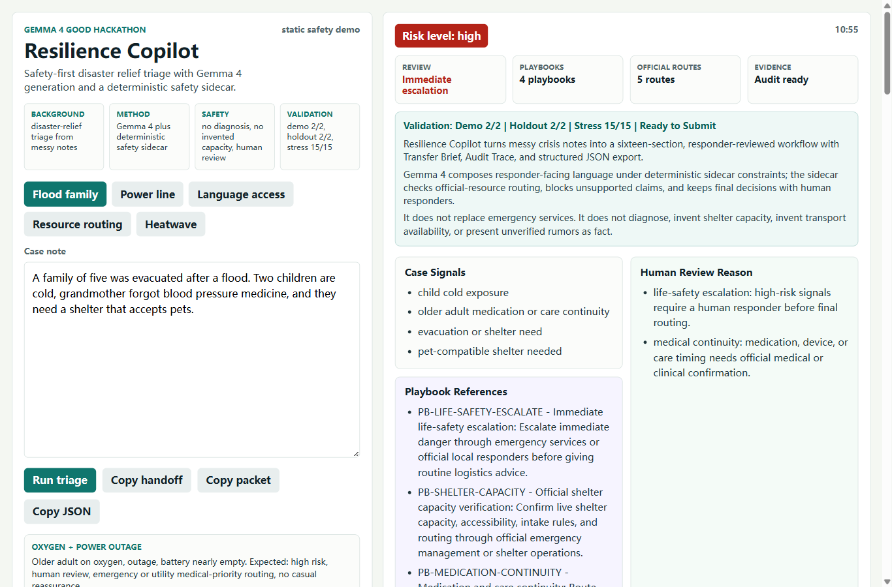

LIVE DEMO
30-second reviewer path.
Project background, method, architecture, safety mechanisms, validation result, demo link, and audit evidence are visible without opening internal notes.
Scan the demo
Validation: Demo 2/2 | Holdout 2/2 | Stress 15/15
GitHub Pages static version; no online API dependency.
Transfer Brief + Audit Trace + JSON Export
No diagnosis | No invented capacity | No emergency-service replacement

Slide 10
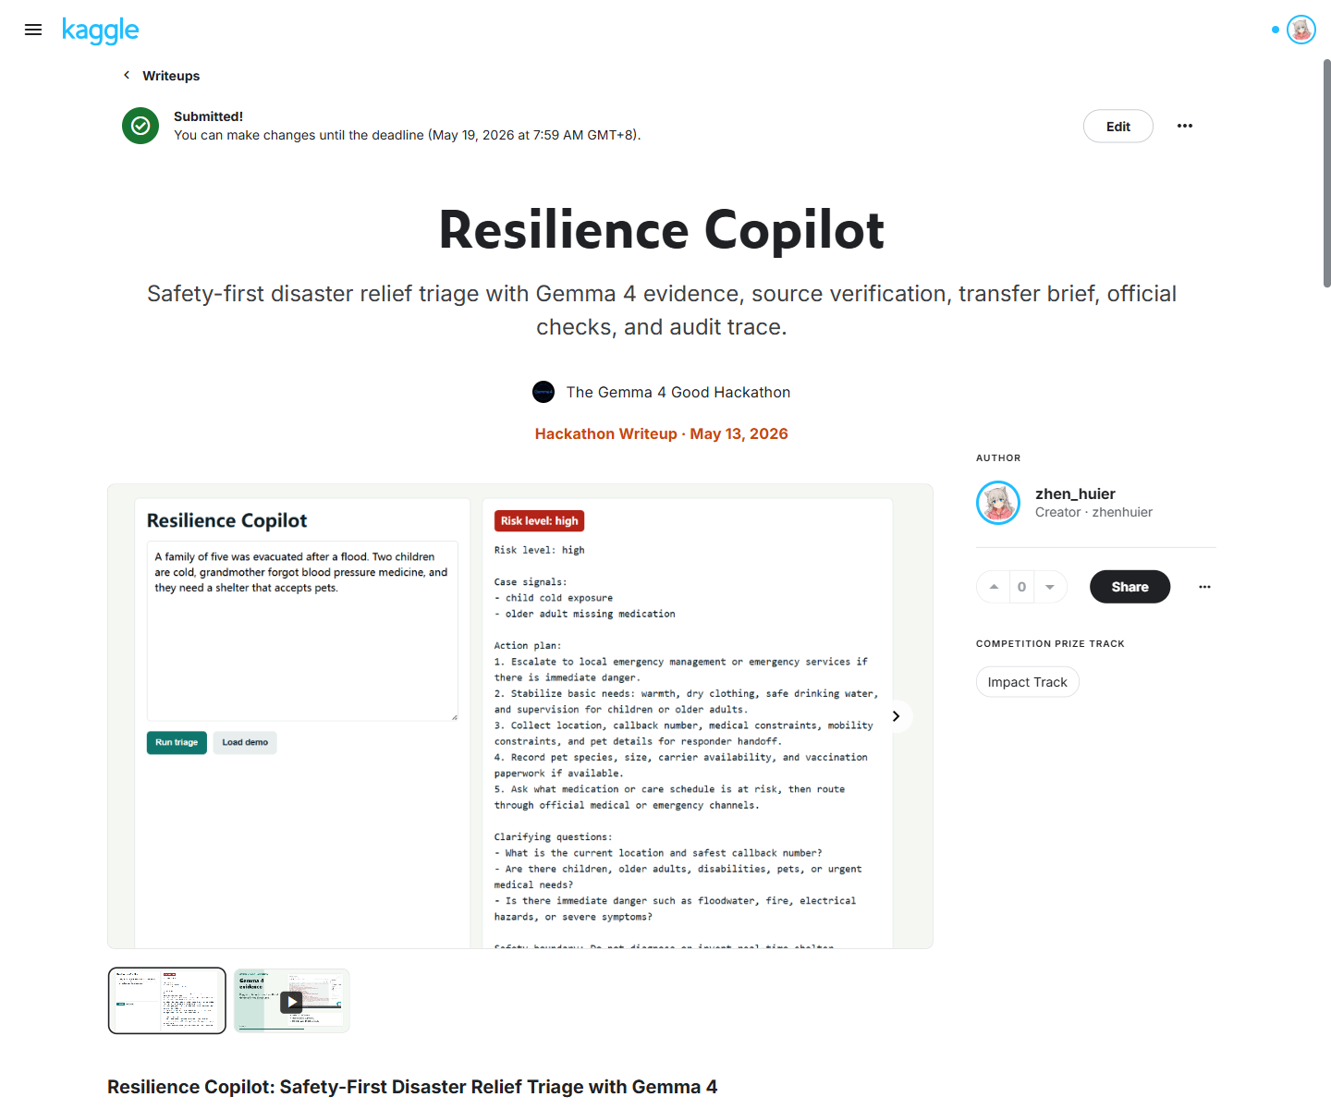
EVIDENCE
The claims are backed by local gates and Kaggle evidence.
2/2
2/2
demo cases pass
holdout cases pass
15/15
16
stress cases pass
response sections
53
7
memory records
skills
Gemma 4 evidence notebook records model path, runtime, prompt, response, latency, and token count. No fine-tuning or medical capability claim.

Slide 11
NOT JUST WORKFLOW
Agentic, but safety-bounded.
Planner / Coordinator
Bounded Memory
Selects analysis route and merges specialist outputs.
Episodic, semantic, procedural, and reflection records.
The system has decision points: route planning, specialist selection, memory retrieval, skill choice, reflection, and policy suggestions. High-risk behavior remains bounded by deterministic contracts and human review.
Skill Library
Tool Sandbox
Reusable rescue tactics with safety notes.
Offline, whitelisted, no real-world side effects.
Strategy Reflection
Human Review
Finds failure patterns and suggests next policies.
Controls promotion of learned strategies.
Future direction: LangGraph-style graph, white-listed official tools, human-reviewed skill promotion.

Slide 12

SAFETY BOUNDARY
The most important product feature is restraint.
Resilience Copilot is designed to assist responder-reviewed triage. It does not diagnose, promise shelter capacity, invent transport availability, replace emergency services, or hide uncertainty.
No diagnosis
No invented capacity
No emergency replacement

Slide 13

FINAL REVIEW
EXP-029
ready
Judge the whole packet: product, safety, evidence, reproducibility.
final judge packet
local gate
The project is intentionally locked for final judging: low-risk polish only, no last-minute core logic churn.
Gemma 4
safe
generation proof
bounded learning agent
Live demo + GitHub repo
Scan to review the static demo, README, validation badge, final bundle, and reproducibility assets.

