Slide 1
SECOND PART:
Algorithms for UNRELIABLE Distributed Systems
(The consensus problem)

Slide 2
Failures in Distributed Systems
Link failure: A link fails and remains inactive; the network may get disconnected
Processor Crash: At some point, a processor stops taking steps
Byzantine processor: processor changes state arbitrarily and sends messages with arbitrary content (name dates back to untrustable Byzantine Generals of Byzantine Empire, IV–XV century A.D.)

Slide 3
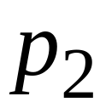
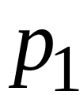
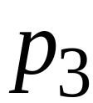
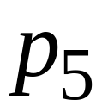
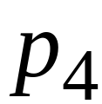
Link Failures
a
Non-faulty
links
a
b
b
a
c
a
c

Slide 4
a
Faulty
link
a
b
b
a
c
c
Some of the messages are not delivered

Slide 5
Crash Failures
a
Non-faulty
processor
a
b
b
a
c
a
c

Slide 6
a
Faulty
processor
a
b
b
Some of the messages are not sent

Slide 7

Round
1
Round
2
Round
3
Round
4
Round
5
Failure
After failure the processor disappears from
the network

Slide 8
Byzantine Failures
a
Non-faulty
processor
a
b
b
a
c
a
c

Slide 9
Byzantine Failures
a
Faulty
processor
a
*!§ç#
*!§ç#
%&/£
%&/£
Processor sends arbitrary messages, plus some messages may be not sent

Slide 10
Round
1
Round
2
Round
3
Round
4
Round
5
Round
6
Failure
Failure
After failure the processor may continue
functioning in the network

Slide 11
Consensus Problem
Every processor has an input x є X
Termination: Eventually every non-faulty processor must decide on a value y.
Agreement: All decisions by non-faulty processors must be the same.
Validity: If all inputs are the same, then the decision of a non-faulty processor must equal the common input (this avoids trivial solutions).

Slide 12
Agreement
Start
Finish
0
2
1
3
3
3
2
3
3
3
Everybody has an initial value
All non-faulty must decide the same value

Slide 13
Validity
If everybody starts with the same value,
then non-faulty must decide that value
Start
Finish
1
2
1
1
1
1
1
1
1
1

Slide 14
Negative result for link failures
It is impossible to reach consensus in case of link failures, even in the synchronous case, and even if one only wants to tolerate a single link failure.

Slide 15
Consensus under link failures: the 2 generals problem
There are two generals of the same army who have encamped a short distance apart.
• Their objective is to capture a hill, which is possible only if they attack simultaneously.
• If only one general attacks, he will be defeated.
• The two generals can only communicate by sending messengers, which is not reliable.
• Is it possible for them to attack simultaneously?

Slide 16


The 2 generals problem
Let’s attack
A
B

Slide 17
Impossibility of consensus under link failures
First of all, notice that it is needed to exchange messages to reach consensus (generals might have different opinions in mind!)
Assume the problem can be solved, and let Π be the shortest (i.e., with minimum number of messages) protocol for a given input configuration.
Suppose now that the last message in Π does not reach the destination. Since Π is correct, consensus must be reached in any case. This means, the last message was useless, and then Π could not be shortest!

Slide 18
Negative result for processor failures in asynchronous systems
For any system topology and for any arbitrary single crash failure, it is impossible to reach consensus in the asynchronous case.
Notice that for the synchronous case it cannot be a given a such general negative result, and impossibility can be given only for specific crash failures in specific topologies
⇒ There is space for positive results on synchronous specific topologies.

Slide 19
Positive results: Assumption on the communication model for crash and byzantine failures
Complete undirected graph
Synchronous network: w.l.o.g., we assume that messages are sent, delivered and read in the very same round

Slide 20
Overview of Consensus Results
Let f be the maximum number of faulty processors
 | Crash failures | Byzantine failures
number of rounds | f+1 | 2(f+1) f+1
total number of processors | f+1 | 4f+1 3f+1
message size | (Pseudo-) Polynomial | (Pseudo-)Polynomial Exponential

Slide 21
A simple algorithm for fault-free consensus
Each processor:
Broadcast its input to all processors
Decide on the minimum
(only one round is needed, since the graph is complete)

Slide 22
Start
0
1
4
2
3

Slide 23
Broadcast values
0,1,2,3,4
0
0,1,2,3,4
0,1,2,3,4
1
4
0,1,2,3,4
2
3
0,1,2,3,4

Slide 24
Decide on minimum
0,1,2,3,4
0
0,1,2,3,4
0,1,2,3,4
0
0
0,1,2,3,4
0
0
0,1,2,3,4

Slide 25
Finish
0
0
0
0
0

Slide 26
This algorithm satisfies the validity condition
Start
Finish
1
1
1
1
1
1
1
1
1
1
If everybody starts with the same initial value,
everybody decides on that value (minimum)

Slide 27
Consensus with Crash Failures
The simple algorithm doesn’t work
Each processor:
Broadcast value to all processors
Decide on the minimum

Slide 28
Start
fail
0
0
1
0
4
2
3
The failed processor doesn’t broadcast
its value to all processors

Slide 29
Broadcasted values
fail
0
0,1,2,3,4
1,2,3,4
1
4
1,2,3,4
0,1,2,3,4
2
3

Slide 30
Decide on minimum
fail
0
0,1,2,3,4
1,2,3,4
0
1
1,2,3,4
0,1,2,3,4
1
0

Slide 31
Finish
fail
0
0
1
1
0
No Consensus!!!

Slide 32
If an algorithm solves consensus for
f failed (crashing) processors we say it is:
an f-resilient consensus algorithm

Slide 33
An f-resilient algorithm
Round 1:
Broadcast my value
Round 2 to round f+1:
Broadcast any new received values
End of round f+1:
Decide on the minimum value received

Slide 34
Example: f=1 failures, f+1 = 2 rounds needed
Start
0
1
4
2
3

Slide 35
Example: f=1 failures, f+1 = 2 rounds needed
Round 1
0
fail
0
0,1,2,3,4
1,2,3,4
1
0
4
(new values)
1,2,3,4
0,1,2,3,4
2
3
Broadcast all values to everybody

Slide 36
Example: f=1 failures, f+1 = 2 rounds needed
Round 2
0
0,1,2,3,4
0,1,2,3,4
1
4
0,1,2,3,4
0,1,2,3,4
2
3
Broadcast all new values to everybody

Slide 37
Example: f=1 failures, f+1 = 2 rounds needed
Finish
0
0,1,2,3,4
0,1,2,3,4
0
0
0,1,2,3,4
0,1,2,3,4
0
0
Decide on minimum value

Slide 38
Example: f=2 failures, f+1 = 3 rounds needed
Start
0
1
4
2
3

Slide 39
Example: f=2 failures, f+1 = 3 rounds needed
Round 1
0
Failure 1
1,2,3,4
1,2,3,4
1
0
4
1,2,3,4
0,1,2,3,4
2
3
Broadcast all values to everybody

Slide 40
Example: f=2 failures, f+1 = 3 rounds needed
Round 2
0
Failure 1
0,1,2,3,4
1,2,3,4
1
4
0
1,2,3,4
0,1,2,3,4
2
3
Failure 2
Broadcast new values to everybody

Slide 41
Example: f=2 failures, f+1 = 3 rounds needed
Round 3
0
Failure 1
0,1,2,3,4
0,1,2,3,4
1
4
0,1,2,3,4
0,1,2,3,4
2
3
Failure 2
Broadcast new values to everybody

Slide 42
Example: f=2 failures, f+1 = 3 rounds needed
Finish
0
Failure 1
0,1,2,3,4
0,1,2,3,4
0
0
0,1,2,3,4
0,1,2,3,4
0
3
Failure 2
Decide on the minimum value

Slide 43
If there are f failures and f+1 rounds then
there is at least a round with no failed processors:
Round
1
2
3
4
5
6
Example:
5 failures,
6 rounds
No failure

Slide 44
Lemma: In the algorithm, at the end of the
round with no failure, all the processors know the same set of values.
Proof: For the sake of contradiction, assume the claim is false. Let x be a value which is known only to a subset of (non-faulty) processors. But when a processor knew x for the first time, in the next round it broadcasted it to all. So, the only possibility is that it received it right in this round, otherwise all the others should know x as well. But in this round there are no failures, and so x must be received by all.

Slide 45
Then, at the end of the round with no failure:
Every (non-faulty) processor knows
about all the values of all other
participating processors
This knowledge doesn’t change until
the end of the algorithm

Slide 46
Therefore, at the end of the
round with no failure:
everybody would decide the same value
However, we don’t know the exact position
of this round, so we have to let the algorithm
execute for f+1 rounds

Slide 47
Validity of algorithm:
When all processors start with the same
input value then the consensus is that value
This holds, since the value decided from
each processor is some input value

Slide 48
Performance of Crash Consensus Algorithm
Number of processors: n > f
f+1 rounds
O(n²•k) messages, where k=O(n) is the number of different inputs. Indeed, each node sends O(n) messages containing a given value in X (such value might be not polynomial in n, by the way!)

Slide 49
A Lower Bound
Theorem:
Any f-resilient consensus algorithm
requires at least f+1 rounds

Slide 50
Proof sketch:
Assume by contradiction that f
or less rounds are enough
Worst case scenario:
There is a processor that fails in
each round

Slide 51

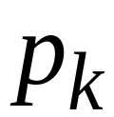
Worst case scenario
Round
1
a
before processor fails, it sends its value a to only one processor

Slide 52
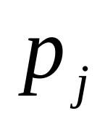
Worst case scenario
Round
1
2
a
before processor fails, it sends its value a to only one processor

Slide 53
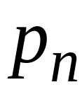
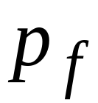
Worst case scenario
Round
1
2
3
f
………
a
before processor fails, it sends its value a to only one processor . Thus, at the end of round f only one processor knows about a

Slide 54
Worst case scenario
Round
1
2
3
f
decide
b
………
a
Processor may decide a, and all other
processors may decide another value, say b

Slide 55
Worst case scenario
Round
1
2
3
f
decide
b
………
a
Therefore f rounds are not enough
At least f+1 rounds are needed

Slide 56
Consensus with Byzantine Failures
f-resilient (to byzantine failures) consensus algorithm:
solves consensus for f failed processors

Slide 57
Lower bound on number of rounds
Theorem:
Any f-resilient consensus algorithm
with byzantine failures requires
at least f+1 rounds
Proof:
follows from the crash failure lower bound

Slide 58

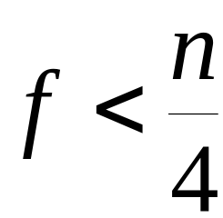

A Consensus Algorithm
The King algorithm
solves consensus in 2(f+1) rounds with:
processors and
failures, where
Assumptions:
  Number f must be known to processors;
  Processor ids are in {1,…,n}.

Slide 59
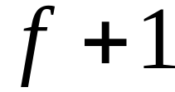
The King algorithm
There are phases
Each phase has 2 broadcast rounds
In each phase there is a different king
⇒ There is a king that is non-faulty!

Slide 60

The King algorithm
Each processor has a preferred value
In the beginning,
the preferred value is set to the initial value

Slide 61

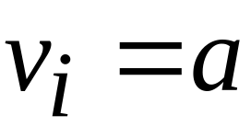
The King algorithm
Phase k
Round 1, processor :
Broadcast preferred value
Let be the majority
of received values (including )
(in case of tie pick an arbitrary value)
Set

Slide 62

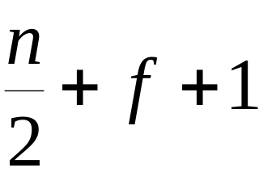
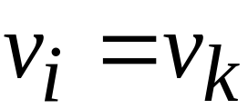
The King algorithm
Phase k
Round 2, king :
Broadcast new preferred value
Round 2, process :
If had majority of less than
then set

Slide 63
The King algorithm
End of Phase f+1:
Each processor decides on preferred value

Slide 64
Example: 6 processors, 1 fault
0
1
0
2
king 2
1
1
king 1
Faulty

Slide 65
Phase 1, Round 1
2,1,1,1,0,0
2,1,1,0,0,0
0
1
2,1,1,0,0,0
2,1,1,0,0,0
1
0
0
2
0
0
1
1
1
2,1,1,1,0,0
king 1
Everybody broadcasts

Slide 66
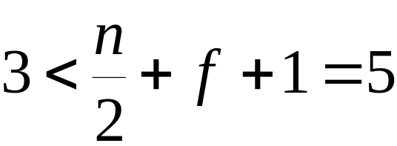
Phase 1, Round 1
Choose the majority
1
0
0
0
1
1
2,1,1,1,0,0
king 1
Each majority vote was
On round 2, everybody will choose the king’s value

Slide 67
Phase 1, Round 2
1
0
0
1
0
0
0
2
1
1
1
king 1
The king broadcasts

Slide 68
Phase 1, Round 2
0
1
0
2
1
1
king 1
Everybody chooses the king’s value

Slide 69
Phase 2, Round 1
2,1,1,1,0,0
2,1,1,0,0,0
0
1
2,1,1,0,0,0
2,1,1,0,0,0
1
0
0
2
0
king 2
0
1
1
1
2,1,1,1,0,0
Everybody broadcasts

Slide 70
Phase 2, Round 1
Choose the majority
1
0
0
0
king 2
1
1
2,1,1,1,0,0
Each majority vote was
On round 2, everybody will chose the king’s value

Slide 71
Phase 2, Round 2
1
0
0
0
0
0
0
0
0
king 2
1
1
The king broadcasts

Slide 72
Phase 2, Round 2
0
0
0
0
king 2
0
1
Everybody chooses the king’s value
Final decision

Slide 73
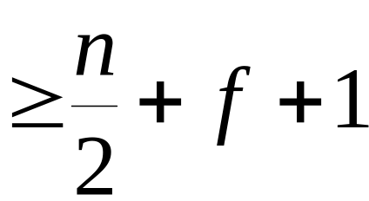
Correctness of the King algorithm
Lemma 1: At the end of a phase φ where the king is non-faulty, every non-faulty processor decides the same value
Proof: Consider the end of round 1 of phase φ.
There are two cases:
Case 1: some node has chosen its preferred
value with strong majority ( votes)
Case 2: No node has chosen its preferred value with strong majority

Slide 74

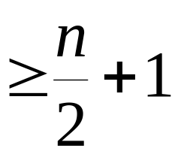
Case 1: suppose node has chosen its preferred value
with strong majority ( votes)
At the end of round 1, every other non-faulty node must have preferred value
(including the king)
Explanation:
At least non-faulty nodes must
have broadcasted at start of round 1

Slide 75
At end of round 2:
If a node keeps its own value:
then decides
If a node gets the value of the king:
then it decides ,
since the king has decided
Therefore: Every non-faulty node decides

Slide 76
Case 2:
No node has chosen its preferred value with
strong majority ( votes)
Every non-faulty node will adopt
the value of the king, thus all decide
on same value
END of PROOF

Slide 77
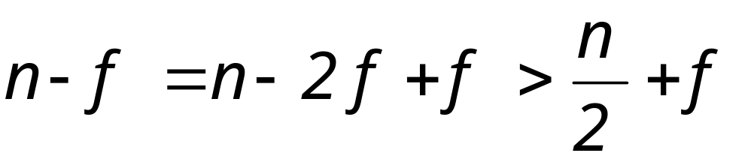
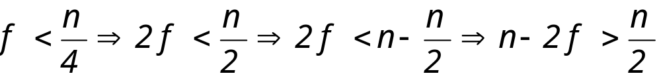
Lemma 2: Let a be a common value decided by non-faulty processors at the end of phase φ. Then, a will be preferred until the end.
Proof: After φ, a will always be preferred with strong majority (i.e., > n/2+f), since:
(indeed )
Thus, until the end of phase f+1, every non-faulty processor decides a.
END of PROOF

Slide 78
Agreement in the King algorithm
Follows from Lemma 1 and 2, observing that since there are f+1 phases and at most f failures, there is al least one phase in which the king is non-faulty (and thus from Lemma 1 at the end of that phase all non-faulty processors decide the same, and from Lemma 2 this will be maintained until the end).

Slide 79
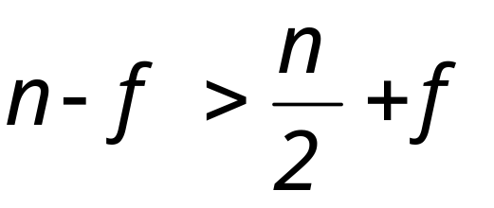
Validity in the King algorithm
Follows from the fact that if all (non-faulty) processors have a as input, then in round 1 of phase 1 each non-faulty processor will receive a with strong majority, since:
and so in round 2 of phase 1 this will be the preferred value of non-faulty processors. From Lemma 2, this will be maintained until the end, and will be exactly the decided output!
END of PROOF

Slide 80
Performance of King Algorithm
Number of processors: n > 4f
2(f+1) rounds
Θ(n²• f) messages. Indeed, each non-faulty node sends Θ(n) messages in each round, each containing a given preference value (such value might be not polynomial in n, by the way!)

Slide 81
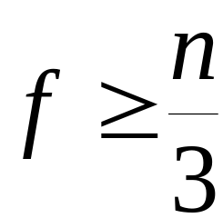
An Impossibility Result
Theorem:
There is no -resilient algorithm
for processors, where
Proof:
First we prove the 3 processors case,
and then the general case

Slide 82
The 3 processes case
Lemma:
There is no 1-resilient algorithm
for 3 processors
Proof:
Assume by contradiction that there is
a 1-resilient algorithm for 3 processors

Slide 83

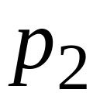
B(1)
Local
algorithm
A(0)
C(0)
Initial value

Slide 84
1
1
1
Decision value

Slide 85
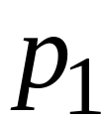

B(1)
A(1)
C(1)
C(1)
C(0)
faulty

Slide 86
1
1
faulty
(validity condition)

Slide 87
B(0)
1
A(0)
C(0)
A(0)
1
1
A(1)
faulty
faulty

Slide 88
0
1
0
1
1
faulty
faulty
(validity condition)

Slide 89
faulty
B(1)
B(1)
B(0)
A(1)
C(0)
0
1
0
1
1
faulty
faulty

Slide 90
faulty
B(1)
B(1)
B(0)
A(1)
C(0)
B(0)
0
1
B(1)
A(0)
C(0)
A(1)
C(1)
0
1
A(1)
C(0)
faulty
faulty

Slide 91
faulty
0
1
0
1
0
1
1
faulty
faulty
Non-agreement!!! Contradiction, since the algorithm was supposed to be 1-resilient

Slide 92
Therefore:
There is no algorithm that solves
consensus for 3 processors
in which 1 is a byzantine!

Slide 93
The n processors case
Assume by contradiction that
there is an -resilient algorithm A
for processors, where
We will use algorithm A to solve consensus
for 3 processors and 1 failure
(contradiction)

Slide 94
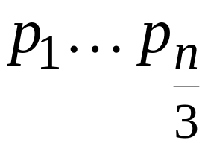
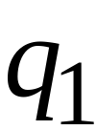
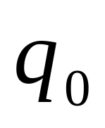
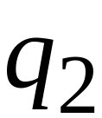
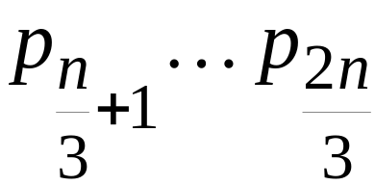
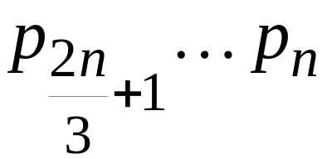



Each process simulates algorithm A
on of processors

Slide 95
fails
When a fails
then of processors fail too

Slide 96
Finish of
algorithm A
k
k
k
k
k
all decide k
k
k
k
k
k
k
k
k
fails
algorithm A tolerates failures

Slide 97
Final decision
k
k
fails
We reached consensus with 1 failure
Impossible!!!

Slide 98
Therefore:
There is no -resilient algorithm
for processors, where

Slide 99
Exponential Tree Algorithm
This algorithm uses
  f+1 rounds (optimal)
  n=3f+1 processors (optimal)
  exponential size messages (sub-optimal)
Each processor keeps a tree data structure in its local state
Topologically, the tree has height f+1, and all the leaves are at the same level
Values are filled in the tree during the f+1 rounds
At the end of round f+1, the values in the tree are used to compute the decision.

Slide 100
Local Tree Data Structure
Each tree node is labeled with a sequence of unique processor indices in 0,1,…,n-1.
Root's label is empty sequence λ; root has level 0 and height f+1;
Root (level 0) has n children, labeled 0 through n-1
Child node of the root (level 1) labeled i has n-1 children, labeled i:0 through i:n-1 (skipping i:i)
Node at level d>1 labeled i₁:i₂:…:i_{d} has n-d children, labeled i₁:i₂:…:i_{d}:0 through i₁:i₂:…:i_{d}:n-1 (skipping any index i₁,i₂,…,i_{d})
Nodes at level f+1 are leaves and have height 0.

Slide 101
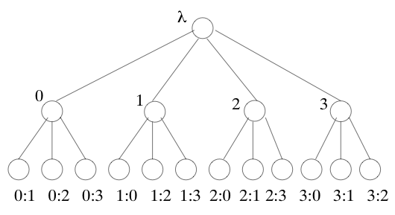
Example of Local Tree
The tree when n=4 and f=1:

Slide 102
Filling in the Tree Nodes
Initially store your input in the root (level 0)
Round 1:
  send level 0 of your tree (i.e., your input) to all (including yourself)
  store value x received from each p_{j} in tree node labeled j (level 1); use a default value “*” if necessary
  node labeled j in the tree associated with p_{i} now contains what p_{j} told to p_{i} about its input;
Round 2:
  send level 1 of your tree to all
  let x be the value received from p_{j} for the node labeled k≠j; then store x in node labeled k:j (level 2); use a default value “*” if necessary
  node k:j in the tree associated with p_{i} now contains "p_{j} told to p_{i} that “p_{k} told to me that its input was x”"

Slide 103
Filling in the Tree Nodes (2)
.
.
.
Round d:
  send level d-1 of your tree to all
  Let x be the value received from p_{j} for node of level d-1 labeled i₁:i₂:…:i_{d-1}, with i₁,i₂,…,i_{d-1} ≠j ; then, store x in tree node labeled i₁:i₂:…:i_{d-1} :j (level d); use a default value “*” if necessary
Continue for f+1 rounds

Slide 104
Calculating the Decision
In round f+1, each processor uses the values in its tree to compute its decision.
Recursively compute the "resolved" value for the root of the tree, resolve(λ), based on the "resolved" values for the other tree nodes:
value in tree node labeled π if it is a leaf
resolve(π) =
majority{resolve(π') : π' is a child of π} otherwise (use a default if tied)

Slide 105
Example of Resolving Values
The tree when n=4 and f=1:
(assuming “*” is the default)
*
0
0
1
1
0
0
1
0
0
0
1
1
1
1
1
0

Slide 106
Resolved Values are Consistent
Lemma 1: If p_{i} and p_{j} are nonfaulty, then p_{i}'s resolved value for tree node labeled π=π'j equals what p_{j} stores in its node π‘ during the filling-up of the tree (and so the value stored and resolved in π by p_{i} is the same!).
Proof: By induction on the height of the tree node.
Basis: height=0 (leaf level). Then, p_{i} stores in node π what p_{j} sends to it for π’ in the last round. By definition, this is the resolved value by p_{i} for π.

Slide 107
Induction: π is not a leaf, i.e., has height h>0;
  By definition, π has at least n-f children, and since n>3f, this implies n-f>2f, i.e., it has a majority of non-faulty children (i.e., whose last digit of the label corresponds to a non-faulty processor)
  Let πk= π’jk be a child of height h-1 such that p_{k} is non-faulty.
  Since p_{j} is non-faulty, it correctly reports a value v stored in its π’ node; thus, p_{k} stores it in its π’j node.
  By induction, p_{i}’s resolved value for πk equals the value v that p_{k} stored in its π node.
  So, all of π’s non-faulty children resolve to v in p_{i}’s tree, and thus π resolves to v in p_{i}’s tree.
END of PROOF

Slide 108
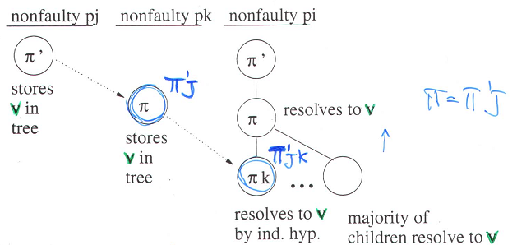
Remark: all the non-faulty processors will resolve the very same value in π, namely v.

Slide 109
Validity
Suppose all inputs of (non-faulty) processors are v.
Non-faulty processor p_{i} decides resolve(λ), which is the majority among resolve(j), 0 ≤ j ≤ n-1, based on p_{i}'s tree.
Since resolved values are consistent, resolve(j) (at p_{i}) if p_{j} is non-faulty is the value stored at the root of p_{j} tree, namely p_{j}'s input value, i.e., v.
Since there are a majority of non-faulty processors, p_{i} decides v.

Slide 110
Agreement:Common Nodes and Frontiers
A tree node π is common if all non-faulty processors compute the same value of resolve(π).
To prove agreement, we have to show that the root is common
A tree node π has a common frontier if every path from π to a leaf contains at least a common node.

Slide 111
Lemma 2: If π has a common frontier, then π is common.
Proof: By induction on height of π:
Basis (π is a leaf): then, since the only path from π to a leaf consists solely of π, the common node of such a path can only be π, and so π is common;
Induction (π is not a leaf): By contradiction, assume π is not common; then:
  Every child π’= πk of π has a common frontier (this would have not been true, in general, if π was common);
  By inductive hypothesis, π’ is common;
  Then, all non-faulty processors resolve the same value for π’, and thus all non-faulty processors resolve the same value for π, i.e., π is common.
END of PROOF

Slide 112
Agreement: the root has a common frontier
There are f+2 nodes on a root-leaf path
The label of each non-root node on a root-leaf path ends in a distinct processor index: i₁,i₂,…,i_{f+1}
Since there are at most f faulty processors, at least one such node corresponds to a non-faulty processor
This node, say i₁:i₂:,…,i_{k-1}:i_{k}, is common (indeed, by Lemma 1 concerning the consistency of resolved values, in all the trees associated with non-faulty processors, the resolved value equals the value stored by the non-faulty processor p_{ik}) in node i₁:i₂:,…,:i_{k-1}
Thus the root has a common frontier, and so is common (by preceding lemma)
Therefore, agreement is guaranteed!

Slide 113
Complexity
Exponential tree algorithm uses
n>3f processors
f+1 rounds
Exponential number of messages: (regardless of message content)
  In round 1, each (non-faulty) processor sends n messages ⇒ O(n²) total messages
  In round r≥2, each (non-faulty) processor broadcasts level r-1 of its local tree, which means a total of n(n-1)(n-2)…(n-(r-2)) messages
  When r=f+1, this is exponential if f is more than a constant relative to n

Slide 114
Exercise 1: Show an execution with n=4 processors and f=1 for which the King algorithm fails.
Exercise 2: Show an execution with n=3 processors and f=1 for which the exp-tree algorithm fails.

