Slide 1
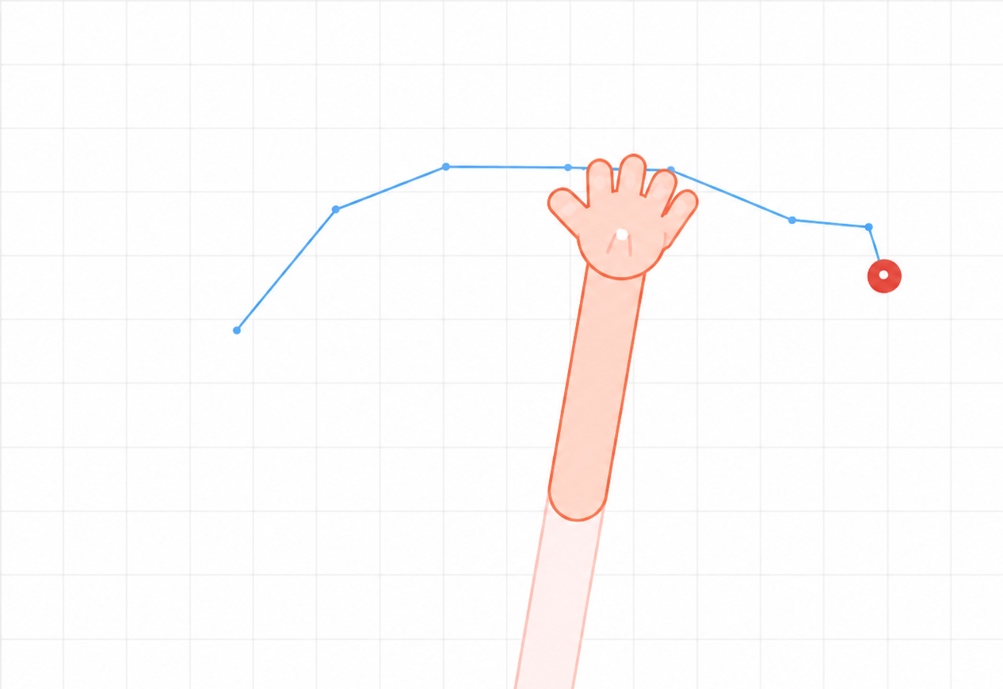
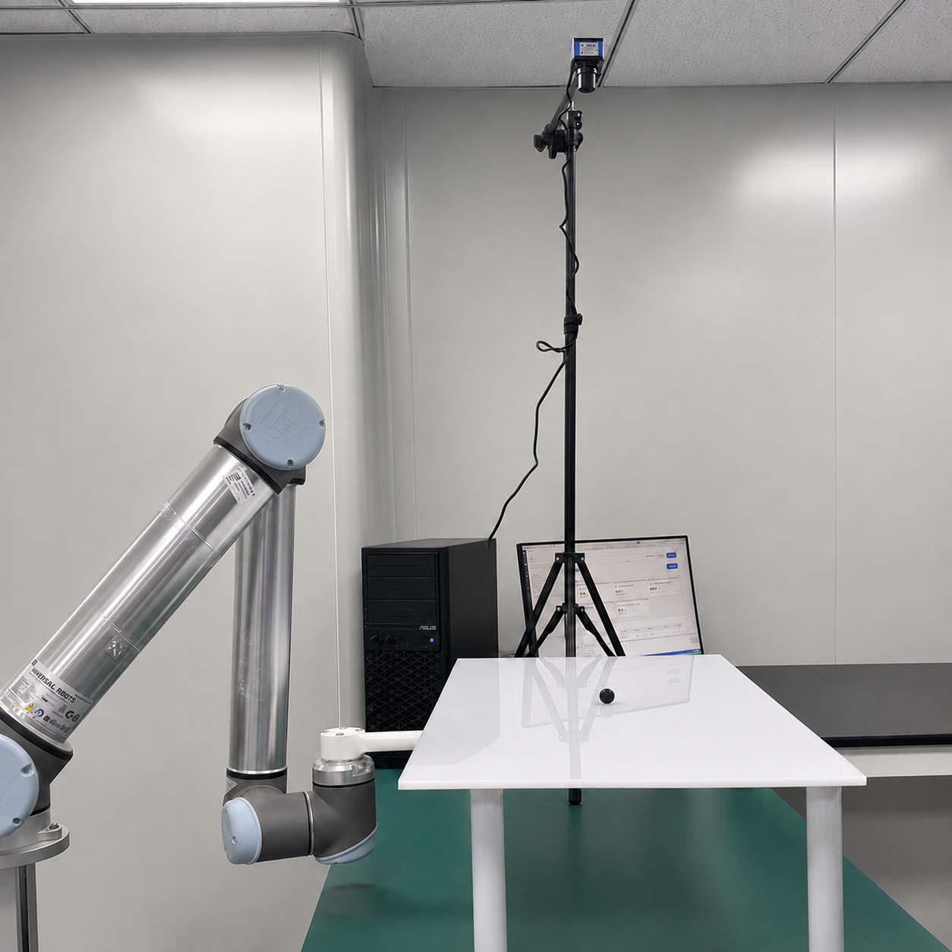
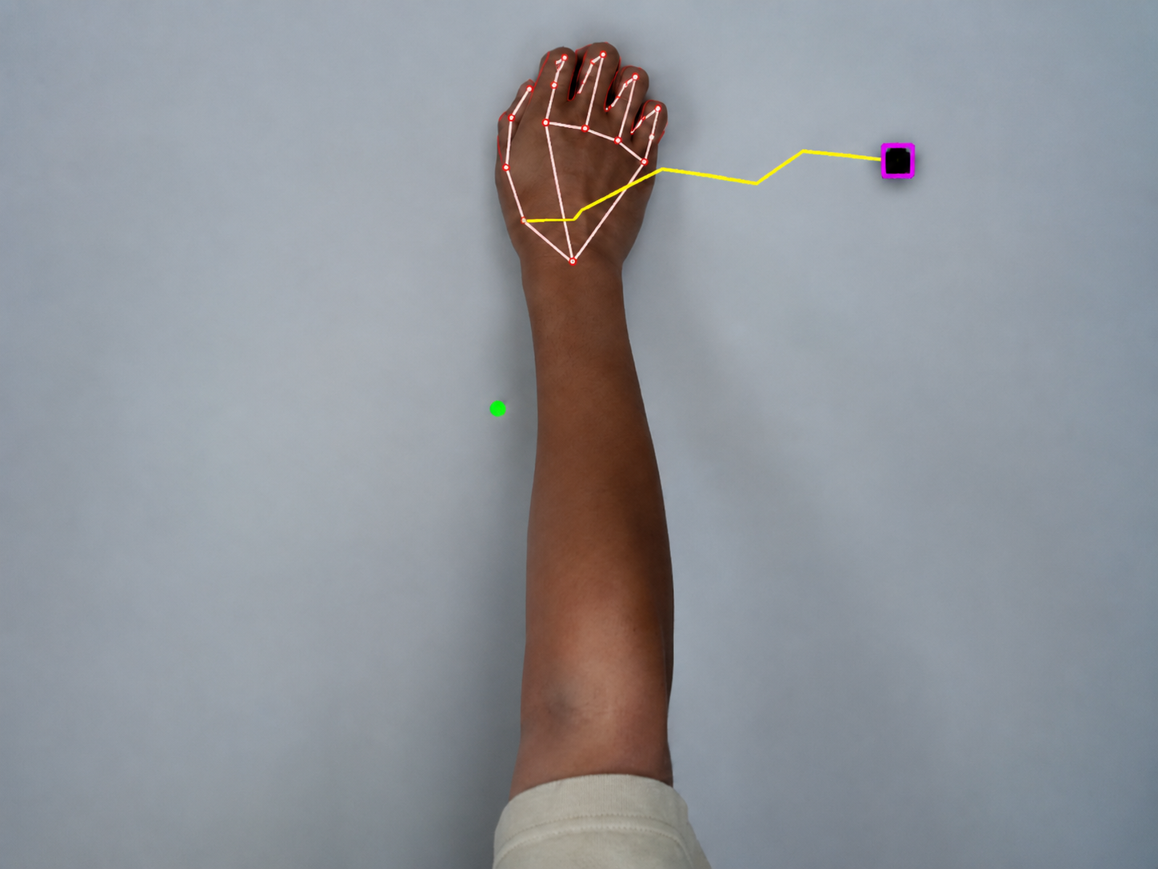
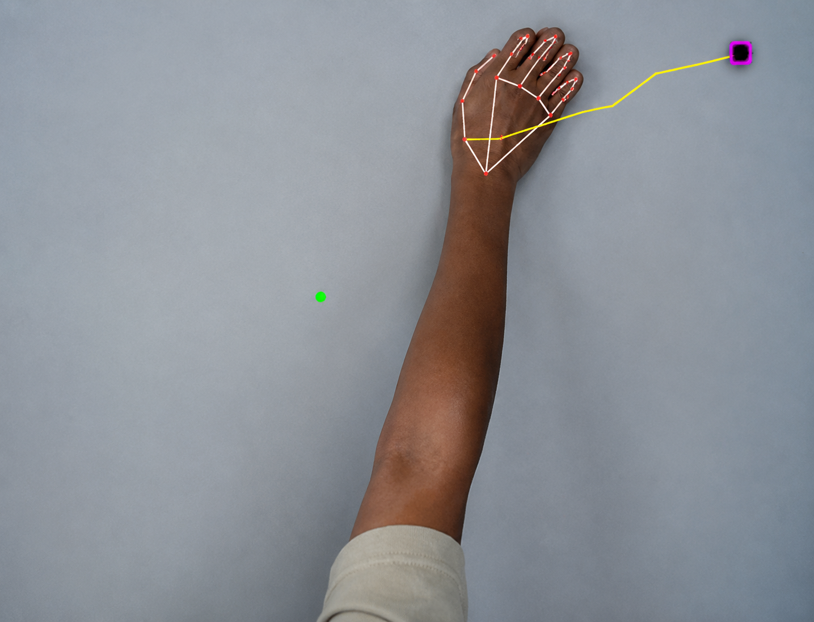
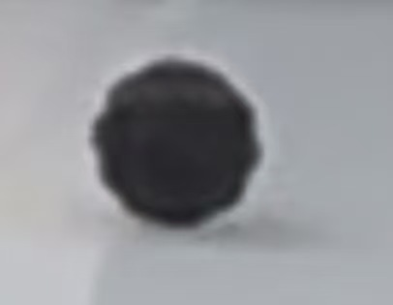
Simulation Environment
Policy Network
Task
Input layer
Hidden layers
Output layer
• Pursuit-evasion interaction
o_t, r_t
Spatial state
Environment
• Virtual hand
• Microrobot
• Workspace
a_t
Temporal state
action a_t
Action
• 2D microrobot motion
(o_t, r_t, a_t)
PPO update
rollout data
Real-time
Observation
motion command
Image-to-Observation
Real-World Rehabilitation Platform
Camera
Spatial state
• Hand position • Microrobot position • Relative distance • Boundary distances
images
Controller
Workspace
（80x50cm）
Detection
Temporal state
• hand displacements
Robotic Arm
Motion history
microrobot

Slide 2
Spatial state branch
Auxiliary task module
s_t
z_s
2
⋮
FC
FC
FC
FC
dx_t,dy_t
Fusion module
t…t+3
128
32
12
64
32
z
f_t
+
FC
PPO actor-critic module
Temporal state branch
concat
X_{ t-15:t }
FC
FC
FC
Actor head
a_t
h_T
z_h
64
64
GRU encoder
2D action
hidden state
FC
128
256
256
64
⋮
GRU
Critic head
FC
FC
FC
V_t
x_{t−15}
⋯
x_t
(scalar)
16 x C
64
32
128
256
256
64

Slide 3
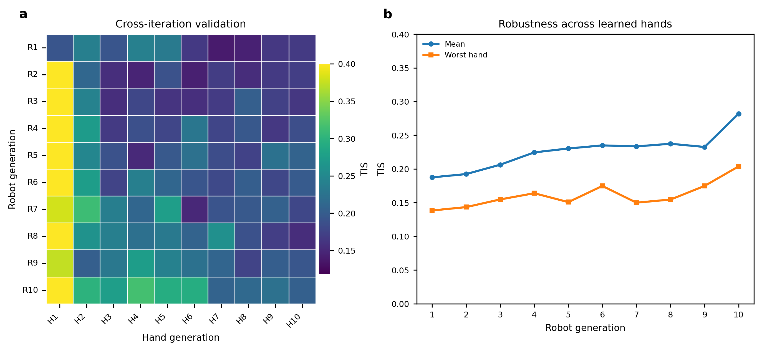
Simulation result I: league training robustness
Source: 10-iteration no-opponent-ID ZPD [3.5, 5.5] league run; cross-generation validation, final-hand decomposition, and PFSP traces.

Slide 4
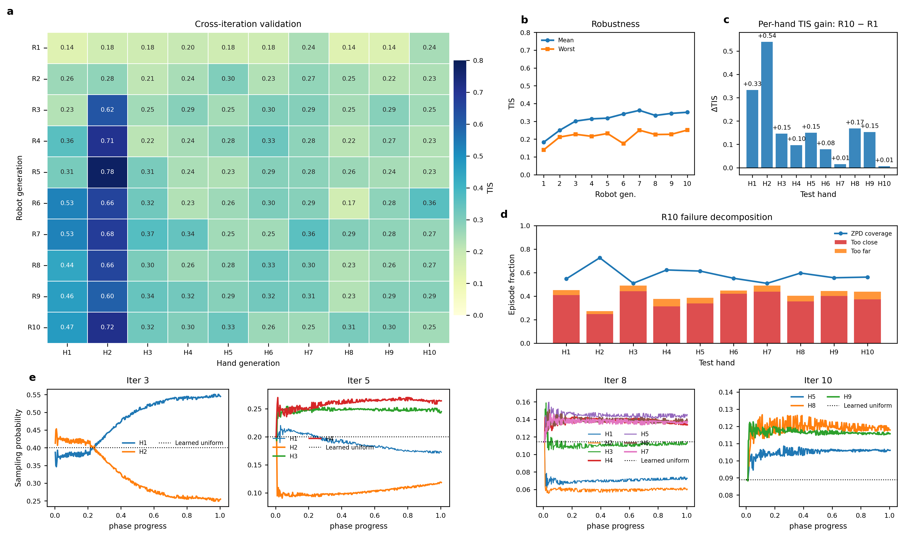
League result detail: cross-generation validation
Source: cross-evaluation matrix over robot generations R1–R10 and learned hands H1–H10; TIS summarizes time inside the ZPD band.

Slide 5
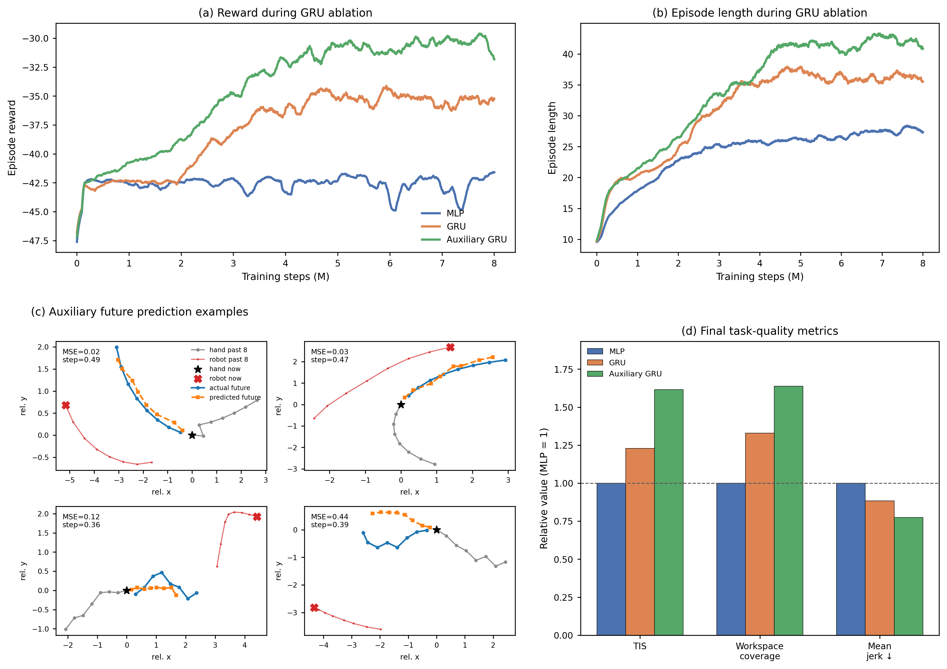
Simulation result II: temporal encoder and auxiliary prediction
Source: GRU ablation logs plus auxiliary future-motion prediction rollouts; panel (d) uses swapped GRU/Auxiliary GRU final-quality metrics.

Slide 6
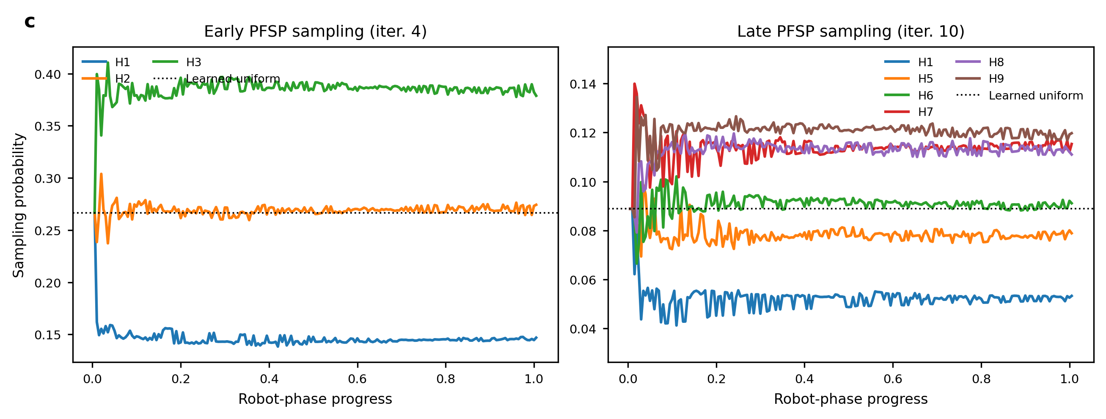
Supplementary result: PFSP opponent sampling dynamics
Source: robot-phase PFSP sampling logs; early sampling concentrates on a few opponents, late sampling spreads across the learned-hand pool.

