Slide 1
HSBC to RBC Mobile Messaging Campaign
Digital Transformation Leadership by Herman Hui

Slide 2
Project Overview
Led HSBC Canada's mobile in-app messaging campaign during the RBC acquisition.
Delivered multilingual messages in English, French, Traditional and Simplified Chinese.
Ensured timely and transparent communication to over 800,000 customers.
Achieved 2.2x digital impression growth (67M+) and 7x increase in user clicks.

Slide 3
My Role and Responsibilities
Owned end-to-end planning and execution of mobile messaging strategy.
Coordinated legal, compliance, and localization teams.
Managed UX content, visual design, QA testing, and deployment.
Ensured accessibility compliance and consistent brand standards.

Slide 4
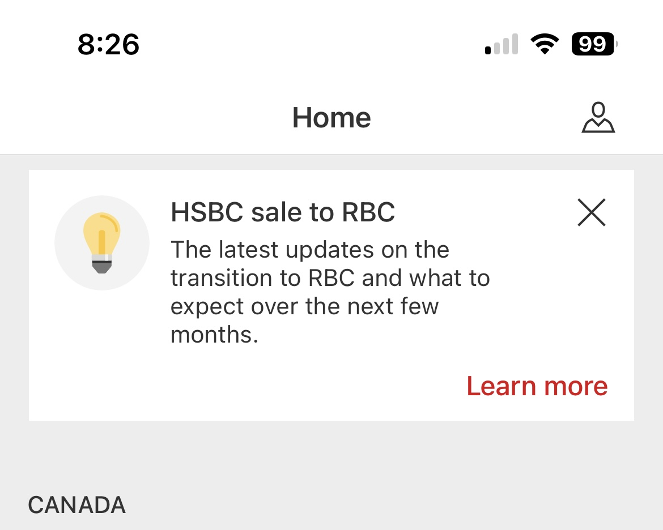
English Banner

Slide 5
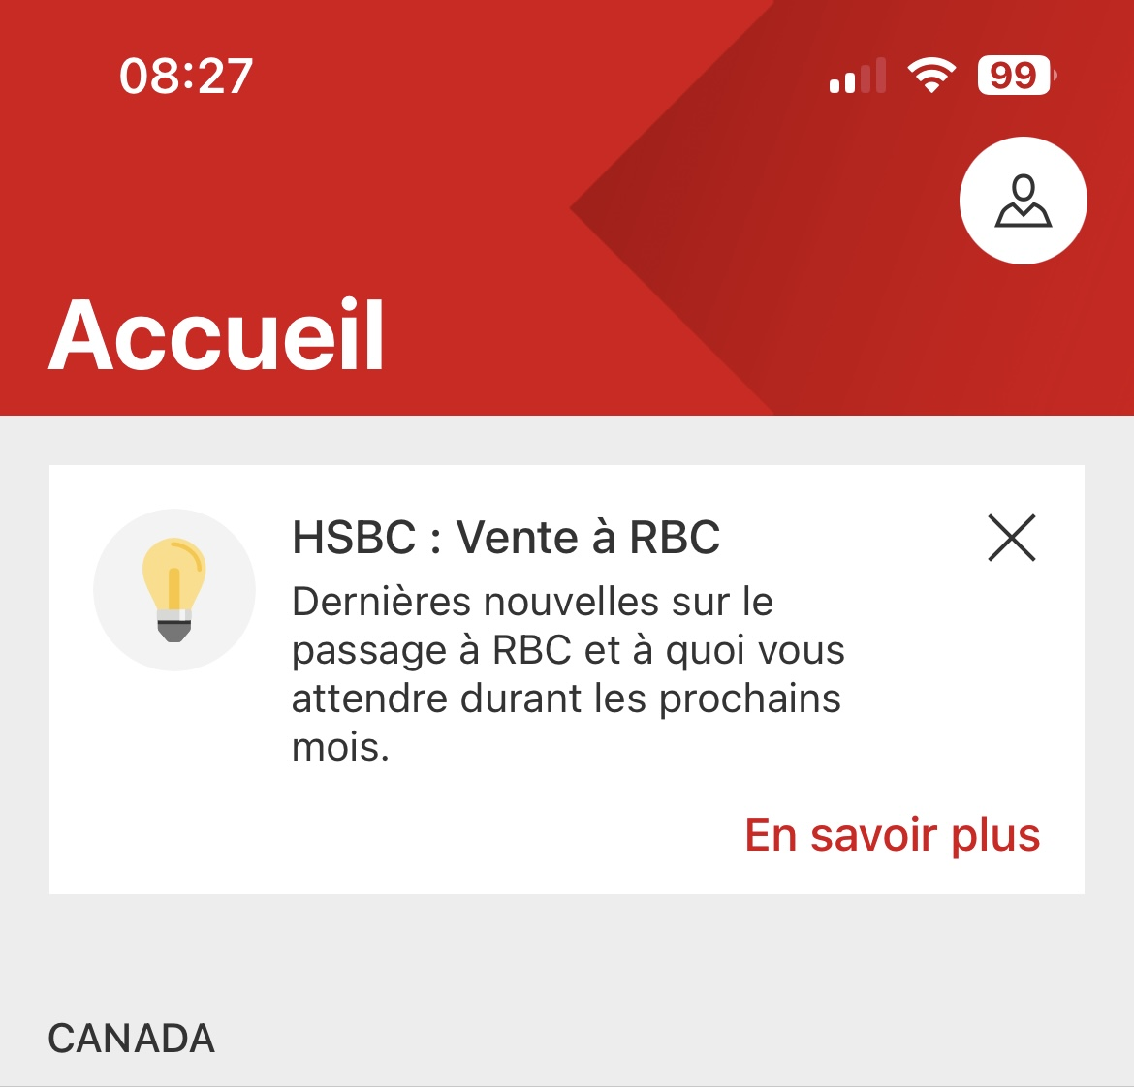
French Banner

Slide 6
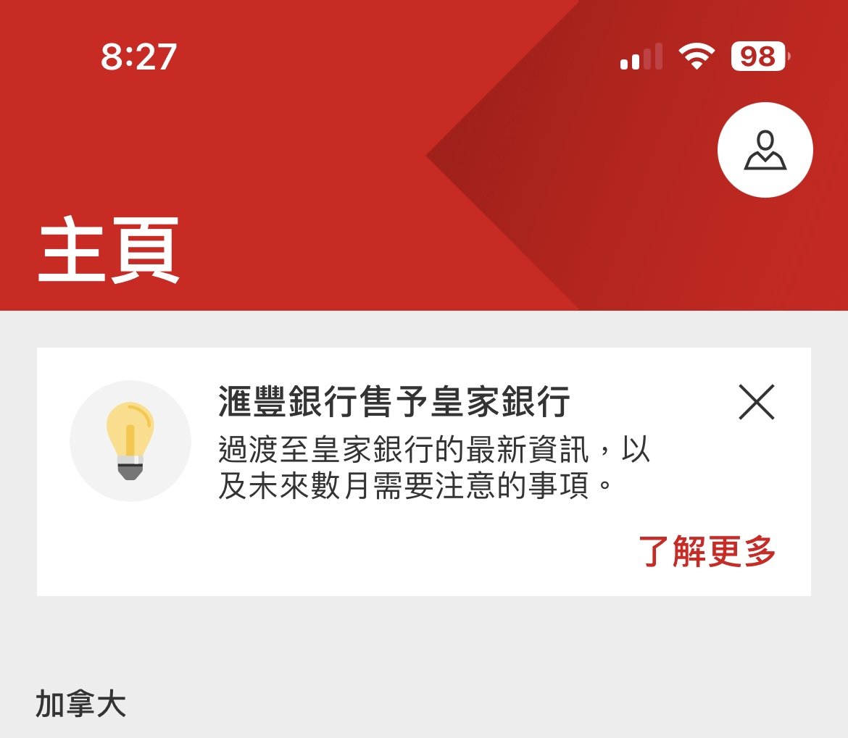
Traditional Chinese Banner

Slide 7
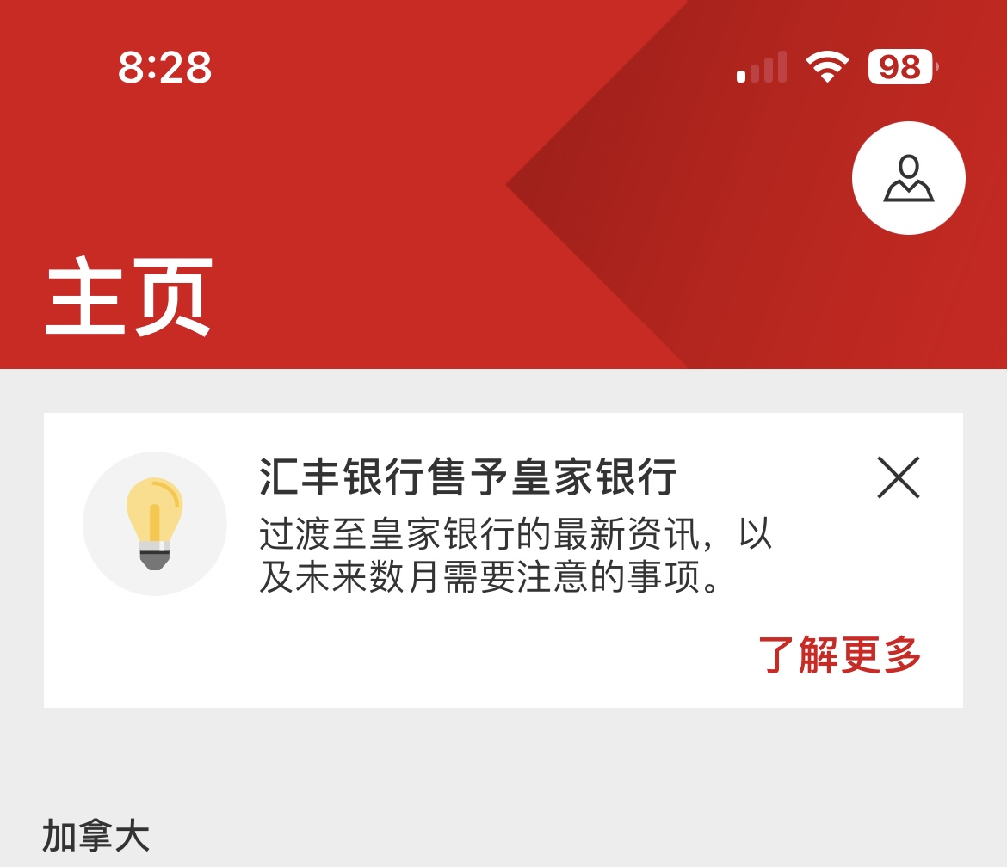
Simplified Chinese Banner

