Slide 1
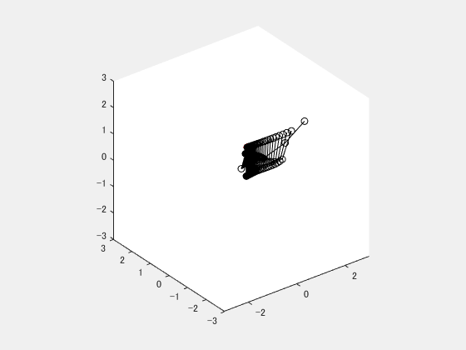
Quiz #5: Three-Link Robot Arm Inverse Kinematics
Modify the sample code to the following DH parameters
% Link lengths
L1 = 1; L2 = 1; L3 = 1;
% Homogeneous transformation matrices for given angles
T01 = DH(0, 0, 0, Q(1));
T12 = DH(pi/2, L1, 0, Q(2));
T23 = DH(0, L2, 0, Q(3));
T34 = DH(0, L3, 0, 0 );
Solve the inverse kinematics for pD = [1; 1; 0];
Robot arm of the sample codes
Robot arm of the modified parameters

