Slide 1
A Review of the Hand Gesture Recognition System:
Current Progress and Future Directions

Slide 2
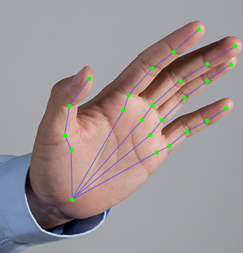
Introduction to Hand Gesture Recognition
Purpose:
Discuss the critical role of nonverbal communication, which accounts for approximately 65% of all communicated information.
Explore the significance of hand gesture recognition in enhancing human-computer interaction (HCI).
Overview:
Introduction to the basic concepts of hand gesture recognition.
Importance of robust and accurate gesture recognition systems for HCI.
Applications of gesture recognition: from everyday interactions to specialized systems like sign language interpretation.

Slide 3
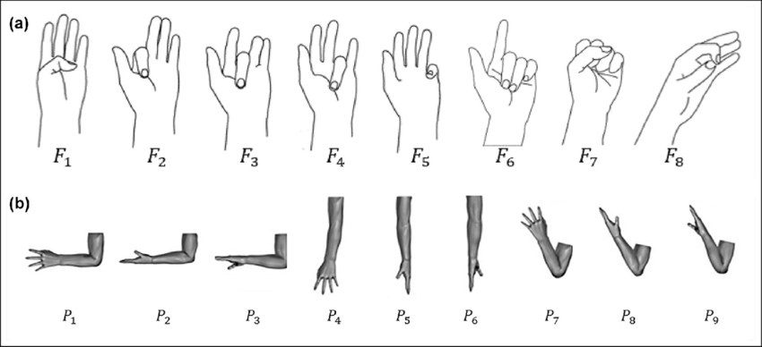
Categories of Gestures
Types of Gestures:
Hand and arm gestures: Recognizing hand poses, sign languages, and uses in entertainment.
Head and face gestures: Includes nodding, shaking the head, eye gaze direction, facial expressions like winking.
Body gestures: Full-body movements and their implications in various applications.
Importance of Each Category:
How different types of gestures contribute to the overall effectiveness of gesture-based communication systems.

Slide 4
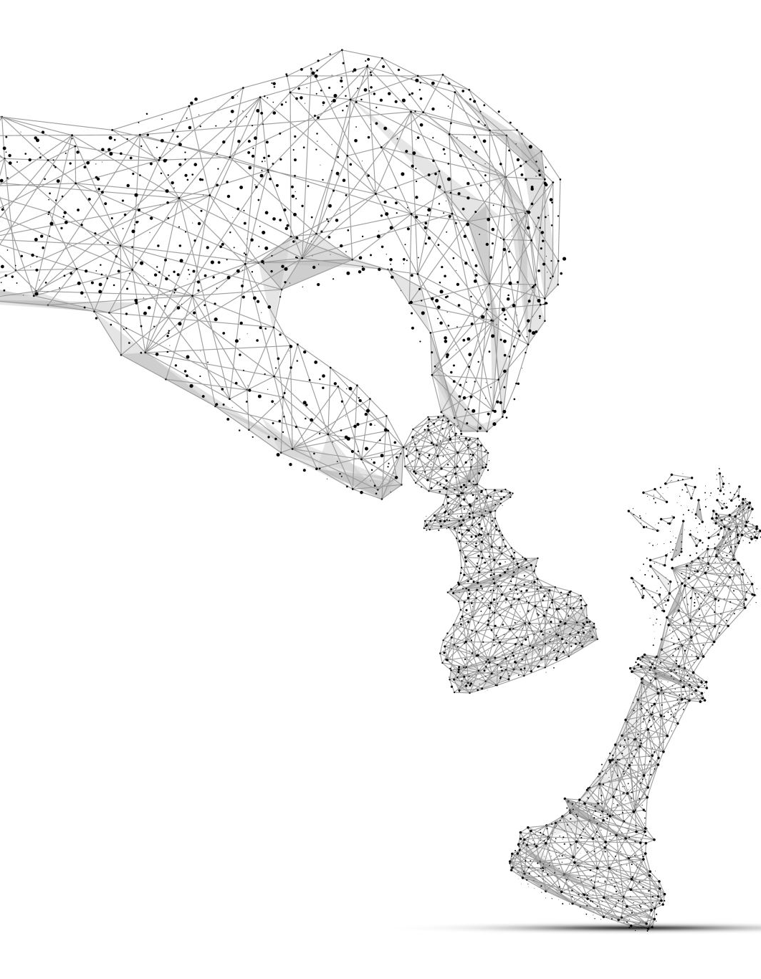
Challenges in Hand Gesture Recognition
Complexity of Gesture Recognition:
Diversity in gesture styles and the inherent variability of human movements.
Environmental influences on gesture recognition accuracy.
Technological Barriers:
Difficulties in capturing accurate and dynamic gestures due to technical limitations in current systems.
Objective of Current Research:
Enhancing the performance of hand gesture recognition systems to overcome communication barriers with non-signing individuals through technology.

Slide 5
Scope and Significance
Scope of the Presentation:
Significance:
Detailed review of recent advancements in vision-based hand gesture recognition systems.
Examination of the current progress, challenges, and future directions in the field.
Understanding the impact of these technologies in real-world applications.
Identifying areas requiring further research and technological development to make these systems more effective and accessible.
5

Slide 6
Background Overview
Understanding Hand Gesture Recognition
Brief history of hand gesture recognition development.
Explanation of how technological advancements have enhanced the capabilities of gesture recognition systems.

Slide 7
Importance of Hand Gesture Recognition in HCI
The Role of Hand Gestures in Human-Computer Interaction
Illustrate how gestures offer a natural and intuitive way for humans to interact with machines.
Examples of HCI devices traditionally used: keyboards, mice, touchscreens.
Potential of hand gesture recognition to replace or augment these devices.

Slide 8
Application Areas for Hand Gesture Recognition
Application Domains of Hand Gesture Recognition
Communication: Facilitating interactions for the deaf and hard of hearing community through sign language recognition.
Education: Use in interactive learning environments.
Rehabilitation: Tools for therapy in motor skills recovery.
Entertainment and Gaming: Creating more immersive experiences.
Discuss how each application benefits from accurate gesture recognition technologies.

Slide 9
Classification of Hand Gesture Recognition Systems
Vision-Based Systems:
Device-Based Systems:
Use cameras to detect and interpret gestures.
Benefits: No physical contact required, allows for natural interaction.
Challenges: Affected by environmental conditions like lighting and background.
Use wearable devices like gloves equipped with sensors.
Benefits: High accuracy and responsiveness.
Challenges: Can be cumbersome and limit natural movement.

Slide 10
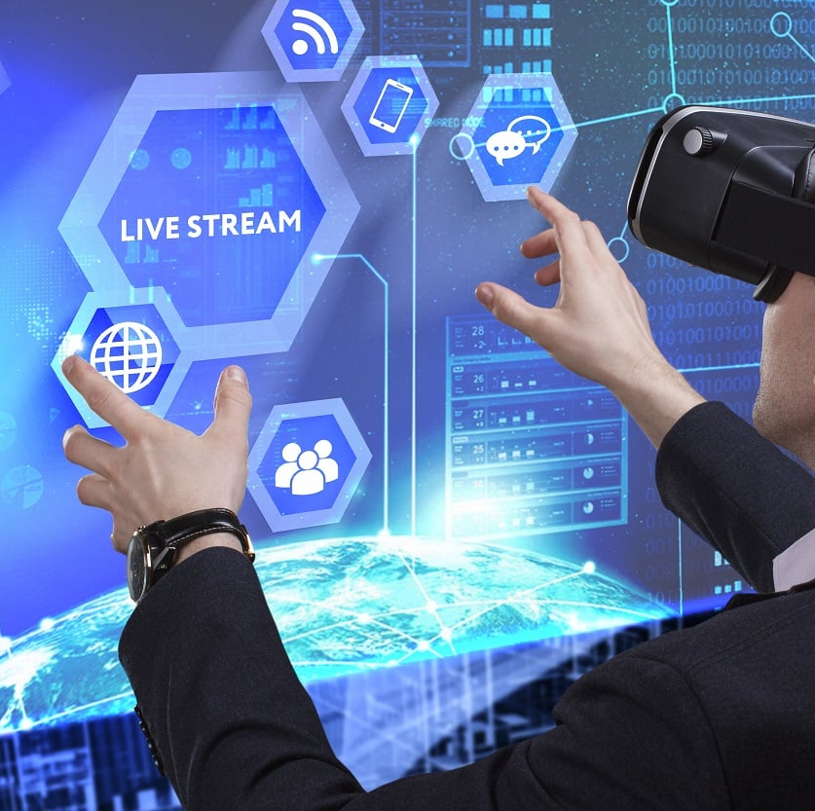
Current Technologies in Gesture Recognition
Overview of key technologies used in gesture recognition:
Cameras and optical sensors for vision-based systems.
Accelerometers and gyroscopes in wearable devices.
Discuss how these technologies capture and process gesture data to translate into meaningful inputs.

Slide 11
Challenges in Hand Gesture Recognition Development
Challenges Facing Hand Gesture Recognition
Variability in human gestures: Differences in gesture styles and execution.
Environmental impact: Performance degradation in non-ideal conditions.
Transition Movements: Difficulty in recognizing transitions between gestures.
Need for continuous and real-time recognition capabilities to enhance user experience.

Slide 12
Research Objectives
Define
Define the primary goal: To critically review the progress of vision-based hand gesture recognition from 2014 to 2020.
Emphasize
Emphasize understanding both the technological advancements and the persisting challenges in the field.
Highlight
Highlight the intention to identify gaps in current research that could pave the way for future innovations.

Slide 13
Scope of the Research
Scope and Delimitation of the Study
Clarify the focus solely on vision-based systems, excluding other forms of gesture recognition like sensor-based systems.
Limitation to studies published within the 2014-2020 timeframe to ensure the relevance and currency of the reviewed data.
Discussion of the geographic and cultural diversity in research practices and its impact on technology adaptation.

Slide 14
Research Questions
RQ1: What are the current issues and progress in terms of data acquisition, data environment, and hand gesture representations in vision-based systems?
RQ2: How do the performances of existing systems measure up, and what are the potential future directions for this technology?
These questions aim to dissect the core areas needing attention and predict trends that could shape the next generation of gesture recognition technologies.

Slide 15
Methodology - Literature Review
Review Methodology
Explain the systematic approach to literature review, focusing on peer-reviewed journals, conference proceedings, and significant academic publications.
Criteria for inclusion: Relevance to vision-based gesture recognition, methodological rigor, and contribution to the field’s advancement.
Utilization of various databases and search tools to compile the most comprehensive review of recent advancements and ongoing challenges.

Slide 16
Data Analysis Approach
Analytical Framework
Describe the qualitative and quantitative methods used to analyze the collected data.
Highlight techniques such as meta-analysis for quantitative studies and thematic analysis for qualitative insights.
Emphasize the role of cross-study comparisons to identify consistent findings, contradictions, and gaps in research.

Slide 17
Expected Outcomes
Anticipated Research Contributions
Outline the expected contributions of the research to both academic knowledge and practical applications in HCI.
Discuss how the findings could influence future technology developments, policy-making, and research priorities in the field of gesture recognition.
Project the implications of this research on improving interaction designs and accessibility of technology for users with disabilities.

Slide 18
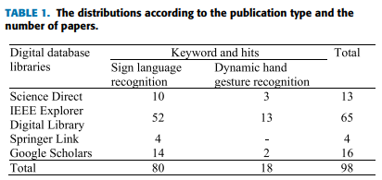
Overview of Research Findings
Key Findings Overview
Summary of the significant trends observed in the literature from 2014 to 2020.
Emphasis on the major technological advancements and persistent challenges in the field.
Introduction to the thematic areas covered in the findings: Data Acquisition, Data Environment, and Hand Gesture Representations.

Slide 19
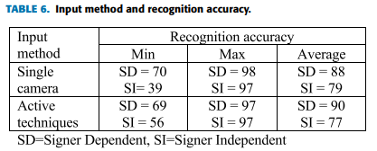
Data Acquisition Techniques
Advances in Data Acquisition
Overview of techniques used to capture hand gestures, with a focus on the evolution of camera technologies.
Comparison of single camera vs. multi-camera setups and their impact on data quality.
Discussion on the use of depth sensors and infrared technologies in improving gesture detection accuracy.

Slide 20
Impact of Data Quality
The Role of Data Quality in Gesture Recognition
Analysis of how data fidelity influences the accuracy of gesture recognition systems.
Examples of studies that have demonstrated improvements in recognition rates with higher quality data.
The ongoing need for robust data acquisition in complex environments.

Slide 21
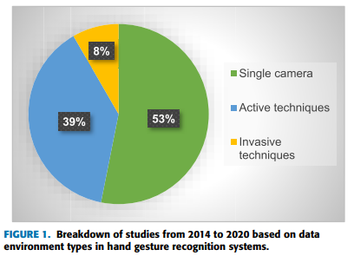
Environmental Challenges
Environmental Influence on Gesture Recognition
Detailed look at how factors like lighting, background noise, and interferences affect recognition systems.
Case studies highlighting solutions to minimize environmental impacts.
Discussion of adaptive systems that dynamically adjust to changing environmental conditions.

Slide 22
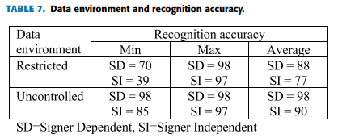
Laboratory vs. Real-World Settings
Laboratory Settings vs. Real-World Application
Comparison of gesture recognition performance in controlled laboratory settings versus unpredictable real-world environments.
Challenges in translating laboratory-based findings to real-world applications.
Examples of successful real-world deployments and the strategies used.

Slide 23
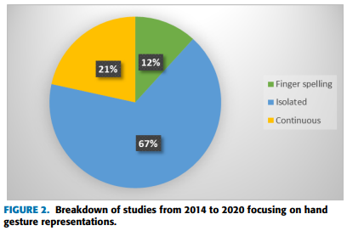
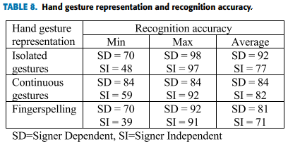
Representation Techniques
Techniques for Representing Hand Gestures
Overview of different methods for representing gestures within systems, including skeletal models and silhouette extraction.
Pros and cons of various representation techniques in terms of computational efficiency and accuracy.
Advances in machine learning models that enhance gesture representation.

Slide 24
Advances in Machine Learning
Leveraging Machine Learning for Gesture Recognition
Examination of how deep learning and neural networks have transformed gesture recognition technologies.
Specific case studies where machine learning has significantly improved recognition rates.
Discussion on the future potential of AI in further refining gesture recognition systems.

Slide 25
Summary of Major Findings
Summary of Key Insights
Recap of the most impactful findings from the review, highlighting breakthroughs and unresolved issues.
Insights into the most promising technologies and methodologies that emerged from the recent literature.
Considerations for future research directions based on gaps identified in the current body of work.

Slide 26
Implications for Future Research
Future Research Directions
Recommendations for future research efforts, emphasizing areas where further investigation is needed.
Potential for new technologies to address current limitations in gesture recognition systems.
Importance of interdisciplinary approaches to tackle complex challenges in this field.

Slide 27
Recap of Key Findings
Recapitulation of Major Insights
Summarize the critical advancements in vision-based hand gesture recognition technology from 2014 to 2020.
Highlight persistent challenges such as environmental variability, data quality, and real-world application discrepancies.
Reiterate the improvements brought by emerging technologies like deep learning and adaptive systems.

Slide 28
Implications for Future Technology
Discuss how the findings can influence future research directions in hand gesture recognition.
The importance of enhancing the accuracy and robustness of these systems for broader applications.
Potential for integration into more complex systems, such as augmented reality and robotics.

Slide 29
Recommendations for Researchers and Practitioners
Recommendations for the Field
Advocate for a multidisciplinary approach involving computer vision, artificial intelligence, and human-computer interaction to solve complex challenges.
Suggest the development of standardized protocols and benchmarks for evaluating gesture recognition systems across different environments.
Encourage the exploration of new sensor technologies and machine learning models that can handle the nuances of human gestures more effectively.

Slide 30
Closing Thoughts
Concluding Remarks
Emphasize the importance of continued research and development to realize the full potential of hand gesture recognition technologies.
Reflect on the societal impacts, such as improving accessibility for individuals with disabilities and enhancing user interaction across various digital platforms.
Express optimism about the future of gesture recognition technology, with a call to action for continued innovation and collaboration.

