Slide 1
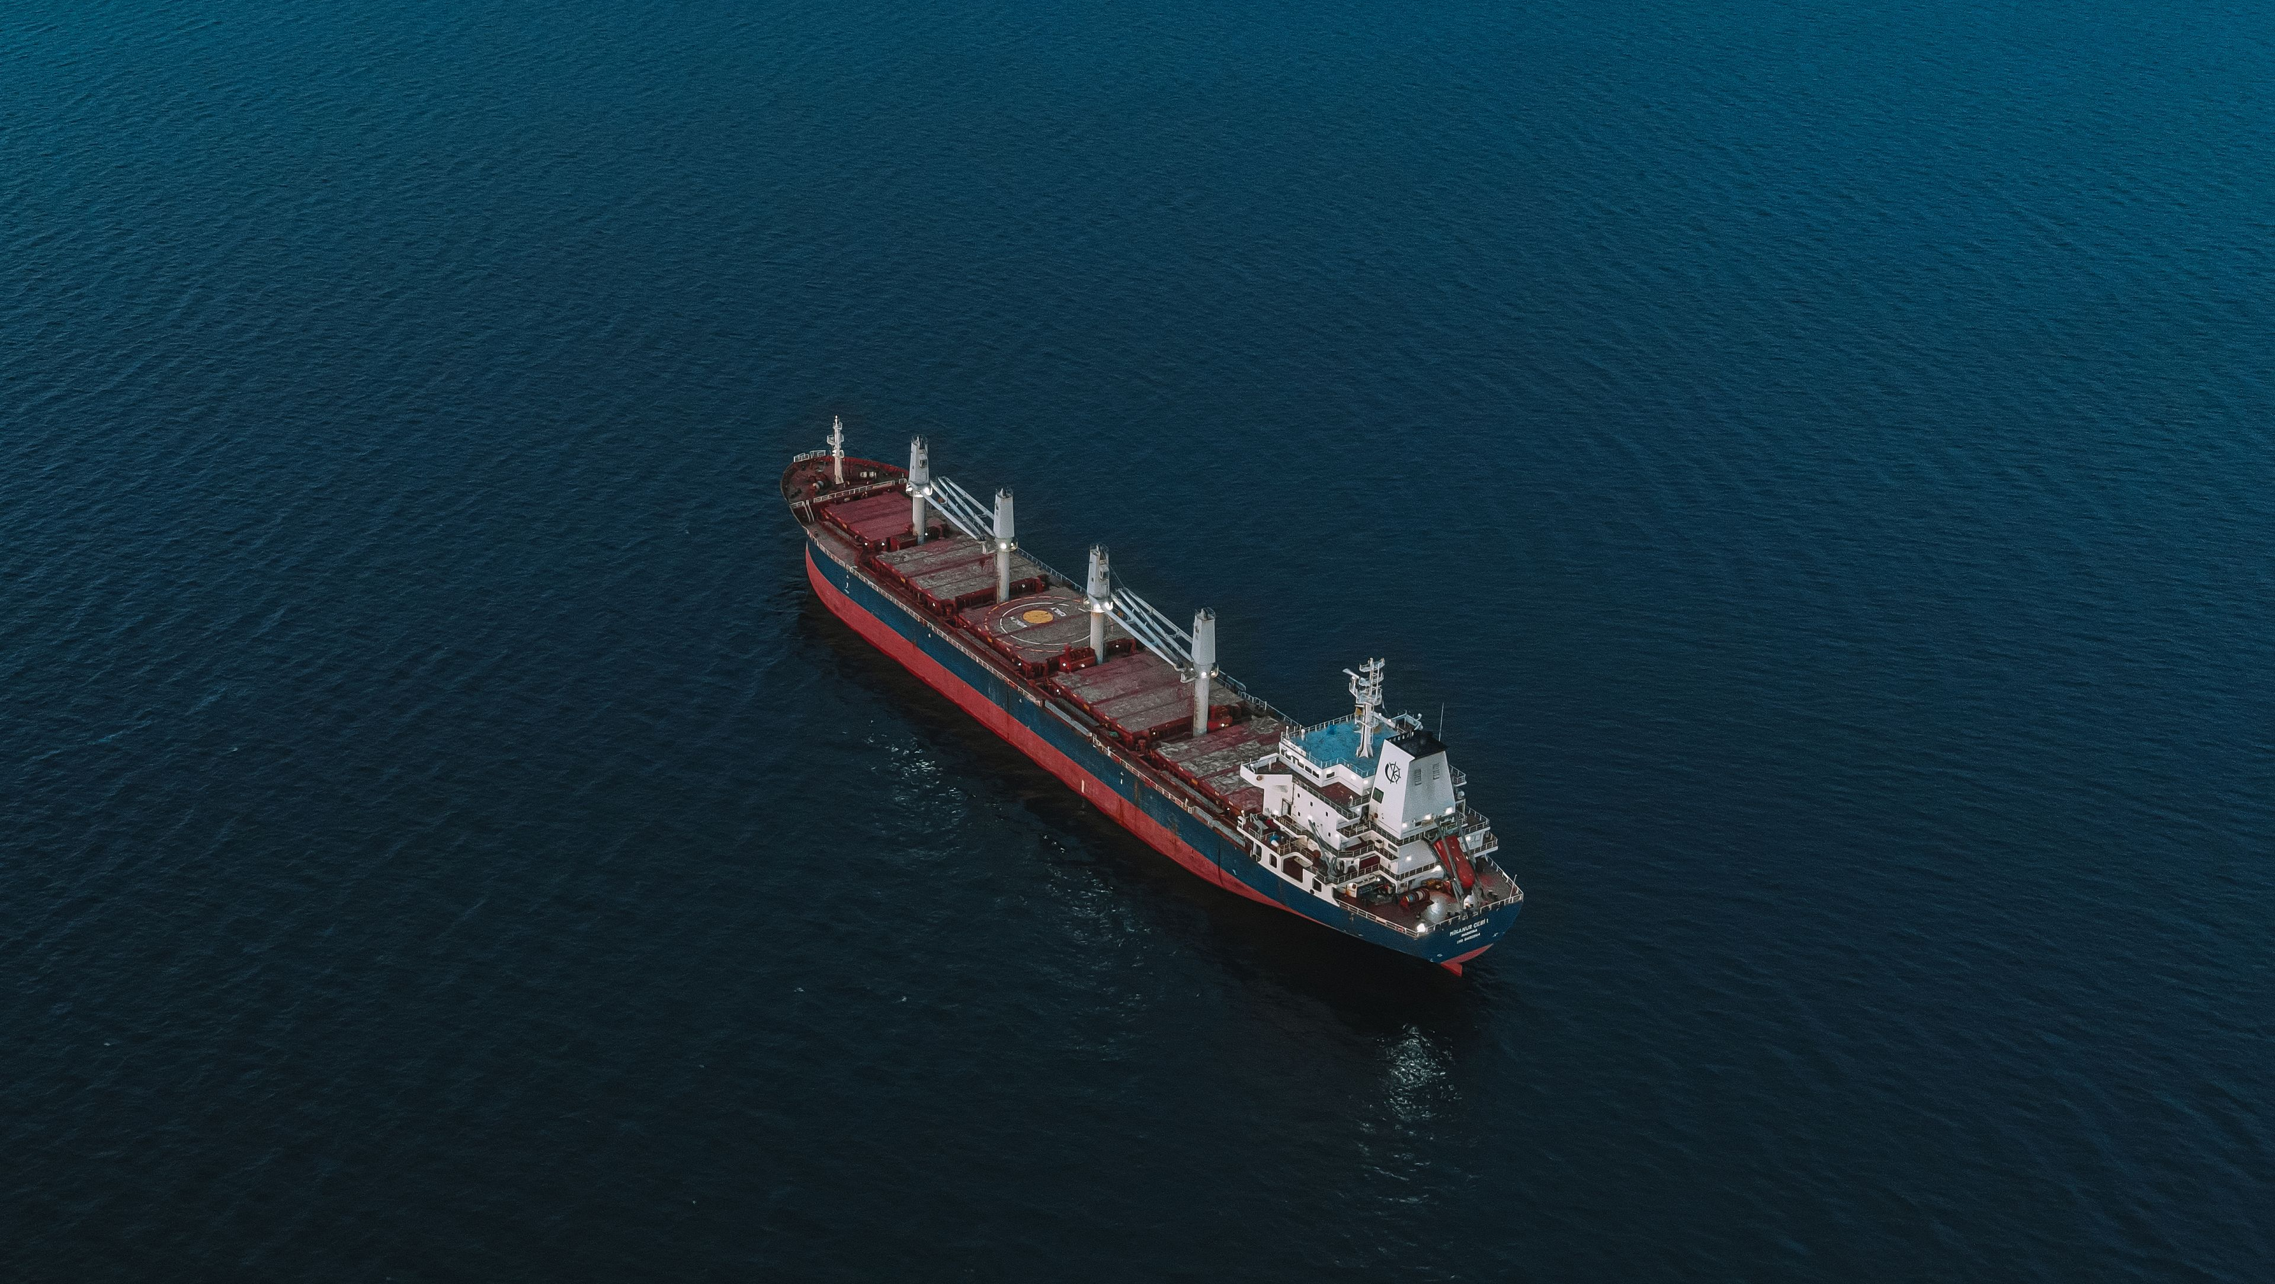

JC GROUP
JC MARINE INTEGRATION SDN BHD
202301042692 (1536608-W)
JC SUPPY SDN BHD
202301050114 (1544028-W)
JC MARINE TECHNOLOGY SDN BHD
202601015161 (1677259-U)
TEL
EMAIL
BUSINESS HOURS
+6011-8888 5899
request@jcmarine.com.my
Mon to Fri
0800hrs to 1700hrs
Sat: 0800hrs to 1200hrs
MIRI
PORT KLANG
SINGAPORE
Lot 10502, BLK 5, KBLD,
Desa Senadin, 98000,
Miri, Sarawak, Malaysia.
No. 29-B, Jalan Berangan,
42000 Port Klang,
Selangor Darul Ehsan,
Malaysia
Blk 3012 Bedok Ind Park E
#04-2032
Singapore 489978
Notes:
Cover concept: 01 Atlantic Minimal / 海洋极简. Supplied JC logo rendered directly from the vector PDF with transparency; no background or white badge. Current confirmed company registry/contact/address data. Stock photograph: Aleksandr Sochnev / Pexels, https://www.pexels.com/photo/aerial-view-of-cargo-ship-on-open-sea-30463262/, Pexels free license; illustrative marine image. This deck contains five cover concepts only for comparison; existing complete31pageprofiles remain separate.

Slide 2
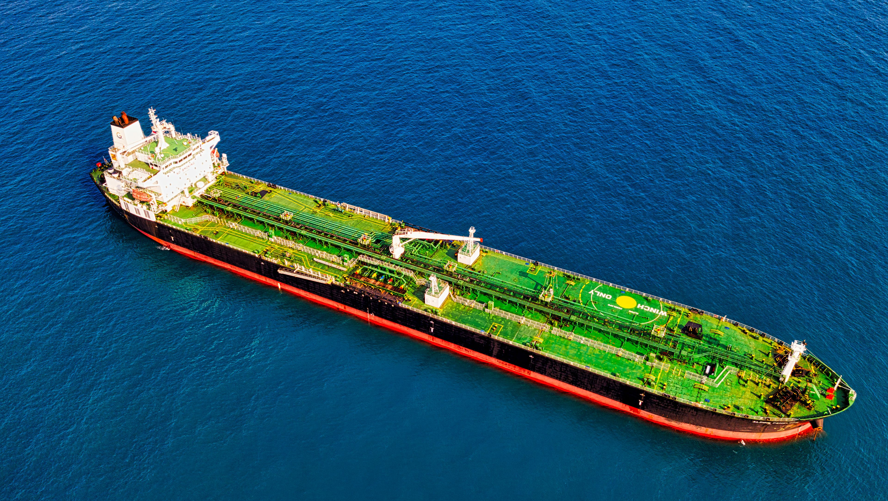
JC GROUP
JC MARINE INTEGRATION SDN BHD
202301042692 (1536608-W)
JC SUPPY SDN BHD
202301050114 (1544028-W)
JC MARINE TECHNOLOGY SDN BHD
202601015161 (1677259-U)
TEL
EMAIL
BUSINESS HOURS
+6011-8888 5899
request@jcmarine.com.my
Mon to Fri
0800hrs to 1700hrs
Sat: 0800hrs to 1200hrs
MIRI
Lot 10502, BLK 5, KBLD, Desa Senadin, 98000, Miri, Sarawak, Malaysia.
PORT KLANG
No. 29-B, Jalan Berangan, 42000 Port Klang, Selangor Darul Ehsan, Malaysia
SINGAPORE
Blk 3012 Bedok Ind Park E #04-2032 Singapore 489978
Notes:
Cover concept: 02 Precision / 精密科技. Supplied JC logo rendered directly from the vector PDF with transparency; no background or white badge. Current confirmed company registry/contact/address data. Stock photograph: Tom Fisk / Pexels, https://www.pexels.com/photo/aerial-view-of-ship-3114588/, Pexels free license; illustrative marine image. This deck contains five cover concepts only for comparison; existing complete31pageprofiles remain separate.

Slide 3
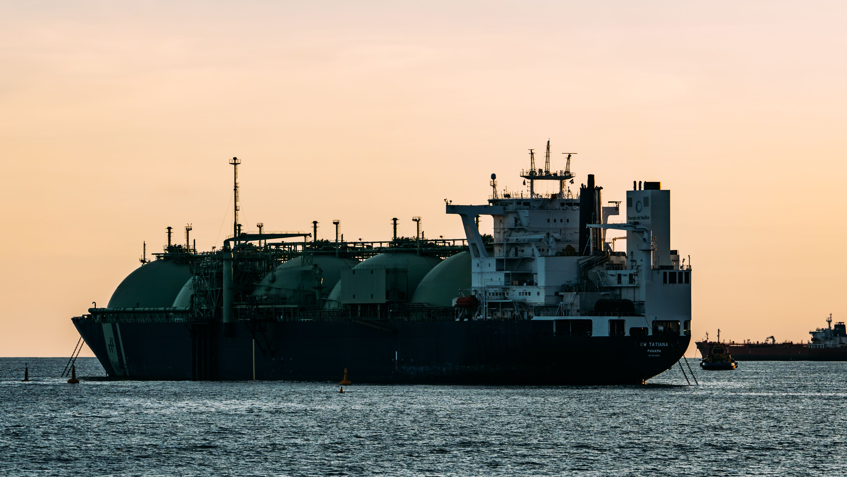
JC GROUP
JC MARINE INTEGRATION SDN BHD
202301042692 (1536608-W)
JC SUPPY SDN BHD
202301050114 (1544028-W)
JC MARINE TECHNOLOGY SDN BHD
202601015161 (1677259-U)
TEL
MIRI
+6011-8888 5899
Lot 10502, BLK 5, KBLD, Desa Senadin, 98000, Miri, Sarawak, Malaysia.
EMAIL
request@jcmarine.com.my
PORT KLANG
No. 29-B, Jalan Berangan, 42000 Port Klang, Selangor Darul Ehsan, Malaysia
BUSINESS HOURS
Mon to Fri: 0800hrs to 1700hrs
SINGAPORE
Blk 3012 Bedok Ind Park E #04-2032 Singapore 489978
Sat: 0800hrs to 1200hrs
Notes:
Cover concept: 03 / Dusk Signature. Supplied JC logo rendered directly from the vector PDF with transparency; no background or white badge. Current confirmed company registry/contact/address data. Stock photograph: Edu Raw / Pexels, https://www.pexels.com/photo/large-cargo-ship-at-sea-during-sunset-38646187/, Pexels free license; illustrative marine image. This deck contains five cover concepts only for comparison; existing complete31pageprofiles remain separate.

Slide 4

JC MARINE INTEGRATION SDN BHD
202301042692 (1536608-W)
JC
JC SUPPY SDN BHD
202301050114 (1544028-W)
GROUP
JC MARINE TECHNOLOGY SDN BHD
202601015161 (1677259-U)
TEL
EMAIL
BUSINESS HOURS
+6011-8888 5899
request@jcmarine.com.my
Mon to Fri
0800hrs to 1700hrs
Sat: 0800hrs to 1200hrs
MIRI
PORT KLANG
SINGAPORE
Lot 10502, BLK 5, KBLD,
Desa Senadin, 98000,
Miri, Sarawak, Malaysia.
No. 29-B, Jalan Berangan,
42000 Port Klang,
Selangor Darul Ehsan,
Malaysia
Blk 3012 Bedok Ind Park E
#04-2032
Singapore 489978
Notes:
Cover concept: 04 Editorial / ivory masthead and parallel company register. Supplied JC logo rendered directly from the vector PDF with transparency; no background or white badge. Current confirmed company registry/contact/address data. Stock photograph: 8 K / Pexels, https://www.pexels.com/photo/fully-loaded-cargo-ship-on-a-sea-12530455/, Pexels free license; illustrative marine image. This deck contains five cover concepts only for comparison; existing complete31pageprofiles remain separate.

Slide 5
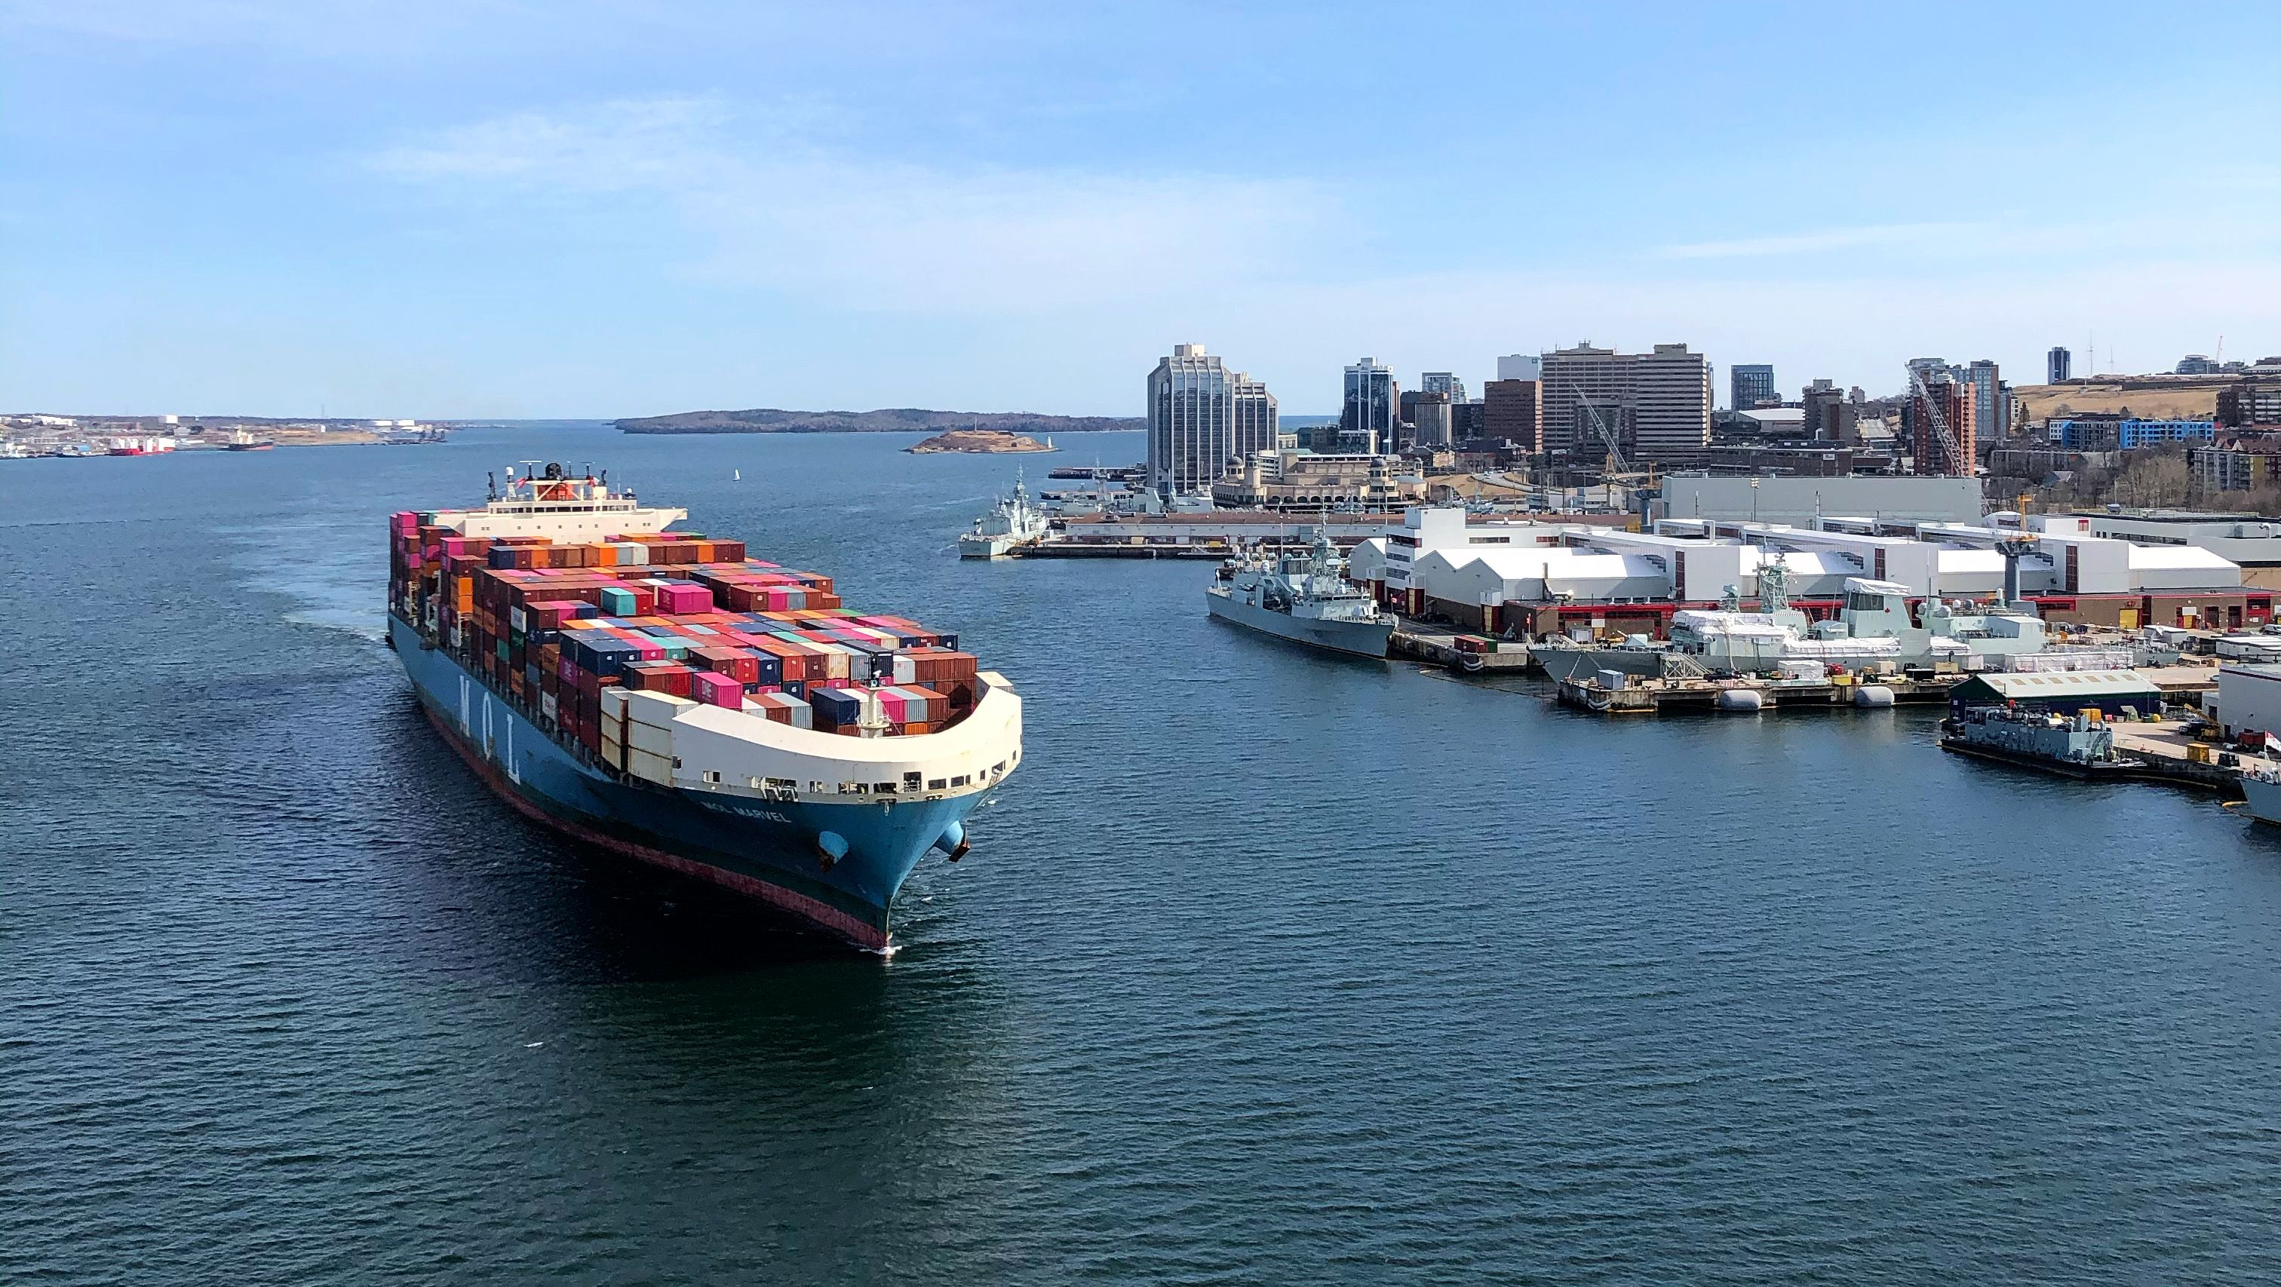
JC GROUP
JC MARINE INTEGRATION SDN BHD
202301042692 (1536608-W)
JC SUPPY SDN BHD
202301050114 (1544028-W)
JC MARINE TECHNOLOGY SDN BHD
202601015161 (1677259-U)
MIRI
TEL
Lot 10502, BLK 5, KBLD, Desa Senadin, 98000, Miri, Sarawak, Malaysia.
+6011-8888 5899
PORT KLANG
EMAIL
No. 29-B, Jalan Berangan, 42000 Port Klang, Selangor Darul Ehsan, Malaysia
request@jcmarine.com.my
BUSINESS HOURS
SINGAPORE
Mon to Fri
Blk 3012 Bedok Ind Park E #04-2032 Singapore 489978
0800hrs to 1700hrs
Sat: 0800hrs to 1200hrs
Notes:
Cover concept: 05 Coastal Brand / 品牌紫色. Supplied JC logo rendered directly from the vector PDF with transparency; no background or white badge. Current confirmed company registry/contact/address data. Stock photograph: Enrique / Pexels, https://www.pexels.com/photo/ship-in-calm-sea-near-port-4041587/, Pexels free license; illustrative marine image. This deck contains five cover concepts only for comparison; existing complete31pageprofiles remain separate.

