Slide 1




JC GROUP
JC MARINE INTEGRATION SDN BHD
202301042692 (1536608-W)
JC SUPPY SDN BHD
202301050114 (1544028-W)
JC MARINE TECHNOLOGY SDN BHD
202601015161 (1677259-U)
TEL
EMAIL
BUSINESS HOURS
+6011-8888 5899
request@jcmarine.com.my
Mon to Fri
0800hrs to 1700hrs
Sat: 0800hrs to 1200hrs
MIRI
PORT KLANG
SINGAPORE
Lot 10502, BLK 5, KBLD,
Desa Senadin, 98000,
Miri, Sarawak, Malaysia.
No. 29-B, Jalan Berangan,
42000 Port Klang,
Selangor Darul Ehsan,
Malaysia
Blk 3012 Bedok Ind Park E
#04-2032
Singapore 489978
Notes:
Latest explicit cover direction: full-bleed harbour photograph with a centre-to-right pale gradient and all company/contact/location details on the right. Use confirmed current Marine Integration, SUPPY and Marine Technology registry, request@jcmarine.com.my and all three locations; the old Connexion text in the layout reference is not reused. Remaining30pages preserved.
Cover image replaced only. Stock photograph by Aleksandr Sochnev / Pexels: https://www.pexels.com/photo/aerial-view-of-cargo-ship-on-open-sea-30463262/ (illustrative marine image).

Slide 2
JC GROUP
JC GROUP
Our group
JC GROUP
JC MARINE INTEGRATION SDN BHD
JC SUPPY SDN BHD
JC MARINE TECHNOLOGY SDN BHD
202301042692 (1536608-W)
202301050114 (1544028-W)
202601015161 (1677259-U)
Marine navigation, communication, automation and technical services.
Marine supplies, fire alarm systems and additional technical services.
Satellite airtime, VSAT / Starlink, leasing, vessel tracking and IT networks.
02
Notes:
Authoritative content: latest user-supplied company profile and explicit Technology name/year correction. Detailed services and working photographs are carried from the original JC Group PPT, updated28October2025. Design kept from selected03/05 16:9 landscape versions. New user text is retained in full; only competed/completed and log-lasting/long-lasting spelling is corrected.
The supplied legal registry spells JC SUPPY; the business narrative uses JC Supply. Both supplied forms are preserved. Technology establishment year2026 follows the latest explicit user correction.

Slide 3

JC GROUP
JC MARINE INTEGRATION
Company’s Vision
OUR VISION
“To excel as the most diversified, progressive and well respected marine services provider within South East Asia”
PROFESSIONAL, PRACTICAL AND PROACTIVE
03
Notes:
Authoritative content: latest user-supplied company profile and explicit Technology name/year correction. Detailed services and working photographs are carried from the original JC Group PPT, updated28October2025. Design kept from selected03/05 16:9 landscape versions. New user text is retained in full; only competed/completed and log-lasting/long-lasting spelling is corrected.

Slide 4
JC GROUP
JC MARINE INTEGRATION
Mission Statement
01
“Highly motivated to ensure all work to be completed successfully within the time frame required by our customers with competent and qualified service technicians & field engineers”
02
“We pledge our commitment to ensure customers/client satisfaction by achieving requirements within the time frame provided”
03
“To enhance support self-motivation environment for our staff that will ensure for long term partnership and maintain quality of life”
04
Notes:
Authoritative content: latest user-supplied company profile and explicit Technology name/year correction. Detailed services and working photographs are carried from the original JC Group PPT, updated28October2025. Design kept from selected03/05 16:9 landscape versions. New user text is retained in full; only competed/completed and log-lasting/long-lasting spelling is corrected.

Slide 5
JC GROUP
JC MARINE INTEGRATION
About us
JC Marine, being a trusted provider of integrated solutions for shipping industry, specializing in marine communication and navigation equipment, as well automation systems since 1999.
Our core services include inspection, troubleshooting, repair, maintenance and programming.
We also offer sales and installation services for new marine equipment on new built vessels and replacement equipment on existing vessels.
05
Notes:
Authoritative content: latest user-supplied company profile and explicit Technology name/year correction. Detailed services and working photographs are carried from the original JC Group PPT, updated28October2025. Design kept from selected03/05 16:9 landscape versions. New user text is retained in full; only competed/completed and log-lasting/long-lasting spelling is corrected.

Slide 6

JC GROUP
JC MARINE INTEGRATION
Type of Services
01
Navigational & Communication Systems
02
Shore Based Maintenance
03
Annual Performance Test (APT) for VDR & SVDR
04
Gyrocompass Calibration
05
Magnetic Compass Adjustment
06
Notes:
Authoritative content: latest user-supplied company profile and explicit Technology name/year correction. Detailed services and working photographs are carried from the original JC Group PPT, updated28October2025. Design kept from selected03/05 16:9 landscape versions. New user text is retained in full; only competed/completed and log-lasting/long-lasting spelling is corrected.

Slide 7
JC GROUP
JC MARINE INTEGRATION
Navigational & Communication Systems
We provide services such as installation, inspection, troubleshooting, repair and maintenance services for the following equipment:
Navigation displays
Steering & heading
Signals & instruments
• Chart plotters
• ECDIS
• Speed Log
• Steering Gear (Electronics and Electricity)
• Auto Pilot
• Gyrocompass
• Rudder Angle Indicator
• Aldis Light
• Wind Speed and Direction
07
Notes:
Authoritative content: latest user-supplied company profile and explicit Technology name/year correction. Detailed services and working photographs are carried from the original JC Group PPT, updated28October2025. Design kept from selected03/05 16:9 landscape versions. New user text is retained in full; only competed/completed and log-lasting/long-lasting spelling is corrected.

Slide 8
Regional service reach
SOUTH EAST ASIA
Service Reach
Repair Solutions
At JC Marine Integration, our commitment knows no borders. Through our extensive network of service partners, we deliver services beyond Malaysia.
With borderless reach, we are able to carry out various services at the sea ports required by our clients.
Time Zones
MIRI
Travel
We work across South East Asia time zones.
Our technicians and service engineers travel as per clients’ requirements.
08
Miri · Port Klang · Singapore
Notes:
16:9 landscape reflow of the reference-inspired regional page. Neutral globe geometry is Natural Earth (public domain). Miri is a locator based on the supplied address, not a branch network or country-coverage guarantee. All service statements follow the original JC Group profile.
The three city names reflect locations supplied by the user, without assigning headquarters or branch status. The locator globe is illustrative; it is not a coverage guarantee.

Slide 9



JC GROUP
JC MARINE INTEGRATION
Brands & authorisations
JC Marine Integration Sdn Bhd
AUTHORISED DEALER
Iridium LT-3100
We, JC MARINE INTEGRATION SDN BHD, are proud to be selected as the authorised distributor of JRC and Alphatron Marine.
We, JC MARINE INTEGRATION SDN BHD, are proud to be selected as the authorised dealer of Iridium LT-3100.
09
Notes:
Brand artwork corrected to the second image supplied by the user: complete combined JRC + Alphatron Marine + Authorized distributor lockup. The two separate cards and their individual captions have been removed. Iridium LT-3100 retains its separate dealer status. All other profile pages are preserved.

Slide 10
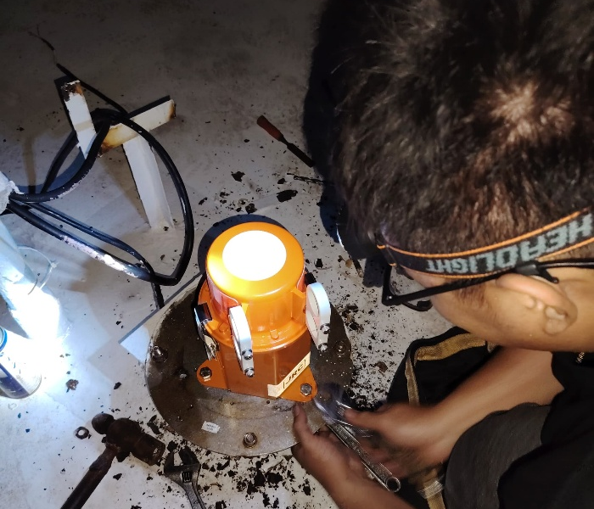
JC GROUP
JC MARINE INTEGRATION
Shore Based Maintenance
JC MARINE INTEGRATION is authorised to facilitate the creation of Shore-Based Maintenance Agreements, which are mandated by flag authorities to validate the functionality of vessels’ GMDSS communication systems.
10
Notes:
Authoritative content: latest user-supplied company profile and explicit Technology name/year correction. Detailed services and working photographs are carried from the original JC Group PPT, updated28October2025. Design kept from selected03/05 16:9 landscape versions. New user text is retained in full; only competed/completed and log-lasting/long-lasting spelling is corrected.

Slide 11
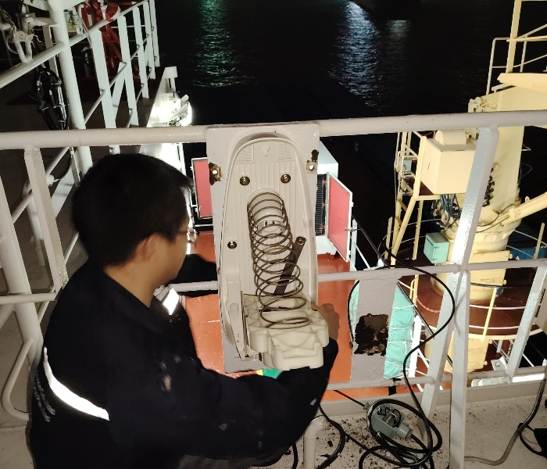
JC GROUP
JC MARINE INTEGRATION
Annual Performance Test (APT) for VDR & SVDR
JC MARINE INTEGRATION has qualified and recognised field engineers and technicians to conduct Annual Performance Tests (APT) for Voyage Data Recorders (VDR) and Simplified Voyage Data Recorders (SVDR).
11
Notes:
Authoritative content: latest user-supplied company profile and explicit Technology name/year correction. Detailed services and working photographs are carried from the original JC Group PPT, updated28October2025. Design kept from selected03/05 16:9 landscape versions. New user text is retained in full; only competed/completed and log-lasting/long-lasting spelling is corrected.

Slide 12

JC GROUP
JC MARINE INTEGRATION
Gyrocompass Calibration
We provide qualified technicians to carry out calibration services for various brands of gyrocompass.
12
Notes:
Authoritative content: latest user-supplied company profile and explicit Technology name/year correction. Detailed services and working photographs are carried from the original JC Group PPT, updated28October2025. Design kept from selected03/05 16:9 landscape versions. New user text is retained in full; only competed/completed and log-lasting/long-lasting spelling is corrected.

Slide 13

JC GROUP
JC MARINE INTEGRATION
Magnetic Compass Adjustment
We provide qualified field engineers to carry out adjustment services for various brands of magnetic compass.
13
Notes:
Authoritative content: latest user-supplied company profile and explicit Technology name/year correction. Detailed services and working photographs are carried from the original JC Group PPT, updated28October2025. Design kept from selected03/05 16:9 landscape versions. New user text is retained in full; only competed/completed and log-lasting/long-lasting spelling is corrected.

Slide 14

JC GROUP
JC MARINE TECHNOLOGY
About us
JC Marine Technology Sdn Bhd, a sister company of JC Marine Integration, was established in 2026 with core activity of providing satellite airtime services for maritime and offshore vessels.
To date, we have supplied and installed over 100 units of VSAT and Starlink systems, together with airtime subscription service.
100+
VSAT & STARLINK SYSTEMS
SUPPLIED AND INSTALLED
14
Notes:
Authoritative content: latest user-supplied company profile and explicit Technology name/year correction. Detailed services and working photographs are carried from the original JC Group PPT, updated28October2025. Design kept from selected03/05 16:9 landscape versions. New user text is retained in full; only competed/completed and log-lasting/long-lasting spelling is corrected.

Slide 15
JC GROUP
JC MARINE TECHNOLOGY
Type of Services
01
02
Internet Airtime Subscription
Airtime Control System
03
04
VSAT / Starlink
Vessel Tracking System
05
06
Satellite Equipment Leasing
IT & Network System
15
Notes:
Authoritative content: latest user-supplied company profile and explicit Technology name/year correction. Detailed services and working photographs are carried from the original JC Group PPT, updated28October2025. Design kept from selected03/05 16:9 landscape versions. New user text is retained in full; only competed/completed and log-lasting/long-lasting spelling is corrected.

Slide 16

JC GROUP
JC MARINE TECHNOLOGY
Internet Airtime Subscription
JC Marine Technology provides comprehensive bandwidth solutions for communication systems as well as satellite airtime services for L-band, FleetBroadband (FBB) and Fleet One.
Internet airtime packages are available as:
Internet airtime packages:
• Prepaid: Various types of packages valid for one month or 30 days, commencing from the day of activation.
• Postpaid: Pay per use at an agreed fixed price.
16
Notes:
Authoritative content: latest user-supplied company profile and explicit Technology name/year correction. Detailed services and working photographs are carried from the original JC Group PPT, updated28October2025. Design kept from selected03/05 16:9 landscape versions. New user text is retained in full; only competed/completed and log-lasting/long-lasting spelling is corrected.

Slide 17

JC GROUP
JC MARINE TECHNOLOGY
Airtime Control System
JC Marine Technology offers an airtime control system on ships. This system features a firewall device capable of monitoring and controlling data usage, ensuring efficient and cost-effective satellite communication, such as:
• CCTV ports
• Email from ships’ computers or laptops
• Restricted websites
• User recognition by PIN code
• Mobile phone application restrictions
• Voucher-based internet access
17
Notes:
Authoritative content: latest user-supplied company profile and explicit Technology name/year correction. Detailed services and working photographs are carried from the original JC Group PPT, updated28October2025. Design kept from selected03/05 16:9 landscape versions. New user text is retained in full; only competed/completed and log-lasting/long-lasting spelling is corrected.

Slide 18

JC GROUP
JC MARINE TECHNOLOGY
VSAT / Starlink
We provide installation services for customers on their vessels, either at berth or at anchorage within port limit areas. At the same time, we provide satellite airtime services for VSAT and Starlink to customers who have already purchased their own satellite equipment and fitted it on their vessels.
Satellite airtime packages are available as:
Satellite airtime packages:
• Prepaid: Various types of packages valid for one month or 30 days, commencing from the day of activation.
• Postpaid: Pay per use at an agreed fixed price.
18
Notes:
Authoritative content: latest user-supplied company profile and explicit Technology name/year correction. Detailed services and working photographs are carried from the original JC Group PPT, updated28October2025. Design kept from selected03/05 16:9 landscape versions. New user text is retained in full; only competed/completed and log-lasting/long-lasting spelling is corrected.

Slide 19
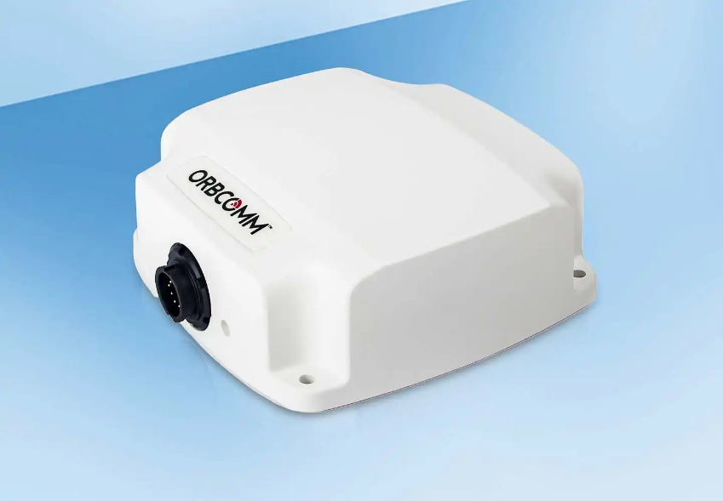
JC GROUP
JC MARINE TECHNOLOGY
Vessel Tracking System
JC Marine Technology provides a ship tracking system powered by POLE STAR Purplefinder, providing reliable real-time tracking solutions.
We provide the following packages:
Tracking packages:
• Installation service for vessel tracking systems
• Airtime subscription for vessel tracking systems
• Equipment leasing and airtime subscription bundle
19
Notes:
Authoritative content: latest user-supplied company profile and explicit Technology name/year correction. Detailed services and working photographs are carried from the original JC Group PPT, updated28October2025. Design kept from selected03/05 16:9 landscape versions. New user text is retained in full; only competed/completed and log-lasting/long-lasting spelling is corrected.

Slide 20
JC GROUP
JC MARINE TECHNOLOGY
Satellite Equipment Leasing
LEASE TO OWN
We provide satellite equipment leasing bundled with internet airtime service.
Lease to Own (VSAT or Starlink)
Monthly charge includes
Agreement of 24 to 60 months, where the monthly charge includes:
Satellite equipment
Mobilisation and demobilisation (installation and dismantling)
The client is eligible to buy the equipment at an agreed price once the lease agreement expires.
Equipment commissioning and setup
Monthly airtime charge
20
Notes:
Authoritative content: latest user-supplied company profile and explicit Technology name/year correction. Detailed services and working photographs are carried from the original JC Group PPT, updated28October2025. Design kept from selected03/05 16:9 landscape versions. New user text is retained in full; only competed/completed and log-lasting/long-lasting spelling is corrected.
Life-time Warranty is the supplied package name; retain the full term, exit and eligible exchange conditions without suggesting unconditional perpetual cover.

Slide 21
JC GROUP
JC MARINE TECHNOLOGY
Satellite Equipment Leasing
LIFE-TIME WARRANTY
We provide satellite equipment leasing bundled with internet airtime service.
Life-time Warranty (VSAT or Starlink)
Monthly charge includes
Agreement of 24 to 60 months, where the monthly charge includes:
Satellite equipment
Mobilisation and demobilisation (installation and dismantling)
The customer is eligible to terminate after 24 months.
The customer is eligible to request a 1-for-1 equipment exchange if the equipment is found faulty or damaged due to non-human-caused damage.
Equipment commissioning and setup
Monthly airtime charge
21
Notes:
Authoritative content: latest user-supplied company profile and explicit Technology name/year correction. Detailed services and working photographs are carried from the original JC Group PPT, updated28October2025. Design kept from selected03/05 16:9 landscape versions. New user text is retained in full; only competed/completed and log-lasting/long-lasting spelling is corrected.
Life-time Warranty is the supplied package name; retain the full term, exit and eligible exchange conditions without suggesting unconditional perpetual cover.

Slide 22

JC GROUP
JC MARINE TECHNOLOGY
IT & Network System
We offer customised IT solutions for customers to meet their unique company requirements and needs.
Our services include the development and implementation of software, IT and network systems for offices and workplaces.
In addition, we provide the following services:
Additional services:
• Server installation, maintenance and monitoring
• Network configuration
22
Notes:
Authoritative content: latest user-supplied company profile and explicit Technology name/year correction. Detailed services and working photographs are carried from the original JC Group PPT, updated28October2025. Design kept from selected03/05 16:9 landscape versions. New user text is retained in full; only competed/completed and log-lasting/long-lasting spelling is corrected.

Slide 23

JC GROUP
JC SUPPLY
About us
JC Supply Sdn Bhd, a sister company of JC Marine Integration was established in 2023 to expand our services into marine supplies.
We aim to deliver high-quality products and services, fostering long-lasting relationships with our customers.
In addition to marine supplies, we offer other services such as marine fire alarm system installation, service, repair and etc.
23
Notes:
Authoritative content: latest user-supplied company profile and explicit Technology name/year correction. Detailed services and working photographs are carried from the original JC Group PPT, updated28October2025. Design kept from selected03/05 16:9 landscape versions. New user text is retained in full; only competed/completed and log-lasting/long-lasting spelling is corrected.

Slide 24
JC GROUP
JC SUPPLY
Type of Services
01
Hot-Works & Fabrication
02
Marine Supplies
03
Marine Fire Alarm System
04
Technical Writing & illustration Services
05
Calibration & Overhaul
24
Notes:
Authoritative content: latest user-supplied company profile and explicit Technology name/year correction. Detailed services and working photographs are carried from the original JC Group PPT, updated28October2025. Design kept from selected03/05 16:9 landscape versions. New user text is retained in full; only competed/completed and log-lasting/long-lasting spelling is corrected.

Slide 25
JC GROUP
JC SUPPLY
Hot-Works & Fabrication
We further extend our service to provide all ranges of hot works services for repair or fabrication jobs.
Our hot work team comprises experienced personnel dedicated to delivering quality service that meets our clients’ expectations.
Our hot work services include:
Hot work services:
• Steel welding
• Aluminium welding
25
Notes:
Authoritative content: latest user-supplied company profile and explicit Technology name/year correction. Detailed services and working photographs are carried from the original JC Group PPT, updated28October2025. Design kept from selected03/05 16:9 landscape versions. New user text is retained in full; only competed/completed and log-lasting/long-lasting spelling is corrected.

Slide 26

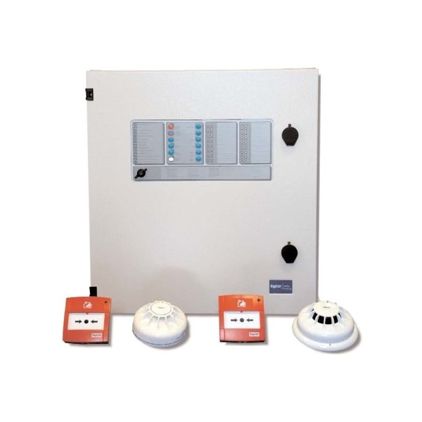

JC GROUP
JC SUPPLY
Marine Supplies
JC Supply provides marine supplies, including but not limited to:
Provision supply
Lifesaving equipment supply
Marine hardware supply
Firefighting equipment supply
Shackles
Lubricating oil and grease
Polypropylene ropes
Coveralls and safety shoes / boots
Marine type-approved valves
Wire ropes
26
Notes:
Authoritative content: latest user-supplied company profile and explicit Technology name/year correction. Detailed services and working photographs are carried from the original JC Group PPT, updated28October2025. Design kept from selected03/05 16:9 landscape versions. New user text is retained in full; only competed/completed and log-lasting/long-lasting spelling is corrected.

Slide 27

JC GROUP
JC SUPPLY
Marine Fire Alarm System
We have qualified and experienced field engineers to carry out installation, repair, troubleshooting and annual inspection for various brands of marine-type fire alarm systems.
We also sell and supply various brands of marine-type fire alarm system panels, fire and smoke detector sensors, and portable-type fire and smoke detector testers.
27
Notes:
Authoritative content: latest user-supplied company profile and explicit Technology name/year correction. Detailed services and working photographs are carried from the original JC Group PPT, updated28October2025. Design kept from selected03/05 16:9 landscape versions. New user text is retained in full; only competed/completed and log-lasting/long-lasting spelling is corrected.

Slide 28
JC GROUP
JC SUPPLY
Technical Writing
We have a technical writing team which specialises in writing ship operating manuals, ship engineering manuals, and maintenance plan manuals for engines, gearboxes, control stands and deck equipment. We can review your existing files and provide fresh insight into how they may be reused, updated and converted.
Ship operating manuals
Ship engineering manuals
Maintenance plan manuals
28
Notes:
Authoritative content: latest user-supplied company profile and explicit Technology name/year correction. Detailed services and working photographs are carried from the original JC Group PPT, updated28October2025. Design kept from selected03/05 16:9 landscape versions. New user text is retained in full; only competed/completed and log-lasting/long-lasting spelling is corrected.

Slide 29
JC GROUP
JC SUPPLY
Illustration Services
Our illustration and graphic services can prepare supporting graphics for technical material, creating new drawings according to customers’ requirements. We have extensive experience in electrical drawings and electrical calculations for vessels converting from domestic to near-coastal operations.
Technical drawings
Electrical calculations
Near-coastal conversions
29
Notes:
Authoritative content: latest user-supplied company profile and explicit Technology name/year correction. Detailed services and working photographs are carried from the original JC Group PPT, updated28October2025. Design kept from selected03/05 16:9 landscape versions. New user text is retained in full; only competed/completed and log-lasting/long-lasting spelling is corrected.

Slide 30

JC GROUP
JC SUPPLY
Calibration & Overhaul
We have qualified service engineers to perform repair, maintenance and overhaul services for gas detectors. Gas detector supply and calibration services are available.
30
Notes:
Authoritative content: latest user-supplied company profile and explicit Technology name/year correction. Detailed services and working photographs are carried from the original JC Group PPT, updated28October2025. Design kept from selected03/05 16:9 landscape versions. New user text is retained in full; only competed/completed and log-lasting/long-lasting spelling is corrected.

Slide 31
JC GROUP
TEL
EMAIL
BUSINESS HOURS
+6011-8888 5899
request@jcmarine.com.my
Mon to Fri: 0800hrs to 1700hrs
Sat: 0800hrs to 1200hrs
MIRI
PORT KLANG
SINGAPORE
Lot 10502, BLK 5, KBLD,
Desa Senadin, 98000,
Miri, Sarawak, Malaysia.
No. 29-B, Jalan Berangan,
42000 Port Klang,
Selangor Darul Ehsan,
Malaysia
Blk 3012 Bedok Ind Park E
#04-2032
Singapore 489978
Notes:
Contact information supplied directly by the user in the latest content update. TEL +6011-88885899; request@jcmarine.com.my; Mon–Fri08:00–17:00, Sat08:00–12:00. Three complete address blocks are kept visible. Location labels do not assign headquarters, branch, registered-office, or service-coverage status.

