Slide 1

JC GROUP / CORPORATE PROFILE
Reliable marine expertise.
Connected solutions.
Marine equipment • Satellite connectivity • Marine supply
JC MARINE INTEGRATION
JC CONNEXION
JC SUPPLY
JC GROUP / COMPANY PROFILE
01

Slide 2

GROUP OVERVIEW
One group. Three areas of expertise.
01
02
03
Marine Integration
Connexion
Supply
Navigation, communication and automation equipment.
Inspection, repair, maintenance and installation.
Satellite equipment, airtime subscriptions and leasing.
Vessel tracking, IT and network solutions.
Marine products and safety equipment.
Calibration, fire alarms, fabrication and technical documentation.
JC GROUP / COMPANY PROFILE
02

Slide 3

VISION & MISSION
Professional. Practical. Proactive.
“To excel as the most diversified, progressive and well-respected marine services provider within South East Asia.”
DELIVER
COMMIT
SUPPORT
Complete work within customers’ timelines with qualified technicians and field engineers.
Meet customer requirements and uphold service quality and satisfaction.
Build a motivated workplace that supports long-term partnerships and quality of life.
JC GROUP / COMPANY PROFILE
03

Slide 4
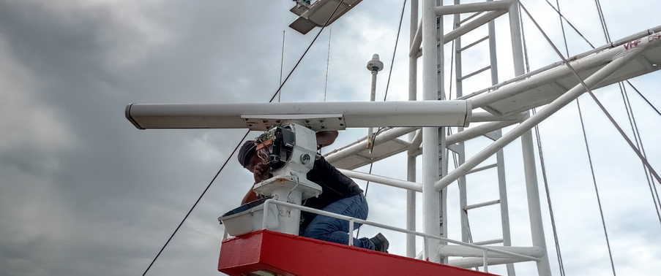
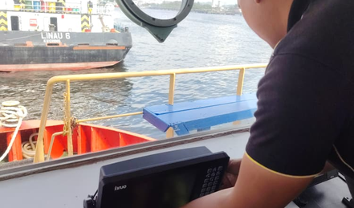
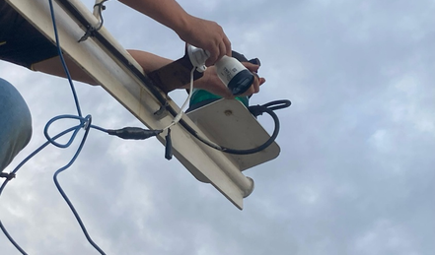
01 / JC MARINE INTEGRATION
Marine expertise since 1999
Integrated solutions for the shipping industry
JC Marine specialises in marine communication and navigation equipment, together with automation systems.
Our services cover inspection, troubleshooting, repair, maintenance and programming, plus the sale and installation of new and replacement equipment.
JC GROUP / COMPANY PROFILE
04

Slide 5


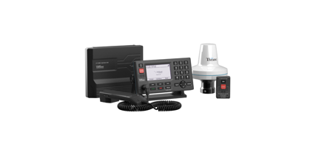
BRAND PARTNERSHIPS
Trusted brands. Proven equipment.
AUTHORISED DEALER
Iridium
LT-3100
AUTHORISED DISTRIBUTOR
JRC & Alphatron Marine
JC Marine Integration Sdn Bhd
Marine satellite communication equipment
JC GROUP / COMPANY PROFILE
05

Slide 6
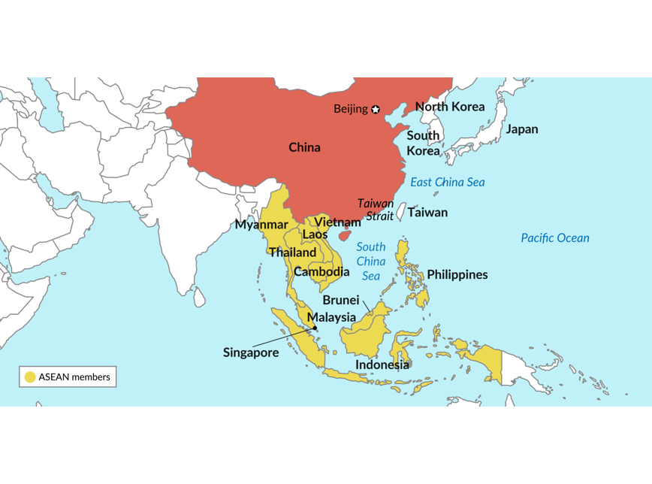
REGIONAL SUPPORT
Service reach across South East Asia
Beyond Malaysia
An extensive service partner network supports customers at their required seaports.
Across time zones
Service coordination across South East Asia time zones.
Where customers need us
Technicians and field engineers travel according to clients’ requirements.
JC GROUP / COMPANY PROFILE
06

Slide 7
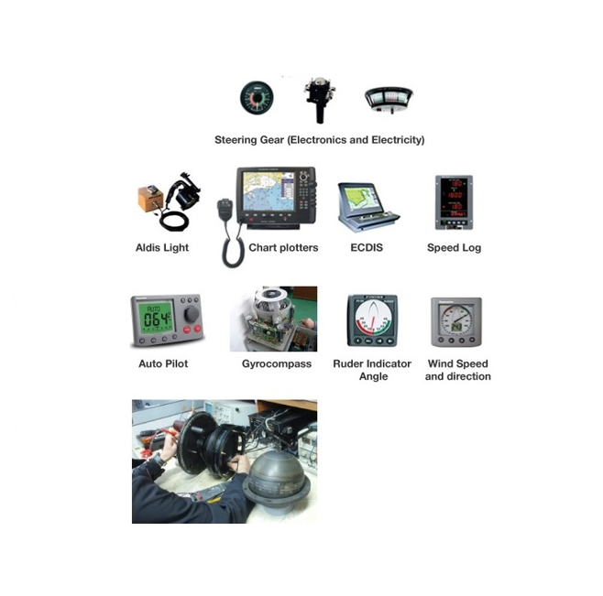
MARINE INTEGRATION / SERVICES
Complete support for marine systems
Navigation & communication systems
Shore-based maintenance
VDR & SVDR annual performance tests
Gyrocompass calibration
Magnetic compass adjustment
INSTALL / INSPECT / TROUBLESHOOT / REPAIR / MAINTAIN
JC GROUP / COMPANY PROFILE
07

Slide 8
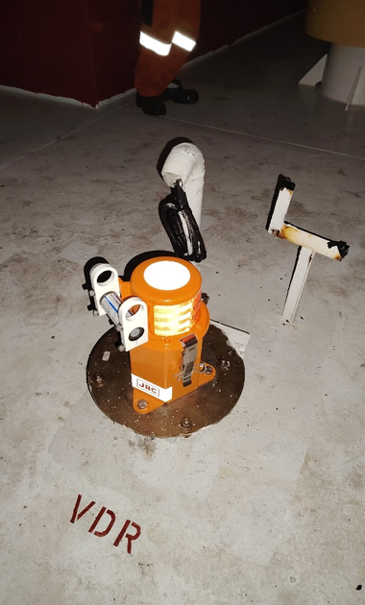
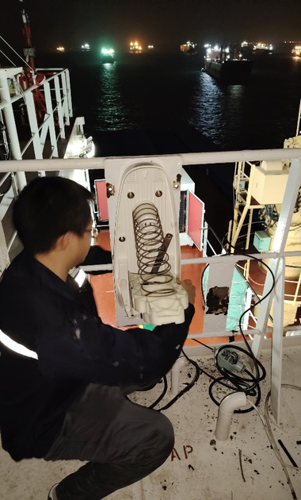
MARINE INTEGRATION
Compliance & annual performance
Shore-based maintenance
Support for Shore-Based Maintenance Agreements mandated by flag authorities to validate the functionality of vessels’ GMDSS communication systems.
VDR & SVDR performance tests
Qualified and recognised field engineers and technicians conduct Annual Performance Tests for Voyage Data Recorders and Simplified Voyage Data Recorders.
JC GROUP / COMPANY PROFILE
08

Slide 9
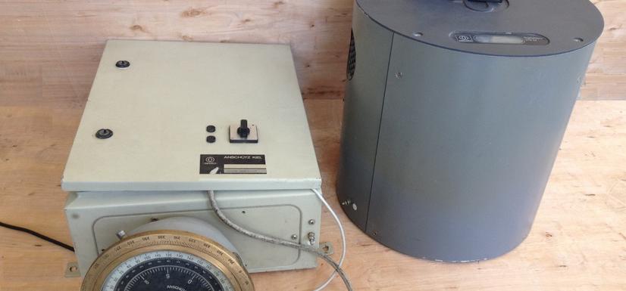

MARINE INTEGRATION
Precision for vessel navigation
Gyrocompass calibration
Magnetic compass adjustment
Qualified technicians calibrate gyrocompasses across various brands.
Qualified field engineers adjust magnetic compasses across various brands.
JC GROUP / COMPANY PROFILE
09

Slide 10

02 / JC CONNEXION
Keeping maritime operations connected
100+
VSAT & Starlink units supplied and installed
Established in 2023, JC Connexion is a sister company of JC Marine Integration, providing satellite airtime services for maritime and offshore vessels.
JC GROUP / COMPANY PROFILE
10

Slide 11
CONNEXION / SERVICE PORTFOLIO
Connectivity from equipment to airtime
01
02
03
Internet airtime
VSAT & Starlink
Equipment leasing
L-band, FleetBroadband and Fleet One.
Equipment installation and airtime services.
Satellite hardware bundled with internet airtime.
04
05
06
Airtime control
Vessel tracking
IT & networks
Monitor, manage and restrict data usage.
Installation, airtime and leasing packages.
Custom systems, servers and network configuration.
JC GROUP / COMPANY PROFILE
11

Slide 12

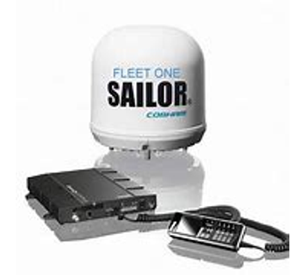
CONNEXION / AIRTIME
Flexible airtime for maritime operations
Satellite internet subscriptions
Bandwidth solutions and satellite airtime for L-band, FleetBroadband (FBB) and Fleet One systems.
Prepaid
POSTPAID
Packages valid for one month or 30 days from activation.
Pay per use at an agreed fixed price.
JC GROUP / COMPANY PROFILE
12

Slide 13
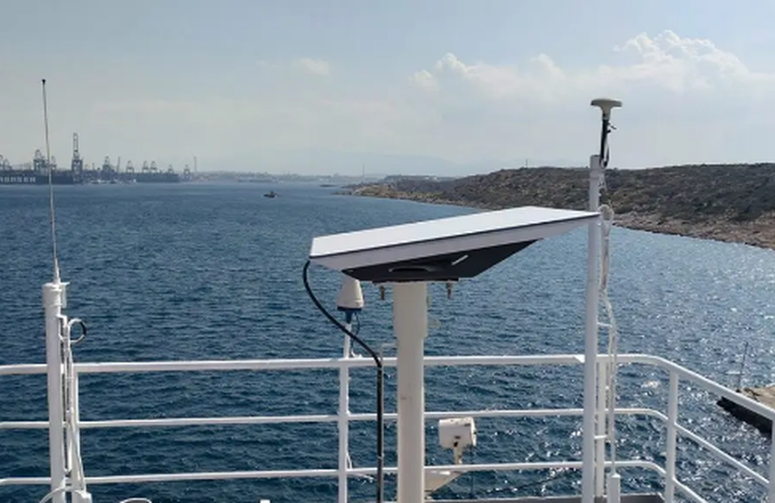
CONNEXION / EQUIPMENT & AIRTIME
VSAT & Starlink installation
Installation at berth or anchorage
Installation on customer vessels within port limit areas.
Airtime services are also available for customers with satellite equipment already installed onboard.
PREPAID / POSTPAID
JC GROUP / COMPANY PROFILE
13

Slide 14
CONNEXION / LEASING OPTIONS
Satellite equipment leasing
01
02
Lease to Own
Life-time Warranty
24–60 month agreement.
Option to buy equipment at an agreed price when the lease expires.
24–60 month agreement.
Option to terminate after 24 months.
1-for-1 exchange for eligible faults or non-human-caused damage.
BOTH PACKAGES INCLUDE
VSAT or Starlink equipment • Installation & dismantling • Commissioning & setup • Monthly airtime
JC GROUP / COMPANY PROFILE
14

Slide 15

CONNEXION / AIRTIME CONTROL
Control usage. Manage satellite costs.
An onboard firewall monitors and controls data usage to support efficient, cost-effective satellite communication.
CCTV ports & ship computer email
Website & mobile application restrictions
PIN-based user recognition
Voucher-based internet access
MONITOR / CONTROL / OPTIMISE
JC GROUP / COMPANY PROFILE
15

Slide 16

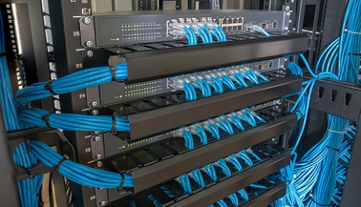
CONNEXION / TRACKING & IT
Vessel visibility & connected workplaces
Vessel tracking
IT & network systems
Powered by POLE STAR Purplefinder for reliable, real-time vessel tracking.
Custom software, IT and network solutions tailored to offices and workplaces.
Tracking system installation
Airtime subscriptions
Equipment leasing & airtime bundles
Server installation, maintenance & monitoring
Network configuration
JC GROUP / COMPANY PROFILE
16

Slide 17

03 / JC SUPPLY
Marine supplies. Technical capability.
Established in 2023
A sister company of JC Marine Integration, expanding the group’s services into marine supplies.
High-quality products and services that support long-lasting customer relationships.
SUPPLY / SAFETY / ENGINEERING
JC GROUP / COMPANY PROFILE
17

Slide 18

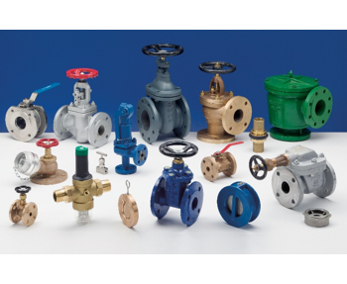

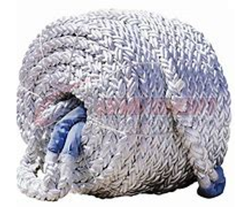
SUPPLY / PRODUCT RANGE
Equipped for everyday marine operations
Provisions & marine hardware
Shackles & wire ropes
Polypropylene ropes
Marine type-approved valves
Lifesaving & firefighting equipment
Lubricating oil & grease
Coveralls & safety shoes / boots
JC GROUP / COMPANY PROFILE
18

Slide 19


SUPPLY / TECHNICAL SERVICES
Calibration, repair & fabrication
Calibration & overhaul
Hot works & fabrication
Qualified service engineers provide repair, maintenance and overhaul services, including gas detector supply and calibration.
Experienced personnel carry out repair and fabrication work, including steel welding and aluminium welding.
JC GROUP / COMPANY PROFILE
19

Slide 20
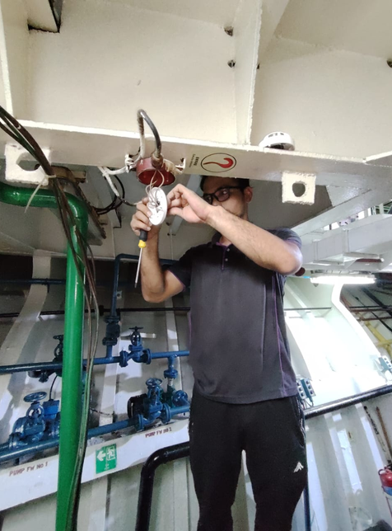
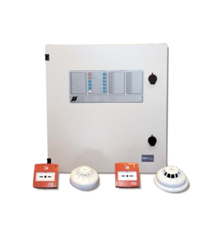
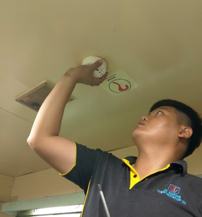
SUPPLY / SAFETY SYSTEMS
Marine fire alarm systems
From installation to annual inspection
Qualified and experienced field engineers service various brands of marine fire alarm systems.
Installation, repair & troubleshooting
Annual inspections
Panels, fire & smoke detector sensors
Portable fire & smoke detector testers
JC GROUP / COMPANY PROFILE
20

Slide 21
SUPPLY / TECHNICAL DOCUMENTATION
Clear documentation. Precise illustration.
01
02
Technical writing
Illustration & electrical design
Ship operating and engineering manuals.
Maintenance plans for engines, gearboxes, control stands and deck equipment.
Review, update and convert existing files.
Supporting graphics and custom technical drawings.
Electrical drawings and calculations for vessels converting from domestic operations to near-coastal service.
JC GROUP / COMPANY PROFILE
21

Slide 22
CONTACT JC GROUP
Let’s support your next voyage.
Service enquiries
BUSINESS HOURS
+6011-8888 5899
Monday–Friday
08:00–17:00
Saturday
08:00–12:00
services@jcmarine.com.my
Lot 10502, Desa Senadin, Block 5,
Commercial Centre Phase 8, Kuala Baram Land District,
98000 Miri, Sarawak, Malaysia
JC GROUP / COMPANY PROFILE
22

Slide 23
CORPORATE INFORMATION
Our companies
01
JC MARINE INTEGRATION SDN BHD
202301042692 (1536608-W)
02
JC CONNEXION SDN BHD
202301044444 (1538360-W)
03
JC SUPPY SDN BHD
202301050114 (1544028-W)
JC GROUP / COMPANY PROFILE
23
Notes:
Source cover lists JC SUPPY SDN BHD; business section uses JC Supply Sdn Bhd. Registered name retained as supplied. Please verify before external publication.

