Slide 1

JC GROUP / COMPANY PROFILE
COMPANY PROFILE
Marine.
Connected.
JC
GROUP
THE
COMPANY
PROFILE
MARINE / CONNECTIVITY / SUPPLY
PROFESSIONAL / PRACTICAL / PROACTIVE
01 / 23
Notes:
Source: JC Group company profile updated 28 October 2025. All service and company information comes from the supplied presentation. No new certification, performance or customer claim is added.

Slide 2
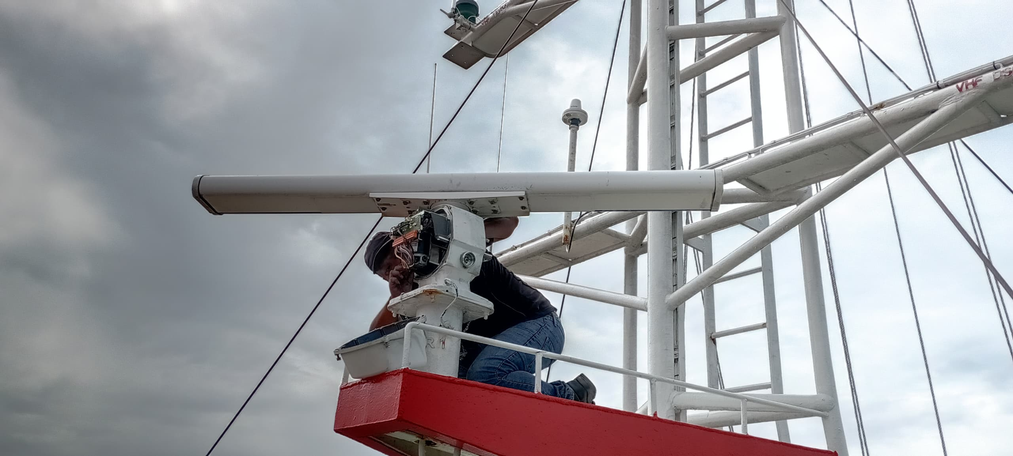


JC GROUP / COMPANY PROFILE
GROUP OVERVIEW
02
One group. Three specialist businesses.
01
Marine Integration
02
Connexion
03
Supply
Navigation, communication and automation.
Equipment service, repair and installation.
Satellite connectivity and airtime.
Leasing, vessel tracking, IT and networks.
Marine products and technical services.
Safety systems, fabrication and documentation.
PROFESSIONAL / PRACTICAL / PROACTIVE
02 / 23
Notes:
Source: JC Group company profile updated 28 October 2025. All service and company information comes from the supplied presentation. No new certification, performance or customer claim is added.

Slide 3
JC GROUP / COMPANY PROFILE
VISION & MISSION
03
Professional. Practical. Proactive.
OUR VISION
01
Deliver
To excel as a diversified, progressive and well-respected marine services provider in South East Asia.
Complete work within customers’ timelines with competent, qualified technicians and field engineers.
02
Commit
Achieve customer requirements and satisfaction within the agreed timeframe.
03
Support
Build a motivated workplace for long-term partnerships and quality of life.
PROFESSIONAL / PRACTICAL / PROACTIVE
03 / 23
Notes:
Source: JC Group company profile updated 28 October 2025. All service and company information comes from the supplied presentation. No new certification, performance or customer claim is added.

Slide 4
JC GROUP / COMPANY PROFILE
SERVICE COVERAGE
04
Local expertise. Regional reach.
SOUTH EAST ASIA
01
Beyond Malaysia
Service partner networks support work at clients’ required seaports.
02
Across time zones
Coordination across South East Asia time zones.
MIRI
03
Mobile field teams
Technicians and service engineers travel according to client requirements.
PROFESSIONAL / PRACTICAL / PROACTIVE
04 / 23
Notes:
Source: JC Group company profile updated 28 October 2025. All service and company information comes from the supplied presentation. No new certification, performance or customer claim is added.
Map geometry: Natural Earth, public domain; regional locator only. Service reach follows the supplied profile, not a country-by-country coverage guarantee.

Slide 5
JC GROUP / COMPANY PROFILE
JC MARINE INTEGRATION
01
JC MARINE INTEGRATION
Marine expertise
since 1999.
Integrated solutions for the shipping industry, specialising in marine communication and navigation equipment, as well as automation systems.
1999 / MARINE EXPERTISE SINCE
PROFESSIONAL / PRACTICAL / PROACTIVE
05 / 23
Notes:
Source: JC Group company profile updated 28 October 2025. All service and company information comes from the supplied presentation. No new certification, performance or customer claim is added.

Slide 6

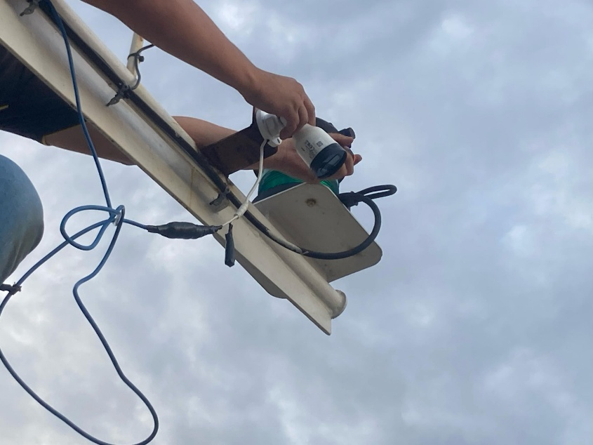
JC GROUP / COMPANY PROFILE
MARINE / TECHNICAL SERVICES
06
A complete equipment service cycle.
01
02
03
04
05
Inspect
Troubleshoot
Repair
Maintain
Programme
SALES & INSTALLATION
New-build vessels.
Existing vessel upgrades.
Supply and installation of new equipment, plus replacement equipment for existing vessels.
PROFESSIONAL / PRACTICAL / PROACTIVE
06 / 23
Notes:
Source: JC Group company profile updated 28 October 2025. All service and company information comes from the supplied presentation. No new certification, performance or customer claim is added.

Slide 7


JC GROUP / COMPANY PROFILE
MARINE / BRAND PARTNERSHIPS
07
Established brands. Specialist support.
AUTHORISED DISTRIBUTOR
AUTHORISED DEALER
JRC & Alphatron Marine
Iridium LT-3100
PROFESSIONAL / PRACTICAL / PROACTIVE
07 / 23
Notes:
Source: JC Group company profile updated 28 October 2025. All service and company information comes from the supplied presentation. No new certification, performance or customer claim is added.

Slide 8
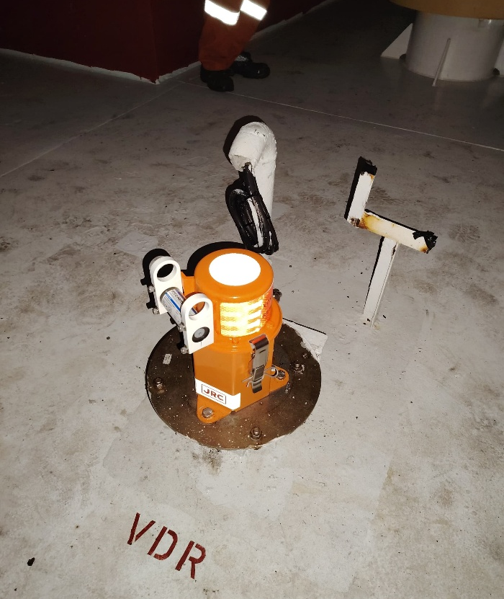
JC GROUP / COMPANY PROFILE
MARINE / SHORE SUPPORT & RECORDERS
08
Maintenance, verification & compliance.
Shore-based maintenance
Support for authorised Shore-Based Maintenance Agreements, mandated by flag authorities to validate vessel GMDSS communication systems.
VDR & SVDR annual performance tests
Qualified and recognised field engineers and technicians conduct APTs for Voyage Data Recorders and Simplified Voyage Data Recorders.
PROFESSIONAL / PRACTICAL / PROACTIVE
08 / 23
Notes:
Source: JC Group company profile updated 28 October 2025. All service and company information comes from the supplied presentation. No new certification, performance or customer claim is added.

Slide 9


JC GROUP / COMPANY PROFILE
MARINE / COMPASS SERVICES
09
Precision for vessel navigation.
01
Gyrocompass calibration
02
Magnetic compass adjustment
Qualified technicians calibrate gyrocompasses across various brands.
Qualified field engineers adjust magnetic compasses across various brands.
PROFESSIONAL / PRACTICAL / PROACTIVE
09 / 23
Notes:
Source: JC Group company profile updated 28 October 2025. All service and company information comes from the supplied presentation. No new certification, performance or customer claim is added.

Slide 10
JC GROUP / COMPANY PROFILE
JC CONNEXION
02
JC CONNEXION
Connectivity
that travels.
Established in 2023, JC Connexion is a sister company of JC Marine Integration, providing satellite airtime services for maritime and offshore vessels.
100+ / VSAT & STARLINK UNITS SUPPLIED / INSTALLED
PROFESSIONAL / PRACTICAL / PROACTIVE
10 / 23
Notes:
Source: JC Group company profile updated 28 October 2025. All service and company information comes from the supplied presentation. No new certification, performance or customer claim is added.

Slide 11
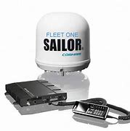
JC GROUP / COMPANY PROFILE
CONNEXION / INTERNET SUBSCRIPTIONS
11
Flexible satellite airtime.
L-band / FleetBroadband / Fleet One
Comprehensive bandwidth solutions and satellite airtime services for maritime and offshore communication.
01
02
Prepaid
Postpaid
A range of packages valid for one month or 30 days from activation.
Pay per use at an agreed fixed price.
PROFESSIONAL / PRACTICAL / PROACTIVE
11 / 23
Notes:
Source: JC Group company profile updated 28 October 2025. All service and company information comes from the supplied presentation. No new certification, performance or customer claim is added.

Slide 12
JC GROUP / COMPANY PROFILE
CONNEXION / INSTALLATION & AIRTIME
12
VSAT & Starlink, installed onboard.
At berth.
At anchorage.
Installation within port limit areas.
Airtime is also available for customers with their own satellite equipment already fitted onboard.
PREPAID & POSTPAID AIRTIME
PROFESSIONAL / PRACTICAL / PROACTIVE
12 / 23
Notes:
Source: JC Group company profile updated 28 October 2025. All service and company information comes from the supplied presentation. No new certification, performance or customer claim is added.

Slide 13
JC GROUP / COMPANY PROFILE
CONNEXION / LEASING PACKAGES
13
Two ways to lease satellite equipment.
Lease to Own
Life-time Warranty
24–60 MONTHS
24–60 MONTHS
Option to purchase the equipment at an agreed price when the lease expires.
Option to terminate after 24 months. Eligible faults or non-human-caused damage qualify for a 1-for-1 equipment exchange.
BOTH PACKAGES INCLUDE
VSAT or Starlink
equipment
Installation &
dismantling
Commissioning &
system setup
Monthly
airtime charge
PROFESSIONAL / PRACTICAL / PROACTIVE
13 / 23
Notes:
Source: JC Group company profile updated 28 October 2025. All service and company information comes from the supplied presentation. No new certification, performance or customer claim is added.

Slide 14
JC GROUP / COMPANY PROFILE
CONNEXION / AIRTIME CONTROL
14
Keep onboard data under control.
An onboard firewall monitors and controls data usage for efficient, cost-effective satellite communication.
01
CCTV ports
02
Email
03
Websites
Access management
Ship computers and laptops
Restrict selected sites
04
PIN codes
05
Applications
06
Vouchers
Recognise individual users
Control mobile app access
Voucher-based internet
PROFESSIONAL / PRACTICAL / PROACTIVE
14 / 23
Notes:
Source: JC Group company profile updated 28 October 2025. All service and company information comes from the supplied presentation. No new certification, performance or customer claim is added.

Slide 15
JC GROUP / COMPANY PROFILE
CONNEXION / VESSEL TRACKING
15
Visibility beyond the horizon.
POLE STAR Purplefinder
Reliable, real-time ship tracking solutions.
01
02
03
Tracking system
installation
Airtime
subscription
Equipment leasing
& airtime bundle
PROFESSIONAL / PRACTICAL / PROACTIVE
15 / 23
Notes:
Source: JC Group company profile updated 28 October 2025. All service and company information comes from the supplied presentation. No new certification, performance or customer claim is added.

Slide 16

JC GROUP / COMPANY PROFILE
CONNEXION / IT & NETWORKS
16
IT systems that support the workplace.
Custom solutions.
Connected workplaces.
Software, IT and network systems developed and implemented around each customer’s office and workplace requirements.
Server installation, maintenance & monitoring
Network configuration
PROFESSIONAL / PRACTICAL / PROACTIVE
16 / 23
Notes:
Source: JC Group company profile updated 28 October 2025. All service and company information comes from the supplied presentation. No new certification, performance or customer claim is added.

Slide 17
JC GROUP / COMPANY PROFILE
JC SUPPLY
03
JC SUPPLY
Products & expertise
for marine operations.
Established in 2023, JC Supply is a sister company of JC Marine Integration, extending the group into marine supplies and additional technical services.
2023 / JC SUPPLY ESTABLISHED
PROFESSIONAL / PRACTICAL / PROACTIVE
17 / 23
Notes:
Source: JC Group company profile updated 28 October 2025. All service and company information comes from the supplied presentation. No new certification, performance or customer claim is added.

Slide 18



JC GROUP / COMPANY PROFILE
SUPPLY / PRODUCT RANGE
18
Supplies, organised around vessel needs.
Deck &
hardware
Safety &
protection
Provisions &
consumables
Marine hardware
Lifesaving equipment
Provision supplies
Shackles & wire ropes
Firefighting equipment
Lubricating oil
Polypropylene ropes
Coveralls
Grease
Marine type-approved valves
Safety shoes & boots
PROFESSIONAL / PRACTICAL / PROACTIVE
18 / 23
Notes:
Source: JC Group company profile updated 28 October 2025. All service and company information comes from the supplied presentation. No new certification, performance or customer claim is added.

Slide 19

JC GROUP / COMPANY PROFILE
SUPPLY / CALIBRATION & FABRICATION
19
Practical skills. Specialist support.
Calibration & overhaul
Hot works & fabrication
Qualified service engineers provide repair, maintenance and overhaul support.
Experienced personnel provide repair and fabrication services.
Gas detector supply
Steel welding
Gas detector calibration
Aluminium welding
PROFESSIONAL / PRACTICAL / PROACTIVE
19 / 23
Notes:
Source: JC Group company profile updated 28 October 2025. All service and company information comes from the supplied presentation. No new certification, performance or customer claim is added.

Slide 20
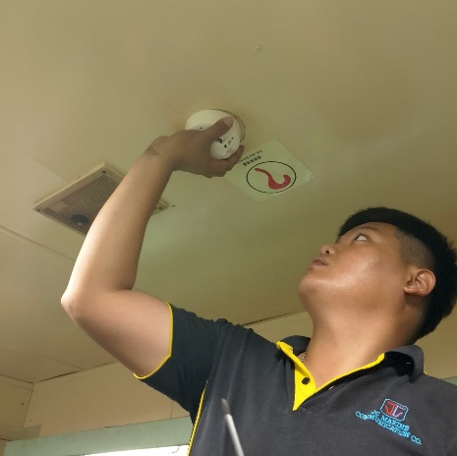
JC GROUP / COMPANY PROFILE
SUPPLY / SAFETY SYSTEMS
20
Marine fire alarm systems.
Installation through
annual inspection.
Qualified and experienced field engineers support various brands of marine-type fire alarm systems.
Installation, repair & troubleshooting
Annual inspections
Fire alarm panels and fire / smoke detector sensors
Portable fire and smoke detector testers
PROFESSIONAL / PRACTICAL / PROACTIVE
20 / 23
Notes:
Source: JC Group company profile updated 28 October 2025. All service and company information comes from the supplied presentation. No new certification, performance or customer claim is added.

Slide 21
JC GROUP / COMPANY PROFILE
SUPPLY / WRITING & ILLUSTRATION
21
Technical clarity, from page to drawing.
Technical writing
Illustration & electrical design
Clear documentation for vessel operations and equipment.
Supporting technical graphics and custom drawings.
Ship operating & engineering manuals
Electrical drawings and vessel calculations
Maintenance plans: engines, gearboxes,
control stands and deck equipment
Domestic-to-near-coastal vessel conversions
Review, update and convert existing files
New illustrations to customer requirements
PROFESSIONAL / PRACTICAL / PROACTIVE
21 / 23
Notes:
Source: JC Group company profile updated 28 October 2025. All service and company information comes from the supplied presentation. No new certification, performance or customer claim is added.

Slide 22
JC GROUP / COMPANY PROFILE
CORPORATE INFORMATION
22
Three companies. A shared commitment.
01
JC MARINE INTEGRATION SDN BHD
202301042692 (1536608-W)
Marine equipment & technical services
02
JC CONNEXION SDN BHD
202301044444 (1538360-W)
Satellite connectivity & network solutions
03
JC SUPPY SDN BHD
202301050114 (1544028-W)
Marine products & additional technical services
PROFESSIONAL / PRACTICAL / PROACTIVE
22 / 23
Notes:
Source: JC Group company profile updated 28 October 2025. All service and company information comes from the supplied presentation. No new certification, performance or customer claim is added.
Naming check: the original cover lists JC SUPPY SDN BHD, while the business section uses JC Supply Sdn Bhd. Registered-name spelling is retained from the source cover and must be verified before formal publication.

Slide 23
JC GROUP / COMPANY PROFILE
CONTACT
LET’S TALK.
SERVICE ENQUIRIES
BUSINESS HOURS
+6011-8888 5899
Monday–Friday
08:00–17:00
Saturday
08:00–12:00
services@jcmarine.com.my
Lot 10502, Desa Senadin, Block 5, Commercial Centre Phase 8,
Kuala Baram Land District, 98000 Miri, Sarawak, Malaysia
PROFESSIONAL / PRACTICAL / PROACTIVE
23 / 23
Notes:
Source: JC Group company profile updated 28 October 2025. All service and company information comes from the supplied presentation. No new certification, performance or customer claim is added.

