Slide 1


JC GROUP
COMPANY PROFILE
JC GROUP / COMPANY PROFILE
Expertise.
Connection.
Confidence.
MARINE / CONNECTIVITY / SUPPLY
Professional. Practical. Proactive.
JC MARINE INTEGRATION / JC CONNEXION / JC SUPPLY
01
Notes:
Source: JC Group company profile updated 28 October 2025. All service and company information comes from the supplied presentation. No new certification, performance or customer claim is added.

Slide 2


JC GROUP
GROUP OVERVIEW
One group. Three specialist businesses.
01
Marine Integration
02
Connexion
03
Supply
Navigation, communication and automation.
Equipment service, repair and installation.
Satellite connectivity and airtime.
Leasing, vessel tracking, IT and networks.
Marine products and technical services.
Safety systems, fabrication and documentation.
JC MARINE INTEGRATION / JC CONNEXION / JC SUPPLY
02
Notes:
Source: JC Group company profile updated 28 October 2025. All service and company information comes from the supplied presentation. No new certification, performance or customer claim is added.

Slide 3
JC GROUP
VISION & MISSION
Professional. Practical. Proactive.
OUR VISION
A diversified, progressive and respected marine services provider in South East Asia.
Deliver
Commit
Support
Competent, qualified people.
Work completed within customer timelines.
Meet customer requirements.
Uphold satisfaction and service quality.
A motivated workplace.
Long-term partnerships and quality of life.
JC MARINE INTEGRATION / JC CONNEXION / JC SUPPLY
03
Notes:
Source: JC Group company profile updated 28 October 2025. All service and company information comes from the supplied presentation. No new certification, performance or customer claim is added.

Slide 4
JC GROUP
SERVICE COVERAGE
Local expertise. Regional reach.
SOUTH EAST ASIA
01
Beyond Malaysia
Service partner networks support work at clients’ required seaports.
02
Across time zones
Coordination across South East Asia time zones.
MIRI
03
Mobile field teams
Technicians and service engineers travel according to client requirements.
JC MARINE INTEGRATION / JC CONNEXION / JC SUPPLY
04
Notes:
Source: JC Group company profile updated 28 October 2025. All service and company information comes from the supplied presentation. No new certification, performance or customer claim is added.
Map geometry: Natural Earth, public domain; regional locator only. Service reach follows the supplied profile, not a country-by-country coverage guarantee.

Slide 5
JC GROUP
JC MARINE INTEGRATION
01
JC
Marine Integration
Marine expertise
since 1999.
Integrated solutions for the shipping industry, specialising in marine communication and navigation equipment, as well as automation systems.
1999 / MARINE EXPERTISE SINCE
NAVIGATION / COMMUNICATION / AUTOMATION
JC MARINE INTEGRATION / JC CONNEXION / JC SUPPLY
05
Notes:
Source: JC Group company profile updated 28 October 2025. All service and company information comes from the supplied presentation. No new certification, performance or customer claim is added.

Slide 6

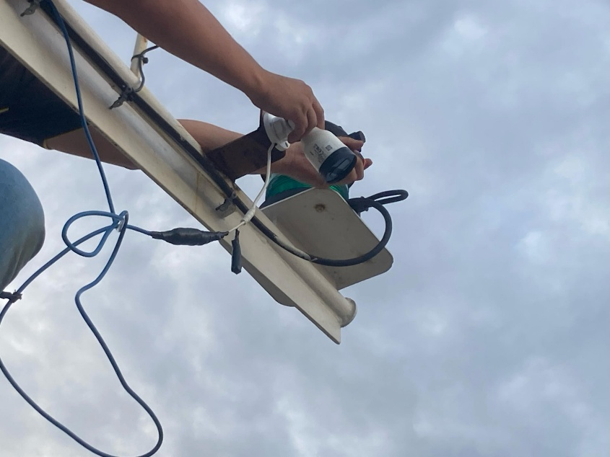
JC GROUP
MARINE / TECHNICAL SERVICES
A complete equipment service cycle.
01
02
03
04
05
Inspect
Troubleshoot
Repair
Maintain
Programme
SALES & INSTALLATION
New-build vessels.
Existing vessel upgrades.
Supply and installation of new equipment, plus replacement equipment for existing vessels.
JC MARINE INTEGRATION / JC CONNEXION / JC SUPPLY
06
Notes:
Source: JC Group company profile updated 28 October 2025. All service and company information comes from the supplied presentation. No new certification, performance or customer claim is added.

Slide 7


JC GROUP
MARINE / BRAND PARTNERSHIPS
Established brands. Specialist support.
AUTHORISED DISTRIBUTOR
AUTHORISED DEALER
JRC & Alphatron Marine
Iridium LT-3100
JC MARINE INTEGRATION / JC CONNEXION / JC SUPPLY
07
Notes:
Source: JC Group company profile updated 28 October 2025. All service and company information comes from the supplied presentation. No new certification, performance or customer claim is added.

Slide 8

JC GROUP
MARINE / SHORE SUPPORT & RECORDERS
Maintenance, verification & compliance.
Shore-based maintenance
Support for authorised Shore-Based Maintenance Agreements, mandated by flag authorities to validate vessel GMDSS communication systems.
VDR & SVDR annual performance tests
Qualified and recognised field engineers and technicians conduct APTs for Voyage Data Recorders and Simplified Voyage Data Recorders.
JC MARINE INTEGRATION / JC CONNEXION / JC SUPPLY
08
Notes:
Source: JC Group company profile updated 28 October 2025. All service and company information comes from the supplied presentation. No new certification, performance or customer claim is added.

Slide 9


JC GROUP
MARINE / COMPASS SERVICES
Precision for vessel navigation.
01
Gyrocompass calibration
02
Magnetic compass adjustment
Qualified technicians calibrate gyrocompasses across various brands.
Qualified field engineers adjust magnetic compasses across various brands.
JC MARINE INTEGRATION / JC CONNEXION / JC SUPPLY
09
Notes:
Source: JC Group company profile updated 28 October 2025. All service and company information comes from the supplied presentation. No new certification, performance or customer claim is added.

Slide 10
JC GROUP
JC CONNEXION
02
JC
Connexion
Connectivity
that travels.
Established in 2023, JC Connexion is a sister company of JC Marine Integration, providing satellite airtime services for maritime and offshore vessels.
100+ / VSAT & STARLINK UNITS SUPPLIED / INSTALLED
AIRTIME / LEASING / NETWORKS
JC MARINE INTEGRATION / JC CONNEXION / JC SUPPLY
10
Notes:
Source: JC Group company profile updated 28 October 2025. All service and company information comes from the supplied presentation. No new certification, performance or customer claim is added.

Slide 11
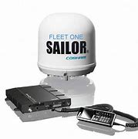
JC GROUP
CONNEXION / INTERNET SUBSCRIPTIONS
Flexible satellite airtime.
L-band / FleetBroadband / Fleet One
Comprehensive bandwidth solutions and satellite airtime services for maritime and offshore communication.
01
02
Prepaid
Postpaid
A range of packages valid for one month or 30 days from activation.
Pay per use at an agreed fixed price.
JC MARINE INTEGRATION / JC CONNEXION / JC SUPPLY
11
Notes:
Source: JC Group company profile updated 28 October 2025. All service and company information comes from the supplied presentation. No new certification, performance or customer claim is added.

Slide 12

JC GROUP
CONNEXION / INSTALLATION & AIRTIME
VSAT & Starlink, installed onboard.
At berth.
At anchorage.
Installation within port limit areas.
Airtime is also available for customers with their own satellite equipment already fitted onboard.
PREPAID & POSTPAID AIRTIME
JC MARINE INTEGRATION / JC CONNEXION / JC SUPPLY
12
Notes:
Source: JC Group company profile updated 28 October 2025. All service and company information comes from the supplied presentation. No new certification, performance or customer claim is added.

Slide 13
JC GROUP
CONNEXION / LEASING PACKAGES
Two ways to lease satellite equipment.
Lease to Own
Life-time Warranty
24–60 MONTHS
24–60 MONTHS
Option to purchase the equipment at an agreed price when the lease expires.
Option to terminate after 24 months. Eligible faults or non-human-caused damage qualify for a 1-for-1 equipment exchange.
BOTH PACKAGES INCLUDE
VSAT or Starlink
equipment
Installation &
dismantling
Commissioning &
system setup
Monthly
airtime charge
JC MARINE INTEGRATION / JC CONNEXION / JC SUPPLY
13
Notes:
Source: JC Group company profile updated 28 October 2025. All service and company information comes from the supplied presentation. No new certification, performance or customer claim is added.

Slide 14
JC GROUP
CONNEXION / AIRTIME CONTROL
Keep onboard data under control.
An onboard firewall monitors and controls data usage for efficient, cost-effective satellite communication.
CCTV ports
PIN-based identification
Ship computer email
Application restrictions
FIREWALL
Restricted websites
Voucher internet access
JC MARINE INTEGRATION / JC CONNEXION / JC SUPPLY
14
Notes:
Source: JC Group company profile updated 28 October 2025. All service and company information comes from the supplied presentation. No new certification, performance or customer claim is added.

Slide 15
JC GROUP
CONNEXION / VESSEL TRACKING
Visibility beyond the horizon.
POLE STAR Purplefinder
Reliable, real-time ship tracking solutions.
01
02
03
Tracking system
installation
Airtime
subscription
Equipment leasing
& airtime bundle
JC MARINE INTEGRATION / JC CONNEXION / JC SUPPLY
15
Notes:
Source: JC Group company profile updated 28 October 2025. All service and company information comes from the supplied presentation. No new certification, performance or customer claim is added.

Slide 16


JC GROUP
CONNEXION / IT & NETWORKS
IT systems that support the workplace.
Custom solutions.
Connected workplaces.
Software, IT and network systems developed and implemented around each customer’s office and workplace requirements.
Server installation, maintenance & monitoring
Network configuration
JC MARINE INTEGRATION / JC CONNEXION / JC SUPPLY
16
Notes:
Source: JC Group company profile updated 28 October 2025. All service and company information comes from the supplied presentation. No new certification, performance or customer claim is added.

Slide 17
JC GROUP
JC SUPPLY
03
JC
Supply
Products & expertise
for marine operations.
Established in 2023, JC Supply is a sister company of JC Marine Integration, extending the group into marine supplies and additional technical services.
2023 / JC SUPPLY ESTABLISHED
MARINE SUPPLIES / SAFETY SYSTEMS / TECHNICAL SERVICES
JC MARINE INTEGRATION / JC CONNEXION / JC SUPPLY
17
Notes:
Source: JC Group company profile updated 28 October 2025. All service and company information comes from the supplied presentation. No new certification, performance or customer claim is added.

Slide 18



JC GROUP
SUPPLY / PRODUCT RANGE
Supplies, organised around vessel needs.
Deck &
hardware
Safety &
protection
Provisions &
consumables
Marine hardware
Lifesaving equipment
Provision supplies
Shackles & wire ropes
Firefighting equipment
Lubricating oil
Polypropylene ropes
Coveralls
Grease
Marine type-approved valves
Safety shoes & boots
JC MARINE INTEGRATION / JC CONNEXION / JC SUPPLY
18
Notes:
Source: JC Group company profile updated 28 October 2025. All service and company information comes from the supplied presentation. No new certification, performance or customer claim is added.

Slide 19

JC GROUP
SUPPLY / CALIBRATION & FABRICATION
Practical skills. Specialist support.
Calibration & overhaul
Hot works & fabrication
Qualified service engineers provide repair, maintenance and overhaul support.
Experienced personnel provide repair and fabrication services.
Gas detector supply
Steel welding
Gas detector calibration
Aluminium welding
JC MARINE INTEGRATION / JC CONNEXION / JC SUPPLY
19
Notes:
Source: JC Group company profile updated 28 October 2025. All service and company information comes from the supplied presentation. No new certification, performance or customer claim is added.

Slide 20

JC GROUP
SUPPLY / SAFETY SYSTEMS
Marine fire alarm systems.
Installation through
annual inspection.
Qualified and experienced field engineers support various brands of marine-type fire alarm systems.
Installation, repair & troubleshooting
Annual inspections
Fire alarm panels and fire / smoke detector sensors
Portable fire and smoke detector testers
JC MARINE INTEGRATION / JC CONNEXION / JC SUPPLY
20
Notes:
Source: JC Group company profile updated 28 October 2025. All service and company information comes from the supplied presentation. No new certification, performance or customer claim is added.

Slide 21
JC GROUP
SUPPLY / WRITING & ILLUSTRATION
Technical clarity, from page to drawing.
Technical writing
Illustration & electrical design
Clear documentation for vessel operations and equipment.
Supporting technical graphics and custom drawings.
Ship operating & engineering manuals
Electrical drawings and vessel calculations
Maintenance plans: engines, gearboxes,
control stands and deck equipment
Domestic-to-near-coastal vessel conversions
Review, update and convert existing files
New illustrations to customer requirements
JC MARINE INTEGRATION / JC CONNEXION / JC SUPPLY
21
Notes:
Source: JC Group company profile updated 28 October 2025. All service and company information comes from the supplied presentation. No new certification, performance or customer claim is added.

Slide 22
JC GROUP
CORPORATE INFORMATION
Three companies. A shared commitment.
01
JC MARINE INTEGRATION SDN BHD
202301042692 (1536608-W)
Marine equipment & technical services
02
JC CONNEXION SDN BHD
202301044444 (1538360-W)
Satellite connectivity & network solutions
03
JC SUPPY SDN BHD
202301050114 (1544028-W)
Marine products & additional technical services
JC MARINE INTEGRATION / JC CONNEXION / JC SUPPLY
22
Notes:
Source: JC Group company profile updated 28 October 2025. All service and company information comes from the supplied presentation. No new certification, performance or customer claim is added.
Naming check: the original cover lists JC SUPPY SDN BHD, while the business section uses JC Supply Sdn Bhd. Registered-name spelling is retained from the source cover and must be verified before formal publication.

Slide 23
JC GROUP
CONTACT
Let’s keep your
operations moving.
SERVICE ENQUIRIES
BUSINESS HOURS
+6011-8888 5899
Monday–Friday
08:00–17:00
Saturday
08:00–12:00
services@jcmarine.com.my
Lot 10502, Desa Senadin, Block 5, Commercial Centre Phase 8,
Kuala Baram Land District, 98000 Miri, Sarawak, Malaysia
JC MARINE INTEGRATION / JC CONNEXION / JC SUPPLY
23
Notes:
Source: JC Group company profile updated 28 October 2025. All service and company information comes from the supplied presentation. No new certification, performance or customer claim is added.

