Slide 1


JC GROUP
Notes:
Based on the supplied JC Group company profile, updated 28 October 2025. Business information and photographs are from the original deck. Layout reference: user supplied brochure cover/back-cover image; its brand names, photographs and contact details are not reused.
Recomposed at 16:9 landscape as requested; photographs and logos retain their aspect ratios.

Slide 2
JC GROUP
GROUP OVERVIEW
Our group
Three specialist businesses support marine equipment, vessel connectivity and marine supply requirements.
JC MARINE INTEGRATION SDN BHD
JC CONNEXION SDN BHD
JC SUPPY SDN BHD
202301042692 (1536608-W)
202301044444 (1538360-W)
202301050114 (1544028-W)
Marine navigation, communication and automation equipment; inspection, repair, maintenance and installation.
Satellite airtime, equipment leasing, vessel tracking, IT and network solutions.
Marine supplies, safety systems, fabrication and technical documentation.
02
Notes:
Based on the supplied JC Group company profile, updated 28 October 2025. Business information and photographs are from the original deck. Layout reference: user supplied brochure cover/back-cover image; its brand names, photographs and contact details are not reused.
Verify legal name: the original cover says JC SUPPY SDN BHD, while the business section says JC Supply Sdn Bhd. Registration wording is retained as supplied.
Recomposed at 16:9 landscape as requested; photographs and logos retain their aspect ratios.

Slide 3
JC GROUP
VISION & MISSION
Our purpose
OUR VISION
Deliver
To excel as a diversified, progressive and well-respected marine services provider in South East Asia.
Complete work within customers’ timelines with competent, qualified technicians and field engineers.
Commit
Meet customer requirements and uphold satisfaction within the agreed timeframe.
Support
Build a motivated workplace that supports long-term partnerships and quality of life.
PROFESSIONAL. PRACTICAL. PROACTIVE.
03
Notes:
Based on the supplied JC Group company profile, updated 28 October 2025. Business information and photographs are from the original deck. Layout reference: user supplied brochure cover/back-cover image; its brand names, photographs and contact details are not reused.
Recomposed at 16:9 landscape as requested; photographs and logos retain their aspect ratios.

Slide 4

JC GROUP
MARINE SERVICES
JC Marine Integration
Marine expertise since 1999.
Integrated solutions for the shipping industry, specialising in marine communication and navigation equipment, together with automation systems.
04
Notes:
Based on the supplied JC Group company profile, updated 28 October 2025. Business information and photographs are from the original deck. Layout reference: user supplied brochure cover/back-cover image; its brand names, photographs and contact details are not reused.
The 1999 date describes the marine expertise stated in the source, not the incorporation date of the current registered company.
Recomposed at 16:9 landscape as requested; photographs and logos retain their aspect ratios.

Slide 5
JC GROUP
MARINE SERVICES
Equipment services
Navigation, communication and automation equipment.
Core service cycle
Equipment supported
Inspection · Troubleshooting · Repair
Maintenance · Programming
Navigation
Chart plotters · ECDIS · Speed log
Steering &
heading
Steering gear (electronics & electricity) · Autopilot · Gyrocompass · Rudder angle indicator
Sales & installation
New equipment for new-build vessels, and replacement equipment for existing vessels.
Other
instruments
Aldis light · Wind speed & direction
05
Notes:
Based on the supplied JC Group company profile, updated 28 October 2025. Business information and photographs are from the original deck. Layout reference: user supplied brochure cover/back-cover image; its brand names, photographs and contact details are not reused.
Recomposed at 16:9 landscape as requested; photographs and logos retain their aspect ratios.

Slide 6

Regional service reach
SOUTH EAST ASIA
Service network
Seaport support
Support beyond Malaysia through service partners.
Services at the ports required by clients.
Regional coordination
MIRI
Mobile service teams
Work across South East Asia time zones.
Technicians and engineers travel as required by clients.
06
Miri, Sarawak, Malaysia
Notes:
Based on the supplied JC Group company profile, updated 28 October 2025. Business information and photographs are from the original deck. Layout reference: user supplied brochure cover/back-cover image; its brand names, photographs and contact details are not reused.
Regional layout adapted from the user-supplied image. Neutral globe geometry is from Natural Earth (public domain). Miri is a source-address locator; no other branches, country coverage promises or unverified service partners are implied.
Recomposed at 16:9 landscape as requested; photographs and logos retain their aspect ratios.

Slide 7


JC GROUP
MARINE SERVICES
Brands & authorisations
JC Marine Integration Sdn Bhd
AUTHORISED DISTRIBUTOR
AUTHORISED DEALER
JRC
Alphatron Marine
IRIDIUM LT-3100
07
Notes:
Based on the supplied JC Group company profile, updated 28 October 2025. Business information and photographs are from the original deck. Layout reference: user supplied brochure cover/back-cover image; its brand names, photographs and contact details are not reused.
Logo grid uses only the three original authorised brands. JRC and Alphatron marks are natively cropped from the supplied combined logo, without changing colours or proportions. Iridium is displayed on white to preserve its transparent black-lettered source mark. Original heading dealer is used; source paragraph inconsistently says distributor, which requires verification.
Recomposed at 16:9 landscape as requested; photographs and logos retain their aspect ratios.

Slide 8
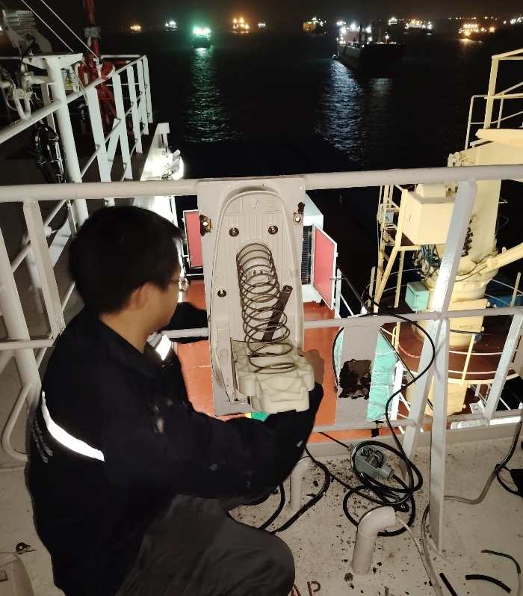
JC GROUP
MARINE SERVICES
Maintenance & performance testing
Shore-based maintenance
JC Marine Integration is authorised to facilitate Shore-Based Maintenance Agreements required by flag authorities to validate vessel GMDSS communication systems.
VDR & SVDR annual performance tests
Qualified and recognised field engineers and technicians conduct Annual Performance Tests for Voyage Data Recorders and Simplified Voyage Data Recorders.
08
Notes:
Based on the supplied JC Group company profile, updated 28 October 2025. Business information and photographs are from the original deck. Layout reference: user supplied brochure cover/back-cover image; its brand names, photographs and contact details are not reused.
Recomposed at 16:9 landscape as requested; photographs and logos retain their aspect ratios.

Slide 9


JC GROUP
MARINE SERVICES
Compass services
Gyrocompass calibration
Magnetic compass adjustment
Qualified technicians calibrate gyrocompasses across various brands.
Qualified field engineers adjust magnetic compasses across various brands.
09
Notes:
Based on the supplied JC Group company profile, updated 28 October 2025. Business information and photographs are from the original deck. Layout reference: user supplied brochure cover/back-cover image; its brand names, photographs and contact details are not reused.
Recomposed at 16:9 landscape as requested; photographs and logos retain their aspect ratios.

Slide 10

JC GROUP
SATELLITE CONNECTIVITY
JC Connexion
Established in 2023, JC Connexion is a sister company of JC Marine Integration, providing satellite airtime services for maritime and offshore vessels.
100+
VSAT & Starlink systems
supplied and installed
Together with airtime subscription services.
Source: supplied company profile, 28 October 2025.
10
Notes:
Based on the supplied JC Group company profile, updated 28 October 2025. Business information and photographs are from the original deck. Layout reference: user supplied brochure cover/back-cover image; its brand names, photographs and contact details are not reused.
Recomposed at 16:9 landscape as requested; photographs and logos retain their aspect ratios.

Slide 11

JC GROUP
JC CONNEXION
Satellite airtime
Bandwidth and satellite airtime solutions for maritime communication systems.
Supported services
Prepaid
Postpaid
L-band
FleetBroadband (FBB)
Fleet One
Packages valid for one month or 30 days from activation.
Pay per use at an agreed fixed price.
Prepaid and postpaid options are also available for VSAT and Starlink airtime.
11
Notes:
Based on the supplied JC Group company profile, updated 28 October 2025. Business information and photographs are from the original deck. Layout reference: user supplied brochure cover/back-cover image; its brand names, photographs and contact details are not reused.
Recomposed at 16:9 landscape as requested; photographs and logos retain their aspect ratios.

Slide 12

JC GROUP
JC CONNEXION
VSAT & Starlink
Vessel installation
Installation on customer vessels at berth or at anchorage within port limit areas.
Airtime support
Airtime is also available to customers who have already purchased and installed their own satellite equipment onboard.
12
Notes:
Based on the supplied JC Group company profile, updated 28 October 2025. Business information and photographs are from the original deck. Layout reference: user supplied brochure cover/back-cover image; its brand names, photographs and contact details are not reused.
Recomposed at 16:9 landscape as requested; photographs and logos retain their aspect ratios.

Slide 13
JC GROUP
JC CONNEXION
Satellite equipment leasing
VSAT or Starlink equipment bundled with internet airtime.
BOTH AGREEMENTS: 24–60 MONTHS
Lease to Own
Life-time Warranty
Option to purchase the equipment at an agreed price after the lease expires.
Eligible to terminate after 24 months.
1-for-1 exchange for equipment faults or non-human-caused damage.
MONTHLY PACKAGES INCLUDE
Satellite equipment · Monthly airtime · Mobilisation & demobilisation (installation & dismantling) · Equipment commissioning & setup
13
Notes:
Based on the supplied JC Group company profile, updated 28 October 2025. Business information and photographs are from the original deck. Layout reference: user supplied brochure cover/back-cover image; its brand names, photographs and contact details are not reused.
Life-time Warranty is the original package name. It does not imply unconditional perpetual coverage. Contract and replacement conditions are retained from the source.
Recomposed at 16:9 landscape as requested; photographs and logos retain their aspect ratios.

Slide 14

JC GROUP
JC CONNEXION
Airtime control
An onboard firewall monitors and controls data usage for efficient, cost-effective satellite communication.
Manage access and usage
CCTV ports
Email from ship computers and laptops
Restricted websites
PIN-based user recognition
Mobile application restrictions
Voucher-based internet access
14
Notes:
Based on the supplied JC Group company profile, updated 28 October 2025. Business information and photographs are from the original deck. Layout reference: user supplied brochure cover/back-cover image; its brand names, photographs and contact details are not reused.
Recomposed at 16:9 landscape as requested; photographs and logos retain their aspect ratios.

Slide 15

JC GROUP
JC CONNEXION
Vessel tracking
Reliable, real-time ship tracking powered by POLE STAR Purplefinder.
Installation
Vessel tracking system installation.
Subscription
Tracking-system airtime subscriptions.
Bundle
Equipment leasing with airtime subscription.
15
Notes:
Based on the supplied JC Group company profile, updated 28 October 2025. Business information and photographs are from the original deck. Layout reference: user supplied brochure cover/back-cover image; its brand names, photographs and contact details are not reused.
Recomposed at 16:9 landscape as requested; photographs and logos retain their aspect ratios.

Slide 16

JC GROUP
JC CONNEXION
IT & networks
Custom software, IT and network systems developed and implemented for each customer’s offices and workplaces.
Server support
Installation, maintenance and monitoring.
Network configuration
Network configuration services tailored to customer needs.
16
Notes:
Based on the supplied JC Group company profile, updated 28 October 2025. Business information and photographs are from the original deck. Layout reference: user supplied brochure cover/back-cover image; its brand names, photographs and contact details are not reused.
Recomposed at 16:9 landscape as requested; photographs and logos retain their aspect ratios.

Slide 17

JC GROUP
MARINE PRODUCTS & SERVICES
JC Supply
Established in 2023, JC Supply is a sister company of JC Marine Integration, extending the group into marine supplies.
Products. Services. Relationships.
We aim to deliver high-quality products and services and build long-lasting customer relationships.
MARINE SUPPLIES / SAFETY / TECHNICAL SUPPORT
17
Notes:
Based on the supplied JC Group company profile, updated 28 October 2025. Business information and photographs are from the original deck. Layout reference: user supplied brochure cover/back-cover image; its brand names, photographs and contact details are not reused.
Recomposed at 16:9 landscape as requested; photographs and logos retain their aspect ratios.

Slide 18

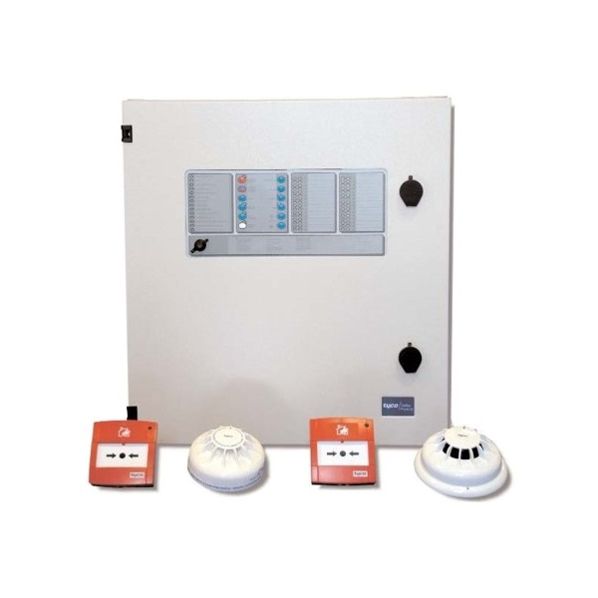

JC GROUP
JC SUPPLY
Marine supplies
Deck &
hardware
Safety &
protection
Provisions &
consumables
Marine hardware; shackles; wire ropes; polypropylene ropes; marine type-approved valves.
Lifesaving equipment; firefighting equipment; coveralls; safety shoes and boots.
Provisions; lubricating oil and grease.
18
Notes:
Based on the supplied JC Group company profile, updated 28 October 2025. Business information and photographs are from the original deck. Layout reference: user supplied brochure cover/back-cover image; its brand names, photographs and contact details are not reused.
Recomposed at 16:9 landscape as requested; photographs and logos retain their aspect ratios.

Slide 19

JC GROUP
JC SUPPLY
Calibration & fabrication
Calibration & overhaul
Hot works & fabrication
Qualified service engineers provide repair, maintenance and overhaul support.
Gas detector supply and calibration services are available.
Experienced personnel carry out repair and fabrication work.
Steel welding
Aluminium welding
19
Notes:
Based on the supplied JC Group company profile, updated 28 October 2025. Business information and photographs are from the original deck. Layout reference: user supplied brochure cover/back-cover image; its brand names, photographs and contact details are not reused.
Recomposed at 16:9 landscape as requested; photographs and logos retain their aspect ratios.

Slide 20

JC GROUP
JC SUPPLY
Marine fire alarm systems
Qualified and experienced field engineers support various brands of marine-type fire alarm systems.
Service
Installation · Repair · Troubleshooting
Annual inspections
Supply
Fire alarm panels; fire and smoke detector sensors; portable fire and smoke detector testers.
20
Notes:
Based on the supplied JC Group company profile, updated 28 October 2025. Business information and photographs are from the original deck. Layout reference: user supplied brochure cover/back-cover image; its brand names, photographs and contact details are not reused.
Recomposed at 16:9 landscape as requested; photographs and logos retain their aspect ratios.

Slide 21
JC GROUP
JC SUPPLY
Technical writing & illustration
Technical writing
Illustration & electrical design
Clear documentation for vessel operations and equipment.
Supporting technical graphics and new drawings prepared to customer requirements.
Ship operating and engineering manuals
Experience includes electrical drawings and electrical calculations for vessels converting from domestic to near-coastal operations.
Maintenance plans for engines, gearboxes, control stands and deck equipment
Review, reuse, update and convert existing files
21
Notes:
Based on the supplied JC Group company profile, updated 28 October 2025. Business information and photographs are from the original deck. Layout reference: user supplied brochure cover/back-cover image; its brand names, photographs and contact details are not reused.
Recomposed at 16:9 landscape as requested; photographs and logos retain their aspect ratios.

Slide 22
JC GROUP
SERVICE ENQUIRIES
ADDRESS
+6011-8888 5899
Lot 10502, Desa Senadin, Block 5,
Commercial Centre Phase 8,
Kuala Baram Land District,
98000 Miri, Sarawak, Malaysia
WhatsApp hotline
services@jcmarine.com.my
BUSINESS HOURS
Monday–Friday
08:00–17:00
Saturday
08:00–12:00
Notes:
Based on the supplied JC Group company profile, updated 28 October 2025. Business information and photographs are from the original deck. Layout reference: user supplied brochure cover/back-cover image; its brand names, photographs and contact details are not reused.
Recomposed at 16:9 landscape as requested; photographs and logos retain their aspect ratios.

