Slide 1
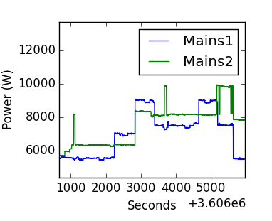
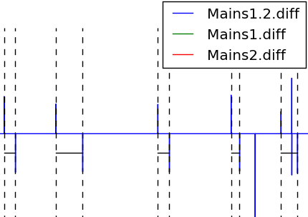
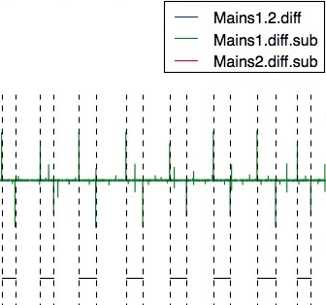
Multiple Phase Aggregated Power
+ Power Levels
Diffs of multi-phases
Multivariate Piecewise
Motif Mining
Left diffs
Piecewise
Motif Mining

