Slide 1
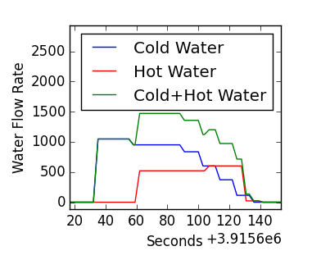
Search piecewise events
Encode events from multiple phases
Mine
frequent
motifs
Recover devices

