Slide 1
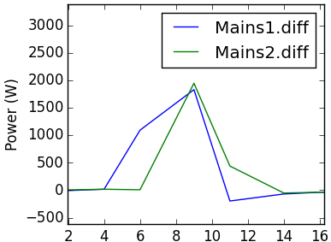
e_{1’}
e_{2’}

