Slide 1
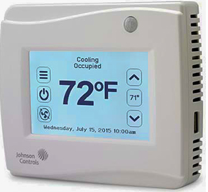
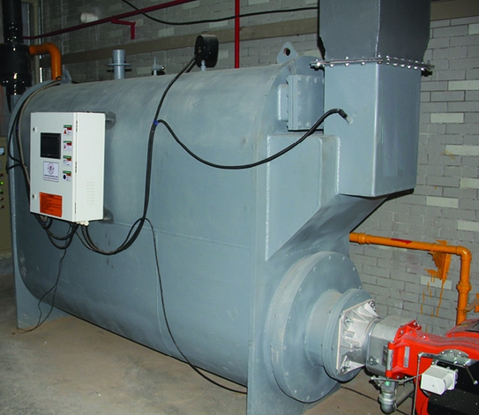
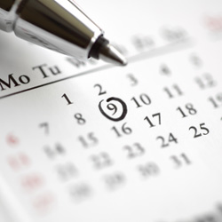

Collect Data
Quantify
Target
Track
Meter
Devices
Cost
Usage
Sensor
When
Time
Temperature
How
Energy Management
Monitor
Control
Conserve

