Slide 1

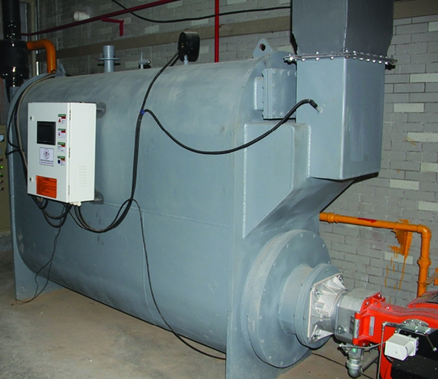
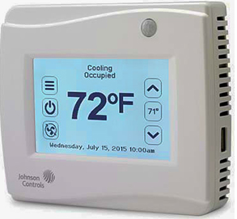


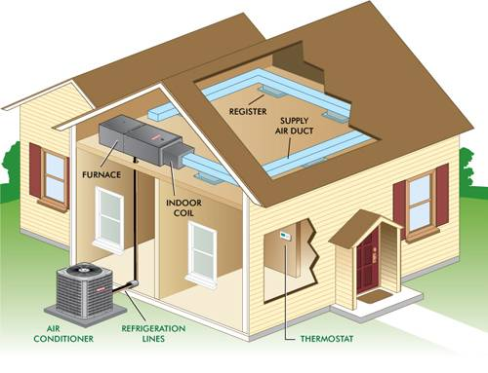

Energy
Efficiency
High-level
Comfort
Environment
Friendliness
Energy Management and Control System
Exporting Sensor and Controller Data
…
Chilled- and Hot-Water Reset
Thermostat Control
Scheduling

