Slide 1

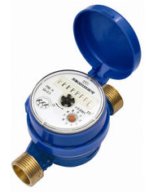
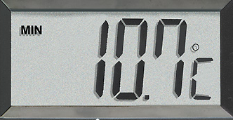


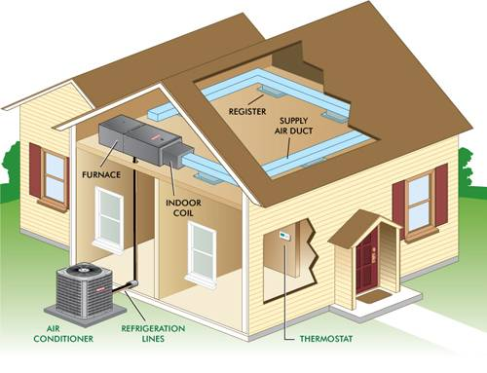

Efficient
Energy
Management
Control
Comfortability
Electricity consumption
Water
usage
Temperature
…
Activities inside
a room

